Slide 1
Redesigning Developmental Mathematics Education:
A National Perspective
Accelerated Learning Project
Third Annual Acceleration Conference on Developmental Education
Community College of Baltimore County
June 17, 2011
Philip Uri Treisman Professor of Mathematics and Public Affairs Executive Director, Charles A. Dana Center The University of Texas at Austin

Slide 2
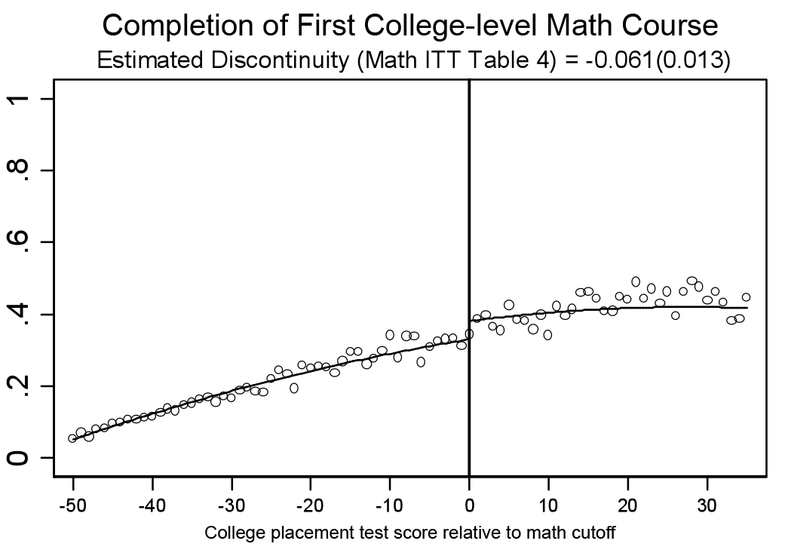
The Problem Addressed
Source: Calcagno, J. C., & Long, B. T. (2008). The impact of postsecondary remediation using a regression discontinuity approach: Addressing endogenous sorting and noncompliance (NCPR Working Paper), New York, NY: National Center for Postsecondary Research.

Slide 3
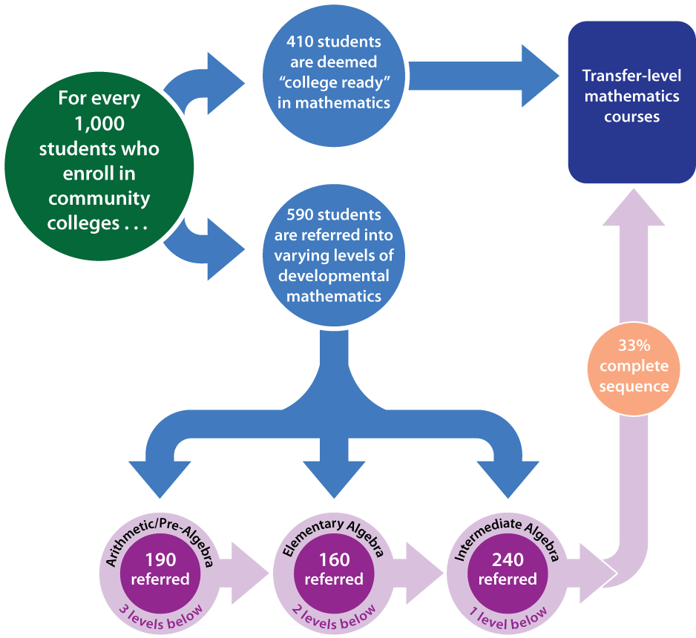
The Typical Developmental Math Sequence in Community Colleges
Source: Bailey, T., Jeong, D. W., & Cho, S. (2010), “Referral, enrollment, and completion in developmental education sequences in community college”, Economics of Education Review, 29(2), 255-270.

Slide 4
Nested Problems in a Broken System
Goals
Placement
Articulation
Student Support
Improvement Infrastructure

Slide 5
Draft: Probably wrong, definitely incomplete
Drivers of the problem
(things that keep us from meeting the aim)
Hypothesized solutions
Slow down initial pace of course so students can get used to the novel setting and expectations
Content provides opportunities for authentic successes in the initial
Successful Course Launch
(First 3-4 Weeks)
Course content in first few weeks
Pace too fast
Doesn’t “catch” interest
Initial course units devote adequate portion of class time to on-ramping
Course is scaffolded to help students see the relevance and build intrinsic interest in opening units
Few opportunities for early success
Faculty clearly establish norms for language use
Faculty help students become comfortable
engaging in productive struggle
Faculty set a norm for coming to a common understanding of math concepts
Little or no common expectations; absence of supportive classroom norms
Faculty create a safe environment for the use of various styles, registers and varieties of English
Faculty make it safe for students to express what they don’t understand
Language use
“Struggle” norms
Faculty help students understand the syllabus
& how grades are calculated throughout the term
Faculty establish norms for group work
Class expectations
“Doing math” norms
Faculty communicate clear attendance
& participation norms
Faculty establish expectation for the need
to revise and edit work, to build understanding
AIM:
Students will be productively persisting at beginning of the fourth week of class
Students know how to use course materials effectively (online tools, texts, etc.) and know how much time they are expected to spend on them
Students’ limited “college knowledge”
Students complete exercises that help them to accurately calibrate their self-efficacy
Faculty convey that doing mathematics is more than memorizing procedures
Effective learning practices
Institutional navigation know-how
Faculty teach basic study strategies: note-taking, looking ahead, time estimates, having materials for class, calendaring assignments, and more.
Students have few or no connections
Faculty have routines for noticing students’ presence or absence in class (& quick folIow-up)
Faculty incorporate early cohort-building and “get to know you” activities
To peers
To institution
Faculty establish group work routines that
foster communication between peers
Students sign a contract that emphasizes investment in the success of all students in the course
To math faculty
Incorporate online opportunities for students to connect to outside of class (cell phones or other technology)
Students are taught that it’s normal to wonder at first whether you belong in the class or in college, but over time those feelings often fade
Potential measures of AIM:
% of students coming to class
% of students coming to class on time
% of assignments turned in
Scores on assignments
% of students seeming disengaged (self-report)
% of students feeling overwhelmed (self-report)
Note: all of these can be measured lesson by lesson
Student mindsets undermine motivation
Explain that mistakes and struggles are information for learning, not signs of lack of potential
Students complete growth mindset intervention
Don’t see selves as math learners
Refute cultural beliefs that some people are “not math people” who can’t improve in math.
Use student-generated data and examples in lessons, and/or ones that address personally important problems
Don’t see relevance of learning math
Faculty ask students to generate ways the course
knowledge can be useful for their own aims in life
Accompany critical feedback with personal assurance that the student can meet a higher standard
Faculty mindsets and understanding
Not all believe all students can be successful
Provide professional development showing the importance of classroom Productive Persistence strategies for student success
Instructors familiarize themselves with students’ language backgrounds and preferences:
Not all believe role is to teach productive persistence
Provide professional development for implementing Productive Persistence strategies
Incorporate student voice in real time feedback to faculty and in professional development
To see measures for each of the primary drivers, click on the “comments” for each.
Not all have the dispositions, skills or training to do productive persistence activities
Provide professional development and training in effective strategies for building on students’ math/statistics knowledge, and students’ interests/goals.
Increase the use of real time data by faculty to analyze student success, backgrounds and goals
Not all understand their students’ cultural backgrounds

Slide 6
Nested Problems in a Broken System
Goals
Placement
Articulation
Student Support
Improvement Infrastructure

Slide 7
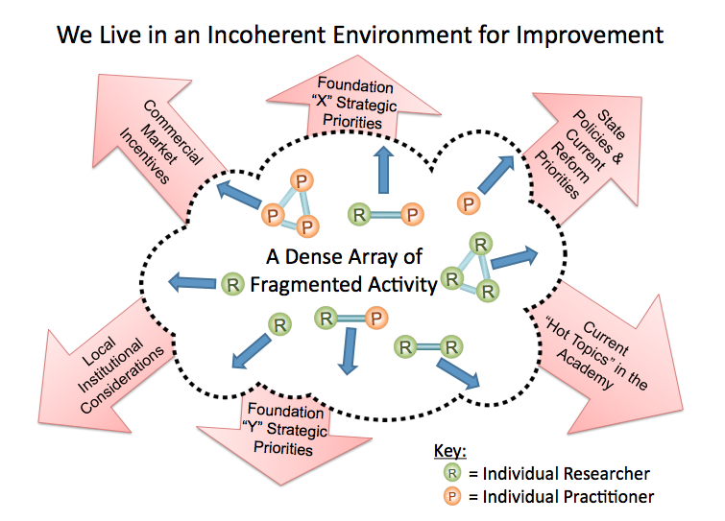
We Live in an Incoherent Environment for Improvement: The Joyful Conspiracy
Source: Bryk, T. and Gomez, L. 2008, Ruminations. Carnegie Foundation for the Advancement of Teaching, Palo Alto, CA.

Slide 8
Our Approach: New Pathways
Quantway
Statway
STEMway

Slide 9
The Promises of Accelerated To-And-Through Pathways
Dramatically increasing student success in college mathematics.
Dramatically increasing students’ ability to use the math they are learning in the world around them.
By working together on common solutions to common problems, we can build viable pathways to upward mobility for our students.

Slide 10
A Joyful Conspiracy

Slide 11
Questions and Answers

