Slide 1
Third Time’s the Charm: Partnering Academic Coaching and Tutoring for Student Success
ALP Conference 2012 June 7, 2012
Nicole Baird
Coordinator of Developmental Education
and
Johari A. Barnes
Academic Coach
Community College of Baltimore County - Catonsville

Slide 2
The Community College Of Baltimore County (CCBC)
Multi campus suburban college in Maryland
Enrolls approximately 71, 400 students: 35,498 credit students and 35,902 non-credit students during FY 2011
Offers more than 50 different Associate degrees and more than 100 certificate programs
Enrolls a student population that closely mirrors Baltimore County’s rich diversity

Slide 3
Focus of Discussion
Overview of CCBC courses and Repeat Policy
Defining Roles
Transformation of Processes
Post Approval/Denial Interventions
Working Collaboratively

Slide 4
Overview of Developmental Education at CCBC
Courses Offered:
Reading 051 – Basic Reading (4)
Reading 052 – College Reading (3.5)
English 051 – Basic Writing I (3)
English 052 – Basic Writing II (3)
Math 081 – Basic Mathematics (3)
Math 082 – Introductory Algebra (3)
Math 083 – Intermediate Algebra (3)

Slide 5
Accuplacer Score Breakdown
Course | Minimum Score | Maximum Score
Reading floor | 20 | 35
Reading 051 | 36 | 60
Reading 052 | 61 | 78
English 051 | 20 | 57
English 052 | 58 | 89

Slide 6
Accuplacer Math Score Breakdown
Course | Arithmetic Score | Algebra Score * | College Math Score
MATH ASE | 20-31 | 20-43 | ---
MATH 081 | 32-120 | 20-43
MATH 082 | --- | 44-64
MATH 083 | --- | 65-120 | 20-44

Slide 7
Policy for Continuous Enrollment of Developmental Students
Students who place in developmental reading, writing, and/or mathematics courses must:
register for each of these courses within their first 15 billable hours.
continue to enroll in developmental courses every semester until all required developmental courses for the program are successfully completed.
work closely with an academic advisor to create a plan for enrolling in and completing required courses.

Slide 8
Grading System for Developmental Education courses
For English and Reading courses
Satisfactory (S) or
Unsatisfactory (U)
For math courses
A, B, C, or F

Slide 9
The College Repeat Policy Revised March 2012
Students who have already received two grades (including W, AU, I, and R) in any course are prohibited from registering for the course for the third or subsequent time without the written permission of an academic dean or his/her designee.
Students will not be permitted for the third or subsequent attempts to take on-line, modified on-line or blended courses.

Slide 10
Coordinator of Developmental Education
Office of Instruction
Review requests to repeat students (500 students/semester college wide)
Developmental Education Programming Coordination
Committee Leadership/ Student Services Liaison
Notes:
ALP, Summer Bridge, AtD initiatives, RDNG floor implementation and all developmental education initiatives

Slide 11
The Old Method
Thirty minute session
Student verbally explained situation
Documentation rarely provided
Decision made on the spot
No deadline to make the request
Limited faculty feedback
Faculty not always notified of repeaters enrolled in their course

Slide 12
The New Method
Written accountability
Investigation conducted
Documentation required
Faculty feedback
Gradebook reviewed (when possible)
Banner (SPACMNT) notes and placement scores reviewed
Thirty minute session
Streamlined college-wide contract
Deadline strictly enforced

Slide 13
Student Referral Process
Academic Advising, Enrollment Service Center, and Disability Support Services
Math, reading and English Departments
Developmental Education faculty
General Education department heads
Academic coaches also contact:
Previously deferred students
Non-payment drops
Current students who need another opportunity

Slide 14
Forms
Request to Repeat a Developmental Education Course
Approval Contract
Alternative Plan for Permission to Repeat a Course
Initial follow-up form

Slide 15
Post Approval Interventions
Faculty notified of repeat students
Faculty feedback requested periodically
Mid-term reports requested
Notes placed in Banner SCT
Mandatory tutoring
Course registration limitations
Academic Coaching

Slide 16
Approval Registration Options
Math
Special Repeat section
Intersession tutoring/Modumath
(PACT)
English
ALP

Slide 17
Denial/Deferral Interventions
Denials
Referred to other institutions
Suggestions for other options
Suggestions for other course/program of study
Deferred approvals
Monthly Academic Coach session
Future approval contingent on effort put forth during the semester

Slide 18
Academic Coach motto…
We tried it your way twice…
now it is time to try it our way!!

Slide 19
Academic Coach
Assists students in developing personal and academic goals
Engages in activities to develop skills
Conducts small group workshop/training sessions
Maintain accurate records of all student contacts.
Notes:
Engages in activities to develop skills in the following areas: time management, test anxiety, study skills, test taking tips/test preparation, active learning, academic planning and goal setting.
Reinforces the plan of study prescribed by the Coordinator of Developmental Education.

Slide 20
Academic Coach Session
Use a holistic approach to address affective issues
30 minute session
Mandatory for all repeat (2U) students
Access to student history
Review syllabi & tutoring history
Discuss study skills, personal issues, grades and any instructor feedback

Slide 21
Tutor’s Role
Peer, para-professionals and faculty volunteers
Provide specific assistance in course material
Communicate student concerns to the academic coach
Enter content-specific notes into SARS

Slide 22
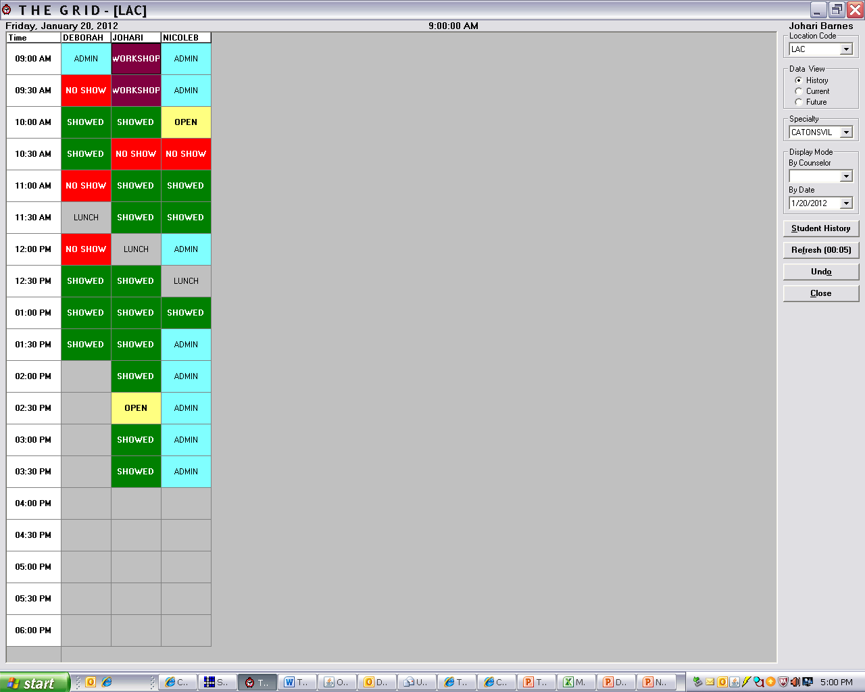
SARS

Slide 23
Fall 2011 Pilot Data
STATUS | R051 | R052 | E051 | E052 | M081 | M082 | M083 | TOTAL
Denied | 6 | 10 | 5 | 18 | 20 | 39 | 39 | 137
Approved | 25 | 27 | 7 | 46 | 62 | 107 | 139 | 413
Total | 31 | 37 | 12 | 65 | 82 | 145 | 178 | 550
Passed | 6 | 10 | 6 | 17 | 24 | 40 | 64 | 167
Failed | 10 | 4 | 0 | 10 | 16 | 34 | 48 | 122
DNR | 8 | 12 | 1 | 14 | 20 | 29 | 24 | 108
Withdrawal | 1 | 1 | 0 | 5 | 2 | 4 | 3 | 17
TTL reg. | 17 | 15 | 6 | 33 | 42 | 78 | 115 | 305
Pass rate | 35% | 67% | 100% | 38% | 57% | 51% | 56% | 55%

Slide 24
Contact Us
Nicole Baird
Coordinator of Developmental Education - Catonsville
nbaird@ccbcmd.edu
(443) 840-2754
Johari A. Barnes
Academic Coach
jbarnes3@ccbcmd.edu
(443) 840-2750

