Slide 1
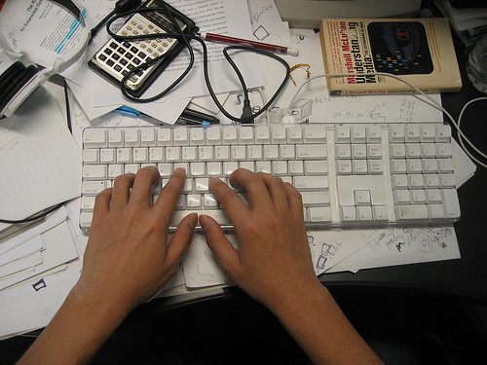
Accelerating the Transition
to English 101
By Geoffrey W. Layton
University of Oklahoma
Geoffrey.Layton-1@ou.edu
2013 ALP CONFERENCE

Slide 2
Developmental Writers . . .

Slide 3
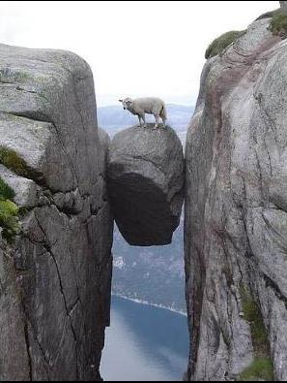
. . . are often stuck between a rock . . .
. . . and a hard place!

Slide 4
First, there’s the “rock” of the writing process model . . .
We teach “process” but grade product.

Slide 5
“There is little research data supporting the major tenets of process approaches over other forms of literacy instruction . . . ”
“The Silenced Dialogue,”
Lisa Delpit quoting E. V. Siddle

Slide 6
SOME COMMENTS BY DELPIT’S STUDENTS REGARDING THE “PROCESS APPROACH”
“She (the writing process teacher – not
Delpit) didn’t teach us anything”;
“When I’m in the classroom, I’m looking
for structure”;
“The teacher claimed to use a process
approach, but what she really did was
hide behind fancy words.”
DELPIT’S CONCLUSION: “Teachers do students no service to suggest, even implicitly, that ‘product’ is not important.”

Slide 7
Some discouraging news from decades of the “process approach” to writing

Slide 8
NAEP, 1999
“The overall writing performance of students has stagnated”
(quoted in “Losing the Product in the Process” EJ Vol 88, No 5

Slide 9
THE WALL STREET JOURNAL 2006
“M.B.A. Recruiters’ No. 1 Pet Peeve:
Poor Writing and Speaking Skills”

Slide 10
CARNEGIE CORP 2007
“A Writing Proficiency Crisis:
A CAUSE FOR ALARM”

Slide 11
CARNEGIE CORP – 2010
“a marked decline in the reading and writing skills of adolescent learners”

Slide 12
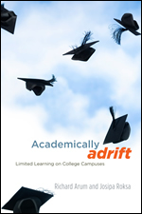
ACADEMICALLY ADRIFT 2011
POOR PERFORMANCE ON THE “COLLEGE LEARNING ASSESSMENT” – ESSENTIALLY A TEST OF WRITING

Slide 13
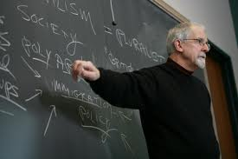
And now, a word from our colleagues in the other disciplines . . .
“WHY CAN’T YOU TEACH STUDENTS HOW TO WRITE?”

Slide 14
So if the “Rock” of the Process Approach is less than effective . . .
. . . there’s always the “hard place” of . . .

Slide 15
GRAMMAR

Slide 16
Impact of Grammar on Writing
Research says
a) little
b) none
c) detrimental
d) all of the above

Slide 17
The “Braddock Report”
“. . . the teaching of formal grammar has a negligible or . . . even a harmful effect on the improvement of writing.”
Richard Braddock, Richard Lloyd-Jones, and Lowell Schoer. Research in Written Composition, Urbana, IL: NCTE, 1963

Slide 18
NCTE
“Resolved, that NCTE urge the discontinuance of testing practices that encourage the teaching of grammar rather than English language arts instruction.” 1985 Resolution

Slide 19
The “Hillocks Report”
“None of the studies . . . provides any support for teaching grammar as a means of improving composition skills.”
George Hillocks, Research on written composition: New directions for teaching. Urbana: NCTE/ERIC, 1986.

Slide 20
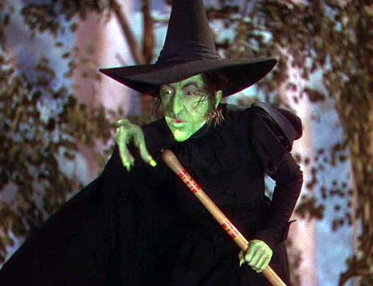
Mike Rose’s “Goddess Grammatica”
The Middle Ages envisioned Grammatica, the goddess of grammar, as a severe old woman with a scalpel and a large pair of pincers. Her right hand grasps a bird by its neck, its mouth open, as if in a gasp or a squawk. Lord, how fitting the choices of emblem – the living thing being strangled, beak open but silent, muted by the goddess Grammatica. And the scalpel, the pincers, are reminders to the teacher to be vigilant for error, to cut it out with the coldest tool. Laura knows the goddess intimately, the squinting figure who breathes up to her side whenever she sits down to write.
Lives on the Boundary

Slide 21
Traditional Grammar Instruction = “Grammar for the Left Brain”
Know the rules!
Learn and apply terminology
Identify Parts of Speech
Focus on Error
“Drill and Kill”
DON’T USE TO TEACH WRITING!

Slide 22
Introducing Grammar for the Right Brain!

Slide 23
“RIGHT BRAIN” GRAMMAR
No memorization or application of terminology.
Students use “Grammar in their heads” (Patrick Hartwell).
Use grammar to teach writing.

Slide 24
How can grammar
(that which we have been told
will inhibit writing)
now be said to
enhance it?

Slide 25
Grammar –
form
enables meaning

Slide 26
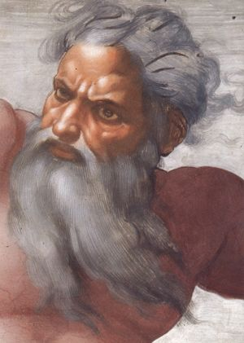
But what is meaning?

Slide 27
The Six Parts of Meaning (rather than the 8 parts of speech):
Who
What
Why
Where
When
How
All created using grammatical forms!

Slide 28
Let’s see how grammatical forms can create
WHEN meaning
WHERE meaning
WHY meaning

Slide 29
Are you ready for some writing?
Props to Hank Williams, Jr. “late” of Monday Night Football

Slide 30
OBJECTIVE: STUDENTS WILL BE ABLE TO USE GRAMMATICAL FORMS TO CREATE WHEN, WHERE, AND WHY MEANING FOR THE FOLLOWING “KERNEL” SENTENCES:
The boy ran.
The girls went.
The baby cried.
The children played.

Slide 31
“WHEN” ADVERBS
Today, yesterday, tomorrow, last night, tonight, daily, weekly, now, then, early(ier), late(r), soon(er), always, never, immediately, sometimes, seldom, often, occasionally, finally, eventually, ultimately, next, after(wards), first, last, not, at, yet, again,
every (hour, day, week, time, year, etc.)
EXAMPLES: Tomorrow, he will return to school.
or,
He will return to school tomorrow.
Modify adverbs to CREATE more detail
EXAMPLES: Last night or Late last night or Very late . . . or Much later/earlier last night . . .

Slide 32
“WHEN” PREPOSITIONS
Before, after, during, in the middle of, past, prior to, until, since, as, at, upon, for,on, about
EXAMPLE: Tomorrow during lunch, he will return to school.
A NOTE ABOUT PREPOSITIONS:
All prepositions are followed by a noun or a pronoun.

Slide 33
“WHEN” DEPENDENT CLAUSE WORDS
(SUBORDINATING CONJUNCTIONS)
Before, after, when, until, while, as long as, as soon as, as
EXAMPLE: Tomorrow during lunch when the other students are not in the building, he will return to school.
A NOTE ABOUT DEPENDENT CLAUSE WORDS
(“SUBORDINATING CONUNCTIONS)
Some of these words – specifically before and after – are the same as prepositions. The difference between a preposition and a subordinating conjunction is simply this: a subordinating conjunction is followed by an entire sentence – a subject and a predicate – rather than just a noun or a pronoun.

Slide 34
“Where” Adverbs
ahead/behind apart/together alone/awa
back/front around backward(s)/forward(s)
near(by)/far up/down in/out
here/there outside/inside sideways anywhere/everywhere/nowhere/somewhere
EXAMPLES: He went outside. He walked inside. He moved sideways. He jumped up. He sat down. He looked around. Leave me alone. Please come here. Go over there. She searched everywhere. Don’t look back. Don’t go far. Stay nearby. Let’s go together. I left it somewhere! I can’t find it anywhere! Drive through. Go around. Stay behind.

Slide 35
“Where” Prepositions
in(to), out (of), above, below, across (from), next to, through, throughout, far (from), on top of, inside (of), outside (of)
along (with, side of), at, by, between, upon, under(neath), beneath
over, about, before, after, ahead of, behind, near(by/to), around
in back of, in front of, beside, beyond, among/amid, apart (from), against, away (from), up (from), down (from), to, from, with, within, on(to), off (of), with/without/within, opposite (from), toward, at
EXAMPLE: He walked outside around the block.

Slide 36
“Where” DEPENDENT CLAUSE WORDS
Subordinating Conjunctions
Where
EXAMPLE: He walked outside around the block where his friends were waiting.

Slide 37
1. “Why” – A Simple Explanation*
A simple explanation gives no real reason to answer the question why. There are two basic structures used to answer this question – the infinitive phrase and the prepositional phrase.
Infinitive Phrase Words to . . . OR in order to . . .
EXAMPLE: I’m going to the store (in order) to buy some milk.
OR
Prepositional Phrase Word – for
EXAMPLE: I’m going to the store for some milk.
* THERE ARE FOUR DIFFERENT TYPES OF “WHY” MEANING.

Slide 38
2. “Why” – Cause and Effect
The question “why” can also be answered by telling how one event causes another event to occur. This is the “standard” or expected answer to the question “why”
Prepositional Phrase Words: because of, by means of, in view of, on account of, due to, for, upon
EXAMPLE: Due to the lack of milk, I’m going to the store to buy some more.
Dependent Clause Words (Subordinating Conjunctions): because, in order that, since, so that, as, for, when (past tense only)
EXAMPLES: I have to go home now because I am very tired. OR for I am very tired. OR as I am very tired. OR since I am very tired. OR so that I can sleep. OR in order that I can sleep. OR (past tense using “when) I had to go home when I was tired.

Slide 39
3. “Why” – Comparison and Contrast
Comparison and contrast is the logical opposite of cause and effect – namely, one event should have caused another to occur, but didn’t; or, one event should not have caused another to occur, but it happened anyway.
Prepositional Phrase Words in spite of, aside from
EXAMPLE: In spite of our lack of milk, I’m not going to the store to buy some more.
Dependent Clause Words (Subordinating Conjunctions) – although, though, even though, aside from the fact that
EXAMPLES: Although we still have some milk, I’m going to the store to buy some anyway. Aside from the fact that I’m tired, I’m having a great time. Even though I woke up late, I still made it to school on time.

Slide 40
4. “Why” – Conditional Cause and Effect
Conditional Cause and Effect describes how one event may cause another event to occur, but it hasn’t happened yet.
Dependent Clause Words (Subordinating Conjunctions) – Unless, Until, As long as, As far as, as soon as, if, if . . . then, when, whenever, provided (that)
EXAMPLES: Unless you get ready to go right now, we can’t leave on time. Until you’re ready to go, we can’t leave. As long as you’re not ready, we can’t leave. As far as I can tell, you’re not ready to go. As soon as you’re ready to go, we can leave. If you’re ready to go, we can leave. If you’re ready to go, then we can leave. When you’re ready to go, we can leave. Whenever you’re ready to go, we can leave. Provided (that) you’re ready to go, we can leave.

Slide 41
WHO, WHAT, and HOW Meaning
Appositives
Noun clauses
Participles
Adverbs
Prepositional phrases
And more!

Slide 42
Does it work?
Do “real” writers use
Grammar for the Right Brain?
Do they construct “the six parts of meaning” using grammar and grammatical constructions?

Slide 43
“Real” writers include student writers!

Slide 44
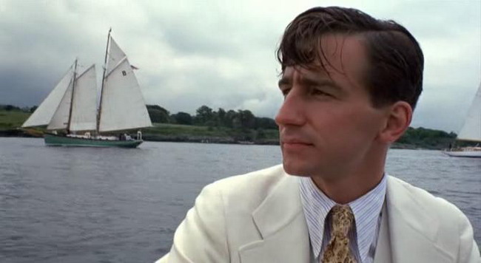
“In my younger and more vulnerable years (“WHEN” PREPOSTIONAL PHRASE), my father gave me some advice (KERNEL SENTENCE) that I’ve been turning over* in my mind (“WHERE” PREPOSITIONAL PHRASE) ever since (WHEN ADVERB).”
*Noun clauses to come
F. Scott Fitzgerald, The Great Gatsby

Slide 45
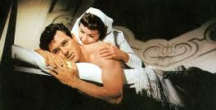
“In the late summer of that year (“WHEN” PREPOSITIONAL PHRASES), we lived (KERNEL SENTENCE) in a house in a village (WHERE” PREPOSITIONAL PHRASES) that looked* across the river and the plain to the mountains (“WHERE” PREPOSITIONAL PHRASES) .”
*Noun clauses to come
Ernest Hemingway, A Farewell to Arms

Slide 46
Further use of structured forms help students learn academic writing.

Slide 47
Mina Shaughnessy’s “Sentence Expansion”
“Expand base sentences using grammatical devices – single word modifiers, prepositional phrases, modifying clauses, etc. – even though students may not know the formal grammatical terms of the devices they are using.”

Slide 48
The problem will be solved with the help of the Almighty, who, except for an occasional thunderstorm, reigns unmolested, high in the heavens above, when all of us, regardless of race or religious difference, can come together and study this severe problem inside out, all day and night if necessary, and are able to come to you on that great gettin’ up morning and say, “Mrs. Shaughnessy, we do know our verbs and adverbs.”

Slide 49
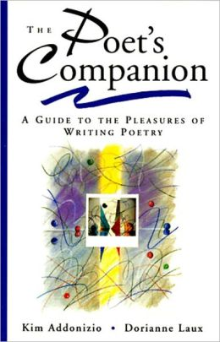
“Grammar can be a door to rooms you might never otherwise discover, a way to realize and articulate your visions in language.”

Slide 50
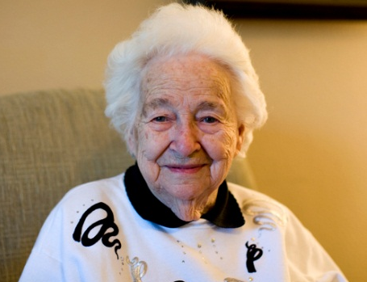
Grandma Stella on Appositives
“My grandmother Stella stands in the kitchen”
My grandmother Stella, a tiny woman/ with long white hair and the face/ of a Botticelli angel,/ stands in the kitchen, a long low room/ filled with the smell/ of grilling onions and roasting garlic,/ a smell I remember from childhood.

Slide 51
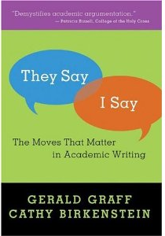
Argument templates generate writing
just like grammatical forms.
“Our templates have a generative quality, prompting students to make moves in their writing that they might not otherwise make or even know they should make.”

Slide 52
Stanley Fish:
What students must learn are the forms.
The content will follow.
Drill students in the forms that enable
meaning.
“What should colleges teach? Part 2”
http://opinionator.blogs.nytimes.com

Slide 53
Can
Grammar for the Right Brain
improve reading skills?
Use grammar to discern meaning.
Meaning discerned through form.
Reading and writing – forms to be
learned together!

Slide 54
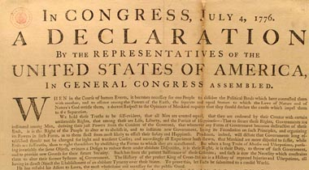
Reading History
When, in the course of human events, it becomes necessary for one people to dissolve the political bands which have connected them
with another, and to assume among the powers of the earth the separate and equal station to which the laws of nature and of nature’s God entitle them (INTRODUCTORY “WHEN”
DEPENDENT CLAUSES AND PREPOSITIONAL PHRASES), a decent respect to the opinions of mankind requires that they should declare the causes which impel them to the separation.*
*Noun clauses to come.

Slide 55
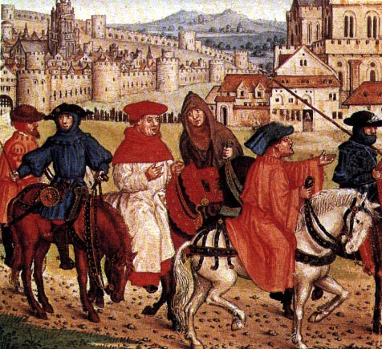
Reading Literature
When in April, the sweet showers fall/
And pierce the drought of March to the root, and all/ The veins are bathed in liquor of such power/ As brings about the engendering of the flower,/ When also Zephyrus with this sweet breath/ Exhales an air in every grove and heath/ Upon the tender shoots, and the young sun/ His half course in the sign of the Ram has run,/ and the small fowl are
making melody/ That sleep away the night with open eye/ (So nature pricks them and their heart engages) (INTRODUCTORY WHEN DEPENDENT CLAUSES)/ Then people long to go on pilgrimages.
Geoffrey Chaucer, The Canterbury Tales

Slide 56
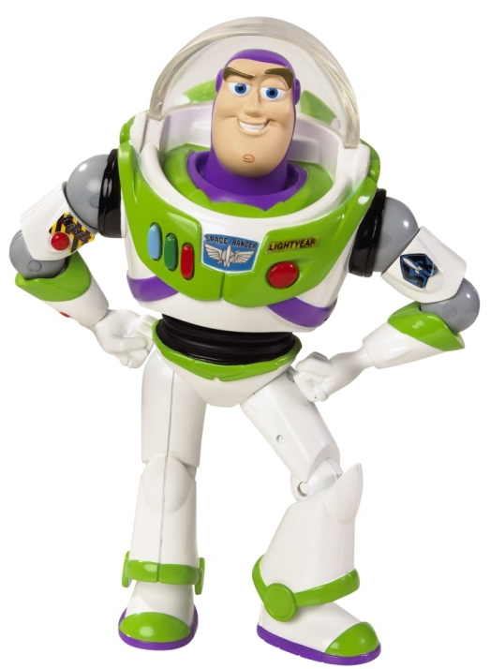
“Grammar
for the Right Brain”
Preparing Students
for English 101 –
and Beyond!

