Slide 1
Acceleration in Mathematics: A Matured Model for Success
Danielle Truszkowski Director of the Accelerated Math Program Jesse Kiefner Assistant Director of the Accelerated Math Program
Kate Abromaitis Developmental Math Coordinator

Slide 2
Background & Results Kate Abromaitis

Slide 3
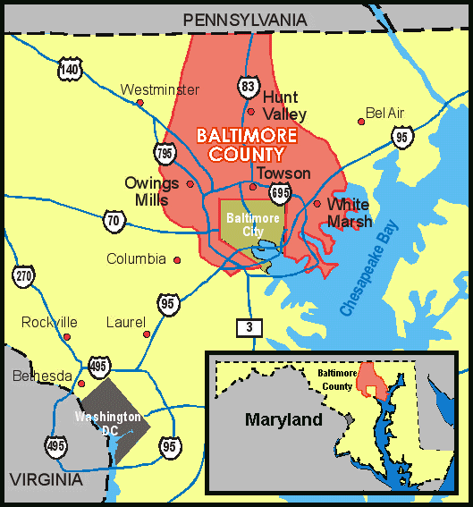
Main Campuses
Catonsville
Dundalk
Essex
Extension Centers
Randallstown
Owings Mills
Hunt Valley
We serve approximately 70,000 students per year.

Slide 4
Math Department
Full-time faculty are located at all three campuses with one stationed at Owings Mills Center.
Math Department offices are located on each of the three main campuses.
Math Department FTEs (Full-Time Equivalents)
FY 2011 = 2,231.0
FY 2012 = 2,200.4
FY 2013 = 2,096.9
Math Department Enrollment
Fall 2013 = 9,434 Spring 2014 = 7,889
Notes:
FY FTEs from PRE in SharePoint
(saved to Enrollment Tracking folder of mine on Dropbox)
Fall 2013 enrollment from EOTW – Sept 13, 2013
Spring 2014 enrollment from beg of third week = Feb 10

Slide 5
Math Course Offerings
MATH 111
“Liberal Arts Math”
MATH 081
Pre-Algebra
MATH 125
Finite Math
MATH 082
Introductory Algebra
MATH 131
MATH 083
Intermediate Algebra
MATH 132
Teacher Ed. Math
MATH 133
MATH 135
Applied Alg. & Trig.
MATH 153
Statistics
MATH 163
College Algebra
MATH 165
MATH 251/2/3
Pre-Calculus
Calculus I, II, III

Slide 6
Developmental Math Enrollment
FY 2013 FTEs
MATH 081 (Pre-Algebra): 302.8
MATH 082 (Intro. Algebra): 377.6
MATH 083 (Inter. Algebra): 481.1
Fall 2013 Enrollments
MATH 081 (Pre-Algebra): 1,564 78 sections
MATH 082 (Intro. Algebra): 1,823 95 sections
MATH 083 (Inter. Algebra): 2,381 107 sections

Slide 7
Accelerated Mathematics Program – AMP It Up!
Established in Fall 2010
Students Enroll in 6-Credit “Combo” Classes
Combined Course Options:
Pre-Algebra & Introductory Algebra
Introductory Algebra & Intermediate Algebra (But…)
Intermediate Algebra & College Algebra
Intermediate Algebra & Applied Algebra and Trigonometry

Slide 8
AMP Offerings
MATH 081
Pre-Algebra
MATH 111
Ideas in Mathematics
MATH 125
Finite Mathematics
MATH 082
Introductory Algebra
MATH 131
MATH 083
Intermediate Algebra
MATH 132
Teacher Ed. Math
MATH 133
MATH 135
Applied Algebra & Trigonometry
MATH 153
Statistics
MATH 163
College Algebra
MATH 165
Pre-Calculus
MATH 251 …
Calculus …

Slide 9
Data – MATH 081/082 Combined
 | Traditional | 081/082 AMP
Pass M 081 | 59.2% | 74.2%
Enroll in M 082 | 48.9% | 100.0%
Pass M 082 | 30.3% | 53.9%
Enroll in M 083 | 25.7% | 53.9%
Pass M 083 | 15.2% | 37.1%
Enroll in Credit math |  | 37.1%
Pass Credit math |  | 27.0%
Fall 2011 (MATH 081 students) Tracked for 2 Years

Slide 10
Data – MATH 083/163 Combined
 | Traditional | Fast-track | 083/163 AMP
Pass M 083 | 64.5% | 75.3% | 81.2%
Enroll in Credit | 49.6% | 63.0% | 100.0%
Pass Credit math | 39.6% | 45.2% | 65.4%
Fall 2011 (MATH 083 students) Tracked for 2 Years

Slide 11
African-American Students
 | Traditional path | AMP path
Pre-Algebra | 43.5%
Introductory Algebra | 44.7%
Intermediate Algebra | 42.3%
College Algebra | 54.1%
66.0%
66.7%
50.5%
58.7%
49.6%
79.5%

Slide 12
Building It Jesse Kiefner

Slide 13
Combined Course Options
Developmental Combination Options
Pre-Algebra / Introductory Algebra
Introductory Algebra / Intermediate Algebra (But…)
Developmental & Credit Combination Options
Intermediate Algebra / College Algebra
Intermediate Algebra / Applied Algebra & Trigonometry
(Each combined pair totals 6 credits.)

Slide 14
Combined Course Setup
Combined courses are 6-credits total.
Each student must register for two courses (3 credits each) that are scheduled during consecutive time periods.
The combined class, both sections, are taught by the same instructor.
No registration blocks! Open to all!
Students cannot drop one course; both courses must be dropped if requesting withdraw.
Topics in each course are integrated.
Students only purchase the higher-level course textbook.
Grading is separated along the way and the student receives two grades. (There’s a catch here.)

Slide 15
Challenge 1: How do we integrate the topics?
Pre-Algebra | Introductory Algebra | Intermediate Algebra | College Algebra | Applied Algebra & Trigonometry
Signed Numbers | Solving Linear Equations | Factoring | Polynomial Functions | Using Linear and Quadratic Functions to Model Data
Ratios & Proportions | Systems of Equations | Rational Expressions | Graphs of Standard Functions | Systems of Equations Using Cramer's Rule
Geometry | Graphing Linear Equations | Functions | Combinations of Functions | Applications of Direct and Inverse Variation
Statistics | Exponents | Quadratics Equations | Exponential and Logarithmic Functions (Advanced) | Exponential and Logarithmic Functions (Advanced)
Percents | Polynomials | Radicals |  | Trigonometric Functions
Algebraic Expressions and Equations (Linear) | Factoring | Exponential and Logarithmic Functions (Basic)

Slide 16
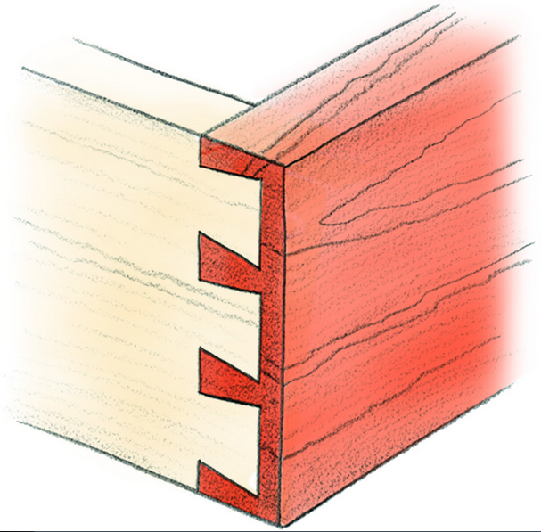
“dovetail strategy”
The Goal
Lower-Level Course Content
Upper-Level Course Content

Slide 17
Challenge 2: How do we assess? What are the rules?

Slide 18
Grading in Combined Courses
Students receive a final grade for each course.
Instructors keep grading separate for each course.
Students can pass the lower-level course and fail the higher-level course.
Any student who fails the lower-level course automatically fails the upper-level course.
Students complete the same comprehensive final exam as students in traditional sections.

Slide 19
Traditional Class Rules
Pre-Algebra
85% Rule
Common Final Exam – 30%
Introductory Algebra
85% Rule
Common Final Exam – 30%
Intermediate Algebra
85% Rule
Common Final Exam – 30%
College Algebra
85% Rule
Common Final Exam – 20-30%
Applied Algebra & Trigonometry
Applied Project Requirement
Comprehensive Final Exam (Instructor Created)

Slide 20
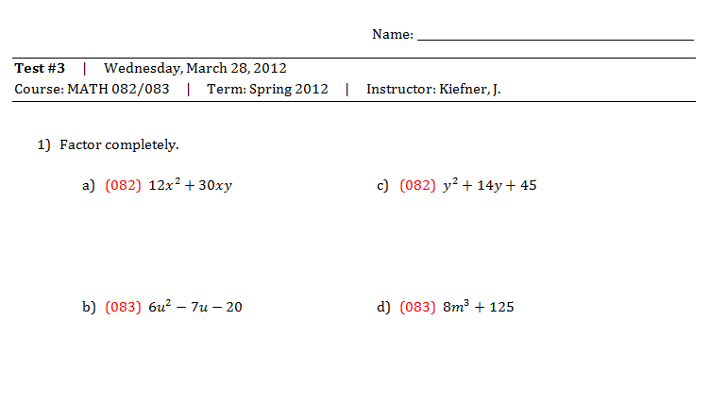
Grading in Combined Courses: Semester Tests
“All in One” Approach

Slide 21
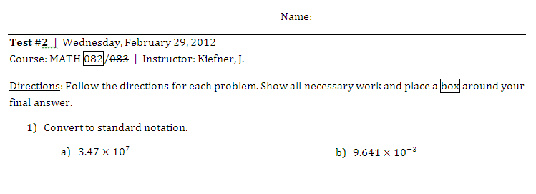
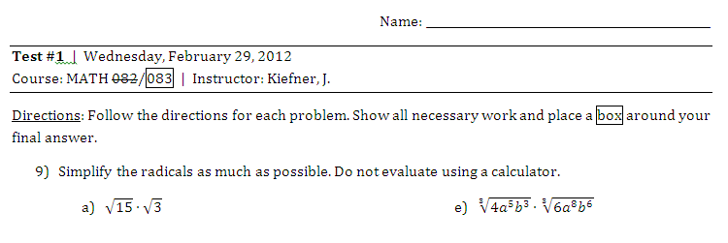
Grading in Combined Courses: Semester Tests
“Side by Side” Approach

Slide 22
Combined Course Instruction: Making the Connection
 | Lower Level | Upper Level
Pre-Algebra / Introductory Algebra | Solving Linear Equations | Solving Quadratic Equations
 | Evaluating Exponents | Scientific Notation
Introductory Algebra / Intermediate Algebra | Exponent Laws | Radicals
 | Graphing Linear Functions | Graphing Quadratic Functions
Intermediate Algebra / College Algebra | Graphing Quadratic Functions | Transformations of Quadratic Functions
 | Factoring | Determining Zeros of a Function
Intermediate Algebra / Applied Algebra & Trigonometry | Solving Quadratic Equations | Applications of Quadratic Equations
 | Evaluating and Graphing Exponential Functions | Modeling Data Using Exponential Functions

Slide 23
Challenge 3: How do we effectively use the extra time?

Slide 24
Managing Extra Time
Interactive Labs
Group Sessions
Review for Exams

Slide 25
Challenge 4: How do we supplement?

Slide 26
How do we make up for missing content?
MATH 081 – Internal Textbook
http://www.ccbcmd.edu/math_science/math/math081text.html
MATH 083 – Resources Collected and Compiled in Blackboard

Slide 29
Advantages of Combined Setup
Overlap in course content allows for additional time to devote to more challenging topics.
Students form a supportive cohort.
Students are able to see the connection and relation between two math courses; content doesn’t appear disjoint.

Slide 30
Student Survey: Overall, do you consider your choice to take a combined course to be a good decision or a poor decision? Explain.

Slide 31
Student Survey: Overall, do you consider your choice to take a combined course to be a good decision or a poor decision? Explain.

Slide 32
Student Survey: What advice would you offer to another student who was considering taking a combined math course?

Slide 33
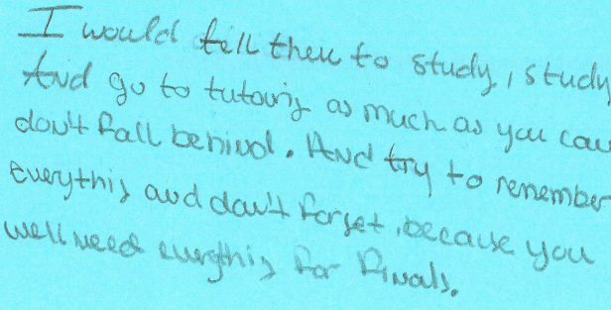
Student Survey: What advice would you offer to another student who was considering taking a combined math course?

Slide 34
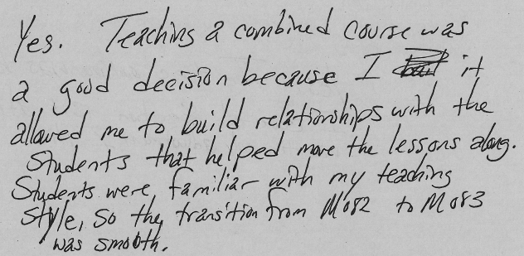
Faculty Survey: Do you believe teaching a combined math course was a good decision for you?

Slide 35
Marketing & Training Danielle Truszkowski

Slide 36
Challenge 5: How do we market?

Slide 37
Marketing Tools
Brochure
Poster
Commercial | https://drive.google.com/file/d/0B9pTQMnDM0jKMy1FeVd2M1FxQ1k/edit?usp=sharing

Slide 38
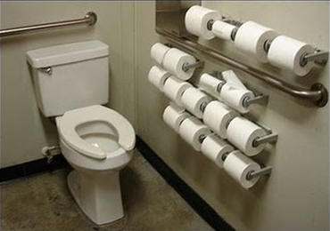
Challenge 6: How do ensure faculty members are prepared?

Slide 39
AMP Instructor Training
Instructors can take one training for all AMP courses.
How do we recruit faculty for training?
Face to Face Training vs. Blended Format
General Overview Technology Training
Online Homework Systems Course Specifics for Each AMP Supplementary Material
Notes:
1. Less work, grant money 2. they come with better questions and more prepared 3. more time, and how to use it.

Slide 40
Blended Format
Instructors participate in online modules before and after in-person training.
In-person training is one full day (approximately 7-8 hours).
All online modules are completed in no more than 10 hours.
Instructors (for now) receive a stipend for successfully completing all training requirements.

Slide 41
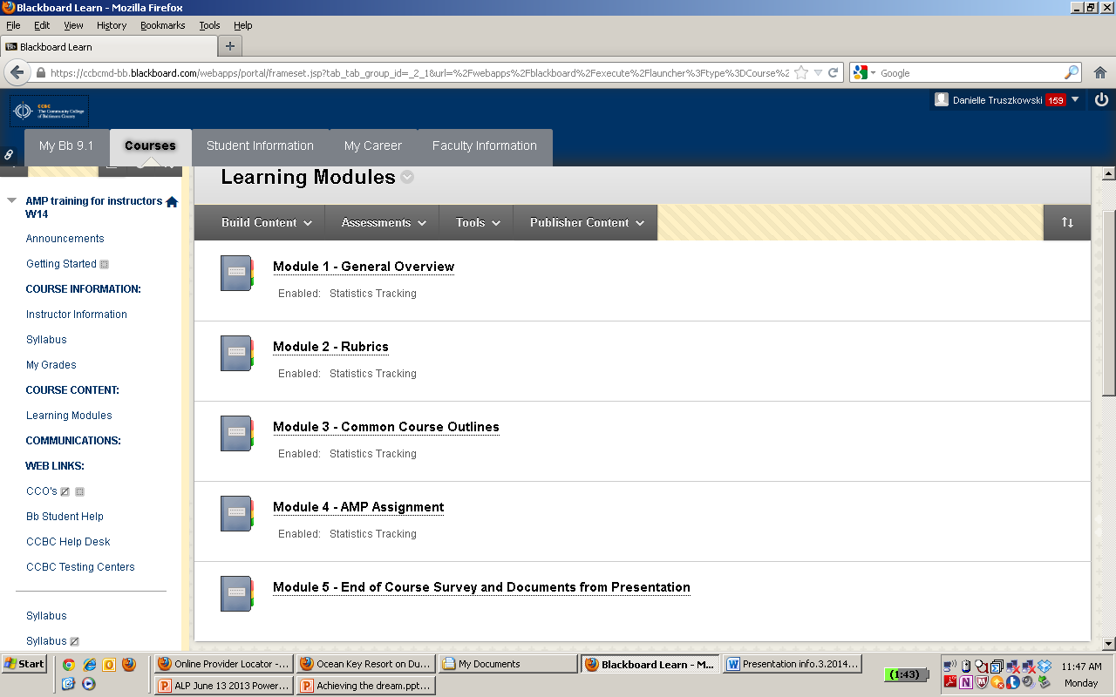

Slide 43
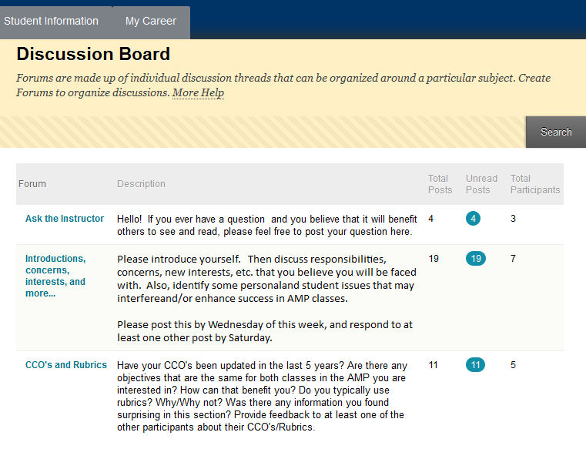

Slide 45
Blended Format
Instructors meet for a face-to-face training (one full day).
Instructors come with more knowledge.
Instructors have richer questions after participating in online modules.
In person, we discuss:
specifics for each AMP course
technology training
online homework systems
supplementary materials (previously discussed)

Slide 46
Sample: Are students properly placed?
AMP (Accelerated Mathematics Program) Information for Advisers
General Program Information
This is an accelerated program designed for students who are capable of learning more than the typical amount of math in one semester. It is typically not an appropriate program for students who have struggled with math in the past and are consequently behind in their math credits.
Successful students will generally have either placed at the high end of the placement score range for their current placement or will have earned an “A” or “B” in their previous math course.
Students need to understand that for a combined course, they will be taking six credits of math in one semester and will need to plan on 12-18 hours/week of study time, in addition to the six hours of class time.

Slide 47
Sample: Teachers on Day 1
Is an AMP class right for you?
Twice the tuition
Twice the time spent on homework and studying
Is this your first time taking the developmental course?
Cannot withdraw from one class without withdrawing from the other
If you fail both classes, you may not be eligible for financial aid. Make sure you discuss the new financial aid policy.

Slide 48
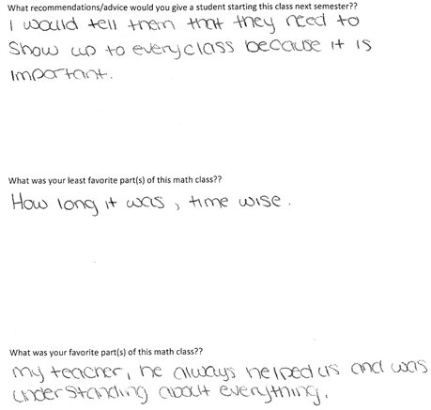
Sample: Sharing Student Surveys

Slide 49
Blended Format
What do instructors learn about time?
Instructors have a week to complete the last two modules online.
They are given a certificate and compensation.

Slide 50
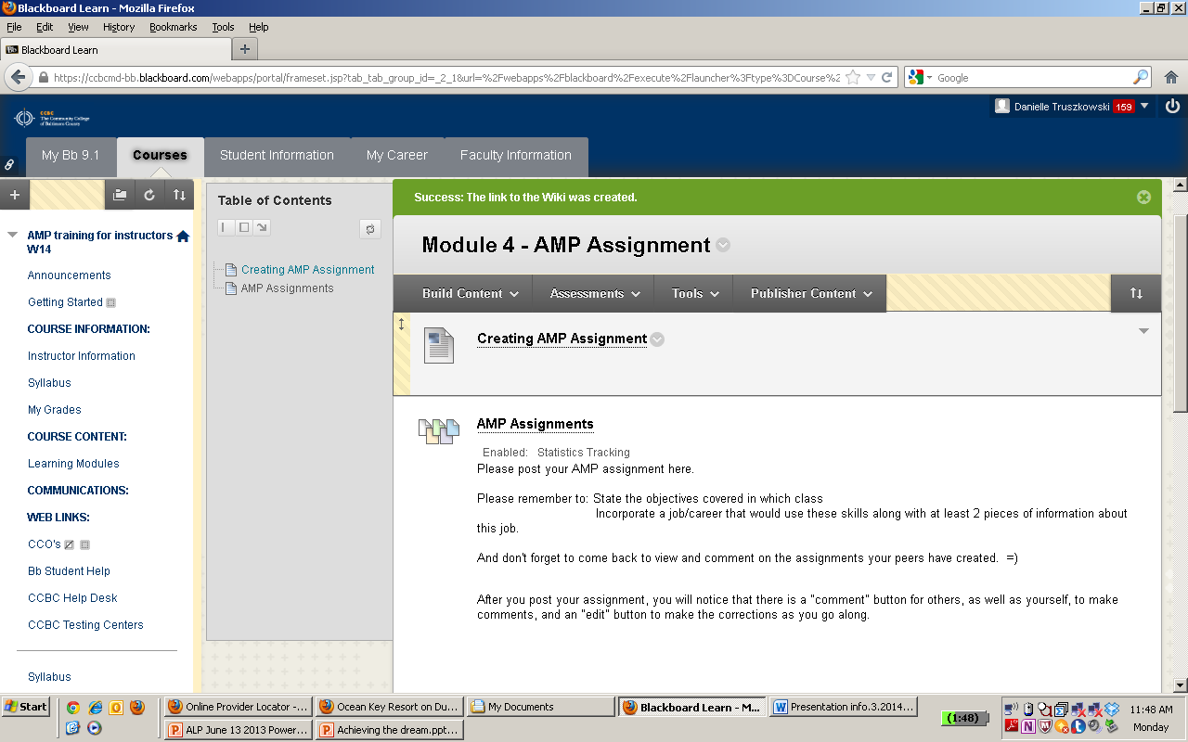

Slide 51
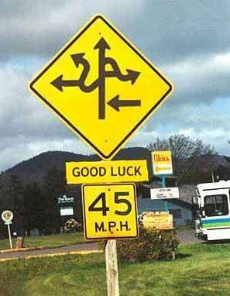
Challenge 7: Where do we go from here?
Continued Marketing
Future of MATH 082/083 Combined
Combining Intermediate Algebra with Ideas in Math?
Increasing Accelerated Sections?
Accelerated Statistics Option?

Slide 52
Contact Us!
Danielle Truszkowski
443-840-2654
dtruszkowski@ccbcmd.edu
Jesse Kiefner
443-840-3737
jkiefner@ccbcmd.edu
Kate Abromaitis
443-840-2644
sabromaitis@ccbcmd.edu

