Slide 1
Genre-Based Strategy Instruction with College Writers: Findings, Reflection and Possibilities
National Conference on Acceleration in Developmental Education
Baltimore, MD, 19 June 2014
Research reported in this article was supported by the
Institute for Education Science, U.S. Department of Education, grant R305A100614.
The opinions expressed are those of the authors.
Michelle Blake
Ilknur Sancak-Marusa
Shannon Mrkich
West Chester University
Charles MacArthur
University of Delaware
Zoi Philippakos
Towson University

Slide 2
Project Goals
Design and evaluate curriculum based on self-regulated strategy instruction that addresses writing strategies and skills, motivation, and self-regulation

Slide 3
Overall Curriculum Design and Achievement Results

Slide 4
Curriculum Organization
Units focused on a genre
e.g., argumentative essay with counterargument
Planning strategies that adapt to genre elements – graphic organizers
Evaluation criteria adapted to genre elements
Self-regulation strategies

Slide 6
Elements of Argumentative Writing
Introduction
Issue: What is the issue? Why is it important?
Position/Thesis: What is your position?
Reasons 2-4
Clear reason: Give a reason for your position
Supporting Evidence: Support your reasons with facts, examples, and explanations.
Opposing Reason and Rebuttal Essay
Opposing reason: What does the other side have to say?
Evidence for opposing reason: Give facts, examples, or explanations.
Rebuttal: Say why you disagree. Give your reasons.
Conclusion
Re-state position: Tell what your position is again.
Finish with a strong point: Leave the reader with something to think about.

Slide 7
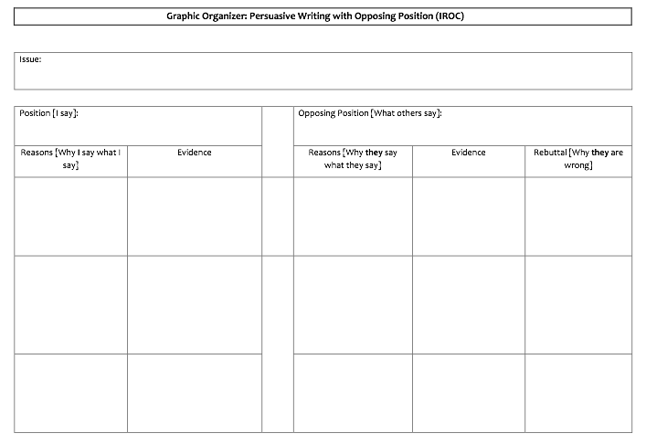

Slide 8
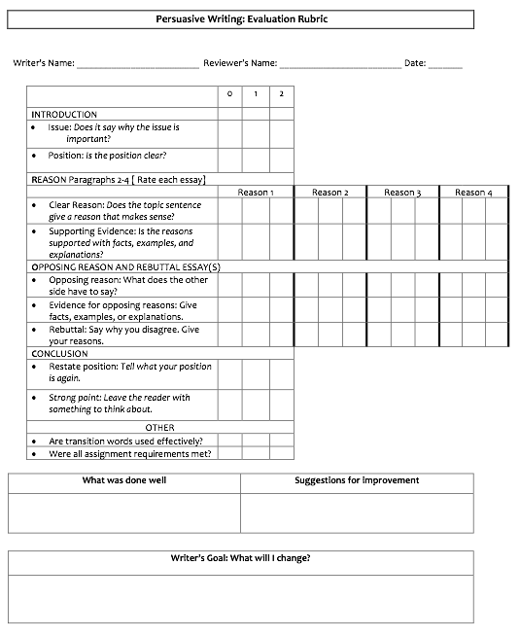

Slide 9
Instructional Sequence: A Strategy for Teaching Strategies
Introduce the genre
Discuss the purpose
Analyze good and weak examples
Discuss the good model, drawing out the genre elements
Apply genre-specific evaluation criteria to model
Apply evaluation criteria to weak example and discuss improvement

Slide 10
Sequence (cont.)
Explain and model the strategy using think-alouds
Explain the strategy steps
Apply the strategy yourself to plan, draft, and revise a paper – thinking aloud.
This observation of actual writing is critical
Collaborative practice or joint construction
Instructor and students together plan, draft, and evaluate a paper.

Slide 11
Sequence (cont.)
Guided practice
Peer review
Prepare via collaborative evaluation of papers by unknown peers using genre criteria
Peer review in pairs or small groups with accountability
Support self-regulation throughout; teach to mastery
Journal entries and class discussion support use of the self-regulation strategies

Slide 12
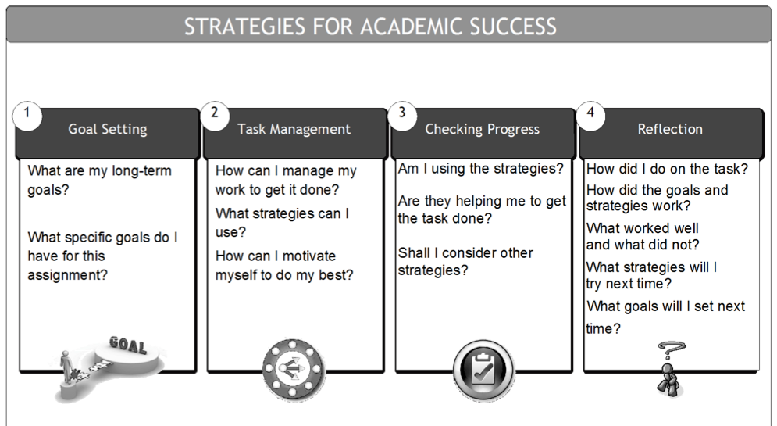

Slide 13
Quasi-experiment: Participants
Two 4-year colleges with large basic writing programs
13 instructors – 6 treatment, 7 control
19 classes – 9 treatment, 10 control
276 students – 115 treatment, 137 control
Demographics: 54% female; 48% minority; 10% non-native English speakers.

Slide 14
Outcome Measures
Essays rated for quality, length, and conventions (pretest and posttest)
Motivation scale (pre /post)
Self-efficacy
Learning goals
Beliefs about writing
Affect

Slide 15
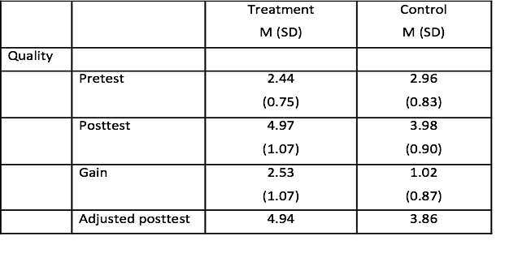
Essay Quality
HLM analysis with covariates (p = .003). Effect size, Glass’s Δ = 1.22.
Notes:
Essays were scored for quality (ideas, content, and organization) and for conventions (grammar, usage, and mechanics), each on a 7-point scale, independently by two raters. Interrater reliability was adequate with correlations of .78 for quality and .75 for conventions.

Slide 16
Quality Gains

Slide 17
Motivation
Significant effect of treatment (vs. control)
Self-efficacy for tasks/processes
E.g., I can write a well-organized essay with an introduction, body, & conclusion.
Mastery goals
E.g., When I’m writing in this class, I’m trying to improve how I express my ideas.
Significant pretest-posttest changes for combined groups in desired direction
Self-efficacy – tasks/processes, grammar, self-regulation
Beliefs about writing - substance and mechanics
Goals – mastery and performance (but not avoidance)
Affect

Slide 18
Self-Guided Strategy In Action

Slide 19
Academic Written English (AWE) is a Gatekeeper of the Academy
The Gateway Must Include
Creating tools to reinforce a clear writing process (Accelerated Learning through Repetition)
Developing assignments details, including assessment tools, that are transparent
Guiding students to understand and develop academic discourse
Improving Critical Thinking Skills

Slide 20
ALP Model
“By the time he reaches college, the BW student both resents and resists his vulnerability as a writer (Shaughnessy 7).
ALP model integrates the skill development of the BW in tandem with the credit-bearing writing courses, without alienating the BW.

Slide 21
Self-Regulated Strategy Instruction and the ALP Model
Self-Regulated Strategy Instruction leads to
Student self-awareness as a Learner
Builds confidence of the BW
Mastery of writing steps through repetition

Slide 22
Self-Regulated Strategy and the BW
They (BW) approach the task in terms they can handle, retell the material to you, summarize it, demonstrate that, yes, they can understand the stuff, and here it is…What you have to do, then, is model step-by-step the kind of critical approach the paper requires (Rose 176).

Slide 23
Mastery from Repetition
The basic writer requires repetition of basic writing skills and processes.
Genre Introduction
Assessment of Weak and Good Models
Collaborative and Instructor-driven Modeling

Slide 24
Master from Repetition
Self-Regulated Strategy Steps
TAPFOR (Topic, Audience, Purpose, Form, Organization, Requirements)
Brainstorm
Graphic Organizer (Outline)
Draft (Instructor Written Feedback)
Revise
Draft (Peer Feedback)
Revise (Instructor Verbal Feedback)

Slide 25
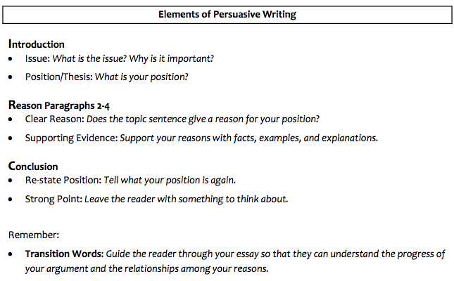

Slide 26
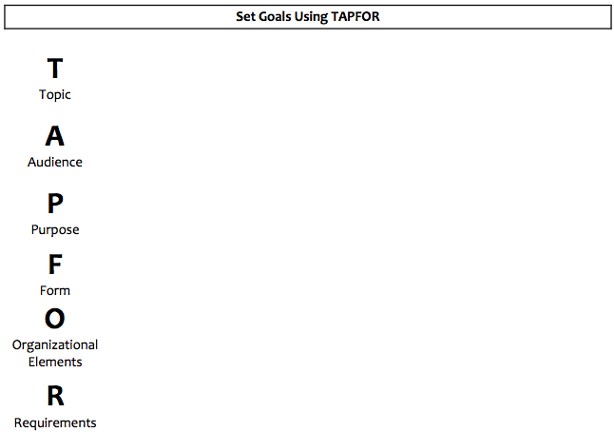

Slide 27
Brainstorm
Issue: Does Basic writing belong in higher education?
For | Against
Students haven’t developed needed writing skills. | All first year students should be placed in credit-bearing composition classes.
Develops student self awareness as learners. | Brands students as “remedial.”

Slide 28
Graphic Organizer
Position: Basic writing is needed for students’ successful in the academy.
Reasons (Why I Say What I Say): | Evidence
Students have misconceptions about what writing involves. | Some believe first drafts are high quality “final” drafts, and do not value drafting or revising.
Students encounter linguistic and cultural obstacles to writing. | ELL students and students’ home discourses do not align with AWE requirements.
Students may be intimidated by writing.
Students lack critical background writing skills.

Slide 29
Think-Aloud Modeling: Making the Implicit Explicit

Slide 30
Think-aloud Modeling
Verbalize cognitive and metacognitive activities while drafting (make the "invisible" explicit )
Demonstrate genre elements and rhetorical “moves” (minimizes the "guess work" of writing process)
Invite multi-sensory involvement (anticipate and address problems “in the moment”)

Slide 31
What does think-aloud writing mean?
drafting text in front of the class — for the first time — (demonstrating difficulties all writer have)
talking out loud about how you come up with the words that you put on the page (breaking down complex thinking process)
referring back to the planning and organizing material you produced (encouraging self-regulation and strategies)

Slide 32
Think-aloud & Writing Strategies
Model the strategy (instructor → TAPFOR, brainstorm, graphic organizer, draft)
Collaborative practice (→ we do all above together on another topic)
Guided practice (students perform all steps on their own topics)
Peer review and Editing

Slide 33
Self-Regulated Strategy Instruction & the Basic Writing Student

Slide 34
BWs feel sharply their lack of control
APPREHENSIVE about lack of mastery of mechanics > sense of lack of control of entire writing project
Mina Shaughnessy Intro to Errors and Expectations (1977): The basic writer “is aware that he leaves a trail of errors behind him when he writes. He can usually think of little else while he is writing. But he doesn’t know what to do about it.” (7)

Slide 35
SRS puts students in control day 1
Class does not begin with cs, thesis statements, or teacher identifying “right” and “wrong,” but with journals and class discussion about the connection between strategy (plan of action) and success.
Students are familiar with material
Students come to own conclusions strategies (be realistic, monitor progress, etc.)

Slide 36
SAS highlights what students DO control
Notes:
Strategy is a plan that the students choose: what works for Malik won’t work for Tara
Strategy/students’ choices are ever at heart of class discussion, journals: “Journal assignment: Look back at the difficulties you have said that you faced as a writer. Think of the strategies you are learning and write a journal entry explaining how these strategies can assist you with specific difficulties.”
Control > Ownership: Mostly very good quiz grades, a small # of very bad ones. Either way, awareness of relationship bw class engagement and grades. Performance is by them; grade is not subject to forces outside them.

Slide 37
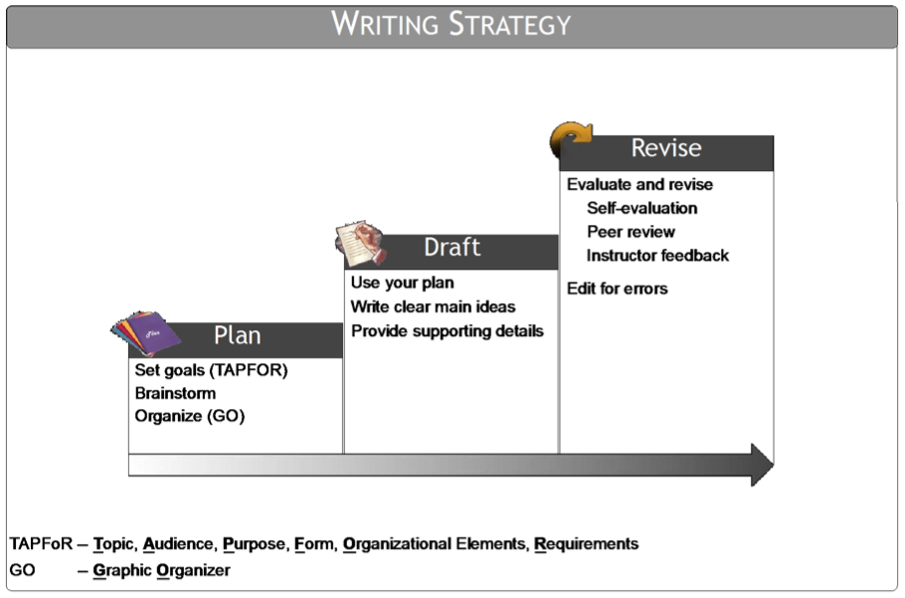
Students control Writing Strategy, not necessarily writing process
Notes:
Students are familiar with this material from prior classes, but admit they do not use.
Difference: “strategy” vs “process”

Slide 38
In the students’ words...
“The writing strategies are exceptionally helpful when it comes to writing an important paper by technically setting you up for success if you do all the steps it is asking of you to the best of your ability.” > STRATEGY IS A TOOL STUDENT USES, AND SHE RECOGNIZES THAT HER EFFORTS MATTER
“I have in the past jumped right into writing a paper because I was too lazy to do the work before. I have learned that this process makes it much easier to write a paper because you have all your main ideas already laid out for you.” > STRATEGY ENCOURAGES OWNERSHIP OF THE PROCESS
“This writing strategy helped reduce the stress I feel when I write. When I started writing without the strategy, I feel rushed to get my ideas onto the page, and when I go back, my paper’s topic wouldn’t be clear.” > STRATEGY GIVES SENSE OF CONTROL

Slide 39
BWs: fearful of failure, unconfident
FEARFUL of failure at every turn > often feel TYRANNIZED by the assignment’s specifics, which many follow almost slavishly
Alice S. Horning (1987): Sense of fear adds “filter” that is “all of the learner’s feelings, motivation, and sense of self as they [sic] play a role in the learner’s ability to master the material under study
Notes:
Horning “Climate of Fear in Teaching of Writing” (Teaching Writing: Pedagogy, Gender, and Equity)
Much easier to TAPFOR than to “plan”
“Task Management” is concrete, laid out
Elements repeated so often, difficult not to master. If not mastered, it is clear that student is not engaged > ownership.

Slide 40
SRS addresses fear and lack of confidence
The concrete steps appeal to unconfident BW who clings to following specifics of assignment
Completing the steps, and being aware of this completion in monitoring progress > sense of accomplishment, confidence
Each task is repeated over and over > builds confidence and leads to sense of mastery

Slide 41
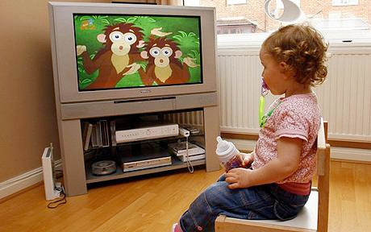
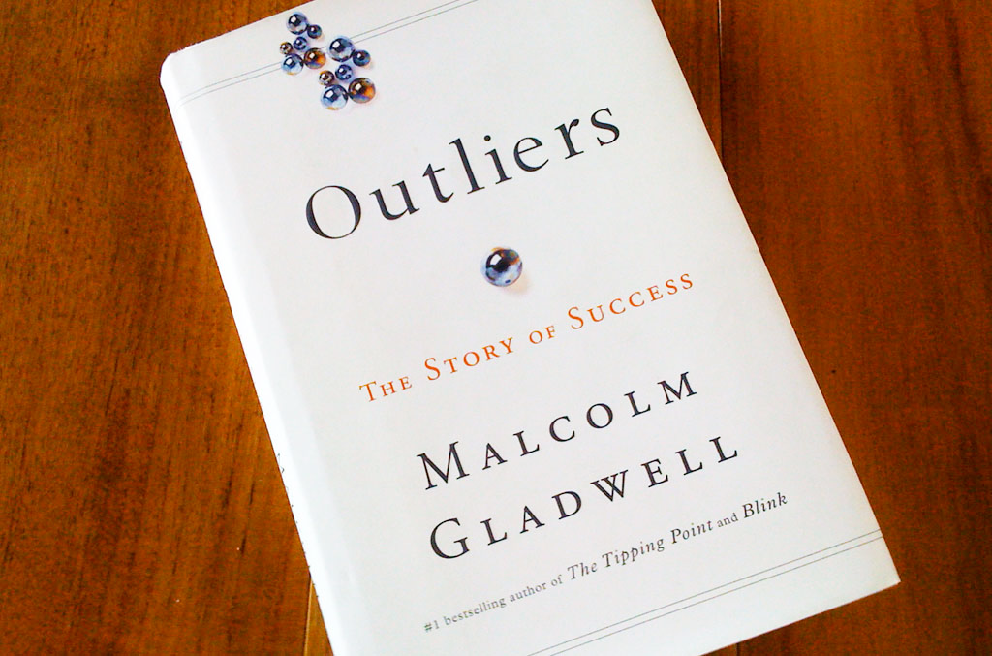
Repetition of curricular elements encourages confidence and mastery
Horning: “[T]he unconscious character of redundancy plays a role in all aspects of language acquisition...” --Teaching writing as a second language (19).

Slide 42
Strategies give sense of CONTROL + Repetition leading to sense of MASTERY, CONFIDENCE = Success

Slide 43
In the students’ words...
“I found it [the graphic organizer] difficult for me because I was trying to figure out what main ideas to put in my essay and then I had to figure out how to make them all connect. So it was a little difficult. Once I finished making it though, I found that it really helped me into writing my paper.”

Slide 44
More words...
“When I completed the graphic organizer, I noticed that it was very helpful because it let me plan out what I wanted to say and how I wanted to say it.” > STRATEGY EMPOWERS STUDENTS

Slide 45
More ...
“I did not get confused or ... say the same things over again because it allowed me to organize my thoughts, ideas, and points. Before, I would know what I wanted to say, but it would always go off into another topic.... It was also overwhelming without the organizer because I had so many ideas...” > STRATEGY AGAIN EMPOWERS, AND GIVES SENSE OF MASTERY OVER, NOT SENSE OF BEING OVERWHELMED BY, THE ASSIGNMENT

Slide 46
Last one for today...
Now that I have a strategy before writing, I feel a lot more confident in my papers, and I am expecting my grade to reflect this new feeling that I have. > STRATEGY GIVES CONFIDENCE, A “NEW FEELING”

Slide 47
In short, SRS Instruction addresses needs particular to the Basic Writer (from Shaughnessy Errors and Expectations)
The basic writer “is aware that he leaves a trail of errors behind him when he writes. He can usually think of little else while he is writing. But he doesn’t know what to do about it.” (7) >> SRS gives steps of what to do, gives control over performance to student
Teachers sense “the struggle to fashion out of the fragments of past instruction a system that will relieve the writer of the task of deciding what to do in each instance where alternative forms or conventions [alternative to academic written English] stick in the mind.” (10) >> SRS empowers student to be able to make decision of what to do
BW students are “pressed by their language-learning faculties to increase the degree of predictability and efficiency in their use of language. This is less a choice they make than an urge they have to move across the territory of language as if they had a map and not as if they were being forced to make their way across a mine field.” (10) >> SRS gives predictable patterns, templates; self-regulation enables them to know they’re not being forced, they are choosing moves to make
“To try to persuade a student who makes these errors that the problems with his writing are all on the outside, or that he has no problems, may well be to perpetuate his confusion and deny him the ultimate freedom of deciding how and when and where he will use which language.” (11) >> repetition of matters “on the outside” lead to mastery and confidence; student gets “freedom” of making decisions
“[I]t may […] be that grammar still symbolizes for some students one last chance to understand what is going on with written language so that they can control it rather than be controlled by it.” (11) >> SRS highlights where student is in control, so he or she can more confidently venture into areas that need more work

Slide 48
If you are interested in the curriculum or have questions about the approach, please contact:
Charles MacArthur
macarthu@udel.edu
Zoi Philippakos
philippakos@gmail.com

