Slide 1
Connecting to Strength: Advancing Academic Persistence in Accelerated Students
JoNelle Toriseva
ALP Conference, Baltimore, MD, June 19th, 2014

Slide 2
Connecting to Strength: Advancing Academic Persistence in Accelerated Students
JoNelle Toriseva, SUNY-Genesee Community College jrtoriseva@genesee.edu
Getting to academic engagement is a crucial step for student success. This presentation centers on ways to help students connect to their strengths to achieve their academic goals. With a focus on academic writing projects, we will discuss ways of developing and increasing academic persistence by overcoming emotional, behavioral & thinking issues and using cognitive apprenticeship, contextualization and experiential writing.

Slide 3
We’ve been doing this for awhile…
The Craft of Thought Meditation, Rhetoric, and the Making of Images, 400–1200
Mary Carruthers

Slide 5
Getting to Engagement
Engaging for College Success: A Multi-Faceted Challenge
Cognitive Apprenticeship, Contextualization and Experiential Writing can set the stage.
Then, students can clear the decks. Here are some approaches to help students with stress-related challenges, prepare for success, practice success and engage in success…
through time management,
growing alliances by forming peer support groups in the classroom & beyond
and implementing good self-care.

Slide 7
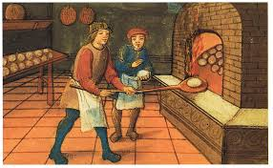
What works?
Contextualization…
Combine skills with content areas.
“People learn when they have a need that is meaningful and real” Goode (2000).
Apprenticeship
Apprenticeship

Slide 8
What’s your story? What have you experienced? How did you get here?

Slide 9
Experiential writing
Writing about place grounds students
Writing the Rocket-- engaging students with their environment. Use field trips to increase student engagement with their writing.
They experience something, they write about it. It builds their group experience and their comfort with the writing project.

Slide 10
Read. Write. React.
Newsactivist.com
Gabriel Flacks
Metaliteracy.org

Slide 11
What limits engagement?
Set yourself up for success…..
Awareness is key. Here are areas to address with your classes:
Expect roadblocks. It might be impossible for you to get where you want without having negative beliefs, emotions or behavior.
Create the environment for success:
at college,
in your social circles,
at home,
at work.

Slide 13
Name your boulder….

Slide 14
Clearing the Decks….
Identify Foes/Allies
Do any of these areas need rebuilding?
Social
Family
Self
Health
Money
Living Situation
Transportation
Unforeseen emergencies

Slide 15
Map…What areas do you have to look at…
Emotional
Social
Health
Support
Financial
Brain support
Family Demand

Slide 16
What’s keeping your from getting what you want in college?
Here are some activities from Allison Miller’s work: Life Essentials
Get Results, and Move on With Your Life
Overcome Economic, Societal and Psychological Barriers,
So that you can learn, grow as a person, stretch yourself intellectually, psychologically and creatively.
Cultivate a Growth Mind-Set

Slide 17
Add yours to the mix….

Slide 18
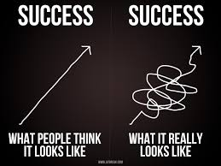

Slide 19
What blocks you from engaging in college?

Slide 20
Devising Timelines:
Avoiding a Breakdown by Breaking It Down
Make an Action Plan
Your Choice of Scope:
--Project Plan
--Class Plan
--Semester Plan
--Daily Plan
--Weekly Plan
-Tame your e-mail, phone calls & other distractions
-Create a conducive work environment by taking time each work to organize and refresh
-Plan small actions to start your work.
-Study/write a few sentences/moments more
-Team up with others
-Acknowledge your achievements

Slide 21
Finding the pitfalls…
Locate the Traps of Negative Thinking,
Feeling,
and Behaving
Practice mindfulness.
Accept that there are thinking, feeling, behaving traps.
2 common types :
Buying Your Thoughts (fuse event with evaluation) e.g. I have
difficulty understanding a reading because I‘m not smart.
The evaluative thought and the event become one and you buy the thought at face value.
Yes-But Thoughts (justify your inaction with your own thoughts and feelings) e.g. I’d like to do my problems today but I don’t know how.
The but here prevents you from moving forward & from asking for help.

Slide 22
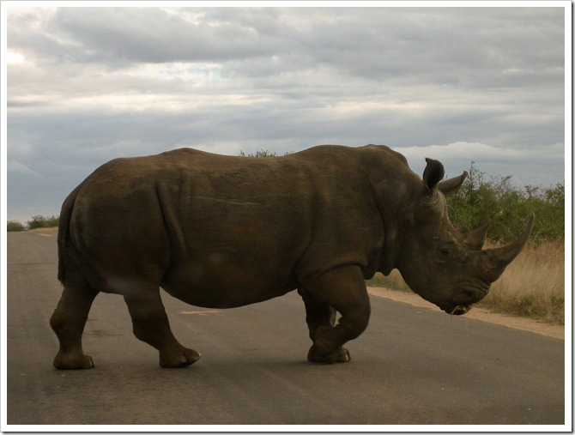

Slide 23
Do Cognitive Defusion:
Purpose: Detangle your evaluations or interpretations of events from your actual experience.
Helps you recognize and experience your evaluative thoughts and unwanted feelings as something that you have, but they do not define you or your experience.
Say “I am having the thought that…”
Consider the difference between “I’m not smart enough to do this;” and “I am having the thought that I’m not smart enough to do this.” In the defused statement you can create some distance and see it as merely a thought. You are able to look at your thoughts as an observer instead of only being able to look out at your world through the lens of your thought. This can be used to address body sensations& emotions

Slide 24
Examples of Cognitive Defusion to Free Yourself from Buying Your Thoughts & Feelings
“I am having the thought that I should always be doing homework.”
“My mind is telling me that I don’t have enough time to make any progress in class today.”
“I am buying the thought that I need to feel highly inspired to write my essay.”
“There goes my mind again thinking my work needs to be perfect.”
“I am noticing that my chest is tight, my stomach hurts, and I am feeling fearful.”
My fears about finding a job and what comes after my degree are knocking on the door.
“I am having the feeling of being depressed and overwhelmed.”
“I am having the experience of shame about the time I spend procrastinating”. (p. 56) Finish…Alison B. Miller

Slide 25
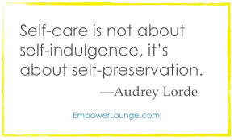

Slide 26
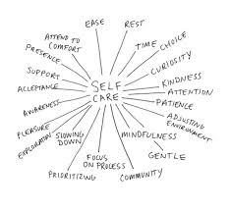

Slide 27
Plan ahead for detours…

Slide 28
Make your own Self-Care Plan:

Slide 29
Sources & Resources:
- With thanks to Center for Community College Student Engagement. (2013). A Matter of Degrees: Engaging Practices, Engaging Students (High-Impact Practices for Community College Student Engagement). Austin, TX: The University of Texas at Austin, Community College Leadership Program.
-Allison Miller’s “Finish Your Dissertation” & Life Essentials http://www.lifeessentialscoaching.com/strategies.html
Hayes and Smith “Get Out of Your Mind and Into Your Life http://www.stevenchayes.com/
“Radical Self-Acceptance” Tara Brach
http://www.tarabrach.com/

