Slide 1
“So … How Are Things Going?”
The Power of Faculty Reflection
in an Informal Space
6th Annual Acceleration in Developmental
Education Conference - June 19, 2014
Embassy Suites – Baltimore, Maryland
Presenters: Linda De La Ysla, Jackie Scott, Bina Pittman,
Lavinia Edmunds, Charlotte Wulf, Brian Sateriale
The Community College of Baltimore County

Slide 2
CCBC Students
Community College of Baltimore County
credit students
33,817
average age
29
female/male
58/42%
students of color
50%
full/part-time
34/66 %
A
L
P
The Accelerated Learning Program

Slide 3
CCBC’s Developmental Education Courses:
MATH
081
MATH
082
MATH
083
RDG
051
RDG
052
ENGL
051
ENGL
052
ENGL
101
ENGL
102

Slide 4
ALP - English
ENG 101
ENG 052
reduces stigma
improves attachment
provides stronger role models
encourages cohort effect
changes attitude toward developmental course
allows individual attention
allows time for non-cognitive
issues
allows coordination of the two courses
A
L
P
The Accelerated Learning Program

Slide 5
What do we do in the ALP 052 class?
The goal for ALP instructors:
Maximize the ALP students’probability of success in the ENGL 101 class.
Strategies include the following:
Conducting class as a writing workshop, an extension/supplement to the 101 class
Answering questions left over from the 101 class
Providing opportunities for more writing practice, short papers to reinforce concepts from the 101 class or prepare for upcoming assignments in the 101 class
Discussing/brainstorming ideas for the next essay in 101
Reviewing drafts of essays the students are working on for 101
Working on reducing the frequency and severity of error in the students’ writing
Addressing non-cognitive issues (life issues, affective issues)
A
L
P
The Accelerated Learning Program
Notes:
After discussing this slide, Peter turns it back to Sarah.

Slide 6
Critical Features of ALP
Students take their developmental writing course concurrently with the credit-level writing course, rather than as a pre-requisite.
The same instructor teaches the ALP course and the credit course.
At least half the students in the credit English course are students who placed into credit-level writing.
The ALP cohort is no more than 12 students.
ALP instructors recognize the importance of paying attention to the non-cognitive issues affecting their students.
The pedagogy in the ALP course is based on “backward design” from the credit course and emphasizes active learning, improved reasoning skills, engaged reading, and more effective editing skills.
A
L
P
The Accelerated Learning Program

Slide 7
Why is faculty development an essential aspect in ALP or other acceleration models?
A
L
P
The Accelerated Learning Program

Slide 8
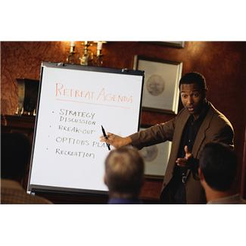
CCBC’s Evolution of ALP Faculty Development
Two-hour orientation
Half-day workshops
Financial literacy
Integrated reading and writing
Non-cognitive issues
Active learning
ALPIN (ALP Inquiry Network)
ALP Faculty Institute
“ALPles & Oranges”

Slide 9
Critical Features of “ALPles & Oranges”
For full-time and adjunct faculty
On-going, monthly, with reminders!
Informal
Support for grappling with uncertainty
An atmosphere of trust

Slide 10
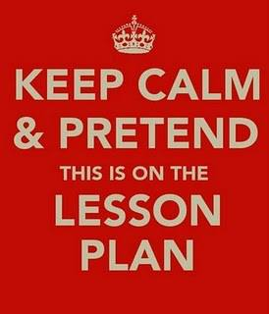
Full-time and Adjunct Faculty
“Each ALP session has helped me tremendously, particularly because of the random participation of instructors, administrators, full-time and adjuncts who attend.”

Slide 11
On-going, Monthly Sessions
“The strength of ALPles and Oranges is in its simplicity. There is no agenda, no assigning of tasks, no long term goals. You can be adjunct or full-time faculty. You can be a newbie or a long-time instructor. These informal meetings allow participants to exchange their ideas, ask questions, and even voice opinions in a room where there is no judgment.”

Slide 12
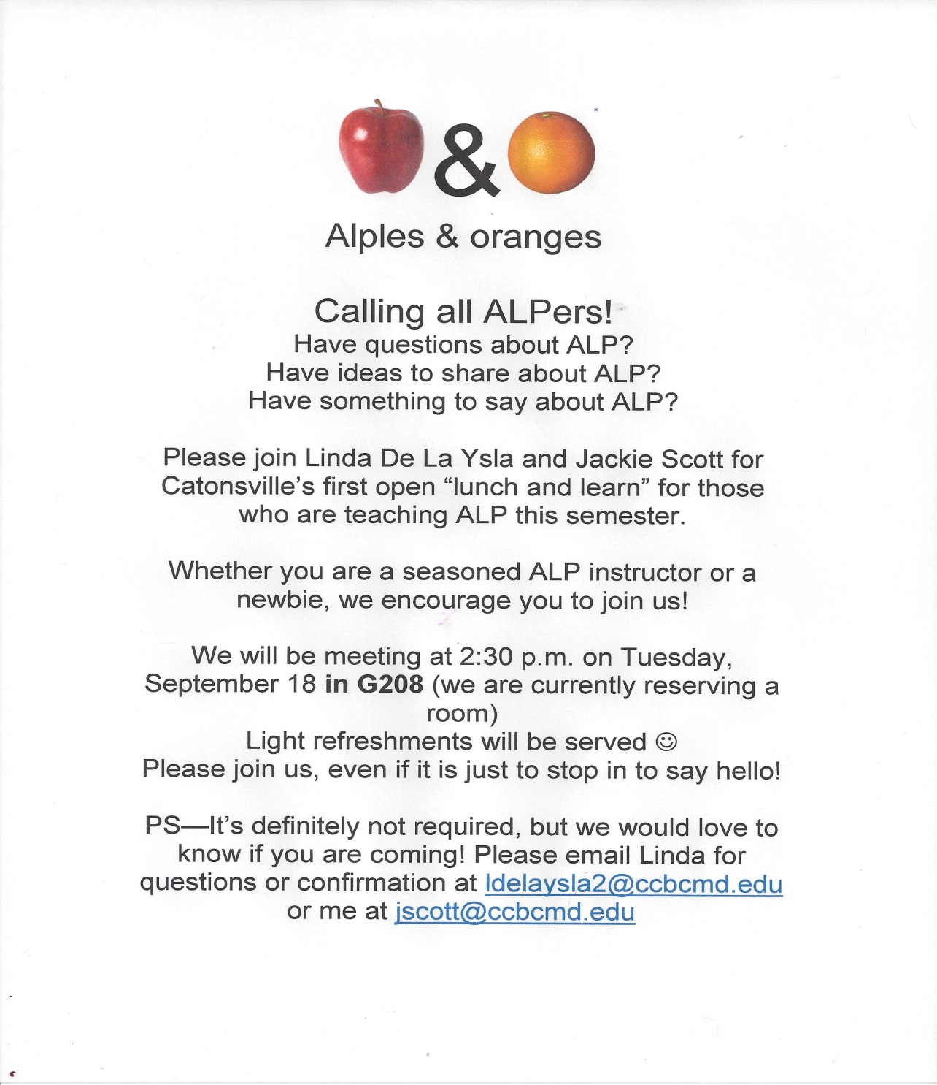
Monthly Sessions with Reminders!

Slide 13
Informal
“ … each instructor can bring whatever is on his or her mind that day … and talk it over with the others who are present. So whether a teacher is concerned about attendance, poor preparation for class, or some other problem that might be a concern, the others at the meeting are willing to discuss that concern and try to offer some advice.”

Slide 14
Support for grappling with uncertainty
“I dreaded approaching the research papers in all of my sections of English because my students inevitably became overwhelmed by the brainstorming, thesis, and research components of the research paper. However, after using Lavinia's model/structure, my students had/have a better grasp of how and why--with specific deadlines for each sequential stage of the paper--that has made a world of difference.”

Slide 15
An Atmosphere of Trust
“The session that soothed my anxiety about my students' poor attendance was when Evan dropped in to say "hi"; he explained the statistics (average students, retention rates, and campus challenges) of each campus: Essex, Catonsville, and Dundalk … I immediately felt better personally and professionally about the whys and how's and the challenges of my ALP sessions.”

Slide 16
Improving Teaching
"The ALPles meetings have proven to be invaluable to my pedagogical approach in teaching my own ALP courses. Much like the supplemental 052 aspect of ALP, the faculty ALPles meetings have provided an nonthreatening, totally inclusive approach to achieving one goal: the improvement of the individual (in our case--the individual ALP instructor). Every attendant is a valued and respected member of the community and feels encouraged to contribute to the dialogue at hand; thus, learning (about teaching ALP) is facilitated by the entire group, not by one central figure, and this 'freedom' results in profound dialogue and profound self-awareness."

Slide 17
Faculty Development
We are still figuring it out.
We don’t think everyone has to teach in the same way.
The fact that teaching ALP is different provides an opportunity.
We raise questions we think ALP faculty should think about.
We provide answers when we have them, sometimes more than one, usually tentative.
We don’t think of the Institutes as telling people how to teach. We provide a smorgasbord of ideas from which we hope faculty will choose what fits with their teaching style.
A
L
P
The Accelerated Learning Program

Slide 18
A Closer Look at Faculty Development
What type of faculty development is offered by your college or department?
How might the “ALPles & Oranges” model be adapted to your college?
A
L
P
The Accelerated Learning Program

Slide 19
Any Questions?

Slide 20
TO CONTACT US:
Linda De La Ysla: ldelaysla2@ccbcmd.edu
Jackie Scott: jscott@ccbcmd.edu
Bina Pittman: bpittman@ccbcmd.edu
Lavinia Edmunds: ledmunds@ccbcmd.edu
Charlotte Wulf: cwulf@ccbcmd.edu
Brian Sateriale: bsateriale@ccbcmd.edu

