Slide 1
Conveying Information for the Affective Domain
working on student success
Baltimore 20 June 2014

Slide 2
Working with the Affective Domain
Domain of learning that primarily engages emotional factors and attitudes
Empathy exercise:
  “Affective Domain.”Teaching Today. Glencoe Glossary. N.d.Web. 24 Mar 2013.
Notes:
You are a returning student, been out of school ten years
First time full time
Work full time
3 little kids
Carved time out to get to classes
No idea the workload amount
No idea HOW to do the work
Triple L student: ;lonely, lost, overloaded

Slide 3

“Nemo.” New York Times. NYTimes.com. 8 Feb 2013. Web. 10 Feb 2013.

Slide 4
Working with the Affective Domain
  Students engaging with peers;
  Students meeting the people and resources that can help;
  Students finding their way;
  Students owning the campus;
  Students producing an authentic product that can be shared;
  Students collaboratively learning AND teaching.

Slide 5
Three Learning Activities & Assessments
1. Information Scavenger Hunt and Presentation
  Rubric assessment of multimodal elements of assignment
2. QR Barcode Scavenger Hunt as quiz
  Required items assess concept attainment
3. CAT feedback
  Self-assessment of student learning
Notes:
Students love getting out of class: both scavenge hunts the students are released from class. Released to make interview appts, conduct interviews, follow the QR barcodes.
Enough time in schedule to complete the project in class

Slide 6
1.Scavenging People and Information
Learning where and how to find answers

Slide 7
Five areas of support
Financial Counseling: Judy Brandis
Library Home Page (virtual): Leslie Murtha
Information Commons: Kathy Fritz
Counseling Center: Tammy Franco
Finding and Communicating with Your Professor: Pat Gandy
Notes:
Learn by Doing John Dewey
Teaching with Your Mouth Shut
Patterning asking questions (they are supplied with a list for each area of student support) and they must scavenge the answers by finding the assigned personnel on campus that help and support the students
Cooperative learning-students often learn best from each other
Active learning--students research and document tips for interviewing: Assisted lecture, valorizing their ideas and input, PPT made by them and saved in BB for review
Flipped classroom: How to Make a Effective Presentation for homework and do the project itself in class in the computer lab
Assisted lecture on tips for public speaking in English 101

Slide 8
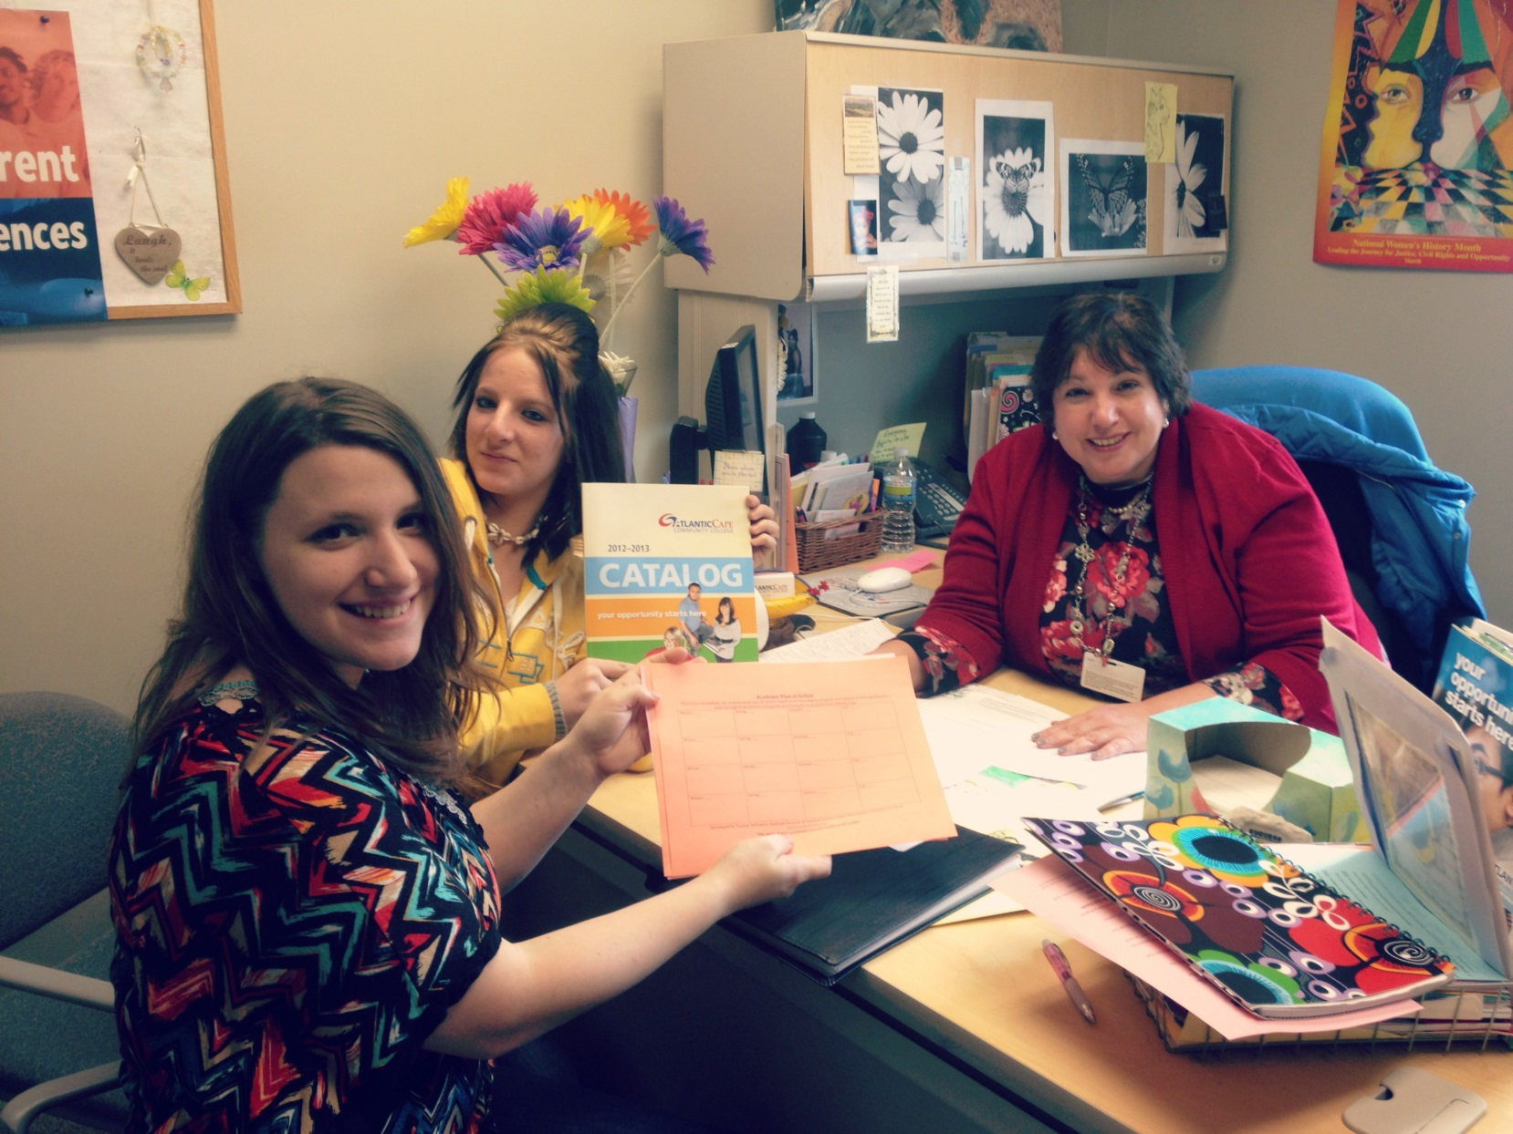
Interviewing
Notes:
Faces speak for me
Formulation of study buddies
Learning and teaching about advising and time management

Slide 9
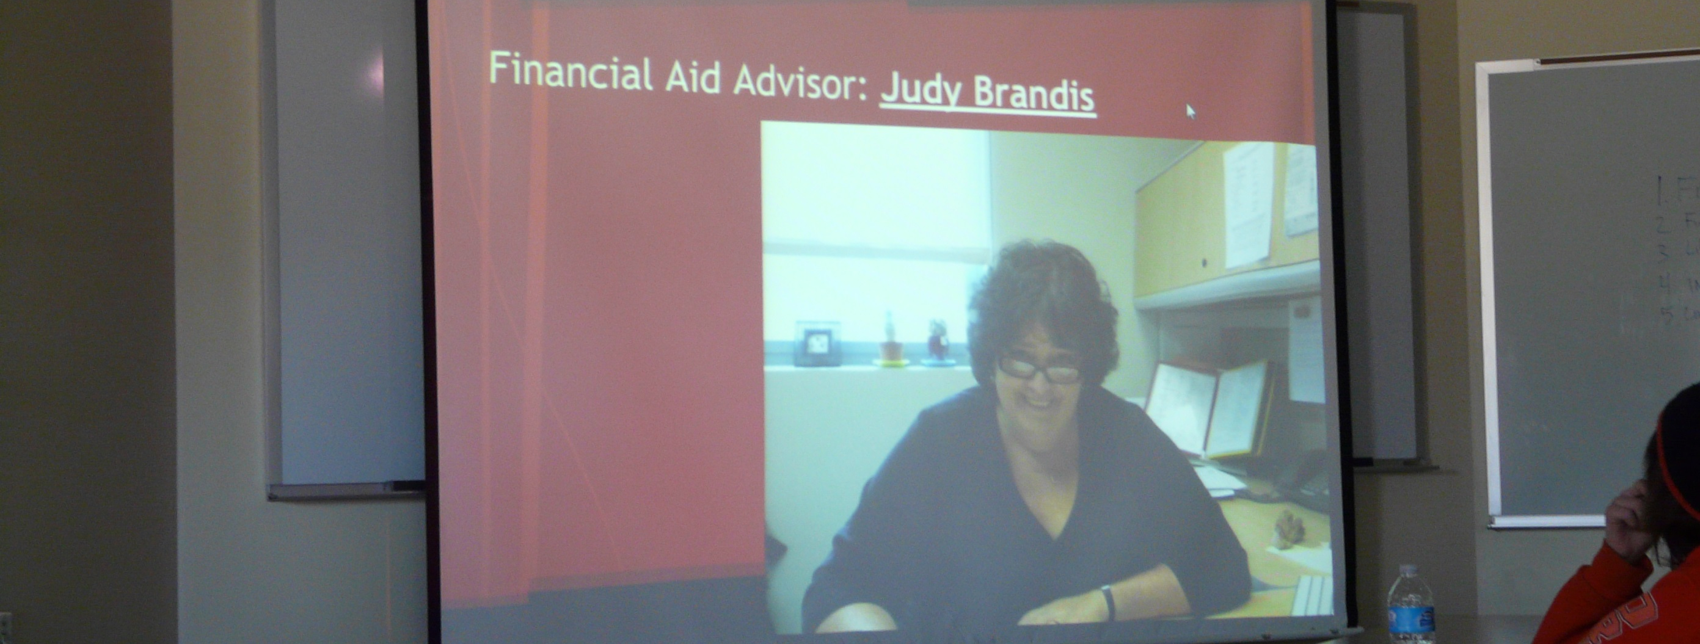
ALPS Project

Slide 10
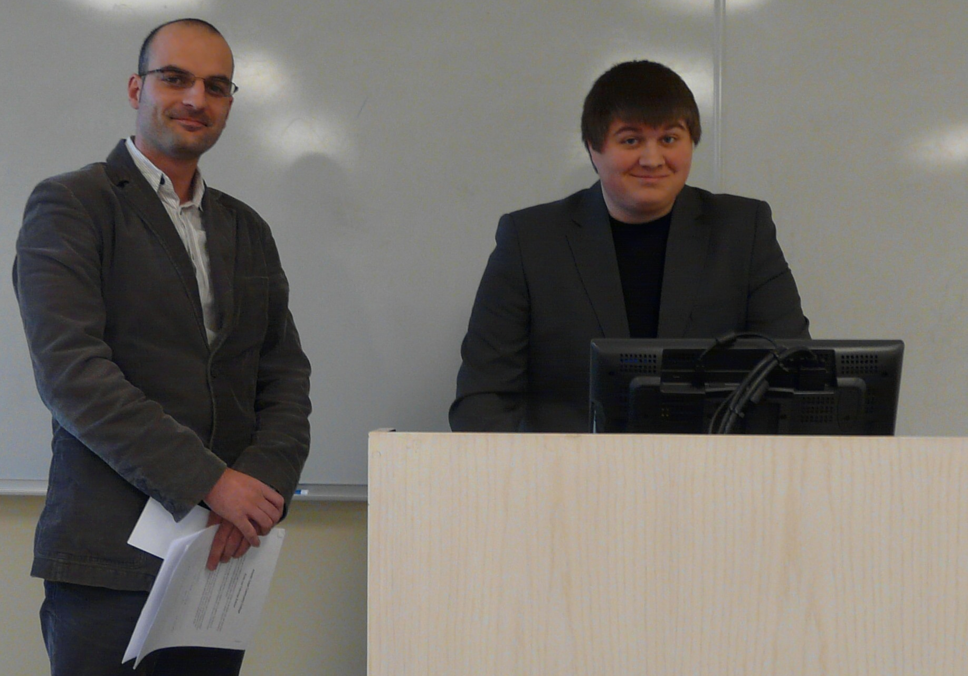
Presenting Answers
about Financial Aid
Notes:
Triple L students—both have world experience and were older and more traveled than the 19 yos in their class
Formed study buddies and helped each other out the entire semester
Hunter Boylan’s study of over 100 CCs best practices=cohorts, learning communities
ALPS does that for us! At last!

Slide 11
2.Application of Learning
QR Barcode Scavenger Hunt

Slide 12
Google
QR barcode generator
www.the-qrcode-generator.com
Notes:
Vale 2013 conference poster session RVCC librarian
Virtual Academic Library Environment

Slide 13
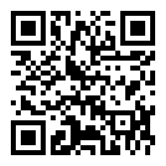
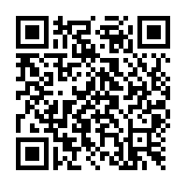
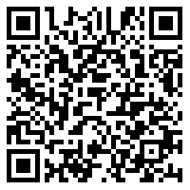
QR Barcode sampling

Slide 14
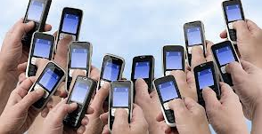
2. QR BAR CODE HUNT
Students download QR bar code reader app on their smartphones
Students practice reading the first QR barcode by the classroom door.
Students leave the classroom one group at a time and follow the QR barcode trail.
Quiz is graded in phone’s gallery.
“Smartphones.” Google Images. Google. n.d. Web.
20 March 2013.

Slide 15
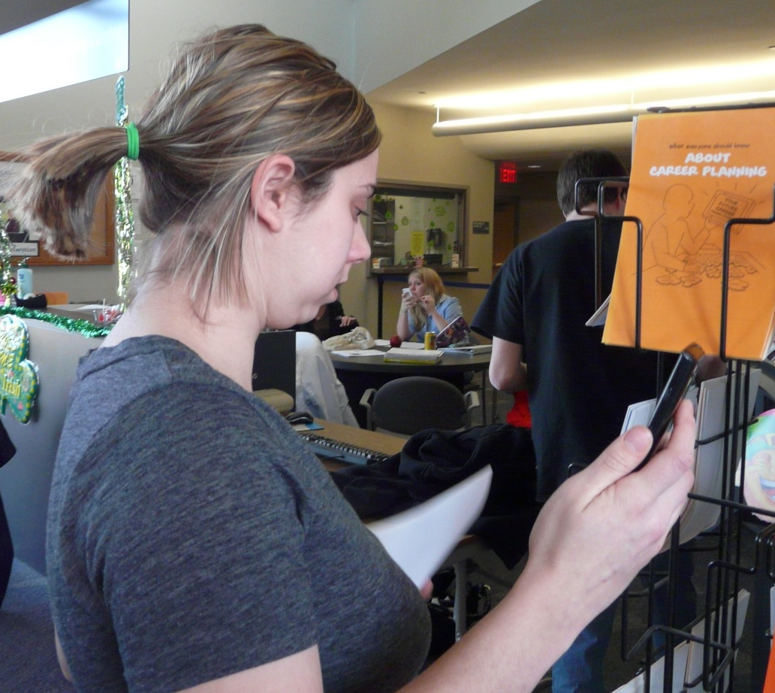
Scavenging

Slide 16
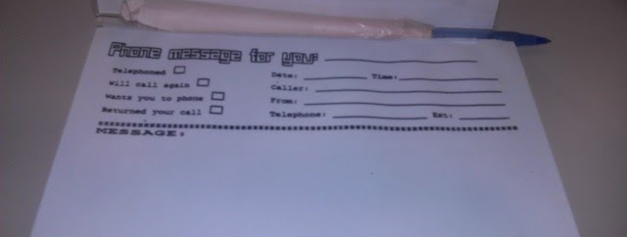
Sample of concrete item students must find

Slide 17


Slide 18
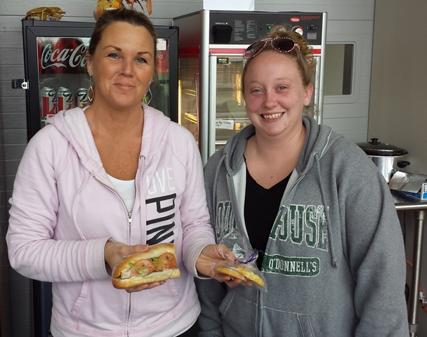

Slide 19
3. Self –Assessment of Learning
What did you learn?

Slide 20
Results of self assessment
Focused listing, no stakes writing, round robin reporting at the end of the tri-partite project.
“I learned the building has a third floor.”

Slide 21
“Nemo.” New York Times. NYTimes.com. 8 Feb 2013. Web. 10 Feb 2013.

Slide 22
