Slide 1
Robert Miller Community College of Baltimore County Critical Thinking Through Connecting Objectives and Rubrics

Slide 2
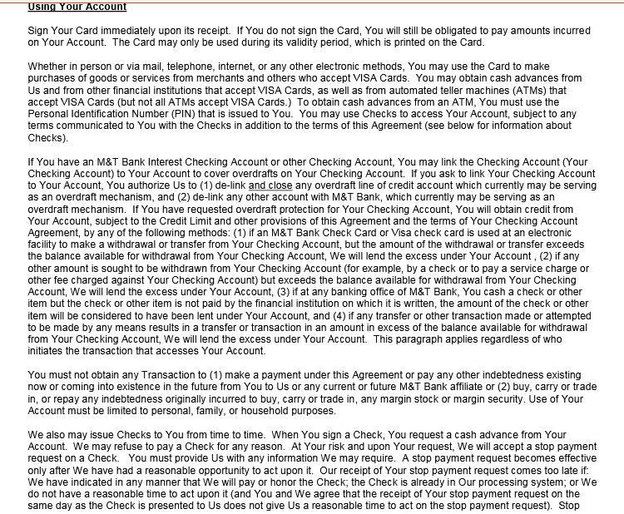
Typical update to credit card account

Slide 3
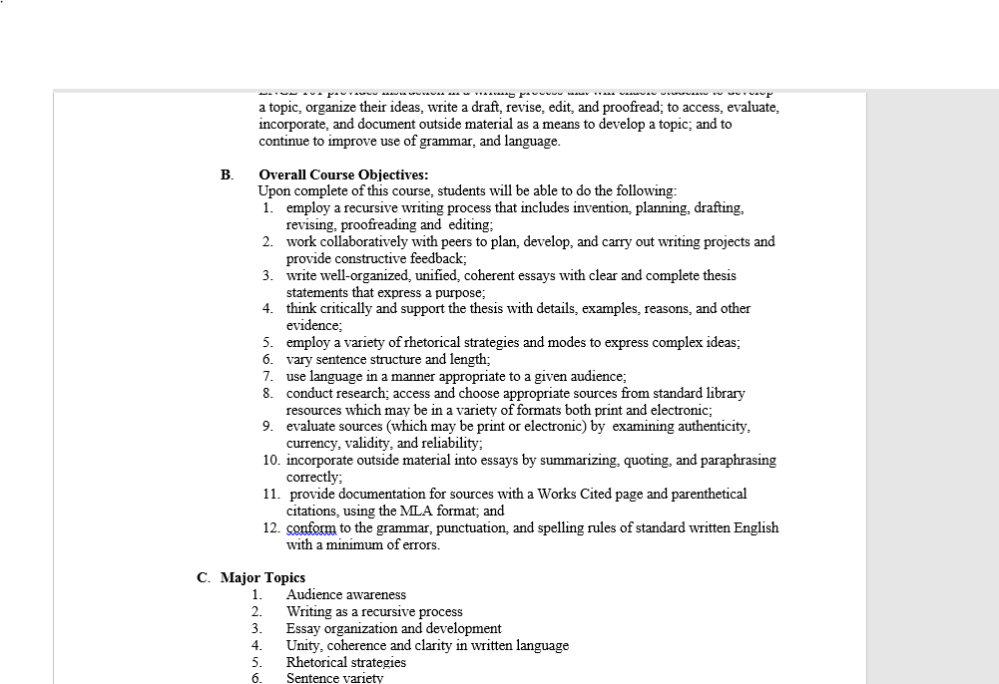
Typical Course Objectives in Syllabus

Slide 4
Not to mention the rest of the syllabus. All 7 to 9 to 12 to …. pages of it!

Slide 5
Hmmmm

Slide 6
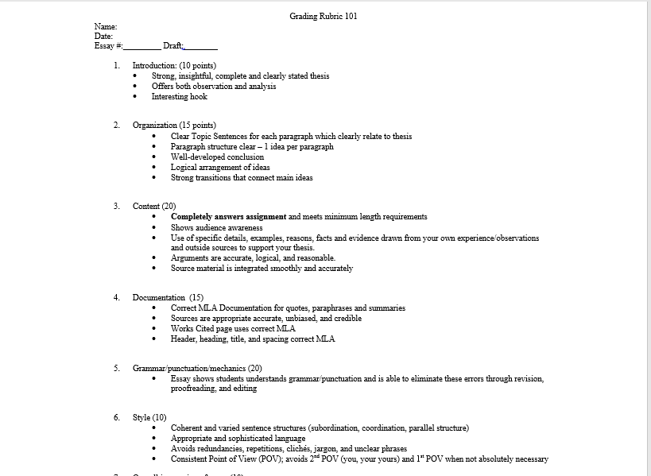
Typical exciting Grading Rubric

Slide 7
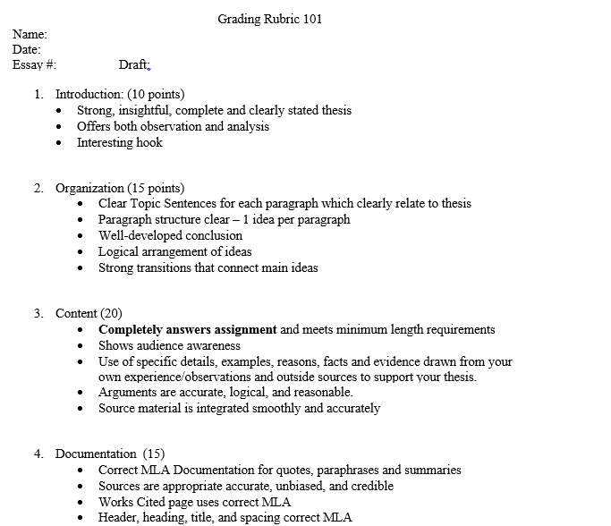
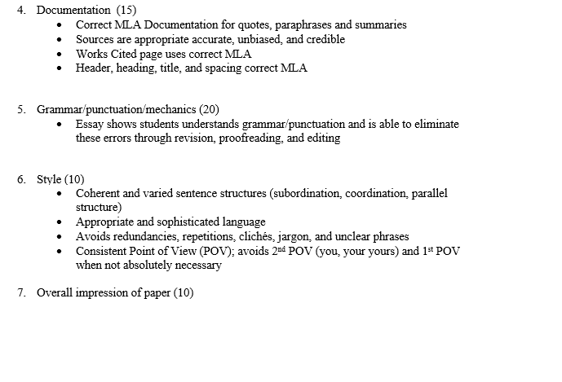
What’s its purpose?

Slide 8
Students see it as assessment unrelated to themselves.
A proclamation from above.

Slide 9
What if?
Students create the scoring rubric based on the Course Objectives?

