Slide 1

The Never Ending Story:
College Readiness
Christi Morgan
English Professor/TSI Coordinator

Slide 2

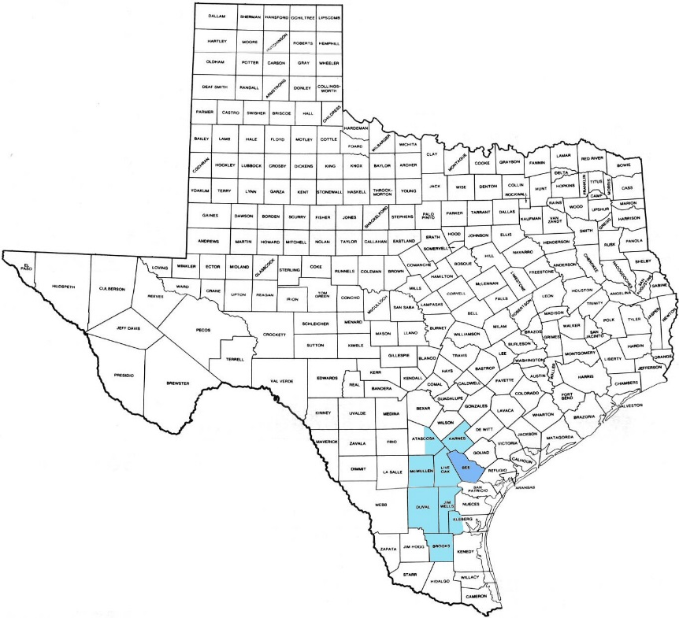
Coastal Bend College Snapshot
Multiple Campus Institution comprised of 4 sites
Service Area over 9,400 square miles (20.8 people per square mile)
68% of students enter as underprepared in one or more area
54% of enrollment dual credit/dual enrollment (serving 20 counties)

Slide 3
The Spark of Change: 2013
Prior to 2013:
Every IHE chose placement test; some liberty to placement scores
DevEd English and Reading taught separately (2 levels of each)
Very little acceleration
Beginning Fall 2013:
Every Texas Institution utilized the same placement exam; prescriptive placement scores
DevEd English and Reading were combined: IRW (Integrated Reading and Writing- 2 levels)
Limited additional acceleration (prior to HB5 & HB2223)
Notes:
I need to begin by explaining some of the changes that have taken place in Texas over the past 5 years- partly to explain where we are as a state but also to explain where CBC was in regards to DevEd

Slide 4
Additional Change: 2013-2017
1. The beginnings of Mathways: Quantitative Reasoning, *Algebra, Statistics
2. HB5: districts must partner with at least one institution of higher education to develop and provide college preparatory courses in English language arts and math. Requires that the courses be designed for grade 12 students whose performance . . . indicates the student is not ready for college-ready coursework.
3. HB2223: requires that certain percentage of underprepared students enrolled in DevEd be reported as enrolled in a co-requisite model, which allows the student to enroll in the entry-level college course but requires co-enrollment in a DevEd course/intervention designed to support the student’s successful completion of the college-level course
4. Lowered Writing cut score to 340
Notes:
Mathways: 2014
HB5: signed into law June 2013
HB2223: signed into law June 2017
July 2017

Slide 5
New state mandates and the need for new interventions
We knew we needed interventions that could:
Increase college readiness without decreasing retention and completion rates
Feasibly and affordably address the needs of the varied student body across four sites
Accelerated models and co-requisites were now necessary
Notes:
Not just in deved but in college level courses as well. Did not want successful in deved but not be prepared for college level coursework
4 sites, limited resources, high poverty rate.

Slide 6
Redesign of College Readiness at CBC
TSI Coordinator, academic deans, and faculty
Creation of accelerated options in DevEd IRW and Mathematics
Creation of co-requisite models for upper level DevEd IRW (0312) and upper level Math (0322) paired with college level gatekeeper course
Creation of TSI Boot Camps for testing preparation
Creation of curriculum assistance and training for HB5 High School College Readiness Course
Notes:
We did not agree at first. IRW does sequential condensed courses; math does ncbos
Still working on coreq model for non alegebraic pathways and potentially pairing with other course besides Engl 1301
Used to use plato as test prep; this replaced

Slide 7
A Transition from Traditional Courses to Accelerated Models

Slide 8
Traditional 16 Week Sequences
IRW
L2: IRW 0312 (students scoring 347-350 Reading; 334-339 Writing)
L1: IRW 0311 (students scoring 342-346 Reading; 333 and below Writing)
Math
L1: Math 0322 (students scoring 343-349)
L2: Math 0321 (students scoring 336-342)
L3: NCBM 0110 (students scoring 310-335)
Notes:
I will be attempting to provide the structural information about Math, but as an English faculty will focus primarily on Reading and Writing. I did bring some Math data with me if anyone is interested, I can certainly share that with you later.

Slide 9
Traditional 16 week Sequences Success Rates In IRW Courses

Slide 10
College Readiness Interventions at Coastal Bend College
Traditional 16 week sequences:
*2 Levels Combined Reading and Writing (IRW)
* 3 Levels Math (1 Level ABE)
Accelerated Sequences: *Condensed (8/8 sequential)
*Mainstreaming (co-requisites)
*NCBOs (just in time instruction)
4 HR TSI Boot Camps
*Reading
*Writing
*Math

Slide 11
Accelerated Sequences: College Readiness in Reading and Writing
IRW 0311 & IRW 0312
8 week IRW 0311 followed by 8 week IRW 0312.
Student Cohort
Same Instructor
One textbook
College Ready in one semester
2016 Success Rates: 100% completion of IRW 0311
85% completion of IRW 0312
IRW 0312 & English 1301
8 week IRW 0312 followed by 8 week English 1301
Student Cohort
Same Instructor
One textbook
College Ready in one semester
2017 (Pilot) Success Rates: 92% completion of IRW 0312 ; 90% completion of English 1301
NCBW 0112 & English 1301
4 week NCBO followed by 12 week English 1301
Student Cohort
Same Instructor
One textbook
College Ready in one semester
2016 Success Rates: 82% completion of NCBW
72% completion of English 1301

Slide 12
Scaling Accelerated Sequences: College Readiness in Reading and Writing
Notes:
In Spring 2017, we continued to offer standard 16 week IRW offerings, but with the continued suggestions from THECB to minimize the amount of time students spend in DevEd sequences, Spring 2017 marked a scaling of accelerated DevEd options offered as pilots of the following:
1. An 8 week IRW 0311 paired with an 8 week IRW 0312 (both sections taught by the same full-time instructor)
2. An 8 week IRW 0312 paired with an 8 week English 1301 (both sections taught by the same full-time instructor) and
3. A 16 week co-requisite NCBW 0112 paired with English 1301 (both sections taught by the same full-time instructor)

Slide 13
Spring 2017 IRW & Co-requisites
Notes:
Mathways: 2014
HB5: signed into law June 2013
HB2223: signed into law June 2017
July 2017

Slide 14
HB2223: Co-Requisite Mandate
All institutions of higher learning will use co-requisite remediation as the required model for students in Developmental education courses
Fall 2018: 25% of all DevEd courses will be offered as co-requisite remediation
Fall 2020: 75% of all DevEd courses will be offered as co-requisite remediation

Slide 15
Scaling Co-requisites to 4 Campuses
Coastal Bend College:
MATH: Phasing out upper level “stand alone” Math 0322. Students placing into Math 0322 are co-enrolled in NCBM 0124 and Math 1314.
READING & WRITING: Phasing out upper level IRW 0312. Students placing into IRW 0312 are co-enrolled in NCBW 0112.

Slide 16
TSI Boot Camps
Instructional Preparation for TSI Assessment

Slide 17
TSI Bootcamps: Reading, Writing, Math
Coastal Bend College Model:
-- Pretest
-- 3.5 Hour Intensive Review of Subject Area
-- 30 minute Break
--Test TSIA in that Subject Area
Course Offered through CE
Student pays for Bootcamp and the one section of the Assessment
Notes:
Saturdays 8:30-12:30 with a 30 minute lunch break followed by the TSI Assessment 1-4
$30 per student

Slide 18


Formation of TSI Bootcamps
Administration met with English and Math Faculty
Chose Distance Learning, using Life Size and Blackboard LMS
Assigned specific faculty members to develop the curriculum
Assigned a Facilitator/Proctor at each site

Slide 19
TSI Bootcamp Results…
Percentages Scoring College Ready

Slide 20
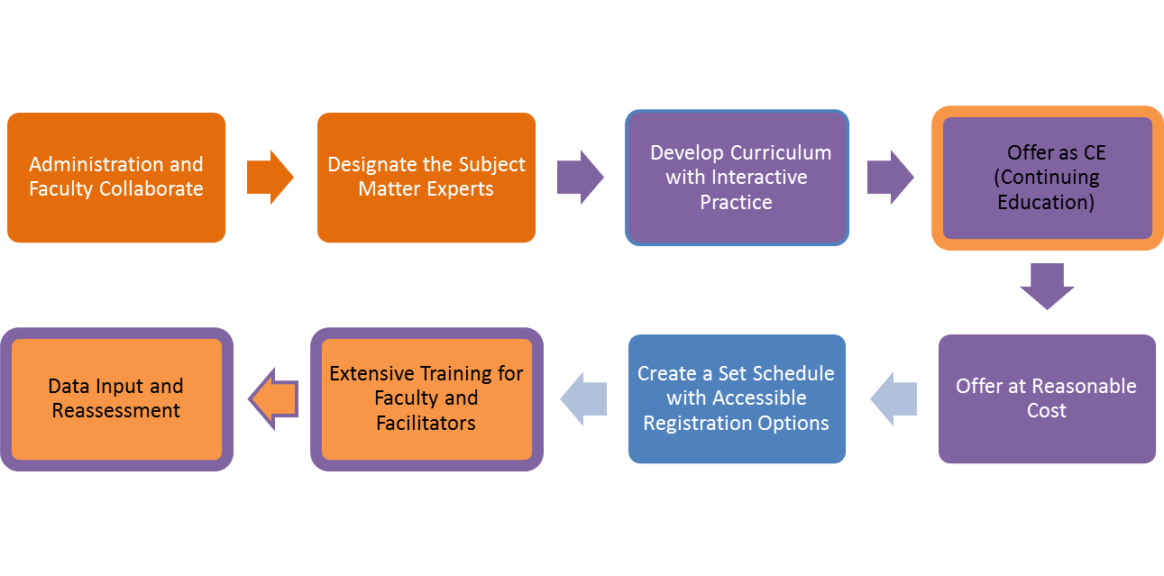
Roadmap for Bootcamp

Slide 21
HB5: High School College Readiness Course

Slide 22

HB5 High School College Readiness Course
Requirements
12th grade students who have met the passing standard on the English Reading and Writing, and Math I and II End of Course Exam.
Partnered high school must have signed MOU with IHE
Faculty must attend training (2 options)

Slide 23
Formation of HB5 High School Readiness Course
TSI Committee met with English and Math Faculty
Chose In House Training and Textbook
Assigned specific faculty members to develop the curriculum
Provided training, mentors, and curriculum for high school partners
Notes:
Problems with MOUs and communication; tracking students

Slide 24
Contact Information
Christi Morgan
TSI Coordinator, English Professor
chrism@coastalbend.edu
(361) 664- 2981 x3004

