Slide 1
Advancing Human Rights Education in ESL
DANIELLE ALDAWOOD, Ph.D.
ASSISTANT PROFESSOR- ESOL
COMMUNITY COLLEGE OF BALTIMORE COUNTY

Slide 2
Main Points:
Research and Population
Impact on students: linguistic, analytic, and transformative
Interest in human rights
Decision to incorporate human rights content
Samples of content in my ESOL and ENGL 101 courses

Slide 3
The Research - Theoretical Basis
human rights education (HRE) = transformative
content-based learning = pedagogically sound approach
critical pedagogy = used in HRE and ESL

Slide 4
POPULATIONS:
Advanced Academic ESL course
Whatcom Community College
1 term
ALPESOL Academic Writing course
Community College of Baltimore County
2 terms

Slide 5
RESULTS
~ 35 students (3 classes)~
4 failures (grade of less than 70%)
Students self-report- Likert scale of 1-10 (10 “agree” 1 “disagree”)
Majority report that:
their language and writing skills have improved (30/35)
they care more about the human rights topics covered in class than before they took the class (30/35)
their critical thinking skills have improved (28/35)
(# of students that gave a score of “8” or higher)

Slide 6
Background and Interest in Human Rights
Students stories and backgrounds
Pursuit of a MA in Social Justice and Human Rights (ASU)
Applied Project
PhD in Justice Studies (ASU)
Implementation in our ESOL 052 (Academic Writing) and 052/ENGL 101 co-req

Slide 7
Why Teach Human Rights?
IMPACT
CONTENT
INVESTMENT
GLOBAL
Notes:
By definition, human rights are global, applicable to every person regardless of where they come from
Discussion of human rights is a topic that students seem to be willing to invest their time in
Content is never-ending, ever-changing, and always real-world with applications to every field a student may study
Students come from diverse backgrounds with diverse plans and they’ll take this knowledge with them

Slide 8
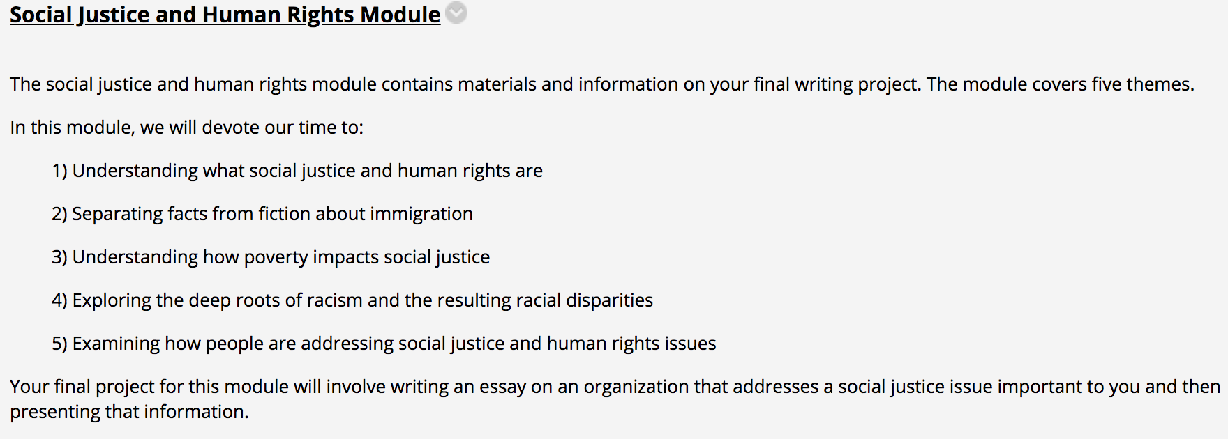
Sample Content - ESOL

Slide 9
Sample Content- ESOL
Theme: What are social justice and human rights?
This theme is devoted to:
Understanding what social justice is and how international human rights can help achieve social justice
Understanding what human rights are
Identifying, discussing, and writing about the issues of social justice and human rights that are important to the students

Slide 10
Sample Content- ESOL
CCOs:
CCO 1 - Write sentences that conform to the rules of academic English with an emphasis on syntax, capitalization, and punctuation
CCO 2 - Formulate simple, compound, and complex sentences
CCO 3 - Use transition signals to achieve coherence
CCO 4 - Apply pre-writing strategies including outlining and brainstorming
CCO 5 - Write paragraphs and essays with a clearly stated main idea, supporting points, and supporting details
CCO 9 - Demonstrate critical thinking in the development and analysis of ideas in essays
CCO 12 - Use technology to enhance language skills, conduct research and produce written work

Slide 11
SJHR Discussion Board Post #1- ESOL
Write one paragraph in which you:
1) define social justice
2) explain one issue of social justice and the "isms" that likely make that issue worse
3) provide two probable ways we can work to address and solve that social justice problem
After you write your post, you are required to write a response to one other student. Focus your response on part 2 and 3 of their post.

Slide 12
SAMPLE ASSIGNMENT- ESOL
For this assignment, I would like you to come up with the five requirements that, if met, would allow you to move to any country of your choosing for an indefinite period of time.
As you come up with your 5 requirements, consider the reasons that you (and other classmates) gave for stating that an open borders policy would not work.
Please try to provide some detail to each of your requirements and incorporate your reasoning for including the requirement.

Slide 13
SJHR Essay - ESOL
1) You will identify and provide information about one social justice issue that we discussed. You need to incorporate some of the course materials as you describe and explain the social justice issue. You will also explain the importance of this issue.
2) You will identify one organization that specifically addresses the social justice issue you chose. You will explain the mission or focus of the organization, what they do, where they do it, and the success they’ve had in addressing this social justice issue.
3) You will explain how ordinary people can get involved with this organization such as the opportunities available for people to work for or volunteer with the organization.

Slide 14
SAMPLE CONTENT - ENGL 101
TOPICS:
SJHR & Intersectionality
Racism: Implicit Bias and Microaggressions
Poverty: Effects Of and Solutions For
Immigration - Current Issues

Slide 15
SAMPLE ASSIGNMENT - ENGL 101
For this assignment, I would like you to think critically about the connections between intersectionality and poverty:
Please incorporate some of your notes from watching the three videos in class (one on intersectionality and two on poverty) and use citations.
Please provide your thoughts on how gender, class, and race impact not only who suffers from poverty but also who is “deserving” and “undeserving” of getting out of poverty.
Remember that I'm looking for critical thought (refer back to your critical thinking handout) with both of these topics.

Slide 16
SJHR ESSAY #1 - ENGL 101
In the Social Justice and Human Rights Module, we cover the topics of poverty, racism, and immigration. Our course materials explore these social justice and human rights issues from many perspectives.
For this assignment, you will write a letter to one of your government representatives (local or in Congress) about the impact of one of these issues on your community and how you would like the representative to address the issue.
Your letter will follow proper expository and argumentative essay formatting.

Slide 17
SJHR ESSAY #2 - ENGL 101
We have covered a variety of topics this semester in 101. For your final writing assignment, you will choose one issue that we have covered this term and do the following:
Explain the issue from a global perspective
Explain and analyze the solutions that have been or are being proposed to respond to the issue
Propose the creation of a non-profit organization that will address the issue and explain what the focus of the organization would be to eliminate or reduce the issue
You will also discuss this information at the end of the term through a short 5 minute PowerPoint or Prezi presentation.

Slide 18
Student comments to push forward:
“Perfect Class. Helps in 101. Needs to be continued.”
“Course is very constructive, and it touches every aspect of our lives. I personally got a lot information, especially about immigration law.”

Slide 19
Comments & Questions

