Slide 1
ALP Pedagogy:
“What Will I Do in My ALP Class?”
Susan Gabriel
ALP Director
Haleh Azimi Elsbeth Mantler
ALP Co-Director ALP Co-Director
Pre-Conference Workshop
CADE 2018

Slide 2
Who’s in the Room?

Slide 3
Workshop Agenda
Introductions and Preview of the Workshop
Brief Overview of ALP at CCBC
ALP Essential Elements: Backward Curriculum Design
ALP Essential Elements: True Integration of Reading, Writing, and Critical Thinking
ALP Essential Elements: Aligning the Co-Requisite Courses
ALP Essential Elements: Scaffolding and Support Strategies and Activities
Theme-Based Teaching Units
Creating and Sharing Theme-Based Teaching Units
Final Thoughts and Questions

Slide 4
Overview of ALP at CCBC

Slide 5
CCBC Demographics
Number of credit students: 31,119
Average age: 29
Female/male ratio: 58%/42%
Students of color: 54%
52% work 20 hours or more per week
50% receive some form of financial aid
Full/Part time ratio: 11/89%
81% of students entering CCBC test into one or more developmental
disciplines
65% Dev. Writing
77% Dev. Mathematics
58% Dev. Reading
Notes:
Three main campuses; 3 extension centers

Slide 6
CCBC’s Dev Ed Reading and English Courses Pre-Acceleration
Most General Education courses
RDG
051
5 hr
RDG
052
4 hr
ENGL
051
4 hr
ENGL
052
3 hr
ENG
101
ENG
102
Total developmental hours for Reading and English = 16

Slide 7
ALP at CCBC: Our New IRW
Co-Requisite Model
ENG 101
ACLT 053
(The ALP Class)
Reduces stigma
Improves attachment
Provides stronger role models
Encourages cohort effect
Changes attitude toward the developmental course
Allows more individual attention
Allows time for dealing with non-cognitive issues
Allows students with dev. placements in writing and reading to enroll
A
L
P
The Accelerated Learning Program

Slide 8
How does an ALP developmental class differ from traditional developmental reading and developmental writing courses?
Goal of traditional developmental reading and developmental writing courses:
For students to pass the developmental courses and to be ready for English 101
Goal of an ALP developmental class:
For students to pass English 101
This Changes Everything!

Slide 9
Why CCBC integrated reading and writing in ALP
ALP had reached 80% scale-up system-wide, but had stalled.
After studying the problem, the main obstacles to full scale were:
Requirement that students with a dev. reading placement take a 4-hr (nonrelated, stand-alone) reading course in addition to the 6-hr ALP sequence (Total of 10 hrs.)
Part-time students were affected the most by this—89% of our students are part-time. Most part-time students take 9 or fewer credit hours each semester.
Notes:
After discussing this slide, Peter turns it back to Sarah.

Slide 10
Details of the new ALP IRW model
Default placement for students with the following Accuplacer scores:
Reading: 61-78 and/or English: 58-89
Taught by ACLT (formerly Reading) and English faculty
Faculty development workshops (FIG’s) and mentoring as part of semester-long IRW ALP faculty training for 88 full-time and adjunct faculty
Students with lower-level placements (Reading: 36-60; English 0-57) take ACLT 052, a 5-hour IRW class.
All stand-alone sections of developmental reading and developmental writing have been eliminated.

Slide 11
ALP Essential Elements
Backward curriculum design
Active/collaborative learning
Integrated reading, writing, and critical thinking skills
Acknowledging effects of non-cognitive issues on student success: productive persistence
Coordination of the two courses, including scaffolding activities for ALP students
Rethinking grammar instruction
“Teaching the way you always
wished you could!”
Notes:
After discussing this slide, Peter turns it back to Sarah.

Slide 12
What do we do in the ALP class (ACLT 053)?
The goal for ALP instructors: Maximize the ALP students’probability of success in the English 101 class. Strategies include:
Conducting class as an extension/supplement to the 101 class—think of it as a 6-hour 101 class, “Triage for English 101”
Answering questions left over from the 101 class
Providing opportunities for closer analysis of the readings, more writing practice using low-stakes, short papers to reinforce concepts from the readings and from the 101 class or to prepare for upcoming assignments in the 101 class—scaffolding
Discussing/brainstorming ideas for the next essay in 101
Reviewing drafts of essays the students are working on for 101
Helping students to be aware of their sentence-level errors and to become better self-editors
Addressing non-cognitive issues (life issues, affective issues)
Notes:
After discussing this slide, Peter turns it back to Sarah.

Slide 13
What an ALP class is not
A study hall: students working on their own
A class mainly focused on grammar
A class consisting only of computer- assisted learning
Notes:
After discussing this slide, Peter turns it back to Sarah.

Slide 14
ENGL 101 Pass Rates
Traditional Students
ALP
80%
67%
65%
66%
65%
62%
61%
60%
57%
40%
30%
28%
29%
29%
29%
27%
20%
N=1044
N=550
N=880
N=590
N=687
N=699
N=588
N=698
N=346
N=653
N=273
N=1001
Fall
2011
Fall
2012
Fall
2013
Fall
2014
Fall
2015
Fall
2016

Slide 15
ALP Course Formats and Plans
Evening classes
Late-start classes
Saturday classes
Summer classes
On-line classes
New initiatives being planned
Placement reform including Directed Self-Placement
Contextualized ENGL 101 courses for ALP based on Guided Pathways
Revamp and scale-up of ALP-ESOL

Slide 16
ALP Essential Elements: Backward Curriculum Design

Slide 17
Former Curriculum Approach in Developmental Writing and Reading Courses
Level-one developmental writing textbook focus on _____?
Sentences
Level-two developmental writing textbooks focus on _____?
Paragraphs
Reading level often 6th grade
“Skill and drill” approach
Students feel as though they’re back in middle school, not in college.

Slide 18
Backward Curriculum Approach in Developmental Writing and Reading Courses
Begin by:
Assigning college-level essays
Using complex, college-level texts as sources
Creating scaffolded assignments and activities to support student success with these challenges

Slide 19
ALP Essential Elements: True Integration of Reading, Writing, and Critical Thinking

Slide 20
The Power of Integrating Reading and Writing for Developmental Students
Susan Bickerstaff, Community College Research Center
Alison Kuehner, Ohlone College

Slide 21
An “Additive” Approach to Integration (not IRW)
“I thought, well, I’ll just keep the comp quizzes. They used to be grammar and punctuation, and I can throw the reading in. So you are just kind of throwing things in where they fit.”
“I think the idea of integrating the two, whether [as a] reading ‘week’ or ‘session’ or ‘class,’ will help the adjuncts. Certainly it would help me to be able to approach reading as a separate task but also relate it, perhaps the next day, as a writing opportunity.

Slide 22
The “Additive” Approach (not IRW)
Integrated Reading and Writing
Reading
Writing

Slide 23
Components of Additive Approach
Discrete learning objectives—”skill and drill” approach
Inadequate curricular materials
Limited confidence in the new discipline
“Cross training” predominant professional development approach
“We took all the writing instructors and then I gave them a crash course in terms of reading. How they could take an existing activity that they already did, and add a little more reading to it?”
Notes:
Many instructors have inclination to take an additive approach to integration

Slide 24
Challenge of Additive Approach
Including all of the content and activities that were included in the old reading and writing developmental courses:
“It was a massive amount of material that they wanted us to put into one semester’s worth of work. It was extremely difficult and my primary concern during that time was to touch upon all that I was told we had to include.”
“The way it is now, I basically teach two skills a week, one reading skill, one writing skill. We have two days on that skill and if they don't get it then there is no backtracking or trying to help them understand it. We are moving on from there.”
Notes:
Many instructors have inclination to take an additive approach to integration

Slide 25
An “Integrative” Approach to Course Design (IRW)
Integrated Reading and Writing
Integrated Reading and Writing

Slide 26
Strategies Used in “Integrative” Courses
Metacognition | Invites students to explicitly reflect on the relationship between reading and writing in order to promote self-awareness of literacy processes.
Course Design by Theme | All/most texts and assignments are connected to a theme. An “anchor text” may be used as the basis for a variety of assignments and activities.
Text-Based Writing | Examples include summaries, journal or personal responses, and critical response essays.
Embedded Skill and Strategy Instruction | Skills and strategies are reinforced or taught in the context of thematic and text-based activities.
Notes:
SECOND, AND PERHAPS MORE IMPORTANTLY, SOME INSTRUCTORS SAW THAT STUDENTS DIDN’T PERFORM WELL WTH THIS APPROACH:
WHILE THE ADDITIVE APPROACH IS COMMON, OUR SENSE FROM OUR DATA IS THAT IT DOES NOT OPTIMIZE AN INTEGRATED CONTEXT.

Slide 27
What does an integrative course look like?
Notes:
SECOND, AND PERHAPS MORE IMPORTANTLY, SOME INSTRUCTORS SAW THAT STUDENTS DIDN’T PERFORM WELL WTH THIS APPROACH:
WHILE THE ADDITIVE APPROACH IS COMMON, OUR SENSE FROM OUR DATA IS THAT IT DOES NOT OPTIMIZE AN INTEGRATED CONTEXT.

Slide 28
Pedagogical Principles of IRW
True Integration of Reading and Writing
College-level Material
Intensive Writing and Extensive Reading
Low-stakes, Collaborative Practice
Intentional Support for Affective Needs
Individualized Instruction

Slide 29
Katie Hern: Chabot College and Co-Founder of the California Acceleration Project
Use theme-based units on topics relevant to students
Use sophisticated texts
Provide scaffolding to help students understand key concepts
Appeal to the “growth mindset” as outlined by Carol Dweck—the Power of Yet!

Slide 30
Sugie Goen-Salter: San Francisco State University
Activating the student’s “schema”: the definition of true learning
“What do I know as a reader that can help me write this research paper?”

Slide 31
ALP Essentials: Aligning the Co-Requisite Courses

Slide 32
Using Theme-Based Units
Partnering with library personnel
On-line educational resources (OER’s)
Multi-modal writing projects

Slide 33
Start at the End (Backward Design): ● What is the essay topic? ● What are the essential questions?
Unit 1: “Education”
5 weeks, English 101 and ACLT 053 (ALP)

Slide 34
The Essay
Overview: Tell me the story of your educational history – the journey you’ve been on, the good, the bad, how you have felt about yourself as a learner in your past schooling. Relate your story to at least two texts we have read so far in class.

Slide 35
Guiding Questions
1. Can educational experiences be transformative? (What might these look like?)
2. What are the policies in place that may have large impacts on our local educational systems? On us personally?
3.How can K-12 educational experience impact a person into adulthood (their families, children, relationships, neighborhoods…)?
**These are just a jumping off point. Students will come up with their own questions as we read, write and talk about the topic.**

Slide 36
Non-cognitive Issues
Many of the writing activities you will see are intended to scaffold the major writing assignment and to engage with texts, but they are also addressing non-cognitive issues in some ways. I take these non-cognitive issues into consideration when planning a unit.
Questions I ask myself:
--How can I get the students to feel they “belong”?
--How can the students feel the ACLT 053 is needed and helpful?
--What are barriers to success for these particular students?

Slide 37
Text 1
The Other Wes Moore by Wes Moore

Slide 38
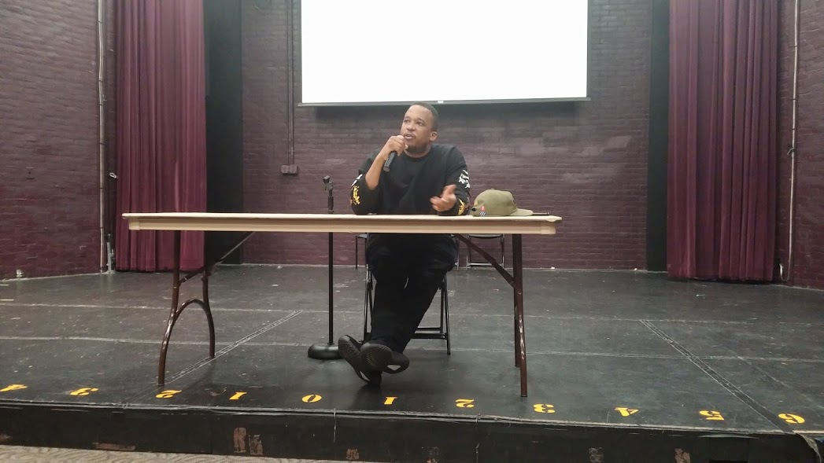
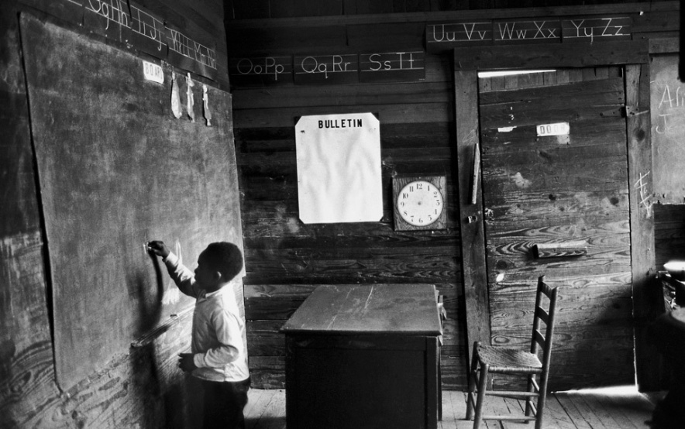
Text 2
“The School of Failure:
How Schools Groom African Americans for the Underclass”
by D. Watkins

Slide 39
Text 3 (end of unit and bridging into second unit)
All the Difference —POV PBS (documentary)

Slide 40
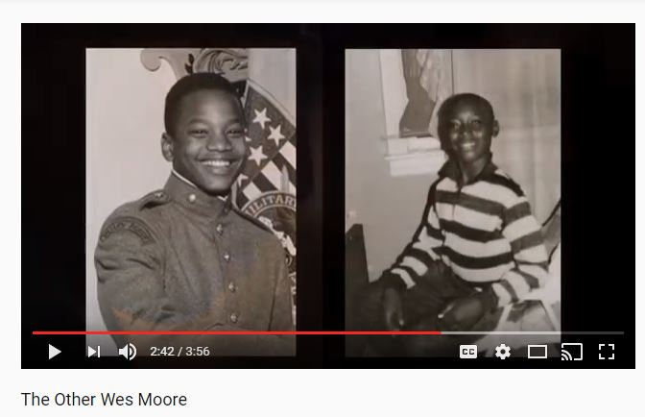
Week 1
ENGL 101
ACLT 053
Diagnostic essay: Write an Educational Autobiography
Wes Moore trailer video.. Access prior knowledge: “What might be major things in people’s lives that lead them in different directions?”
Comic Strip Story “How did you get here to this seat today?”
Feelings About Writing Survey
Journal #1: Pre-reading
1. Where are places you hear people referred to as “other”?
2. After watching the video in 101, think of three questions you expect to answer as you read this book.
Notes:
Comic strip??

Slide 41
Week 2
ENGL 101
ACLT 053
Short low-stakes quiz on Chapter 1 in TOWM
Discussion questions in small groups for Chapter 1
Discussions about academic writing
Read and annotate an academic student essay
Journal 2: Reader to text
Journal 3 Describe one particularly good experience you had in your past education and tell me about why it was good. (This might be in an English class or in a different subject.) Describe one bad experience you have had in the same way and explain. (pre-writing)
“Group Text” with quote from TOWM
Reconstruct an essay that has been broken apart

Slide 42
Week 3
ENGL 101
ACLT 053
Essay 1 instructions and expectations
Quiz on Chapter 2 in TOWM
Pre-reading for “The School of Failure” (watch videos of Watkins on CNN panel)
Pre-writing techniques
Go over citations and MLA
Group pre-writing in class (brainstorm & informal outline, share with class)
Focused citation & MLA instruction if needed
Journal 4 & 5: reader to text
Begin to read “The School of Failure” and annotate together

Slide 43
Week 4
ENGL 101
ACLT 053
Quiz on Chapter 3 in TOWM
Peer review of fully formed rough draft of Essay #1
Small group discussions about “The School of Failure”
One on one conferences with me with draft of Essay #1
Share annotated article with a partner & present with partner 2 questions you have for D. Watkins
Journal 6 (text to text): How do you interpret the quote: "In third grade I was reading at second-grade reading level. Later in life I learned that the way many governors projected the numbers of beds they'd need for prison facilities was by examining the reading scores of third graders" ( Moore 54)? How can you relate this to any ideas in The School of Failure?
Research and present some of the historical references in article

Slide 44
Week 5
ENGL 101
ACLT 053
Quiz Chapter 4 in TOWM
Final copy Essay #1 due
“Take Temperature”-- discuss the guiding questions, Essay #1, and the unit overall.
Start watching All the Difference
In-class Reflective Essay about the writing process (meta-cognitive)
Journal 7 student to text TOWM
Conduct research about All The Difference in small groups and present to class

Slide 45
Unit 2: Social Capital and Mindset
Essay Topic: How do mindsets and social capital operate in both The Other Wes Moore and All the Difference? Trace how growth and fixed mindset were present in the lives of these men and how this effected them. How did social capital impact their lives? Along with the two texts, you must also include one outside source that helps support the theoretical aspects of the essay.
Guiding Questions:
How can a social network impact a person’s education and future?
How can the mindset contribute to a result in someone’s life?
What are other factors that determine our futures?

Slide 46
Gentrification Unit and Template

Slide 47
Creating Theme-Based Teaching Units: Your Turn

Slide 48
Sharing Theme-Based Teaching Units
Guidelines for “sharing” units
Using poster paper, provide some of the following info
Title/focus of the unit
Essential questions
Essay prompt info
Texts and additional sources
Additional info as you wish
Tape your poster sheet(s) around the room
Gallery walk
Brief presentation with questions from the attendees

Slide 49
Final Thoughts and Questions

Slide 50
ALP Pedagogy:
“What Will I Do in My ALP Class?”
Contact us:
sgabriel@ccbcmd.edu
hazimi@ccbcmd.edu
emantler@ccbcmd.edu
ALP Website:
http://alp-deved.org
Enjoy the conference!

