Slide 1
Troubleshooting Common Problems in the Math Classroom
Conference on Acceleration in Developmental Education
June 6, 2019
Rachel Polakoski
Cuyamaca College
Rachel.Polakoski@gcccd.edu

Slide 2
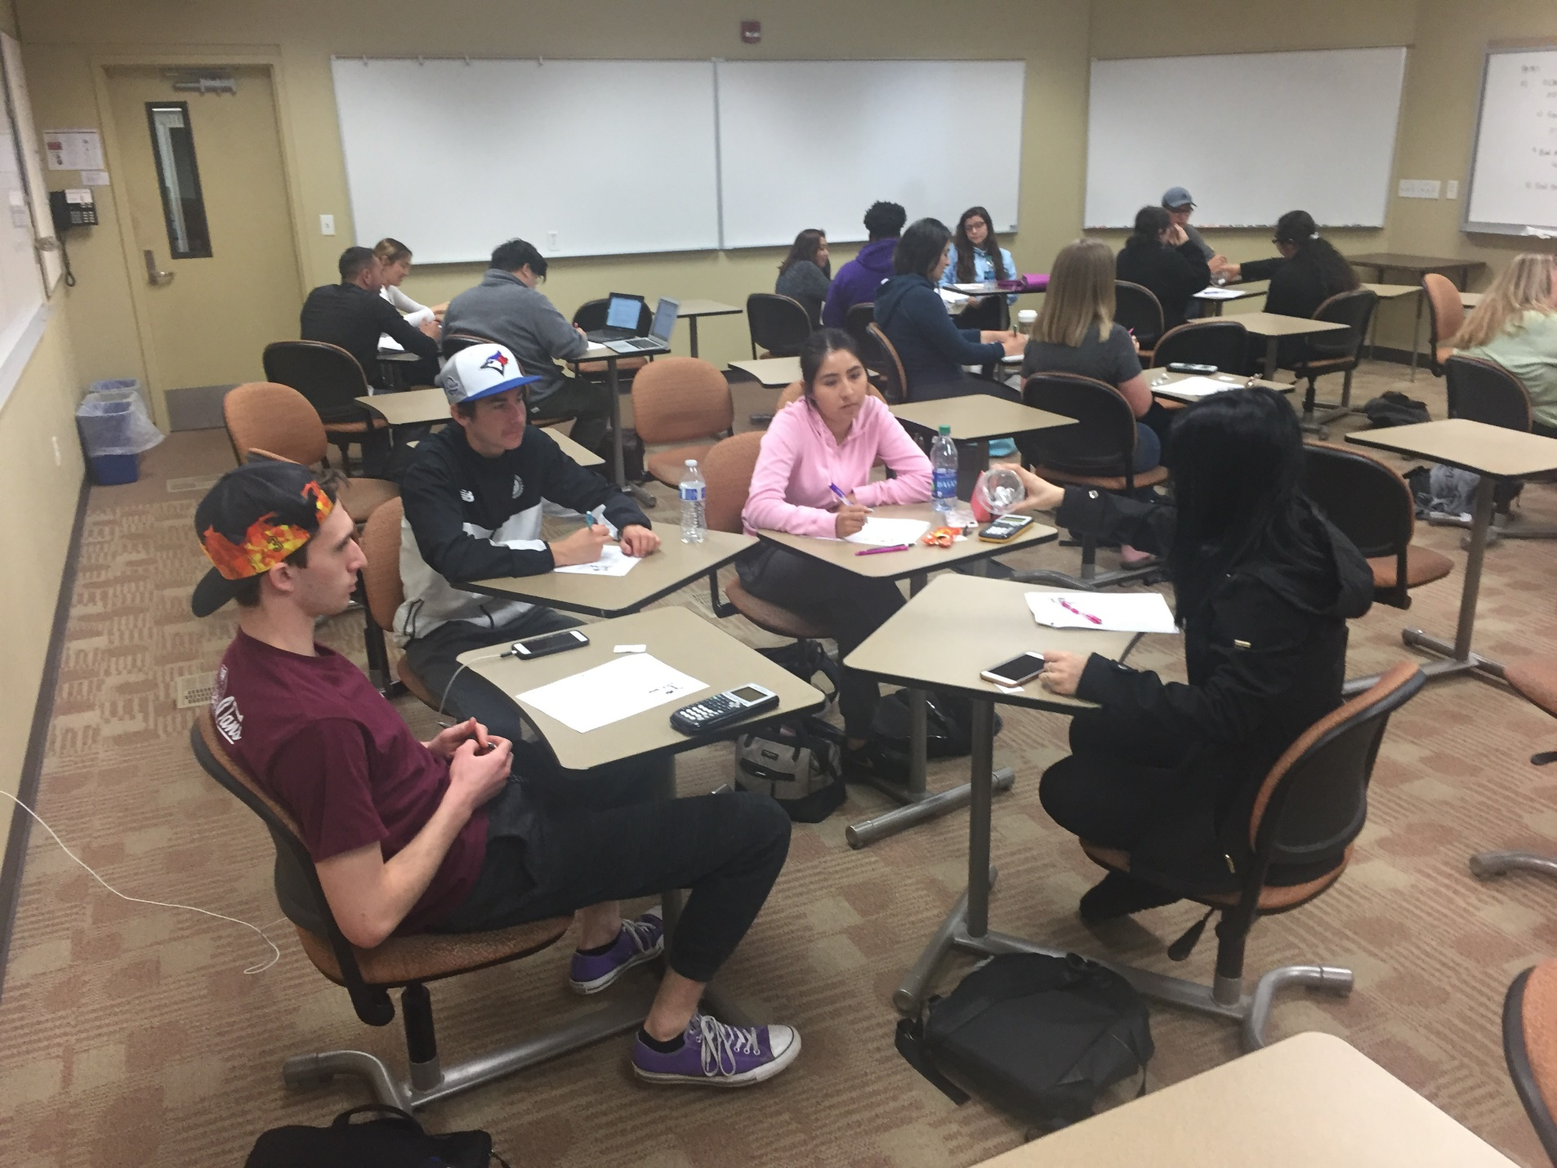
Paradigm Shift in Teaching & Learning
The interactive math classroom founded on the California Acceleration Project Design Principles
Contextualized teaching and learning
Just-in-time remediation
Focus shifts from the teacher to the student
Productive struggle with brains-on activities
Teacher-guided discovery
Low stakes, collaborative practice
Intentional support for the affective domain

Slide 3
My focus as a teacher…
How do I engage students in a high-challenge, high-support curriculum while also attending to their fears and anxiety in the math classroom?
Keeping students engaged, on task and productively struggling
Communicating to students through my words and actions that I believe they are capable of college-level mathematical thinking

Slide 4
Changing Students Expectations - The Honeymoon Period
First two weeks of school
Setting up classroom norms
Productive Struggle
Group work
Respectful communication
Pair-Share: Discuss with your neighbors. Do you do anything to help set classroom norms other than going through the syllabus?
Report out!
First Day Student Activity: What are all of the reasons you don’t like group work?

Slide 7
Facilitation Note
Take time to set up each interactive strategy with your class. It may seem like you are “wasting” a lot of class time early in the semester, but it pays off in the long run! Once routines are in place, the classroom runs like a well-oiled machine ☺
Establish Norm: Hand Raise to call back together for whole group closure.

Slide 8
Classroom Scenario #1 – Students Will Not Take Risks
Students consistently ask for help and need validation of their work. They are nervous to be wrong and often disengage in class as a result.
How can you encourage students to participate and overcome their fear of errors?
Low Stakes Collaborative Practice
Speed Dating, Think-Pair-Share
Celebrating Mistakes (AD)
Conscientious and consistent use of micro-affirmations (AD)
Frequent emotional check-ins (AD)
Growth Mindset/Productive Struggle (AD)
Allowing for Anonymous Participation (AD)
Snowball fight
Notes:
Snowball fight
Celebrate in public, criticize in private.
PollEverywhere or Canvas Ungraded Survey

Slide 9
Classroom Scenario #2 – Students not completing homework
Students are showing up without their homework completed.
How can you motivate students to show up on time with their homework completed and ready to go?
Fess Up
Strange Choices (AD)
Notes:
Speed Dating

Slide 10
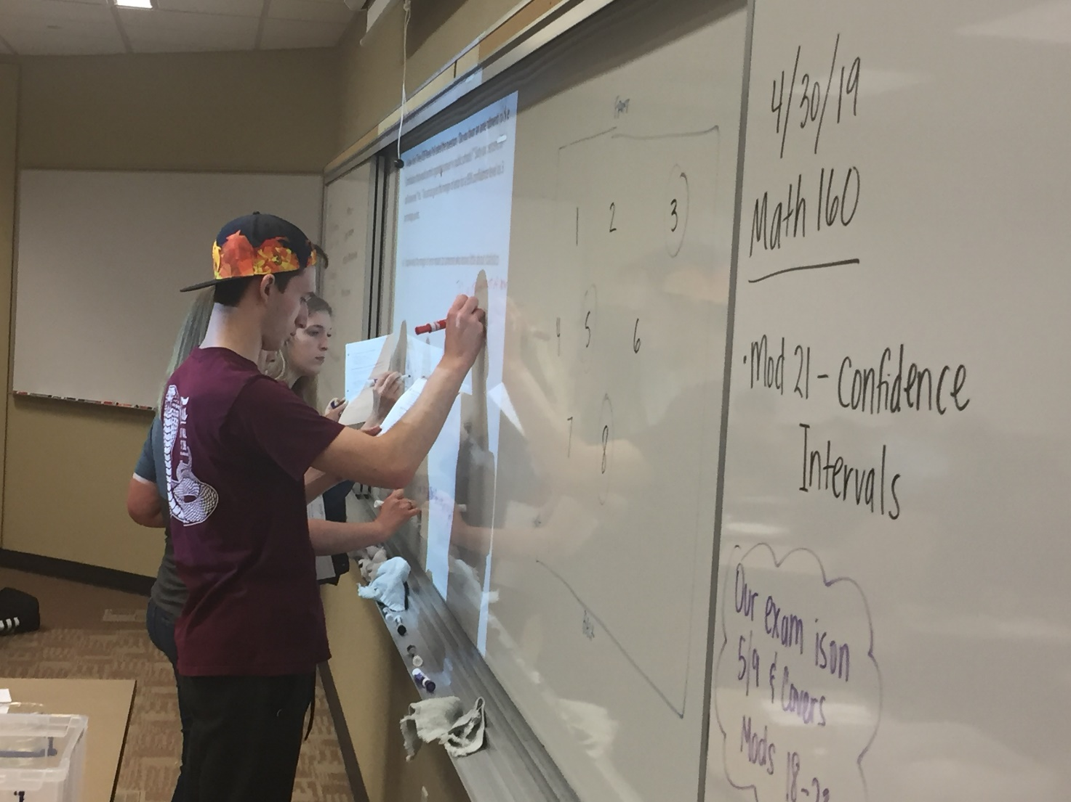
Classroom Scenario #3 – Keeping Students Engaged and On Task
It is midway through the semester and the students are now more comfortable in the classroom. You notice that when students enter groups, there is a lot of socializing happening, and not a lot of work.
How can you motivate groups to stay focused and on task during group work?
Low stakes accountability mechanisms:
Paper Exchange/People Mover
Whole Class Quiz
Group Quiz with a Pencil Drop
Victim vs. Creator Mindset (AD)
Notes:
Random Groups

Slide 11
Classroom Scenario #4 – Students Showing Up Late for Class
Students trickle into class over the first thirty minutes of class.
What can you do to motivate students to show up on time to class?
Review before a quiz/Speed Dating
Welcoming late students & follow up conversations (AD)
Notes:
Group Shuffle

Slide 12
Toolbox of Strategies
https://app.box.com/s/tn35gd0p6psqn1602a8malaqdx8i3r5w/folder/50236226081
Other tips and tricks
Group cards – see toolbox link for printables!
Classroom map drawn on the board
Random group selector
Signal to call the class back to order
Timer

Slide 13
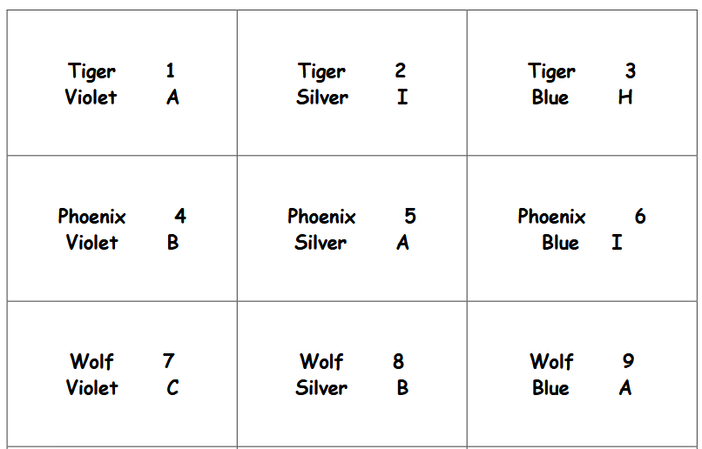
Group Card Sample

Slide 14
Questions?
This presentation has been made available through CADE.
Contact me:
Rachel.Polakoski@gcccd.edu
Cuyamaca College in San Diego
Thank you for coming!

