Slide 1
^{Acceleration for Beginners}
Jesse Kiefner Director, Accelerated Math Program
Danielle Truszkowski
Assistant Director, Accelerated Math Program

Slide 2
^{Today’s Agenda}
Nuts and Bolts of AMP
Marketing
Data
Advising
Faculty Training
Engagement Activities
Scaling Up

Slide 3
Who is CCBC?

Slide 4
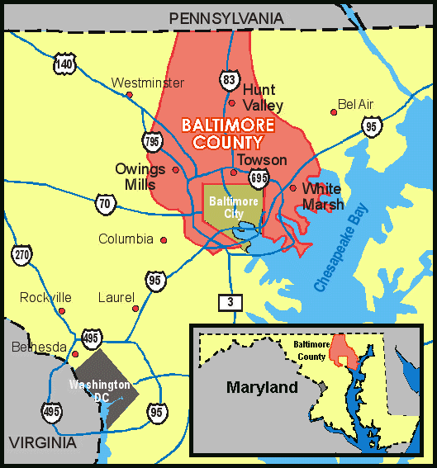
MAIN CAMPUSES
Catonsville
Dundalk
Essex
EXTENSION CENTERS
Randallstown
Owings Mills
Hunt Valley

Slide 5
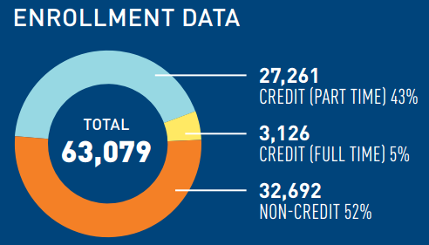
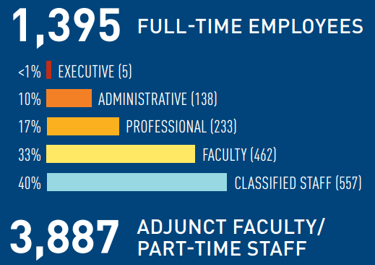

Slide 6
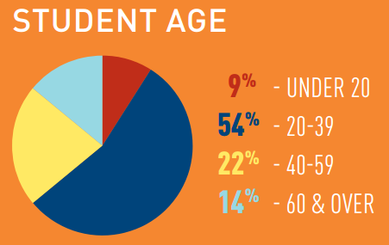
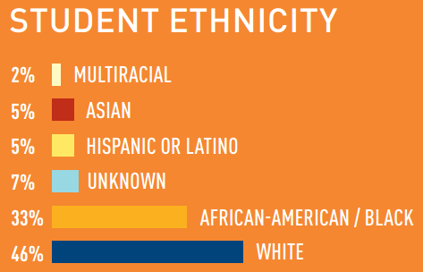
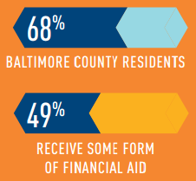
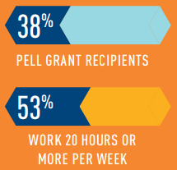

Slide 7
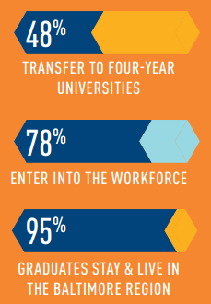
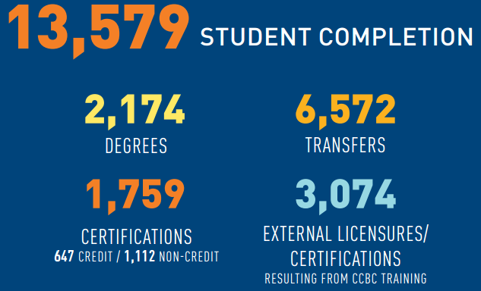
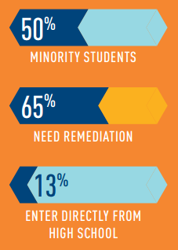
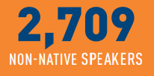

Slide 8
Mathematics Department

Slide 9
CCBC MATHEMATICS COURSE
125
Non-Scientific Major Programs AND Business/Liberal Arts Program
081
082
153
Statistics Track
125
Non-Scientific Major Programs AND Business/Liberal Arts Program
083
131
Teacher Education Programs
132
135
Radiography and Some Other Technical Programs
153
Statistics Track
Engineering/Computer Science Track
163
165
251
252
253
230
243
257
259

Slide 10
FACULTY AND STUDENT MAKEUP
Approximately 50 FT Faculty
Approximately 40% FT and 60% PT
Student Enrollment, Spring 2017
MATH 081: Pre-Algebra | 814
MATH 082: Introductory Algebra | 1,277
MATH 083: Intermediate Algebra | 978
MATH 125: Finite Math & Modeling | 532
MATH 153: Intro. to Statistical Methods | 1208
MATH 163: College Algebra | 821

Slide 11
PLACEMENT
HOW?
WHAT TO DO?
Placement Test
Take placement test on any campus at Testing Center. Accuplacer MATH can be taken twice. Students who wish higher placement must then “appeal”. Appeal is request to take a pencil-and-paper type test on material from the course they placed into.
Transfer Credits
Bring transcript showing general education math credits from another college or university to CCBC for evaluation. If completed in Maryland, the highest level developmental math course, Intermediate Algebra can be used for placement.
SAT or ACT Scores
Placement by SAT MATH score of 500 or higher (or by ACT MATH score 21 or higher) places the student into an entry-level general education math course (MATH 111, 125, 131/2/3, 135, 163). For higher placement, the student must take Accuplacer MATH.
High School AP Scores (Mathematics)
Students with documentation of AP math scores of 3, 4, or 5 from high school can be awarded college credit and placement according to this chart.

Slide 12
Accuplacer Scores - Update Later with New Scores
Placement | Whole Number Arithmetic | MATH 081 | MATH 082 | MATH 083 | MATH 111 only | MATH 125, 131, 132, 135, 153, 163 | MATH 165 | MATH 251
ARITHMETIC (CPTA) | Below 32 | 32 or above
Elementary Algebra (CPTG) |  | Below 44 | 44-64 | 65 or above | 108 or above OR
College Level Math (CPTM) |  |  |  |  | 40 or above | 45-69 | 70-89 | 90 or above

Slide 13
Mathematics Acceleration

Slide 14
ALP versus AMP
ALP (ACCELERATED LEARNING PROGRAM)
AMP (ACCELERATED MATH PROGRAM)
English/reading acceleration
Developmental students integrated with credit-level students
Math acceleration
Same set of students in both classes
All students at developmental level
True cohort model
English/reading acceleration
Developmental students integrated with credit-level students
Math acceleration
One set of students in both classes
All students at developmental level
True cohort model

Slide 15
Why is math acceleration needed?
Incoming Students Not College-Ready in Mathematics ≈ 70%
Success Rates of Traditional Developmental Mathematics Courses ≈ 50%
SB 740 – Pathway Must Include Credit Bearing Math and English Within the First 24 Credit Hours of Courses for First Time Degree Seeking Students

Slide 16
Meet 100 First-time Students starting in 2010 who placed in MATH 081

Slide 17
Relevant Facts
Of these 100 students who placed in lowest level of developmental math, Pre-Algebra:
68 are minority
67 are part-time
51 live below the poverty line
52 work

Slide 18
Of those 100 math students…
Fewer than 10 passed a credit math course…
How many graduated?

Slide 19
three

Slide 20
Accelerated Mathematics Program AMP It Up!
Established in Fall 2009
Students Enroll in 6-Credit “Combo” Classes
Course Topics are Integrated
Combined Course Options:
Pre-Algebra & Introductory Algebra
Introductory Algebra & Intermediate Algebra
Intermediate Algebra & College Algebra
Intermediate Algebra & Applied Algebra and Trigonometry

Slide 21
CCBC MATHEMATICS COURSE
125
Non-Scientific Major Programs AND Business/Liberal Arts Program
081
082
153
Statistics Track
125
Non-Scientific Major Programs AND Business/Liberal Arts Program
083
131
Teacher Education Programs
132
135
Radiography and Some Other Technical Programs
153
Statistics Track
Engineering/Computer Science Track
163
165
251
252
253
230
243
257
259

Slide 22
Early Data Analysis

Slide 23
MATH 081/082 – Two Year Cohort (Fall 2011)
 | Traditional | 081/082 AMP
Pass MATH 081 | 59.2% | 74.2%
Enroll in MATH 082 | 48.9% | 100.0%
Pass MATH 082 | 30.3% | 53.9%
Enroll in MATH 083 | 25.7% | 53.9%
Pass MATH 083 | 15.2% | 37.1%
Enroll in Credit MATH | < 5% | 37.1%
Pass Credit MATH | < 5% | 27.0%

Slide 24
MATH 081/082 – Semester by Semester
 | Traditional MATH 081 | Accelerated MATH 081 | Traditional MATH 082 | Accelerated MATH 082
Fall 2011 | 48.5% | 71.6% | 49.5% | 58.7%
Spring 2012 | 45.3% | 76.5% | 50.6% | 72.3%
Fall 2012 | 54.4% | 74.4% | 55.4% | 71.8%
Spring 2013 | 52.5% | 66.1% | 52.7% | 73.2%
Fall 2013 | 53.6% | 72.3% | 50.2% | 51.1%
Spring 2014 | 49% | 63.3% | 51.8% | 68.4%

Slide 25
MATH 083/163 – Two Year Cohort (Fall 2011)
 | Traditional | 083/163 AMP
Pass MATH 083 | 64.5% | 81.2%
Enroll in Credit | 49.6% | 100.0%
Pass Credit math | 39.6% | 65.4%

Slide 26
MATH 083/135 – Two Year Cohort (Fall 2011)
 | Traditional | 083/135 AMP
Pass MATH 083 | 64.5% | 80.0%
Enroll in Credit | 49.6% | 100.0%
Pass Credit math | 39.6% | 75.5%

Slide 27
African-American Students
 | Traditional | AMP Path
Pre-Algebra | 43.5%
 |  | 66.0%
Introductory Algebra | 44.7% | 66.7%
 |  | 50.5%
Intermediate Algebra | 42.3% | 58.7%
 |  | 49.6%
College Algebra | 54.1% | 79.5%

Slide 28
Latest Data Analysis – Students Beginning at the MATH 081 Level

Slide 29
MATH081 PASS RATES BY STUDENT TYPE

Slide 30
MATH082 COMPLETION RATES BY STUDENT TYPE

Slide 37
Latest Data Analysis – Students Beginning at the MATH 083 Level

Slide 43
MATH163\CREDIT MATH PASS RATES BY RACE & STUDENT TYPE

Slide 44
Scaling Up
Semester | 081/082 Sections | Total 081 Sections | Percent of 081 Sections That are 081/082 AMP
Fall 2014 | 5 | 76 | 6.58%
Spring 2015 | 6 | 62 | 9.68%
Fall 2015 | 14 | 72 | 19.44%
Spring 2016 | 10 | 48 | 20.83%
Fall 2016 | 14 | 56 | 25.00%
Spring 2017 | 12 | 44 | 27.27%
Semester | 083/163 Sections | Total 083 Sections | Percent of 083 Sections That are 083/163 AMP
Fall 2014 | 7 | 102 | 6.86%
Spring 2015 | 9 | 88 | 10.23%
Fall 2015 | 15 | 108 | 13.89%
Spring 2016 | 14 | 81 | 17.28%
Fall 2016 | 12 | 61 | 19.67%
Spring 2017 | 8 | 51 | 15.69%

Slide 45
Building the Program

Slide 46
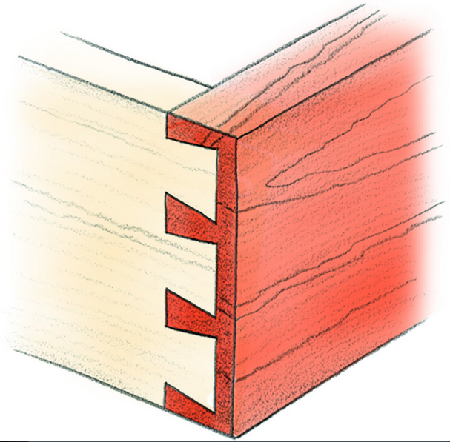
The Goal
Lower-Level Course Content
Upper-Level Course Content
“dovetail strategy”

Slide 47
Combined Course Setup
Combined courses are 6-credits total.
Students cannot drop one course; both courses must be dropped if requesting withdraw.
Each student must register for two courses (3 credits each) that are scheduled during consecutive time periods.
Topics in each course are integrated.
The combined class, both sections, are taught by the same instructor.
Students only purchase the higher-level course textbook.
No registration blocks! Open to all!
Grading is separated along the way and the student receives two grades.

Slide 48
Administrative Details
Online Registration
Number of Students Per Class
Scheduling Six Hour Classes
Using Existing Courses

Slide 49
How Do We Integrate?

Slide 50
Combined Course Instruction: Making the Connection
 | Lower Level | Upper Level
Pre-Algebra / Introductory Algebra | Solving Linear Equations | Solving Quadratic Equations
 | Evaluating Exponents | Scientific Notation
Introductory Algebra / Intermediate Algebra | Exponent Laws | Radicals
 | Graphing Linear Functions | Graphing Quadratic Functions
Intermediate Algebra / College Algebra | Graphing Quadratic Functions | Transformations of Quadratic Functions
 | Factoring | Determining Zeros of a Function
Intermediate Algebra / Applied Algebra & Trigonometry | Solving Quadratic Equations | Applications of Quadratic Equations
 | Evaluating and Graphing Exponential Functions | Modeling Data Using Exponential Functions

Slide 51
Assessment in Combined Courses
Students receive a final grade for each course.
Any student who fails the lower-level course automatically fails the upper-level course.
Instructors keep grading separate for each course.
Students complete the same comprehensive final exam as students in traditional sections.
Students can pass the lower-level course and fail the higher-level course.
The same “course rules” are applied.

Slide 52
Traditional Class Rules
1
4
Pre-Algebra
85% Rule
Common Final Exam – 30%
College Algebra
85% Rule
Common Final Exam – 20-30%
2
5
Introductory Algebra
85% Rule
Common Final Exam – 30%
Applied Algebra & Trigonometry
Applied Project Requirement
Comprehensive Final Exam (Instructor Created)
3
Intermediate Algebra
85% Rule
Common Final Exam – 30%

Slide 53
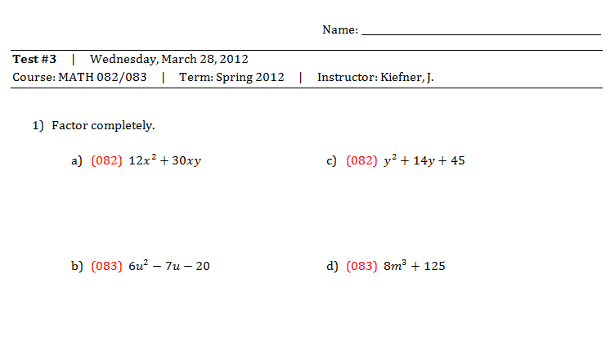
Grading in Combined Courses: Semester Tests
“All in One” Approach

Slide 54
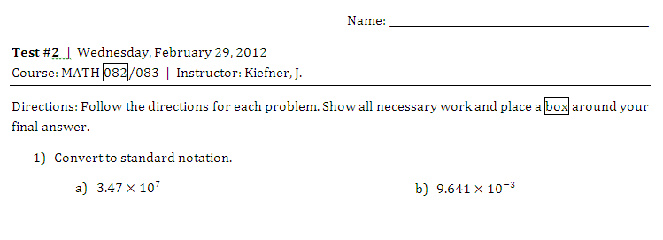
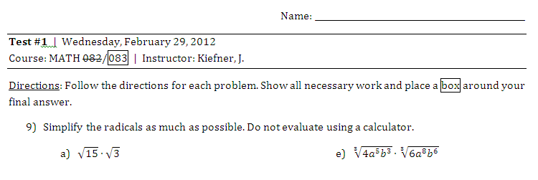
Grading in Combined Courses: Semester Tests
“Side by Side” Approach

Slide 55
Advantages of Combined Setup
Overlap in course content allows for additional time to devote to more challenging topics.
Students form a supportive cohort.
Students are able to see the connection and relation between two math courses; content doesn’t appear disjoint.

Slide 56
Supplementing with OERs

Slide 57
How do we make up for missing content?
OPEN SOURCE TEXTBOOKS
http://www.ccbcmd.edu/Programs-and-Courses/Schools-and-Academic-Departments/School-of-Mathematics-and-Science/Mathematics.aspx
ORIGINAL TEXTBOOK SOURCES
http://www.wallace.ccfaculty.org/
http://www.mathispower4u.com/
ONLINE HOMEWORK (OPTIONAL)
www.myopenmath.com or ALEKS (MATH 083/163)

Slide 58
Facilitating Student Engagement

Slide 59
Managing Extra Time
INTERACTIVE LABS (OPTIONAL)
Modeling Tuition Lab
Bottle Water Flow lab
Exponential Decay Lab
Work Together Lab
GROUP SESSIONS
REVIEW FOR EXAMS

Slide 60
Lab 1
Students model the CCBC tuition billing structure using a linear equation.
The y-intercept and slope are considered in the context of an application.
The linear model is examined graphically.
Students find this lab eye-opening.

Slide 61
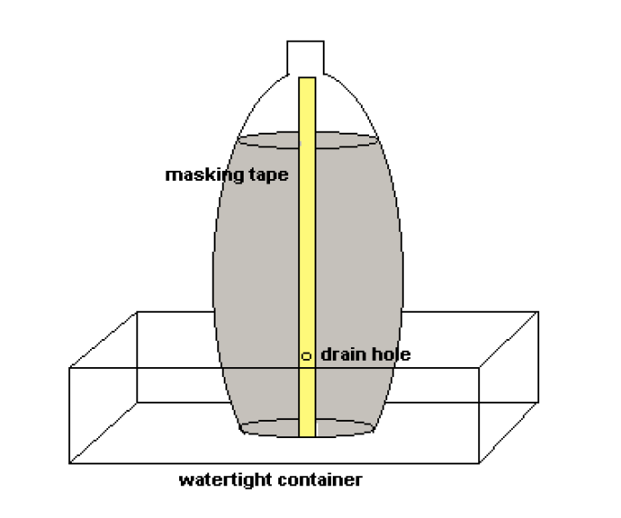
Lab 2
Uses a quadratic to model fluid flow from a two-liter bottle of water
Nice break after factoring quadratics
Students should bring in used two-liter bottles
Students love this lab!

Slide 62
Lab 3
Exponential decay problem involving the environmental impact of tropical rainforest destruction.
Students create an exponential model and use it to predict the amount of rainforest remaining in the future.
Students use logarithms to solve exponential equations.
Students don’t exactly love this lab.

Slide 63
Lab 4
Similar to Lab 2, students use a water flow experiment to test the validity of a rational equation that predicts the time required to drain a container.
Difficult logistically because students must fill the container and let water drain three times.
Students love this lab.

Slide 64
Marketing

Slide 65
Marketing Tools
Brochure
Commercial
Poster
Advising Tool

Slide 66
Faculty Training Model

Slide 67
AMP Instructor Training
Instructors participate in one training for all AMP courses.
Training offered twice per year (January & August).
1st Model: Two Full Days
2nd Model: Online Modules Blended with One Full Day
3rd Model: One Half Day (Current)

Slide 68
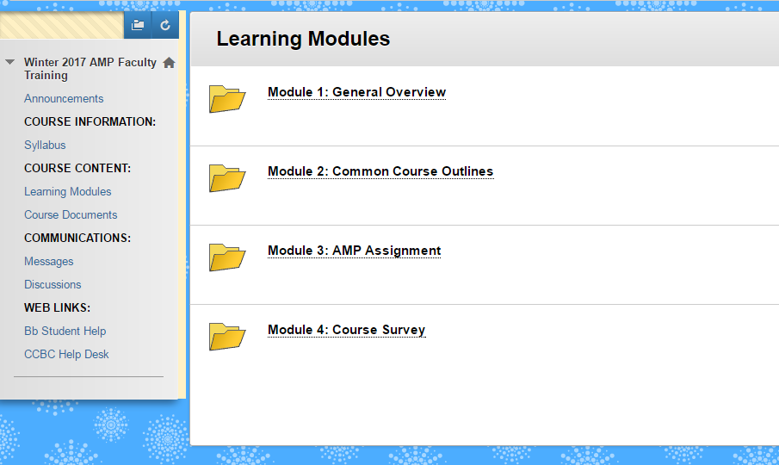

Slide 69
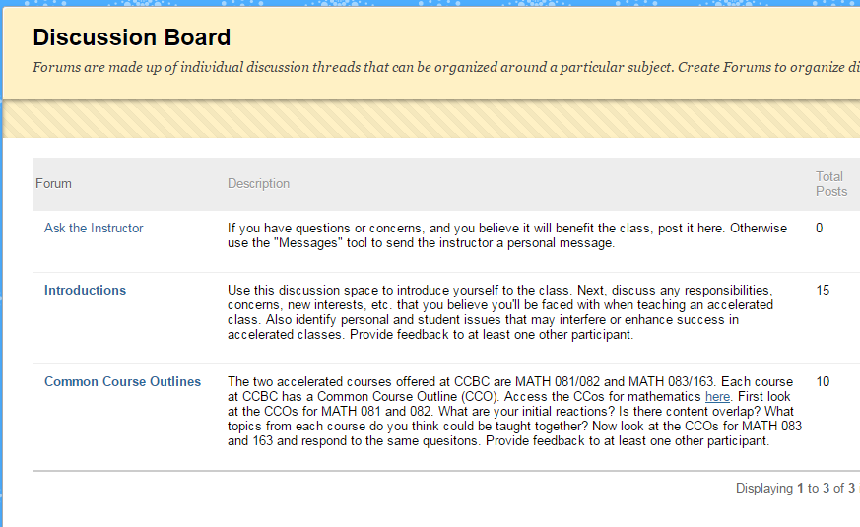

Slide 70
Day 1 Discussions
Is an AMP class right for you?
Twice the time is spent on homework and studying.
What should you do to be successful in a math course?
You cannot withdraw from one class without withdrawing from the other.
Attendance is extremely important. Miss one class is equivalent to missing a week.
If you fail one or both classes, you risk losing financial aid. Discussing the financial aid policy is key.

Slide 71
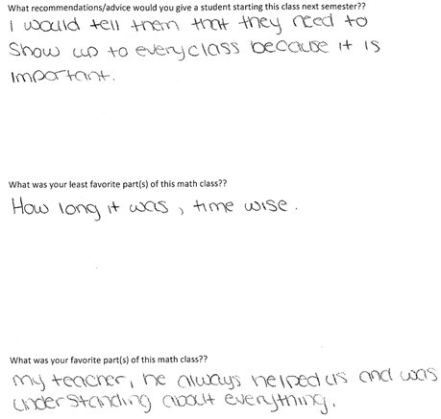
Sample: Sharing Student Surveys

Slide 72
Future of AMP

Slide 73
The Road Ahead
Mentorship of Faculty
Continued Marketing
Combining Introductory Algebra with Statistics and Finite Math

Slide 74
www.ampatccbc.org
AMP@ccbcmd.edu

