Slide 1
Acknowledging Student Capacity by Reforming Curriculum and Placement in English

Slide 2
The Traditional Approach
http://video.butte.edu/media/ENG-118/Simpsons_OnlyMoveTwice.html
Notes:
Until relatively recently, this has been our systemic response to students. But as Bart points out, slowing down to catch up is not really a logical approach.

Slide 3
The Traditional Composition Sequence at Butte
215
4 levels below
(4 units)
217
3 levels below
(4 units)
219
2 levels below
(4 units)
119
1 level below
(3 units)
2
Transfer Comp
Notes:
Most of us are aware of the pipeline effects brought about by these long sequences, through which fewer students are able to complete the sequence the more levels it has.

Slide 4
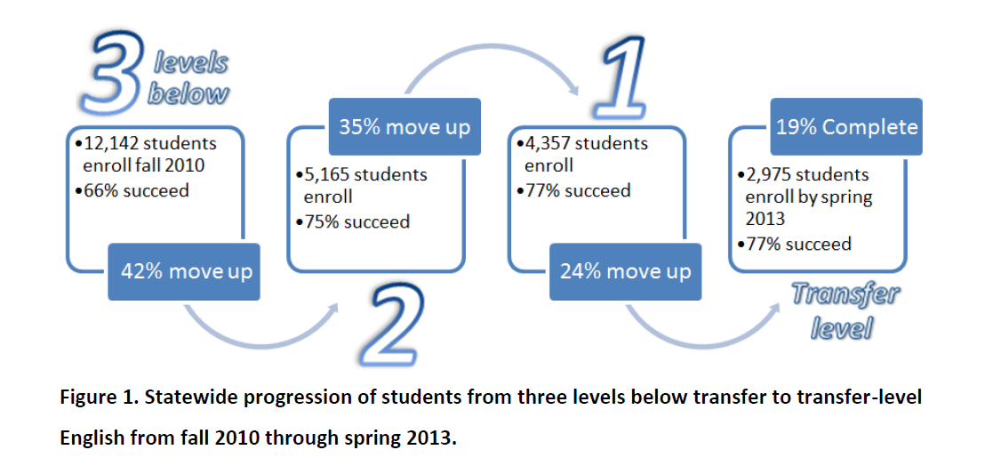
Consequences of the Traditional Approach

Slide 5
The Accelerated Composition Sequence at Butte
118
Accelerated Course
4 units
215
4 levels below
(4 units)
217
3 levels below
(3 units)
2
Transfer Comp
219
2 levels below
(4 units)
119
1 level below
(3 units)
Notes:
When we developed this course, over a third of our students were placing two levels below in English. We started offering this course in 2011.

Slide 6
Design Principles for Accelerated Course
Just in time remediation
Backward design
Support for affective issues
More challenging, integrated reading/writing
Thematic approach
20-hour training program for instructors
Notes:
Design principles

Slide 7
Completion of College English in Two Years
Notes:
Definite completion and equity gains for accelerated students. Af-Am 58 219, 13 118; Asian 98 219, 14 118, Hispanic 201 219, 15 118, white 552 219, 76 118

Slide 8
Meanwhile, Back at the Assessment Ranch . . .
After switching placement tests and setting new cut scores, we were surprised to find that more than twice as many students were eligible to enroll directly in college English.
Old test/cut scores: 23% of incoming students “college ready” in English
New test/cut scores: 48% of incoming students “college ready” in English
Notes:
Fewer students placing two levels below—that percentage was cut in half
Also, no changes were made to the college-level course

Slide 9
How did Lower-Scoring Students Do Under the New Policy-- the Ones Previously Placed into Remediation?
We estimated this group by considering the previous placement ratios
Under previous placement ratios:
*Students scoring between 73-88 on new test would likely have been placed into developmental coursework
*Students scoring between 89 and 99 on new test would likely have been placed into college English
Notes:
We were hearing lots of concern that we had allowed too many students into college English, students were in over their heads, they were being harmed by being overplaced into a class that was too hard for them, etc. So we asked how lower-scoring students were doing under the new policy—the ones previously placed into remediation.

Slide 10
What Grades Would We Expect From the Lower-Scoring Students if They Were Truly Less Prepared?
What proportion of As and Bs?
What proportion of Cs?
What proportion of failing grades (Ds, Fs, and Ws)?
Notes:
This is an interactive exercise—let’s ask what they would expect for each grade, relative to students from higher placement range

Slide 11
Grade Distribution in College English
Placement Score Range | A | B | C | D/F/W
Students likely placed into college English under prior ratios Scores: 89-99 on new test N=2481 | 23% | 27% | 15% | 36%
Students likely placed into remediation under prior ratios Scores: 73-88 on new test N=1927 | 15% | 25% | 19% | 42%
Notes:
No wonder COMPASS has been pulled and the company is admitting the test’s lack of predictive power!
Point out that if faculty are concerned that only 59% of the lower-scoring group passed, they should keep in context that this is 20 points higher 1A completion than among (Fall 2010-Spring 2011: 39% students who start one level below go on to complete college English in 1-year. Also the old ratios would mean that the 40% of students who earned As and Bs would be excluded from the course.
41% of lower-scoring earned grades of D/F/FW/W, compared to 36% of students in the higher-scoring range. They were also less likely to earn As. However, they did not significantly underperform in comparison to the higher-scoring students. We found it noteworthy that the lower scoring group did not receive a disproportionate number of Cs, as might have been expected if they were borderline college ready. In fact, 40% earned As and Bs in a course they would have been excluded from under prior placement ratios.

Slide 12
Implication #1: Revealing Student Capacity
The previous placement policy underestimated student capacity.
“The tests themselves weren’t as effective at determining readiness as we would like.” (ACT spokesperson explaining why the company is phasing out COMPASS). https://www.insidehighered.com/news/2015/06/18/act-drops-popular-compass-placement-test-acknowledging-its-predictive-limits
--This was especially true for students of color, as we’ll see

Slide 13
Placement and Equity
First-Time Freshmen (FTF) Cohort enrolled for credit | Fall 2010 percent placed at transfer level | Fall 2012 percent placed at transfer level
White | 36.49% | 58.46%
Hispanic | 19.17% | 41.25%
Asian | 18.75% | 34.88%
African American | 15.11% | 37.28%
Source: BC Momentum Report, Accessed Nov. 2014
Notes:
Equity gaps in placement still exist, but they narrowed; keep in mind that the more of your group places directly into college English/transfer level, the more of your group will complete the course due to pipeline effects/exponential attrition in the sequence

Slide 14
How Did the Changes Impact Completion?
Notes:
Students of color catching up, but the placement gap translates to a completion gap
African American N= 284 (’07-‘10) N = 145 (’12-‘13)
Asian N= 458 (’07-‘10) N=283 (’12-‘13)
Hispanic N= 1,092 (’07-‘10) N= 746 (’12-‘13)
White N= 4,250 (’07-‘10) N=2,014 (’12-‘13)
All N= 6,972 (’07-‘10) N= 3,475 (’12-‘13)

Slide 15
Completion of College English in One Year College-Wide – first-time freshman cohort
Tripled for African American students (8% ➔ 23%)
Doubled for Hispanic students (13% ➔ 27%)
Doubled for Asian students (17% ➔ 35%)
1.6 times higher for White students (23% ➔ 37%)
Old policy:
Whites’ completion nearly 3 times higher than African Americans’
New policy:
There’s still a gap, but whites’ completion now just 1.5 times higher than African Americans’
Notes:
There is a gap in completion.

Slide 16
Here’s Student Performance in the Class. Notice Anything?
Student Race/Ethnicity | Fall 2014 College English Success Rate
Asian (n=91) | 76.9%
All (n=1851) | 65.5%
Hispanic (n=437) | 66.7%
White (n=1052) | 64.8%
African-American (n=51) | 64.7%
Source: BC Course Student Demographics Report, English 2, accessed Jan. 2015
Notes:
No gap. Once students get to the course, no equity gap in performance in the course. Some of these students have been directly placed, and some are pipeline survivors.
Spring 2015 looks the same—previous years, maybe a 10 percentage point gap at most, half the size of the gap we see in placement

Slide 17
So Is The Completion Gap a Placement Gap or an Ability Gap, or Both? Here’s the Current Placement Gap Again:
First-Time Freshmen (FTF) Cohort enrolled for credit | Fall 2012 percent placed at transfer level
White | 58.46%
Hispanic | 41.25%
African American | 37.28%
Asian | 34.88%
Source: BC Momentum Report, Accessed Nov. 2014
Notes:
According to statewide rules: “When the ratio is below 80% or the minority group placement rate is less than 80% of the majority group placement rate into the upper level course(s), the college must consider and evaluate what the causative factors could be that account for the observed differential placement. Monitoring and documentation must continue over time. As appropriate, steps need to be considered to alleviate the situation. It becomes important to re-evaluate the fairness of the test as a tool to guide placement recommendations.” http://extranet.cccco.edu/Portals/1/SSSP/Matriculation/Assessment/DisproportionateImpact.pdf

Slide 18
Implication #2: Equity Gaps in Placement Unjustifiably Perpetuate Equity Gaps in Achievement
Disproportionately placing students of color into developmental courses “contributes to further disparities…in retention and completion rates, graduate school participation rates, and access to opportunities for deep and engaged learning throughout their postsecondary careers.” (USC Center for Urban Education)
Notes:
If the company itself says the test doesn’t predict student achievement, and we’re disproportionately placing students of color into remediation, it really is unjustifiable.

Slide 19
So Why The Huge Equity Gaps in Placement?
Perhaps the test measures something students of color don’t do well at but that isn’t that important for success in English. The company itself says the test doesn’t predict college readiness/course performance!
For students of color and students who identify as “bad at English,” stereotype/ identity threat could explain their underperformance on placement tests.

Slide 20
Stereotype/Identity Threat
“Apprehension arising from the awareness of a negative stereotype or personal reputation in a situation where the stereotype or identity is relevant and thus confirmable”
– Josh Aronson, “Rising to the Challenge of Stereotype Threat”
https://www.youtube.com/watch?v=ahN-dSh_lTc

Slide 21
It Can Happen to Anyone
Steele and Aronson (1995): African American students from Stanford solved only half as many verbal GRE questions when asked demographic questions beforehand
Similar results have occurred for many other groups:
Latino students reminded of performance-based stereotypes on verbal tests (Aronson & Salinas, 2005)
Female students on mathematics tests (Spencer, Steele, & Quinn, 1999)
European American males reminded that Asians outscore whites on math tests (Aronson et al. 1999)
http://www.researchgate.net/publication/222534527_Stereotype_threat_identity_salience_and_spatial_reasoning

Slide 22
Stereotype/Identity Threat and Placement Tests
Students are at greater risk of stereotype threat when there has been an increase in the salience of their stigmatized identities due to cues in the testing environment
-- McGlone and Aronson 2006
http://www.researchgate.net/publication/222534527_Stereotype_threat_identity_salience_and_spatial_reasoning
Notes:
Reminding students of relevant “achieved positive identities” can overcome the impact of stereotype threat—for girls on a spatial reasoning test, their identity as private college students; framing tests as challenges and teaching growth mindset can also help performance on standardized tests

Slide 23
Students
Vincent and Barry: Both African American men who appeared to have been under-placed
Academically capable students placed into developmental coursework
Both were quite anxious about how others would evaluate their writing and tended toward perfectionism; both had been homeless and seemed to keenly feel their difference from the general student population at Butte
Notes:
Both likely to have had the experience, at some point including right before testing, of being the only African American person in the vicinity

Slide 24
Implications
Previous curricular structure and placement policy underestimated student capacity. Placement validation measures did not pick up on the problem.
Disproportionate placement perpetuates unjustifiable equity gaps in student completion.
Stereotype/identity threat impacts students’ standardized test performance and is one possible cause of disproportionate placement ratios.

Slide 25
Conclusion: Acknowledging Student Capacity by Reforming Curriculum and Placement in English
Our placement policies and curricular structures must be changed so as to lessen/erase equity gaps in student achievement.
This is a social justice issue, one which we have the power to change.
*For more information about Butte’s placement and curricular reforms, read “Let Them In: Increasing Access, Completion, and Equity in College English,” available at http://cap.3csn.org/files/2014/12/Let-Them-In-Final.pdf

