Slide 1
Collaborative research in acceleration
Jennifer Brezina, Ph. D. Daylene Meuschke, Ed. D.
Catherine Parker, M.A.
College of the Canyons

Slide 2
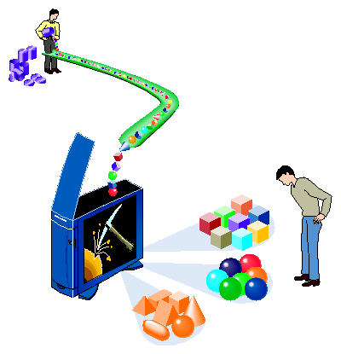
Data, data, everywhere . . . . .
Institutional research offices support planning, are responsible for internal and external data requests, and are often called upon to respond to specific data requests for programs.
Faculty and deans plan for their programs, are responsible for responding to available data and using it to make decisions, and are often called upon to explain and justify program efficacy.
Image from http://healthinformatics.wikispaces.com/Clinical+Informatics

Slide 3
What can happen
“Look what we did!”
Project design often not optimal for research
Project not prioritized in research office pipeline
Project not evaluated at right moment
Research questions not clearly framed
Research office may not have enough information about the goals or details of the project to move forward
Data dump
Researchers may miss the nuances in the data or not see all of the implications due to lack of context
Faculty and deans may not completely understand the implications of the data
Key research questions can be missed
Faculty and deans may not be invested in the research and may not act on it in a timely way

Slide 4
In a collaborative model
Involvement from the start
Initial data
Conversation and questions
The research office is involved starting with the idea stage, helping to frame research questions to make sure the data requested is the right data to inform planning
Initial data are provided
Conversation and questions – and sometimes more data
This process takes time: to build partnerships, to develop trust, and to take the time needed to talk things through

Slide 5
Example 1: English acceleration
Researchers were part of the discussion of acceleration in English from the beginning, attending a Faculty Inquiry Group meeting and department meetings as needed
The size of the pilot was determined based on input from researchers
The research evaluation plan was set up before the class was offered
Content experts helped to explain the data to help show the dramatic impact of the new course
Data were shared informally as the research brief was written to help inform curriculum decisions being made before the brief was finalized

Slide 6
Example 2: math acceleration
Researchers were part of acceleration discussions at Math department meetings from the beginning
Working alongside faculty advocates, researchers helped explain pipeline data to Math faculty
The research evaluation plan was set up before the class was offered
Content experts helped to explain the data to show the dramatic impact of the new course

Slide 7
Example 3: EAP for English placement
Local high school teachers brought the issue to the English department through the Learning Consortium meetings that take place monthly
While there was no clear community college data yet, the English department voted to accept EAP-College Ready for ENGL-101 placement based on CSU data
The research evaluation plan was designed in collaboration between English and Institutional Research, striving to get data as soon as possible while ensuring a large enough sample size
Raw success rate data was provided for a key English department meeting and presented by the dean as the department was deciding whether or not to accept EAP-Conditional for placement
Data were shared with local high school teachers through the Learning Consortium meetings and also through a research brief

Slide 8
Example 4: ESL cut score validation
ESL 070 (score range 71-90)
57 students/91% overall success rate
Scores | Number of Students | Success Rate
71-77 | 13 | 92%
78-84 | 29 | 90%
85-90 | 15 | 93%
ESL 080/083 (score range 91-105)
73 students/100% overall success rate
Scores | Number of Students | Success Rate
81-90 | 11 | 100%
91-94 | 11 | 100%
95-99 | 31 | 100%
100-105 | 31 | 100%
ESL 100 (score range 106-120)
154 students/79% overall success rate
Scores | Number of Students | Success Rate
101-105 | 23 | 87%
106-110 | 66 | 82%
111-115 | 64 | 77%
116-120 | 24 | 79%
Success rate data were unusual
Meeting between ESL faculty, dean, Institutional Research, SSSP director, and Assessment Center staff
Additional context discussed:
Disparity between number of students taking assessment and students enrolling in ESL
Changes taking place in curriculum in ESL and English
Additional research needed with follow-up conversations in the fall

Slide 9
The model in action

Slide 10
The model in action

Slide 11
The model in action

Slide 12
The model in action

Slide 13
results
More transparency with the data and the resulting reports
Better context leads to more useful action implications
Workload improvements
Better communication
Increased credibility for both groups
Image from http://thecareertools.com/2013/01/14/what-are-my-goals-for-my-coming-career-life/

Slide 14
Contact Information
Jennifer Brezina: Jennifer.Brezina@canyons.edu
Daylene Meuschke: Daylene.Meuschke@canyons.edu
Catherine Parker: Catherine.Parker@canyons.edu

