Slide 1




ALP Pedagogy:
“What Will I Do in My ALP Class?”
Susan Gabriel
ALP Director
Elsbeth Mantler
ALP Faculty
Pre-Conference Workshop
2016 Conference on Acceleration in
Developmental Education

Slide 2

Who’s in the Room?

Slide 3



ALP Pedagogy
Workshop Agenda
Overview of ALP at CCBC—Brief!
Key Features of ALP Teaching
Active/Collaborative Learning
Backward Curriculum Design
  Aligning the FYC and ALP Syllabi
Scaffolding and Support Strategies and Activities
Grammar, Grading, and Other Grand Concerns
Final Thoughts and Questions
A
L
P
The Accelerated Learning Program

Slide 4
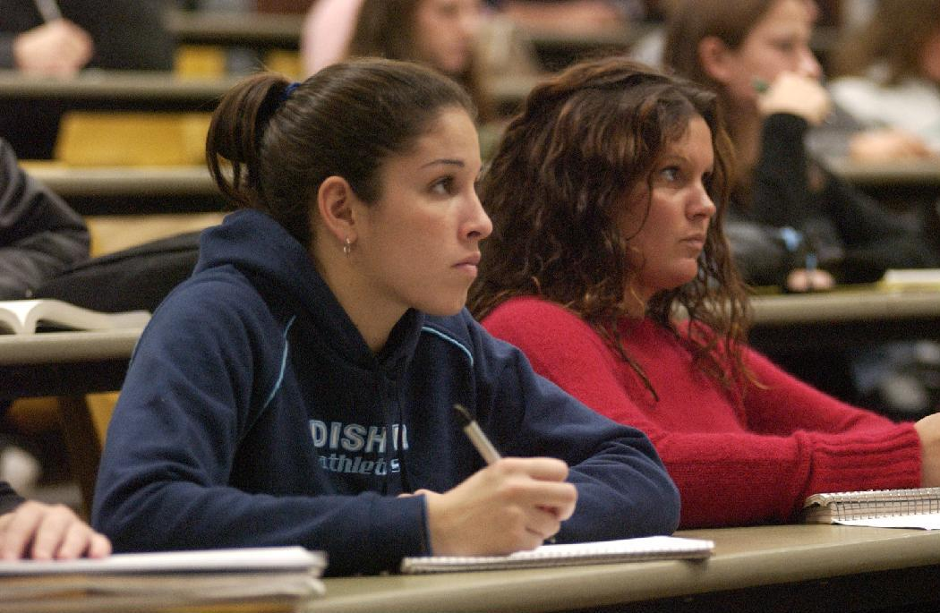
CCBC Demographics
Number of credit students: 33,064
Average age: 29
Female/male ratio: 58%/42%
Minority Students: 49%
52% work 20 hours or more per week
51% receive some form of financial aid
Full/Part time ratio: 13/87%
81% of students entering CCBC test into one or more developmental
disciplines
65% Dev. Writing
77% Dev. Mathematics
58% Dev. Reading
Notes:
Three main campuses; 3 extension centers

Slide 5

CCBC’s Developmental Education Courses:
MATH
081
MATH
082
MATH
083
RDG
051
RDG
052
ENGL
051
ENGL
052
ENGL
101
ENGL
102

Slide 6

CCBC’s New Integrated Reading/Writing Sequence: Beginning Fall 2016
ACLT
052
5 cr.
ENGL
101
3 cr.
ACLT
053
3 cr.
ENGL
101
3 cr.
ENGL
102
3 cr.

Slide 7


ALP at CCBC: New Model Beginning Fall 2016
ENG 101
ACLT 053
Reduces stigma
Improves attachment
Provides stronger role models
Encourages cohort effect
Changes attitude toward the developmental course
Allows more individual attention
Allows time for dealing with non-cognitive issues
Allows students with dev. placements in writing and reading to participate
A
L
P
The Accelerated Learning Program

Slide 8
How does an ALP developmental writing class
differ from a traditional one?
Goal of a traditional developmental course:
.
For students to pass the developmental course
and be ready for first-year composition
Goal of an ALP developmental course:
For students to pass the first-year composition course
A
L
P
The Accelerated Learning Program
Notes:
After discussing this slide, Peter turns it back to Sarah.

Slide 9
What do we do in the ALP 052 class?
The goal for ALP instructors: Maximize the ALP developmental students’probability of success in the ENGL 101 class. Strategies include:
Conducting class as a writing workshop, an extension/supplement to the 101 class—we think of it as a 6-hour ENGL 101 class
Answering questions left over from the 101 class
Providing opportunities for more writing practice, short papers to reinforce concepts from the 101 class or prepare for upcoming assignments in the 101 class
Integrating critical reading and thinking strategies
Discussing/brainstorming ideas for the next essay in 101
Reviewing drafts of essays the students are working on for 101
Working on reducing the frequency and severity of sentence-level error in the students’ writing
Addressing non-cognitive issues (life issues, affective issues)
A
L
P
The Accelerated Learning Program
Notes:
After discussing this slide, Peter turns it back to Sarah.

Slide 10
ALP Pedagogy: Key Features
Incorporating active/collaborative learning
Utilizing backward design from the FYC course
  Aligning the FYC and ALP syllabi
  “Throw away your traditional dev. ed. writing syllabus!”
  Customizing ALP support and scaffolding activities based on the FYC assignments
Integrating reading and writing
Improving thinking skills
Addressing non-cognitive issues
Improving editing skills: re-thinking grammar instruction
“Teaching the way you always wished you could!”

Slide 11

ALP Key Feature: Active/Collaborative Learning

Slide 12
Active/Collaborative Learning Group Categories
Base groups
  Stable, long-term groups
  Formed by the students
  Support, encouragement, and accountability
Informal groups
  Temporary groupings (2-3 students)
  Provides a way for students to meet and work with more of their classmates
Formal groups
  Usually formed by the instructor
  Group projects

Slide 13

Appointment Scheduler
Take out your appointment scheduler sheet.
Use your appointment scheduler to set up 5 appointments between the hours of 8:00 and 12 :00.
Under “Interesting Fact,” record something significant you learn about each of your appointment partners.
You have 10 minutes to complete
this task.

Slide 14
Advantages and suggestions for this activity
Can be used throughout the semester to create informal groups for a variety of collaborative learning activities
Allows students to work with different partners each time
Wait to do until the second week of classes when class lists become more stable
Ask students to keep scheduler available—take a picture of the sheet with their phone
Be flexible

Slide 15
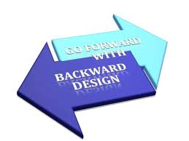
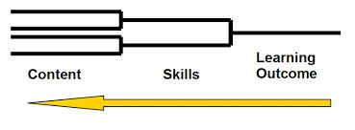
ALP Key Feature: Backward Design

Slide 16
ALP Key Feature: Backward Design
Current developmental writing textbooks and readers:
  Level-one developmental writing texts focus on ?
    sentences
  Level-two developmental writing texts focus on ?
    paragraphs
  Reading level is often 6th grade.
  Students feel as though they are back in middle school.
In ALP backward design you begin by:
  assigning college-level essays,
  based on complex, college-level texts, with
  activities and assignments to support student
  success with these challenges.
  Let’s consider CCBC’s common course 0utlines.

Slide 17

FYC and ALP Syllabi Alignment
Start with your FYC syllabus and plan “backwards” for the ALP class.
Let’s look a side-by-side semester plan for a set of English 101/ALP classes.
Questions?

Slide 18
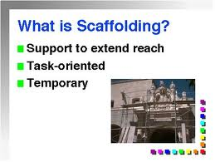
Scaffolding and Support Activities for the ALP Class
Let’s look at the ALP scaffolding and support activities for an English 101 assignment.

Slide 19
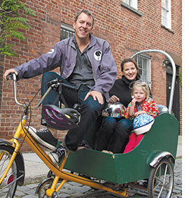

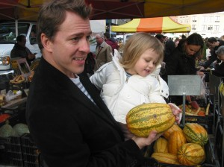
What was the topic of research essay?
This essay was tied to a book students read called No Impact Man. It is a non-fiction piece by Colin Beavan about a man and his family trying to live impact free in NYC for a year.
Students picked a topic related to local environmental issues.

Slide 20
Research Essay Expectations
The essay called for a unique thesis or argument about said issue.
The essay was not a “for” or “against” essay. Rather, it gave students an opportunity to make their own unique claim about a topic.
4-6 pages
Minimum of 3 outside sources and smooth quote integration

Slide 21
Sample Topics
Fracking in Maryland
Inner Harbor Swimmable by 2020 Campaign
Plastic Bag ban in Baltimore City
Aquaculture in Maryland
Conowingo Dam Controversy
Urban Farming in Baltimore City
Issues with Farm Pollution in the Chesapeake Bay
Wind power in MD
Blue Crab population in the Chesapeake Bay
Commercial Fishing regulation in the bay
Microbeads
GMO’s or labeling of GMO’s (genetically modified organisms)
Fishing regulations in the state
**These topics are merely suggestions. If students can think of another topic that is relevant, I want them to explore it! I ask them to run it by me first, though. I want to make sure the topic is feasible for the assignment.

Slide 22
classroom Activities to scaffold research essay writing
1. CHOOSING A TOPIC
You have one activity in your pack that I give to my students in the developmental class. This is handed out before the students receive the instructions for the essay. My hope is that they can pick a topic that is genuinely interesting to them.

Slide 23
2. Evaluating sources
The class visited the library and were taught a lesson about research methods within the CCBC databases. At this visit and during the next class period students conducted research on the CCBC databases with the help of a librarian and myself.
√ Source Evaluation Checklist: A checklist given to 053 students to help them look at sources with a critical eye. (Accuracy, Purpose, Timeliness, Authority, etc.)
Activity with Sources “Check Out or Leave it on the Shelf”

Slide 24
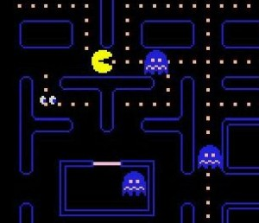
Check out of Leave on the Shelf?
We are information consumers.

Slide 25
As much information as we consume, it is important for us to use a critical eye to decide if sources we are using and things we are reading are reliable or not.
So, we are going to practice seeing if some sources from the data base for the research essay are reliable.

Slide 26
Instructions: Read your source.
After reading the article, answer these questions:
What year was the article written?
Can you tell if the author has any affiliations? If so, what might they tell the reader?
Would these affiliations cause any type of bias about the topic?
What might the author’s purpose be judging on your reading of the piece?
What type of research does the article use to prove it’s point? Could there be any potential bias with their sources?
Based on your answers to these questions, would you…

Slide 27
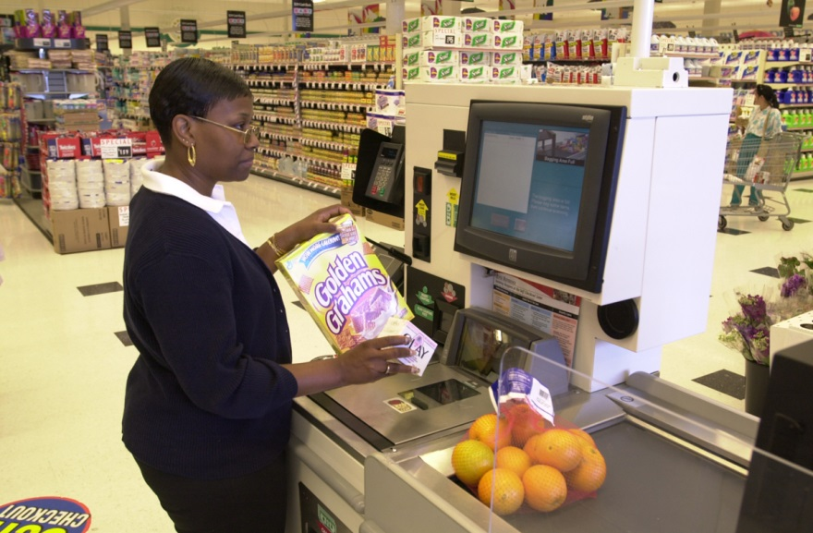
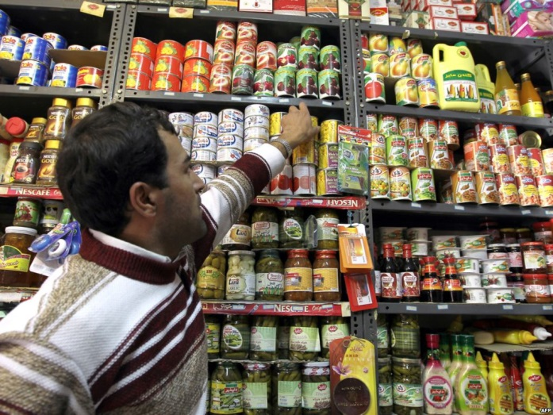
Decide is your source ready to “Check Out”
Or, does it need to be put “back on the shelf”

Slide 28
3. Prewriting for the essay
Informal Annotated bibliography: Students must summarize main points of a source, explain how it relates to their essay, and write an MLA citation for the source.
Informal Outline: Students must show proof of a thesis and main ideas of the essay in whatever way they like (this includes diagrams, outlines, lists, etc.).
The format of these documents is not as important to me as the ideas generated here.

Slide 29
How did i make these prewriting activities more engaging?
After the students completed both of these activities on their own, the students shared their outlines in a “round table” type of format. Each student explained the main idea of their essay and how they planned to support it.
Their ideas were then “work shopped” by their peers.
I intervened as little as possible, and let the students provide feedback top each other
This step is very important because it lets students feel confident and prepared to being writing their draft.

Slide 30
4.Quote Integration
Students write a paragraph that explains one idea about their research topic. They are asked to use at least one quote from one of your sources.
This is a worksheet that might help the students revise that paragraph. The goal is twofold: to help the students understand how paragraphs like this can be constructed, and to give them a head start on the 101 paper.

Slide 31
5. During the draft process
Students meet with me individually with their drafts to help work on their essays.
Peer review and round table discussions are held in both the 101 and 053 class looking at sample essays and essays of peers.

Slide 32
6.After the Essay is completed, Self-assessment
Students write a reflective essay in the 053 class after they turn in their final copy of the research essay. This helps with the meta-cognitive aspect of the writing process.
Instructions: I want you to think about the following question when writing this essay:
What was the most difficult part of writing this essay?
What did you learn from writing this essay?
How will this essay change the way your approach writing?
What did you feel you were successful with in this essay?

Slide 33
Meet with your 9:00 appointment partner to complete the following task:
Using one of your FYC assignments, develop a set of scaffolding and support activities for an ALP class.

Slide 34
Part II: Small Group Task
With your partner, join with 2 other pairs and discuss all of your ideas.
Decide on the best ALP scaffolding plan to report to the whole group.

Slide 35

ALP Key Feature: Rethinking Grammar Instruction

Slide 36
The Research on Teaching Grammar
Braddock, Richard, Richard Lloyd-Jones, and Lowell Schoer. Research in Written Communication. Urbana, IL: NCTE, 1963.
Hillocks, George. Research on Written Communication. Urbana, IL: NCTE, 1986.
Kolln, Martha. “Closing the Books on Alchemy.” College Composition and Communication. 32.4 (Jun 1981) 139-51.
Studies show that there is little to no correlation between correctly completing grammar worksheets and being able to create grammatically correct sentences. Worksheet proficiency does not carry over into our students’ writing. (See bibliography.)

Slide 37
Our traditional definitions of grammar concepts are COIK.
  What is a sentence?
  A sentence is a group of words that includes at least one subject and one verb and that expresses a complete thought.
    The woman running after the bus.
    She found it in the back seat of her car.

Slide 38
Rethinking Our Traditional Definitions of Grammar Concepts
  Rei Noguchi’s definition
  A sentence is a group of words that makes sense when placed on the line below:
  They refused to believe the idea
  that _______________________________
  the woman running after the bus

Slide 39
Rethinking Our Traditional Definitions of Grammar Concepts
  Rei Noguchi’s definition
  A sentence is a group of words that makes sense when placed on the line below:
  They refused to believe the idea
  that _______________________________
  she found it in the back seat of her car

Slide 40
Rethinking the Goal of Teaching Grammar
The goal of whatever we do under the vague umbrella of “teaching grammar” is not turning our students into grammarians, but into more effective editors of their own writing.

Slide 41
Possible Strategies
Conduct all grammar instruction within the context of your students’ writing.
Use minimal marking and self-editing strategies.

Slide 42
Minimal Marking
Richard Haswell (1983)
  Writing comments on student papers does not yield positive results.
  A better approach would be to facilitate rather than judge.
  Method
    No corrections marked in the text.
    Check marks placed in the margins.
    Total number of checks recorded at the end of the paper.
    Students find and correct surface errors.
    Advantages:
    Avoids information overload
    Challenges students—presents a puzzle
    Engages students
    Provides self-motivation to be a better self-editor

Slide 43
Self-Editing Strategies
  Error Logs
  Self-Editing Checklists

Slide 44
Possible Strategies
Conduct all grammar instruction within the context of your students’ writing.
Use minimal marking and self-editing strategies.
Incorporate “just-in-time” instruction in the context of assignments.

Slide 45
Meet with your 10:00 appointment partner to complete the following task:
Make a list of the successful strategies you use for “teaching grammar.”

Slide 46
Part II—Small Group Task
With your partner, join with three other pairs and share your ideas.
Decide on the 2 “best ideas” to share with the whole group.

Slide 47
Grading in an Accelerated Class
  Grade/assess the ALP students in your FYC/ALP classes, using the same level of expectations you use in a standard FYC class.
  For students who do not pass your FYC, grade/assess them using the following criteria:
    Did the student reach the skill level required to pass your traditional developmental writing class?
    Would the student benefit from taking both classes again, or should he/she repeat only your FYC?

Slide 48
Final Thoughts and Questions

Slide 49
ALP Pedagogy:
“What Will I Do in My ALP Class?”
Contact us:
sgabriel@ccbcmd.edu
emantler@ccbcmd.edu
ALP Website:
http://alp-deved.org
Enjoy the conference!

