Slide 1
Inside an Accelerated,
Integrated Reading & Writing Classroom
Pre-Conference Workshop
Conference on Acceleration in
Developmental Education
Baltimore, MD June 15, 2016
Katie Hern
Co-Founder, California Acceleration Project
English Instructor, Chabot College
khern@chabotcollege.edu
http://cap.3csn.org
Notes:
Things to have open & minimized on screen –
http://video.butte.edu/media/ENG-118/Simpsons_OnlyMoveTwice.html
CAP website at Freire video
Summary of guidelines for choosing reading

Slide 2
http://video.butte.edu/media/ENG-118/Simpsons_OnlyMoveTwice.html

Slide 3
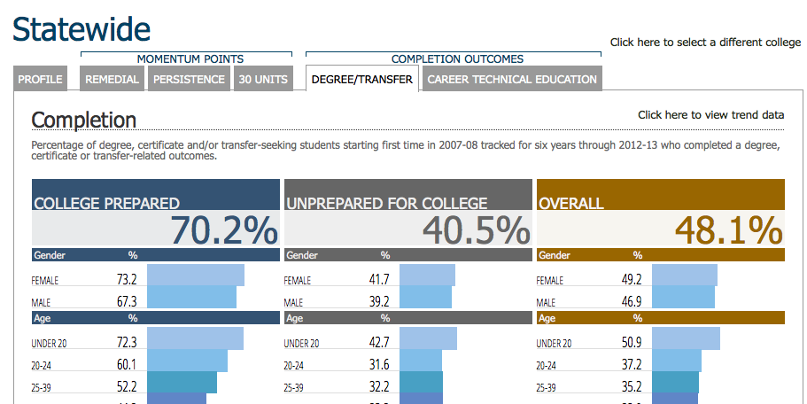
Student Success Scorecard
Statewide, more than three-quarters of incoming students are classified “unprepared”

Slide 4
Traditional Remediation
Standardized tests are used to identify students who need additional preparation
Students scoring below “college-level” are required to enroll in 1-4 remedial courses in math and/or English
In lower-level remedial classes, tasks are more basic, less challenging than in higher levels
In math, remediation is a repeat of K-12 math content through Algebra II, students need to make it through all of this content before taking any college-level math course
Notes:
Research over the last five years has yielded surprising some insights about the limitations of this approach. We are going to start by sharing a few stories with you, from colleges that are breaking down these assumptions and getting much better and more equitable results.

Slide 5
Butte: What if we let more students into college English?
While setting cut scores for a new placement test, Butte College discovered that twice as many students were now assessing as “college ready” in English.
Placement into college English:
Increased from 23% to 48% of incoming students
One-Year Completion of College English
Tripled for African American students
Doubled for Hispanic and Asian students
1.6 times higher for white students
Achievement Gaps:
The gap between White and Black students’ completion of college English was cut nearly in half.
Under-Estimation of Students:
40% of the students who previously would have been placed into remediation earned As and Bs in college English
Notes:
After giving info on increased placement into college level, talk about the fears this raised – students will struggle in 1A, experience high failure rates, Butte should return to the old ratios out of concern for under-prepared students

Slide 6
CAP: What if we tailored math remediation to what students wanted to study in college?
Completion of Transfer-Level Math
The first 8 colleges piloting accelerated statistics pathways in CAP

Slide 7
Las Positas: What if we provided only one level of remediation below the college level?
At Las Positas College, most students take just a single semester of integrated reading and writing instruction below college English, with only the lowest-scoring 8% taking more.
Fall 2014 Pilot:
The lowest scoring group can take the one-level-below English course if they enroll in an additional 2 hour/week workshop with the same instructor
Eligibility for College English:
More than doubled in half the time.
67% passed & were eligible for college English in one semester
vs. 29% who took the two-semester sequence the year before

Slide 8
What if colleges & universities offered only co-requisite models of remediation?
Fall 2015 Statewide Data: Tennessee

Slide 9
The Unintended Consequence of Remediation Policies
The more levels of developmental courses a student must take, the less likely that student is to ever complete college English or Math.
      Bailey, Thomas. (February 2009). Rethinking Developmental Education. CCRC Brief. Community College Research Center. Teachers College, Columbia University.

Slide 10
Disappearing Students:
English-Writing in California
Students’ Starting Placement English-Writing | % Completing Transfer-Level English in 3 Years
One Level Below | 48%
Two Levels Below | 34%
Three or more Levels Below | 19%
Across CA, students of color 2-3 times more likely to begin in lowest levels than white students
Statewide data, Basic Skills Cohort Tracker, Fall 2009-Spring 2012
Notes:
Data on racial demographics from: Perry, M.; Bahr, P.R.; Rosin, M.; & Woodward, K.M. (2010). Course-taking patterns, policies, and practices in developmental education in the California Community Colleges. Mountain View, CA: EdSource.

Slide 11
Disappearing Students:
Mathematics in California
Students’ Starting Placement Mathematics | % Completing Transfer-Level Math in 3 Years
One Level Below | 35%
Two Levels Below | 15%
Three or more Levels Below | 6%
Across CA, more than half of Black and Hispanic students in remedial math begin here
Statewide data, Basic Skills Cohort Tracker, Fall 2009-Spring 2012
Notes:
Initial placement really determines your destiny – your likelihood of EVER completing a bachelor’s degree determined right here.

Slide 12
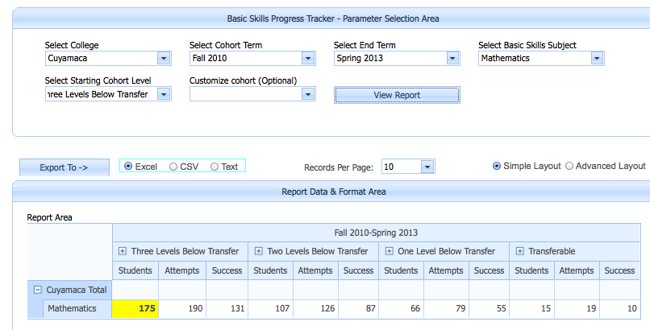
Completion of Transfer-Level Math in 3 years
Cuyamaca students starting 3 levels below transfer

Slide 13
Placement as Destiny
Mt. San Jacinto College Data – Fall 2015 – English
White students were 2x more likely to be placed into transfer-level English than Hispanics and nearly 4x more likely than African Americans
  Chance of passing college English in 2 years: 73%
African American and Hispanic students were more than 2x more likely that white students to have to take multiple semesters of remediation in English
  Chance of passing college English in 2 years: 23%-38%

Slide 14
How do we determine who is “college ready”?
Sample Item: Accuplacer “Sentence Skills” Test
Writing a best seller had earned the author a sum of money and had freed him from the necessity of selling his pen for the political purposes of others.
Rewrite, beginning with The author was not obliged
The new sentence will include
A) consequently he earned
B) because he had earned
C) by earning
D) as a means of earning
Notes:
CCRC analysis has shown that both Accuplacer and Compass are incredibly weak predictors of students’ abilities – and just a couple months ago, the company that makes Compass acknowledged this and announced that they would no longer be offering the test.

Slide 15
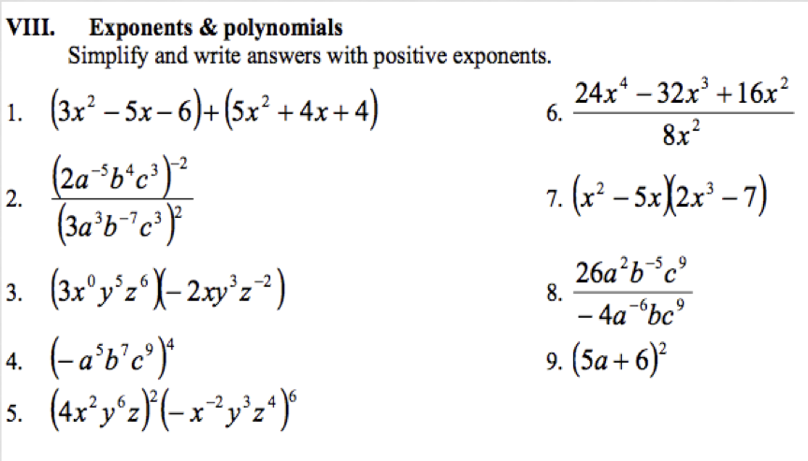
Are you college ready?

Slide 16
Attrition among Students Placed into Remediation:
A Structural Problem
Students placed 2 levels below college English/Math face 6 “exit points” where they fall away:
  Do they enroll in the first course?
  If they enroll, do they pass the first course?
  If they pass, do they enroll in the next course?
  If they enroll, do they pass the second course?
  If they pass, do they enroll in the college-level course?
  If they enroll, do they pass the college-level course?
  Students placed 3 levels down face 8 exit points.

Slide 17
Illustration: Chabot College
Students beginning two levels below College English:
  Do they enroll in the first course? ??%
  If they enroll, do they pass the first course? 66%
  If they pass, do they enroll in the next course? 93%
  If they enroll, do they pass the second course? 75%
  If they pass, do they enroll in the college-level course? 91%
  If they enroll, do they pass the college-level course? 78%
(0.66)(0.93)(0.75)(0.91)(0.78)= 33%
Fall 2006 Cohort. Students tracked from their first developmental English enrollment and followed for all subsequent English enrollments for 3 years. Pass rates includes students passing on first or repeated attempts within timeframe. Basic Skills Cohort Tracker, DataMart.

Slide 18
A Thought experiment: What if more students passed the first course?
  How many would complete the college level course?
  (0.66)(0.93)(0.75)(0.91)(0.78 ) = 33%
If 75% passed the first course…
37%
If 80% passed the first course…
40%
If 90% passed the first course…
45%
What if 90% passed and persisted at each point?
(0.90)(0.90)(0.90)(0.90)(0.90) = 59%
Notes:
75% = 37%
80% = 40%
90% = 45%
After reporting out from group, Myra tell story re: her own stupiphany.

Slide 19
BOTTOM LINE
Improving our results within the existing multi-level system will never be enough – we must eliminate or significantly reduce the exit points where we lose students in remediation.

Slide 20
Three High-Leverage Strategies
Changing Placement Policies:
Colleges broaden access to transfer-level courses, and make access more equitable, by adjusting cut scores, using robust multiple measures, and requiring algebra-based testing and remediation only for access to courses that require substantial algebra.
Implementing Co-requisite Models:
Students classified as “below transfer level” are allowed to enroll in a transfer-level course with extra concurrent support, saving them at least a semester of stand-alone remediation and reducing their chances of dropping out (e.g., “1A-plus” models: students co-enroll in English 1A and 2 additional units with the same instructor).
Redesigning Remedial Courses:
Multi-level sequences in English and math are replaced with accelerated courses that are well aligned with the transfer-level requirements in students’ chosen pathway.
Notes:
Talking points – these strategies have two things in common:
they shorten students path through transfer-level courses and eliminate exit points, and
all are grounded in the belief that students are capable of doing higher level work than we have traditionally assumed

Slide 21
Chabot College
English 102: Reading, Reasoning, Writing (Accelerated)
A 4-unit integrated reading and writing course, one-level-below college English, open to students with any placement score
  Alternative to two-semester, 8-unit sequence
  Students self-place in either the accelerated or two-semester path
  Developed with “backwards design” from college English: Students engage in the same kinds of reading, thinking, and writing of college English, with more scaffolding and support
  Offered since mid-1990s; college has expanded accelerated offerings in last decade so that the course now represents 66%-’75% of entry-level developmental sections

Slide 22
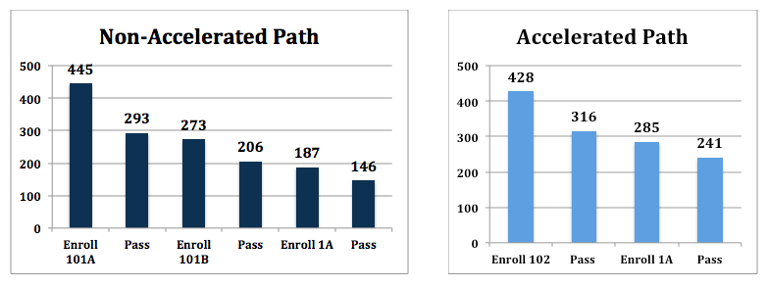
Higher Completion of College English
Fall 2006 Cohorts
Fall 2006 Cohorts
Students completing college English: 33%
Students completing college English: 56%
Data from the Basic Skills Progress Tracker, Data Mart, California Community Colleges Chancellor’s Office. Students are followed for three years from their first enrollment in a basic skills English course (English 101A or 102) and tracked for all subsequent enrollments in English, including repeats.
Notes:
Talking points:
Consistent over a decade – always 23-26 points higher completion in accelerated course
This remained true even when we changed section offerings so that MOST students are now in the accelerated path
Other data: ALL student groups do better in accelerated path, including ESL students, students with disabilities, and students with very low accuplacer scores
CCRC study controlled for all sorts of other variables and found that not only did accelerated students pass college English at higher rates, they were more likely to go on to transfer( (7-10 points higher) and graduate (4-6 points higher)

Slide 23
Window into an accelerated classroom
Integrated Reading and Writing Course One-Level-Below College, open to all students (no min. placement score)
Footage from Katie Hern’s class, Chabot College, Fall ’09, week two of the semester
Students working collaboratively to understand an excerpt from Paolo Freire’s Pedagogy of the Oppressed. Discussion builds on earlier readings by Malcolm X, Mike Rose, & Jean Anyon.

Slide 24
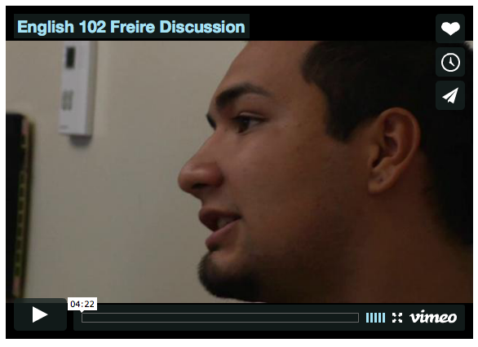
http://cap.3csn.org/teaching/reading-writing-classes/

Slide 25
Window into a Classroom
Look through the handout “Window into an Accelerated Classroom,” then talk in groups:
  What stands out to you as you look through these course materials?
  What excites you?
  What questions & concerns come up for you?

Slide 26
Window into CAP Instructional Cycle
Speed Dating
Post-reading activity in which students process the assigned reading in rapidly shifting pairs, clarify misunderstandings, and prepare for upcoming quiz and essay

Slide 27
Speed Dating: Round One
Introduce yourself to your date.
Describe what Dweck means by “fixed mindset” and “growth mindset” so that someone who hasn’t read the article could understand her ideas.

Slide 28
Speed Dating: Round Two
Introduce yourself to your date.
How do students with fixed mindsets respond to things that are challenging or difficult in school, compared to students with growth mindsets?

Slide 29
Speed Dating: Round Three
Introduce yourself to your date.
How might you apply Dweck’s research in your own classroom?

Slide 30
Attending to the Affective
When students aren’t successful, the key issue is often not their reading and writing skills…
Handout: Summary of affective practices
Related Link:
http://gallery.carnegiefoundation.org/collections/windows_on_learning/katie_hern/index.html

Slide 31
Thematic Courses
Don’t skimp on volume
Go for nonfiction about relevant issues
Evaluate the balance of narrative, information, and argument
Evaluate the density of unexplained references and terminology

Slide 32

Katie’s Tips re: Full-Length Anchor Texts

Slide 33
CAP Instructional Design Principles
Streamlined developmental curricula should reflect:
  Backward design from college-level courses
  Relevant, thinking-oriented curriculum
  Just-in-time remediation
  Low-stakes, collaborative practice
  Intentional support for students’ affective needs
  Illustrated in depth in Toward a Vision of Accelerated Curricula & Pedagogy (Hern & Snell, 2013). http://www.learningworksca.org/accelerated-pedagogy/

