Slide 1
Up to the Challenge:
California Community Colleges Expand Access to College English & Math
California Acceleration Project www.AccelerationProject.org
Conference on Acceleration in Developmental Education
June 15, 2017 – Denver, CO
Katie Hern CAP Co-Founder English Instructor Chabot College khern@chabotcollege.edu | Myra Snell CAP Co-Founder Math Instructor Los Medanos College msnell@losmedanos.edu
Notes:
Handouts:
> Homework sheet with prompts from SSSC
Blank disaggregated placement data table
4-page CAP research brief
Sample assessments handout (SSSC 2014)
Affective practices

Slide 2

170,000+ California community college students begin in remedial math
in a typical year
110,000+ of them will never complete the math required to earn a degree

Slide 3
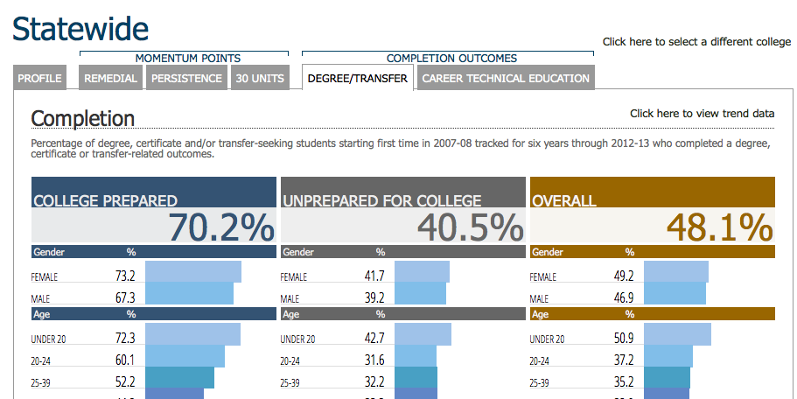
Student Success Scorecard
Statewide, more than three-quarters of incoming students are classified “unprepared”

Slide 4
Placement Is Destiny
Students’ Starting Placement | % Completing Gateway Math in 3 Years
One Level Below Gateway | 35%
Two Levels Below Gateway | 15%
Three or more Levels Below Gateway | 6%
Across CA, more than half of Black and Hispanic students in remedial math
begin here
Statewide data, Basic Skills Cohort Tracker, Fall ‘09-Spring ‘12

Slide 5
Inequitable Placement
Drives Inequitable Completion
Nationally and across California, students of color are disproportionately excluded from college-level courses and disproportionately required to take multiple remedial classes in math and English.
A study of three California community colleges estimates that 50-60% of racial inequities in degree completion and transfer-readiness is explained by initial placement.

Slide 6
Thought Experiment:
What do you think would happen if we…?
Placed most students into gateway college-level math courses
Provided extra support at the college-level instead of requiring remedial classes
Required remedial algebra courses only for Business/STEM pathways
Notes:
Let them talk in pairs/small groups for 5 minutes then report back what they think would happen

Slide 7
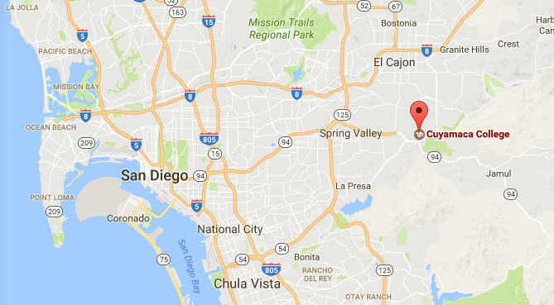
Cuyamaca College

Slide 8
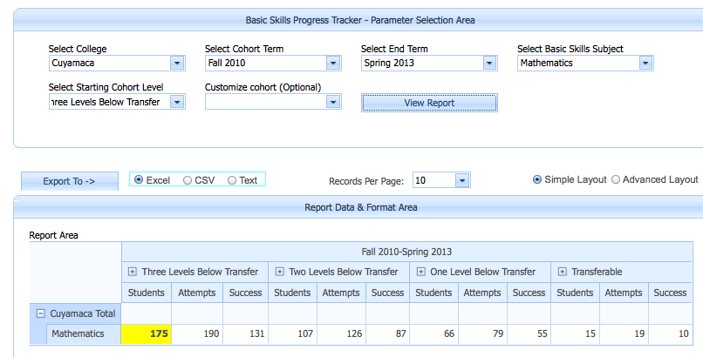
Before
Completion of Gateway Math from Pre-Algebra

Slide 9
After
Math Transformation - Fall 2016
5 math pathways: General Ed, STEM, Business, Education, Technical
Placement based on students’ high school GPA & math coursework, which they self-report when taking the assessment test
Corequisite models offered for all first-tier college-level courses, with just-in-time remediation through attached 2 or 3 unit courses
84% eligible for Statistics (regular or w/ support)
59% eligible for gateway-level business/STEM math (regular or w/ support)
Lowest possible placement is one non-transferable course -- Intermediate algebra with corequisite support, for students in B-STEM pathways

Slide 10
After
Equitable Access to Gateway Math
Incoming Students | Placed into Gateway Math (2015) | Placed into Gateway Math (2016)
All | 24% | 84%
African American | 9% | 73%
Hispanic | 21% | 85%
White | 27% | 84%
Asian | 36% | 90%

Slide 11
After
Dramatic Increases in Gateway Completion
Placement in Traditional Sequence | Success in Gateway (w/support) (Fall 2016) |  | Complete Gateway Math in 2 Years (Fall 2013 Cohort)
All Levels | 364 | 67% | 850 | 40%
Gateway Math | 35 | 77% | 255 | 79%
One Level Below | 102 | 69% | 215 | 36%
Two Levels Below | 110 | 66% | 296 | 19%
Three or More Levels Below | 47 | 62% | 84 | 4%
Notes:
All students (first-time and returning) who took a transfer course (statistics, business calculus, PreCalculus, College Algebra) with support
For first-time students enrolled in transfer-level math plus support (n=263),
67% succeeded overall (single attempt, no repeats)
54% of those who attempted a business/STEM math course
74% of those who attempted college statistics

Slide 12
After
Dramatic Increases in Gateway Completion
Placement in Traditional Sequence | Complete Gateway Math in 2 Years (Fall 2013 Cohort) |  | Success in Gateway (w/support) (Fall 2016)
All Levels | 850 | 40% | 364 | 67%
Gateway Math | 255 | 79% | 35 | 77%
One Level Below | 215 | 36% | 102 | 69%
Two Levels Below | 296 | 19% | 110 | 66%
Three or More Levels Below | 84 | 4% | 47 | 62%
Notes:
All students (first-time and returning) who took a transfer course (statistics, business calculus, PreCalculus, College Algebra) with support
For first-time students enrolled in transfer-level math plus support (n=263),
67% succeeded overall (single attempt, no repeats)
54% of those who attempted a business/STEM math course
74% of those who attempted college statistics

Slide 13

Karly Franz, Cuyamaca College
Goal: Teach high school biology
Returning Adult:
Away from math for 5 years
Studied fashion design, worked as a historical costumer
Placement via Standardized Test (Accuplacer):
Intermediate Algebra
Corequisite Remediation:
Enrolled directly in Pre-Calculus with 2 units of concurrent support
Grade in Pre-Calculus: 89

Slide 14
Three High-Leverage Strategies
Changing Placement Policies:
Colleges broaden access to gateway courses, and make access more equitable, by adjusting cut scores, using robust multiple measures, and requiring algebra-based testing and remediation only for access to courses that require substantial algebra.
Implementing Co-requisite Models:
Students classified as “below college level” are allowed to enroll in a gateway course with extra concurrent support, saving them at least a semester of stand-alone remediation and reducing their chances of dropping out (e.g., “1A-plus” models: students co-enroll in English 1A and 2 additional units with the same instructor).
Redesigning Remedial Courses:
Multi-level sequences in English and math are replaced with accelerated courses that are well aligned with the gateway requirements in students’ chosen pathway.
Notes:
Talking points –describe our literature scan- what we were looking for – big increases on the needle, narrowing of equity gaps
Describe what Cuyamaca did for each of these strategies
Why do these produce such strong, consistent results?
I’m going to dig into two big reasons why, then highlight some additional evidence that these strategies work

Slide 15
Why do these strategies work?

Slide 16
Reason #1:
The limitations of standardized placement tests
Sample Item: Accuplacer “Sentence Skills” Test
Writing a best seller had earned the author a sum of money and had freed him from the necessity of selling his pen for the political purposes of others.
Rewrite, beginning with The author was not obliged
The new sentence will include
A) consequently he earned
B) because he had earned
C) by earning
D) as a means of earning
Notes:
CCRC analysis has shown that both Accuplacer and Compass are incredibly weak predictors of students’ abilities – and just a couple months ago, the company that makes Compass acknowledged this and announced that they would no longer be offering the test.

Slide 17
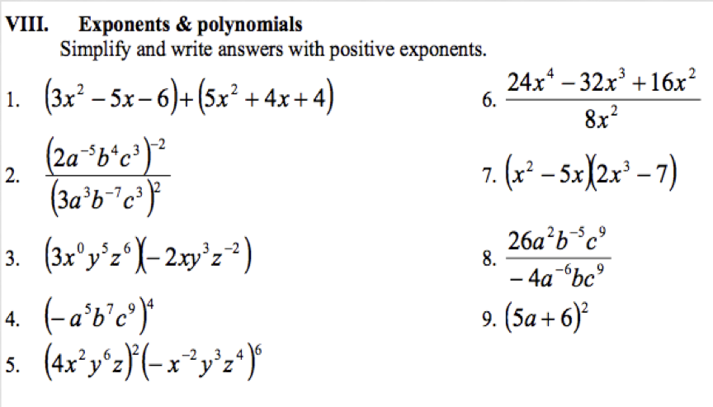
Are you college ready?

Slide 18
Placement tests do a poor job identifying who will – and will not – do well in college.
Accuplacer scores in English explain about 1% of the variation in course grades; in math less than 4% (Cal-Pass data).
Severe under-placement error is three times more prevalent than over-placement error (those placed into remediation who could have earned a B or better in a college course vs. those placed into college course who fail) (Scott-Clayton, 2012).
Fewer than 10% of the topics in Elementary and Intermediate Algebra are needed for the study of Statistics, yet tests of these skills block students’ access to college-level Statistics courses.

Slide 19
Reason #2:
Attrition Is Guaranteed in Traditional Remediation
Students placed 2 levels below college English/Math face 6 “exit points” where they fall away:
  Do they enroll in the first course?
  If they enroll, do they pass the first course?
  If they pass, do they enroll in the next course?
  If they enroll, do they pass the second course?
  If they pass, do they enroll in the college-level course?
  If they enroll, do they pass the college-level course?
  Students placed 3 levels down face 8 exit points.

Slide 20
Illustration: Chabot College
Students beginning two levels below College English:
  Do they enroll in the first course? ??%
  If they enroll, do they pass the first course? 66%
  If they pass, do they enroll in the next course? 93%
  If they enroll, do they pass the second course? 75%
  If they pass, do they enroll in the college-level course? 91%
  If they enroll, do they pass the college-level course? 78%
(0.66)(0.93)(0.75)(0.91)(0.78)= 33%
Fall 2006 Cohort. Students tracked from their first developmental English enrollment and followed for all subsequent English enrollments for 3 years. Pass rates includes students passing on first or repeated attempts within timeframe. Basic Skills Cohort Tracker, DataMart.

Slide 21
Thought experiment:
What if more students passed the first course?
  How many would complete the college level course?
  (0.66)(0.93)(0.75)(0.91)(0.78 ) = 33%
If 75% passed the first course…
37%
If 80% passed the first course…
40%
If 90% passed the first course…
45%
What if 90% passed and persisted at each point?
(0.90)(0.90)(0.90)(0.90)(0.90) = 59%
Notes:
75% = 37%
80% = 40%
90% = 45%
After reporting out from group, Myra tell story re: her own stupiphany.

Slide 22
BOTTOM LINE
Improving our results within existing multi-level course sequences will never be enough – we must eliminate or significantly reduce the exit points where we lose students.

Slide 23
Broadening Access to
College-Level Courses

Slide 24

Andrés Salazar, College of the Canyons
Math Placement via Accuplacer:
Arithmetic
4 levels Below a Gateway Course
Likelihood of completing gateway math in 3 years: 12%
Basic Skills Cohort Tracker
Fall 2013
353 students started in Arithmetic
⬇
Spring 2016
43 of them had completed
gateway math

Slide 25
Andrés Salazar, College of the Canyons
Goal: Bachelor’s Degree in Music Conducting
High School Math: A in Algebra II
High School GPA: 4.0
Enrolled directly in College Statistics through Multiple Measures Placement
Grade: A
Completed gateway math requirement in one semester instead of five

Slide 26
College of the Canyons
Multiple Measures Placement in Math, Fall 2016
Eligibility for College Statistics more than quadrupled, increasing from 15% to 71% of incoming students
Students qualify for Statistics through test OR self-reported high school measures (GPA, grades in Algebra I or II)
No changes to curriculum, no co-requisite support provided -- students were simply allowed to enroll in the existing course
Success rate in course remained steady
For students who started in Statistics but previously would have been placed into remediation, 66% succeeded in their first attempt
This completion rate was five times higher than among students who started in remediation a year earlier (66% in one semester vs. 13% in one year)

Slide 27
Las Positas College
Multiple Measures in English – Fall 2016
Eligibility for college English more than doubled - increasing from 35% to 78% of incoming students
Students qualify for college English by test OR high school GPA of 2.5 or higher (self report – no transcript required)
No changes to curriculum, no co-requisite support provided -- students were simply allowed to enroll in the existing course
Success rates in college English held steady
Among students who previously would have been placed into remediation (N=348), 77% passed college English and 58% earned As or Bs
Completion of college English was 1.75 times higher than among students who started in remediation one year earlier (77% in one semester vs. 44% in one year)

Slide 28

Luis Sanchez,
Las Positas College
Qualified for College English by GPA only
First-generation college student
Generation 1.5: US born and educated, parents do not speak English
Bilingual: feels most comfortable and most himself in English
Earned Bs on all four essays, turned in all other assignments
Perfect attendance
Grade: A-

Slide 29
Las Positas College
English 1A Success Rates By Assessment Test Entry Method
Fall 2016
N = 593
N = 220
N = 348
N = 25

Slide 30
N = 144
N = 155
N = 52

Slide 31

Alex Arguello, Solano College
Goal: Degree in Fire Technology
High School:
C and D student
Skipped school regularly because of personal difficulties Had to attend 5 months of Saturday school to graduate
Initial Course Placement (Accuplacer):
3-Levels-Below College English
Passed, found it too easy
Corequisite Remediation:
At teacher recommendation, skipped two remedial courses and enrolled in a section of College English with extra support (3 hours of additional instruction)
Grade in College English: B
Grade in Subsequent Composition Course: A

Slide 32
Solano College
Multiple Measures & Corequisite English
Eligibility for college English increased from 18% to over 70%
Students qualify by test OR high school GPA or English grades, whichever is higher (self report – no transcript required)
Students who don’t qualify for regular college English can enroll in sections that have 3 additional hours with instructor
Course success rates held steady
Among students enrolled in college English plus co-requisite support (n=205), 65% succeeded in college English
Completion of college English was twice that of students who started in English remediation a year earlier (65% in one semester vs. 31% in one year)

Slide 33
A Vision of the Possible
Tennessee has stopped offering traditional remedial courses at all public colleges and universities. Students assessed as “not college ready” enrolled in college English and math with additional concurrent support.

Slide 34
Statewide Co-Requisite Implementation
2015-2016: Tennessee Board of Regents (TBR)

Slide 35
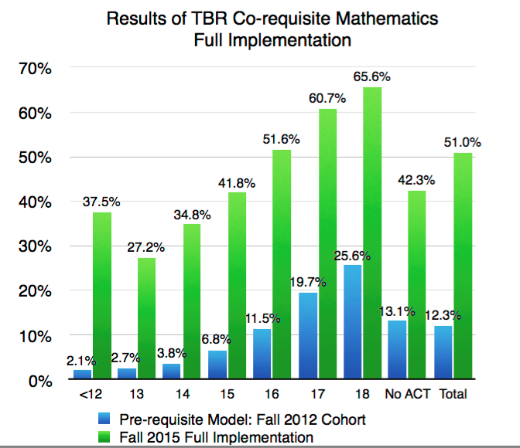
Co-Requisites for everyone?
What about low-scoring students?

Slide 36
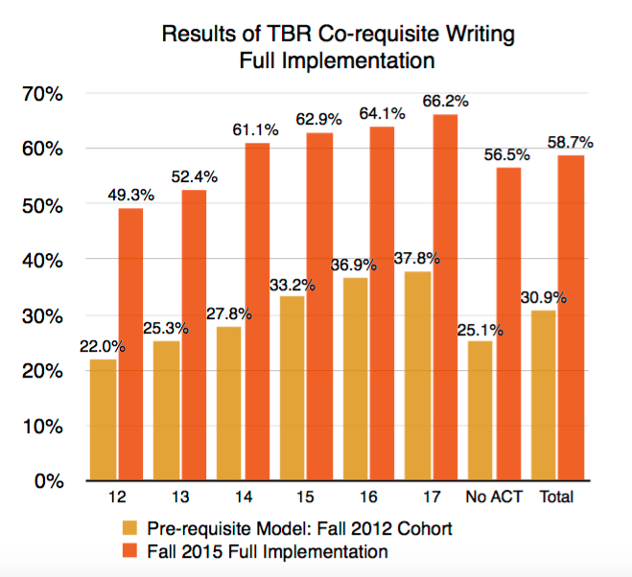
Co-Requisites for everyone?
What about low-scoring students?

Slide 37
Broadening Access to College Level
THE highest leverage strategy for improving completion
Power Moves for Placement
High School GPA – the strongest indicator of how students will perform in college is how they performed in all their classes during four years of prior schooling
“Best of” placement – students qualify for college-level courses based on high school measures OR test score, whichever is higher (“disjunctive” placement)
Self-reported information – high school GPA and coursework provided in response to questions during assessment process so that all students have access to multiple measures placement
Pathways approach in math: algebra testing and remediation only required for access to gateway courses requiring substantial algebra
Co-Requisite models instead of remedial classes for students who don’t meet criteria for regular college-level courses

Slide 38
Mobilizing Change:
Lessons from California

Slide 39
California Statewide Landscape
Across 113 community colleges, remediation policies are determined locally, most students remain stuck in traditional remedial sequences.
Vast under-placement across the state – capable students are being placed into remediation who don’t need it, making them less likely to complete college & producing racial achievement gaps
Existing student protections are not being followed
  Title 5 prohibits students from being required to take a pre-requisite unless they are “highly unlikely” to succeed without it (55003)
  State guidelines on disproportionate impact are supposed to safeguard against assessment policies in which minority students’ access to a college-level course is less than 80% of white students
Few CA colleges are offering co-requisite models of remediation, despite strong results nationally
Glacial pace of change in math
Notes:
Refer them to their placement spectrum handout

Slide 40
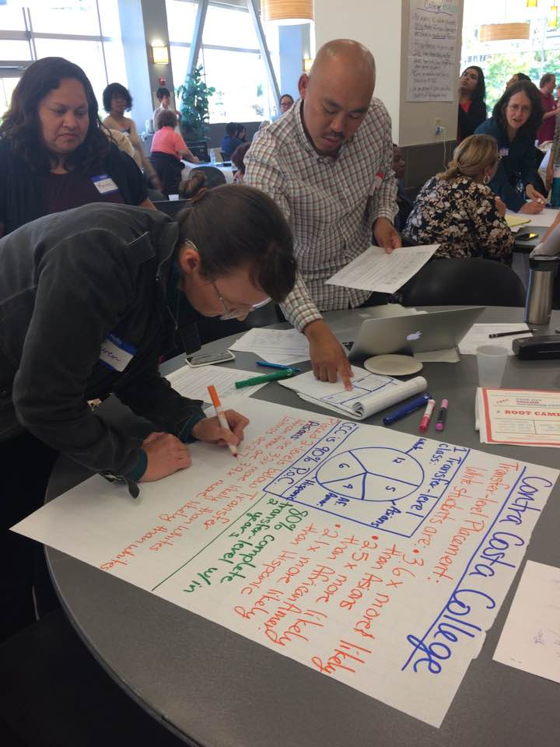
Using Data to Mobilize Faculty
Making the Invisible Visible, Creating Urgency
Examining data on student placement, disaggregated by race/ethnicity
Examining data on completion of college English/math for students who begin at different levels of the curriculum
Making plans to implement practices that reduce inequities

Slide 41
Inequitable Placement
Drives Inequitable Completion
Mt. San Jacinto College (Fall 2015)
White students were 2x more likely to be placed into transfer-level English than Hispanics and nearly 4x more likely than African Americans
  Chance of passing college English in 2 years: 73%
African American and Hispanic students were more than 2x more likely that white students to have to take multiple semesters of remediation in English
  Chance of passing college English in 2 years: 23%-38%
Notes:
LOOK AT YOUR PLACEMENT TABLE – HOW DOES WHITE STUDENTS’ ACCESS TO COLLEGE LEVEL COURSES COMPARE TO BLACK AND HISPANIC STUDENTS? HOW DOES PLACEMENT INTO LOWER LEVELS OF REMDIATION VARY BY ETHNICITY?

Slide 42
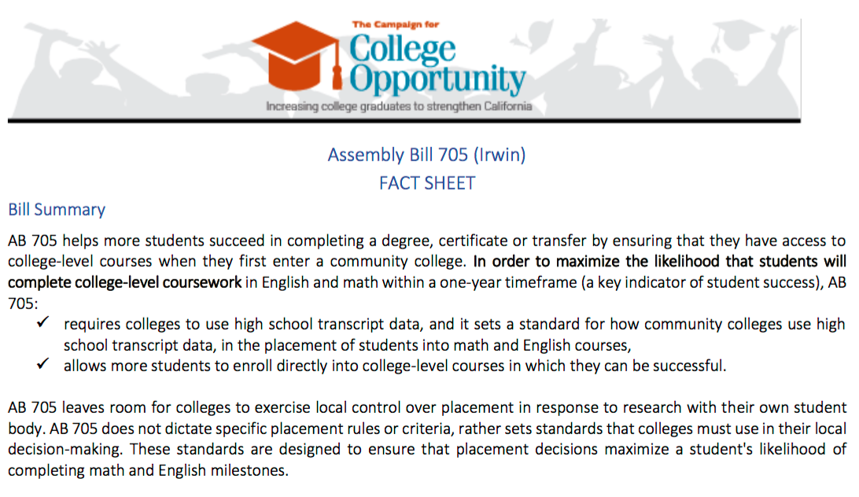
Legislation for Sound
System-Level Policy

Slide 43
We must “be willing to disrupt the current systems of higher education and take responsibility for those aspects of inequality that are under our control.”
Researchers from the Center for Urban Education
America’s Unmet Promise
AAC&U

