Slide 1
Making Grammar Great Again
Conference on Acceleration in developmental education
Denver June 16 2017
Alison Kuehner Ohlone College

Slide 2
Why care about grammar?

Slide 3
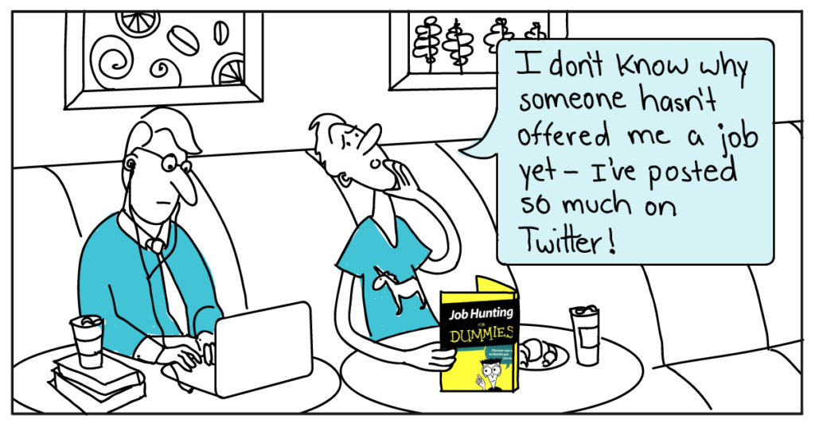
Grammar is important to get a job
PBS Interview:
“The way you use language reveals who you are, how you think, and how you work. And that will affect your career profoundly.”
Ask the Headhunter: The sign of ignorance all employers hold against you by Nick Corcodilos, July 8, 2014, PBS NewsHour interview
http://www.pbs.org/newshour/making-sense/ask-the-headhunter-whats-the-skill-all-employers-judge-you-on/
Notes:
Poor grammar can be perceived as a lack of intelligence, a lack of care or effort; poor grammar distracts from the message Especially true in college: Quote from instructor giving advice to students along with paper assignment, basically advising them to proofread because errors signal to an instructor that a student does not care about the quality of his or her writing

Slide 4
Grammar is important to get a date
News Headline: “'U R dumped!' Women say bad spelling and grammar are the biggest turn off when looking for love online”
Match.com study revealed 96% of women think grammar is essential
Another found male profiles with two mistakes were 14% less successful
However, women's spelling mistakes have no impact on their response
http://www.dailymail.co.uk/femail/article-3262219/Bad-spelling-grammar-biggest-turn-women-using-online-dating-sites.html#ixzz4hN0tX9OM
Notes:
Poor grammar can be perceived as a lack of intelligence, a lack of care or effort; poor grammar distracts from the message Especially true in college: Quote from instructor giving advice to students along with paper assignment, basically advising them to proofread because errors signal to an instructor that a student does not care about the quality of his or her writing

Slide 5
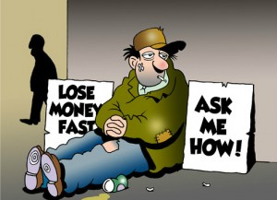
Grammar is important to save money
News Headline: “Lack of Oxford Comma Could Cost Maine Company Millions in Overtime Dispute”
“A class-action lawsuit about overtime pay for truck drivers hinged entirely on a debate that has bitterly divided friends, families and foes: The dreaded — or totally necessary — Oxford comma, perhaps the most polarizing of punctuation marks.”
https://www.nytimes.com/2017/03/16/us/oxford-comma-lawsuit.html?_r=0
Notes:
Poor grammar can be perceived as a lack of intelligence, a lack of care or effort; poor grammar distracts from the message Especially true in college: Quote from instructor giving advice to students along with paper assignment, basically advising them to proofread because errors signal to an instructor that a student does not care about the quality of his or her writing

Slide 6
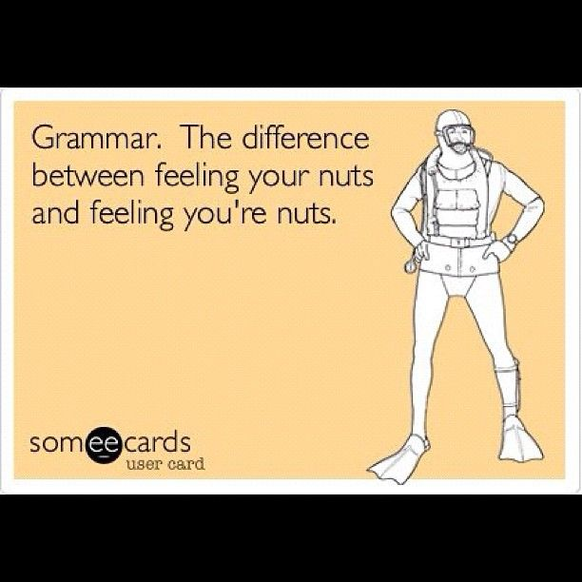
Grammar is important
Grammar helps writers to effectively communicate their ideas

Slide 7
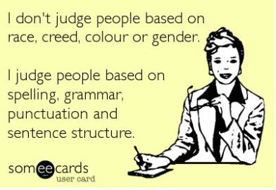
Grammar is important
Good grammar reduces stigma and judgment
Notes:
Poor grammar can be perceived as a lack of intelligence, a lack of care or effort; poor grammar distracts from the message Especially true in college: Quote from instructor giving advice to students along with paper assignment, basically advising them to proofread because errors signal to an instructor that a student does not care about the quality of his or her writing

Slide 8
What is grammar?
Grammar focuses on writing at the sentence level
Grammar is knowing how to use language effectively

Slide 9
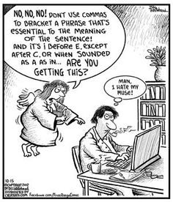
What is the role of grammar in writing instruction?
The goal of grammar instruction is to enable students to become better writers and better editors of their own writing. It is not the goal of grammar instruction to turn students into grammarians.
Grammar instruction should not be all about error correction. Rather it should be about editing and producing skillful writing.

Slide 10
What do we expect from college writers?
Student writers should . . .
Follow the conventions of English (e.g.: lack of errors)
Follow the conventions of academic writing (e.g.: acknowledge sources)
Demonstrate syntactic fluency and sophistication (e.g.: sentence variety)
Employ well-chosen words (e.g.: precise, specific, and accurate)
Use appropriate tone and voice (e.g.: third person)

Slide 11
Do you teach grammar? If so, how?
Possible approaches:
1) Skills-based
2) Sentence Combining
3) Modeling Approach

Slide 12
Modeling approach to teaching grammar

Slide 13
Modeling approach: What it is
Positive modeling demonstrates to students what they should or could do in their writing
Examining examples from professional readings helps students understand effective sentence patterns and punctuation usage that skillful writers employ
Providing useful examples--sentences students can use in their own writing--encourages students to expand their writing repertoire
Practicing allows students to experiment with syntax or punctuation

Slide 14
Modeling approach: Why teach it
“Grammar” is about making meaning: the goal of writing is to communicate ideas to readers, so students need to examine effective grammar and usage in the context of writing
Understanding the strategic use of syntax and punctuation can help writers emphasize or de-emphasize ideas, conform to the expectations of academic writing, and effectively communicate their ideas to their intended audience
Understanding how, why, and when writers use certain sentence patterns or punctuation can help students become better readers

Slide 15
Modeling sentences: How it works
Identify a sentence type you want students to use
Find examples of that sentence type in the class readings
Analyze why the writer uses that sentence type
Analyze how the sentence functions
Have students imitate that sentence type
Practice, play, praise, repeat

Slide 16
Modeling sentences: Examples from readings of appositives
More than 40 years ago, Walter Mischel, PhD, a psychologist now at Columbia University, explored self-control in children with a simple but effective test. - - Opening sentence from “Delaying Gratification” (APA)
Recently, B.J. Casey, PhD, of Weill Cornell Medical College, along with Mischel, Yuichi Shoda, PhD, of the University of Washington, and other colleagues tracked down 59 subjects, now in their 40’s, who had participated in the marshmallow experiments as children. Sentence about halfway in “Delaying Gratification” (APA)

Slide 17
Modeling sentences: Analyzing sentences from readings
Questions for students:
Why did the author include the underlined information about these people in these sentences?
How did the writer include the information?
When did the writer include this information in the reading?
How often did the writer include information like this?
Why might you, as a writer, include similar information when you write your essay about the Marshmallow test readings? How would you do that?
Practice: Write 2 sentences using appositives. Write about the researchers who conducted or questioned the Marshmallow test.

Slide 18
Student sentences using appositives
Sonja Lyubomirsky, psychology professor at the University of California Riverside, found “very close evidence that in just about every country around the world, rich people are happier than poor people.” (C.M.)
According to the article, “How the Brain Gets Addicted to Gambling,” Mark Lefkowitz, one of the members of the California Council on Problem Gambling, persuades casinos to give gamblers a choice to ban themselves on their behalf. (S.J.S.)
Wes Moore, the Rhodes Scholar and decorated veteran, became more successful than the other Wes Moore, who is serving a life sentence, due to the influences of his family, education, and environment he was surrounded by. (M.F.)

Slide 19
Research on modeling: What experts say
“Modeling integrates reading, writing, and grammar” - National Council of Teachers of English
“Modeling is a first and natural step in growth as a writer” -Joseph Williams, Ten Lessons in Clarity and Grace

Slide 20
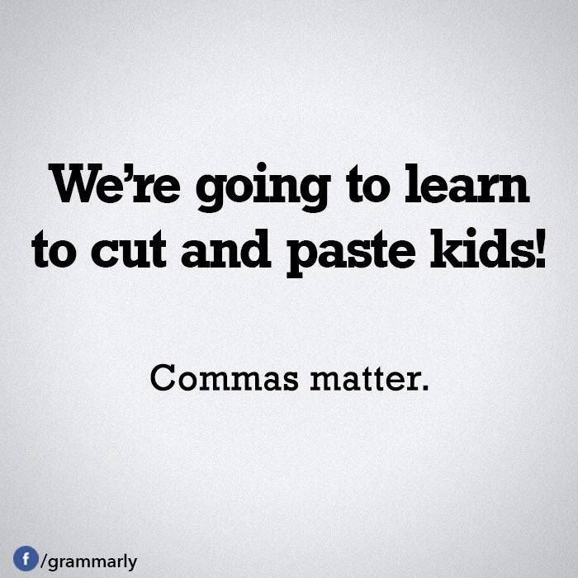
Modeling punctuation

Slide 21
Punctuation makes meaning

Slide 22
Punctuation makes meaning
A professor gives his students a sentence and instructs them to punctuate it correctly: Woman without her man is nothing
The men in the class write: Woman, without her man, is nothing.
The women in the class write: Woman! Without her, man is nothing.

Slide 23
Punctuation makes meaning
Project Semicolon
. . ."a semicolon is used when an author could've chosen to end their sentence, but chose not to. The author is you and the sentence is your life".
http://www.huffingtonpost.com/2015/07/07/project-semicolon-tattoos_n_7745358.html

Slide 24
Modeling punctuation: How it works
Identify punctuation students are using incorrectly in their writing or not using at all
Find examples of that punctuation in the class readings
Analyze why the writer uses that punctuation
Examine how the sentence functions—as a sentence and in the larger context of the reading
Have students imitate and practice writing sentences using that punctuation
Practice, play, praise, repeat

Slide 25
Modeling punctuation: Examples from readings using colons
Colons: A few rules and examples
Use a colon, following a complete sentence, to introduce an idea that explains, defines, or gives examples of what was just stated.
Example: “The bitter riots were sparked by King’s assassination, but the fuels that kept them burning were the preexisting conditions: illegal but strictly enforced racial segregation, economic contraction, and an unresponsive political system” (Moore 18-19).

Slide 26
Modeling punctuation: Activity
Write two sentences using colons following the guidelines below: • Write a sentence using a colon to introduce an idea that explains, defines, or gives examples of what was just stated. Example: The other Wes Moore lives by his brother’s motto: “send a message” if someone disrespects you (33).

Slide 27
Modeling approach: Teaching tips
Look to reading for lessons
Consider students’ own writing
Prioritize most serious and/or high frequency errors
Introduce new syntax, word choice, or punctuation in class
Provide models—from readings and student writing
Give students time to practice in class
Allow writing practice in and out of class
Review = collect & share good examples from posts

Slide 28
Modeling approach: Progression
1. simple sentences 2. simple sentences with intro. elements 3. appositives Variable ➔ depends on students’ writing ➔ depends on readings 4. coordination 5. subordination 6. quote integration 7. parallelism 8. semicolons and colons 9. dashes and parentheses

Slide 29
Modeling approach: Advantages
Flexible approach
Integration of reading and writing in an authentic way
Minimal grammar instruction
Efficient lessons
Opportunity to reread the text
Focus on editing writing
Positive approach

Slide 30
Modeling approach: Disadvantages
Not systematic
More time intensive for instructor
May not provide enough examples and practice
Examples from readings may be complicated or messy

Slide 31
Developing a modeling activity
Read the article “The Wrong Way to Teach Grammar” with an eye to producing a grammar or punctuation modeling lesson
What sentence types or patterns might you pull from this reading to inspire students?
What punctuation moves might you use from this reading with students?

Slide 32
Questions? Comments? Thoughts?
Alison Kuehner
Ohlone College
akuehner@ohlone.edu

