Slide 1
IRVINE VALLEY COLLEGE: ESL Pathways to Student Success Jeff Wilson Rebecca Beck
Notes:
Jeff

Slide 2
Acceleration
As we know, the framework of acceleration is to improve student success for those referred to developmental education by departing “from the traditional multi-course sequence in favor of a more streamlined structure…by reducing the time required to complete academic requirements” (Edgecombe, 2011).
Notes:
Jeff:
We all know this. This is why we are here!
One one hand, we have the acceleration framework which is to figure out how to efficiently streamline students to transfer level writing. The way to do this is varied, but one major theme is to reduce the number of levels to reduce the number of exit points. The data is clear. If we can redesign developmental English, Math and ESL classes, both at a course and sequence level to increase student learning, reduce time and $ costs at the same time, let’s do it.

Slide 3
Language Acquisition
A natural process that takes 7-10 years to achieve fluency (Thomas & Collier, 1995)
Acquisition is a skill not a subject
BICS (Basic Interpersonal Communication Skill)
CALP (Cognitive Academic Language Proficiency) (Cummins)
Notes:
Jeff:
However, on the other hand, we have language acquisition, which, at first glance, might be the polar opposite of the acceleration. Why is this?
BICS = informal, “playground” English used for living and surviving in a country. BICS can be achieved (and often is) by a learner himself or herself.
CALP = former, school, academic English used for college, politics, high end jobs, and the like. Two different levels of acquisition. Most 2nd language learners that achieve a level of proficiency achieve it in BISCs only. Few achieve proficiency in CALP, but that, as language instructors, is our goal. Unlike BICS, CALP is usually acquired with a combination of independent acquisition and classroom instructor.
So what do ESL courses do? They help accelerate language acquisition.

Slide 4
Acceleration in ESL
How do we work with these incongruent frameworks together to improve the success of ESL students?
Notes:
Jeff
How do we bring together two incongruent realities? How do we merge the realities of the long amount of time needed to acquire language and the push for shorter sequences in developmental education? For us at IVC, the answer is choosing the appropriate models of acceleration and applying them to our program.
Given the context of language acquisition, some models of acceleration are more appropriate than others.
Rebecca is next

Slide 5
ESL Pathways to Student Success: Two Approaches
1) Adaptable ESL Curriculum
Our ESL sequence enables students the opportunity to skip levels based on individual performance.
Notes:
Rebecca,
From the acceleration models defined in the CCR brief, we have adapted avoidance and curriculum redesign.

Slide 6
2) Academic English Curriculum and Sequence Redesign
New curriculum engages language learners in more complex reading, writing, and thinking tasks while addressing the linguistic dimension of CALP acquisition
ESL courses provide a clear and equitable pathway to Writing 1

Slide 7
Approach #1 Adaptable Curriculum Progression Lock-step (traditional model) vs. Adaptable (accelerated model)
Notes:
Rebecca
1. Our acceleration model includes two pathways
2. We offer the lock step progression is for those students who only use English in the classroom and Korean for the rest of the day, or deliberately want the additional instruction.
3. The flexible/adaptable progression on the other hand is for those who do well in our classes and are immersed in an English environment as mentioned before. This is for our Ronaldos of English

Slide 8
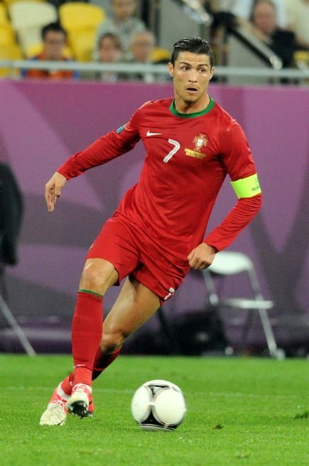
Language is a skill, not a subject
Language development outside of class
Notes:
Rebecca
First, language is a skill, not a subject. As an acquired skill, students absorb it over time, unlike a subject like history or psychology where you are learning information from a traditional lecture approach. You cannot memorize it nor cram for it the night before.
Like Ronaldo in the picture here. He became good at the skill of soccer by not only practicing with his coach and team, but also by investing countless hours on his own. Similarly, students can practice English with a coach, like taking a class at IVC with us, but they can also practice on their own. How do they practice? They need exposure. How do they get exposure?

Slide 9
Student Advancing Slower (Lock-Step)
1 level below
Writing 1
3 levels below
5 levels below
7 levels below
2 levels below
4 levels below
6 levels below
*Accordion analogy is adapted from Laney College
Notes:
Rebecca
Here is a visual of what our flexible and adaptable program can be – the accordion. We chose this because we all know what an accordion does – it expands and compresses depending on the notes being played. We have a seven level program that begins with low beginners needing survival English to advanced learners one level below Writing 1. I know some of you might question the need for 7 levels? But remember, we are an open access institution – any student regardless of English proficiency can enroll in community college.
This 1st slide shows our traditional sequence offered. A student may place anywhere in our sequence….But for this example, lets say a student places 7 levels below transfer writing, speaks English only in that ESL class, and then goes home and watches tv in Mandarin, shops in Mandarin, and skypes in Mandarin, he or she will probably need to take each one of our levels in the traditional fashion.
They are not getting exposed to the language nor are they essentially dribbling the English soccer ball around like Ronaldo. They live in their own language pocket. They will need as many levels as possible to move up the sequence.
The next slide…

Slide 10
Student Advancing Fast (Accelerated)
3 levels below
1 level below
Writing 1
5 levels below
7 levels below
2 levels below
4 levels below
6 levels below
Notes:
Rebecca
…shows the student on the opposite end of the spectrum. These are the students who are not only very diligent in our classes but also are fully engaged with the English speaking world.
They use English all the time in and outside of class. They may have picked up a job, a romantic fling, or are on the tennis team here at IVC. They are probably taking a lot of other college classes here at IVC as well. In some cases, we also, they may have assessed poorly and were initially placed at too low of a level. This possibility of acceleration allows students to “jump” levels if can demonstrate language level proficiency at the next level.
So, if you wondering how this “skipping” is done? We have a process in place – all students write in-class and this is assessed by two faculty other than the classroom instructor about 4 weeks prior to the semester ending. The ESL faculty then deem the student ready or not for the next level. This has been institutionalized

Slide 11
Student Adjusting to Progress (Flexible)
3 levels below
1 level below
Writing 1
5 levels below
7 levels below
2 levels below
4 levels below
6 levels below
Notes:
Rebecca
Lastly, this third image is probably the most realistic situation where students might initially follow the lock-step traditional, pathway, then accelerate for a class or two, and then turn back to the traditional model in the Academic Path when Academic English instruction begins.
In sum, students can always take the slower, more diligent sequence or they can move faster through this course sequence, hence acceleration happens if they show proficiency at that level.
What is our theory behind this flexible and adaptable program? What does this do for our students?
In essence, our modified curriculum empowers students to have the flexibility to design his progression through language learning and more importantly, it does not automatically keep them buried under layers of basic skills instruction.
And now J will explain our other approach

Slide 12
Approach # 2
Academic Writing Sequence Redesign:
New ESL pathway to WR 1
Instructional Curriculum Design Change
Notes:
Jeff
Removing some levels in the sequence to WR 1
Changing the way we teach ESL writing and providing students more resources

Slide 13
Old sequence for ESL students
WR 1
(transfer-level Writing)
WR 201
(1 level below WR 1 for native speakers of English)
ESL Level 6
WR 301
(2 levels below WR 1 for native speakers of English)
ESL Level 5
ESL Level 4
and below
Notes:
Jeff
1) In the past, students enrolled in our ESL courses, completed our sequence, and then had to start all over with the developmental English writing sequence for native speakers although they had already learned how to organize and write paragraphs and essays. Our students essentially had to go backwards to go forward.
2) This slowed down ESL students and stigmatized them in many ways. Furthermore, as research has shown and many of you know, students who are forced to progress through multiple layers of basic skills instruction have more chances of dropping out
3) So, how could we help our students navigate this more quickly, YET effectively? We designed an Academic English curriculum.

Slide 14
New sequence for ESL students
WR 1
(transfer-level Writing)
ESL 201
(1 level below WR 1 for native speakers of English)
ESL writers now have a direct path to
transfer-level writing
Developmental writing and reading is taught concurrently with language focused instruction
ESL 301
(2 levels below WR 1 for native speakers of English)
ESL 370 and below
Notes:
Jeff
Now, students can go directly to WR 1 without having to back-track to developmental writing in the English department. In our ESL classes, we teach both basic skills writing and reading & language skills.
Using backward design and working with our English colleagues, we looked at the demands of transfer level writing and worked backwards.

Slide 15
New Parallel Basic Skills
Sequence For All students
WR 1
(transfer-level Writing)
WR 399
WR 201
ESL 201
WR 301
ESL 301
RD 370
RD 370
ESL 370
ESL 361 and below
Notes:
Jeff
Our Academic English sequence gives a language learner a CLEAR AND EQUITABLE pathway to WR 1.
We collaborated with our colleagues in the English department to ensure the writing curriculum remained intact and we designed the language instruction to support an ESL student’s development as an academic writer
The difference is the English department composition courses are 3 units plus a writing conference course and our classes are 5.5 units. This means that ESL students receive the same 3 units of writing instruction in the English classes with an addition of 2.5 units of language support. The extra .5 is earned in the language lab. Our courses require students to enroll in the language lab to continue the language instruction and support.
So, this was one of our approaches. The next approach deals with how we revamped our instructional practices.

Slide 16
Redesign Framework
Our advanced writing courses are designed to prepare language minority students for transfer-level writing
Students work with “complex reading, writing, and thinking tasks” that expose language learners to a demanding and relevant academic curriculum
Backwards design approach
“Just in time instruction” VS “Just in time remediation”
Notes:
Rebecca
As Jeff said, our courses enable our students to move all the way to WR 1, and with these premise, we had to closely examine the pedagogical practices guiding our instruction.
We are not just responsible for language AND Writing instruction, but we also have to teach critical thinking skills,
This new mode of instruction is more demanding and complex. At this level ESL students need to learn the use of English for rhetorical and aesthetic purposes. They need to learn the habits of mind needed to engage with the academic community, habits such as evaluating meaning from text, and the arguments presented in these texts; they need to critique the logic from these arguments, in essence a whole set of new skills. And the mastery of academic language is arguably the most important determinant of academic success, and not only for a learner of English, but for all our students.
The pedagogy behind Academic English instruction is that a language learner is a lifetime learner. As the cognitive demands of college increase, so do the linguistic demands, so these new Academic English courses allow writing, reading, and language instruction to work in sync, real-time as the students acquire new knowledge.

Slide 17
Instructional Redesign: Six Components
Integrating reading with writing
Language (not just grammar)
Culture and Academic literacy
Practicum model
Supplemental Instruction
Faculty support
Notes:
Rebecca
Here is a snapshot of how 6 components that are central to our revised teaching practices

Slide 18
1. Integrating Reading with Writing
Intensive reading
Read Like a Writer (RLW) techniques on specific sections of a text such as Outliers: The Story of Success by Gladwell.
Guided annotation techniques such as personal connections and evidence/support using WR 1-level articles, blogs and journals
Extensive reading
Model sustained silent reading
Poster Presentations
Reading circles
Student choice of novel for independent reading
Notes:
Rebecca,
Here are some techniques that focus on reading instruction

Slide 19
Integrating Reading with Writing for the ESL writer
Recognizing the difference between formal vs. informal register
Prescriptive vocabulary instruction
Academic vocabulary development (AWL)
Creating connections between ideas (cohesion): reference words, logical connectors, classifier words
COCA (Corpus of Contemporary American English)
Notes:
Rebecca

Slide 20
2. Language
Editing Logs for Focused Error Analysis to become effective self-editors
Symbol | Language Error to Focus on | Example from my essay | Corrected version
VT | Verb tense | I try to be healthy for a long time. | I have been trying to be healthy for a long time.
G/I | Gerund/Infinitive | I want walk everyday to say active. | I want to walk everyday to stay active.
WF | Word form | I never feel boring when I exercise. | I never feel bored when I exercise.
Over time, students will understand their top 3 common errors and have guided, individual practice on these errors (via supplemental instruction).
Notes:
Jeff,
To grammar or not to grammar, that is the question
For our classes, we try to enable student to become self editors. To do this, we have them conduct research on their own writing, including short writes and essays. We provide language “hints”, or symbols, that give students direction on how to fix their own mistakes and they record their mistakes. After we have about 5 of these editing logs, students analyze what their top errors have been. We then, starting in fall, will refer them to specific grammar software in our language lab component that will help them aquire the grammar rule for each one of their top errors. Students have to notice and be aware of their own errors first before they can aquire profiecincy in the form.
The goal here is to foster confidence to be their own editors in the future. This personalized error correction will allow the students to develop transferable linguistic knowledge, skills, strategies, and processes that can be used in a wide range of courses and assignments during their studies.
Semantic and Syntactical

Slide 21
2. Language
Controlled and guided composition to practice discrete semantic and syntactic structures used in academic writing
To report what someone wrote:
Reporting Verb + That + Noun Clause
Gladwell asserts that success is a combination of hard work, talent, and opportunity.
As + Subject + Reporting Verb + , + Independent Clause
As Gladwell asserts, success is a combination of hard work, talent, and opportunity.
Notes:
Language acquisition is tricky. Many parts of academic language are more idiomatic or vocbaulary based. For example, check this example.
Review example
Chunks of academic language and collocations require different linguistic choices. If we practive a few frequent academic chunks of language, such as those used in summaries or paraphrases, students will be able to acquire these language moves and apply them in trasnfer level classes such as history, political science, and others.
At this level of instruction, form and content cannot be separated because form (grammar) guides context. Depending on what word you are going to use, sometimes there is a strict grammar sturcture you might use. A simpler example is gerund and infitive use. For example, after “enjoy” we always have to use a geurnd “swimming” and never an infinitive. This is true at the upper levels with academic chunks of language where the writer is trying to not learn English but refining it. Once the learner aquires this academic chunk, she can re-use it it un future classes multiple times. We try to teach high frequency academic clusters to meet this need.

Slide 22
2. Language
Text analysis to demonstrate cohesion in writing and linguistic choices a writer makes in academic writing to help with organization and “flow” of a text
Some think of flow in a linear way, but reader experience of flow in a piece of writing is more like a web of connections. (J. Harlig)
Notes:
Rebecca

Slide 23
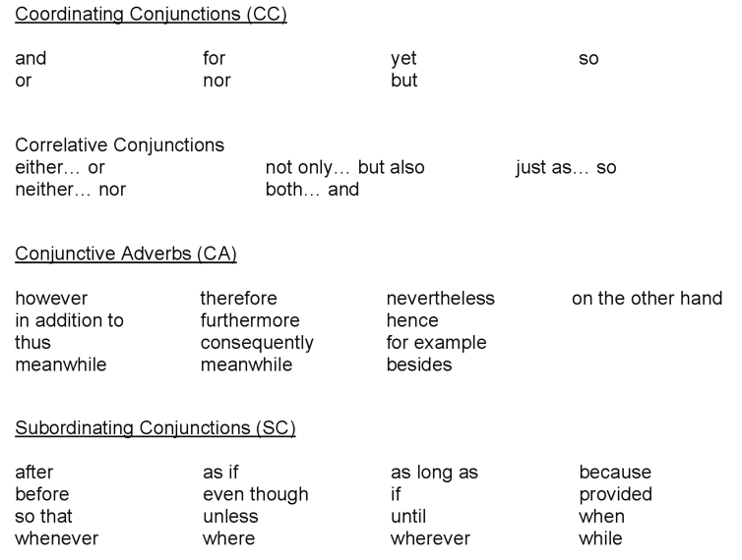
Logical connectors in writing textbooks

Slide 24
Language Based Study of Connectors
Identifying thematic string sequences
Focused: In a sequence of sentences, all of the new information at the end of a sentence is related back to the same old information at the beginning of the sentence. Pattern: A-B A-C A-D A-E and so on or A-B B-C B-D B-E and so on
Chaining: This sequencing links the end of one sentence to the beginning of the next sentence. Pattern: A-B B-C C-D and so on
Note: Few paragraphs use chaining exclusively and most paragraphs are a combination of focused and chaining strings.

Slide 25
Focused thematic string
“Old Information”
(1) Two competing myths about Freud
(2) The first myth, that of official psychoanalysis,
(3) The second, opposing myth,
“New Information”
have gradually developed.
depicts Freud as a lonely genius, isolated
and ostracized by his colleagues.
places Freud as getting all his ideas from
someone else and taking credit for what
were in fact no more than minor
modifications in previously developed
theories.
Adapted from: Little Red Schoolhouse materials by Joseph Williams, handout from Karen Lunsford, UCSB

Slide 26
Chaining thematic string
Over the last three years, municipal bonds have been used to buoy sinking housing markets. For this purpose, municipalities have issued not general obligation bonds, but rather revenue bonds. These bonds are backed by below-market interest rate mortgages. Mortgages carrying below-market rates are capable of generating sufficient income to compensate purchases because the bonds have tax-exempt status. That status makes possible relatively low rates.
From: Little Red Schoolhouse, Joseph Williams
Notes:
Rebecca
How do we work on this?
We Give students short paragraphs from assigned texts or articles in their fields. Ask them to identify the pattern: focused, chaining or combination.

Slide 27
3. Cultural and Academic Literacy
Balance is key
Successful text choices focus on the human experience instead of relying on a “niche” American cultural experiences (e.g. football)
Successful text choices also can focus on teaching common aspects of American cultural knowledge (e.g. American history, current events)
Academic expectations

Slide 28
4. Practicum Model
Computer Lab
In a two-day a week instructional model , one day in the traditional class and the other day in the computer lab
Flipped classroom approach to writing instruction
In-class, instructor led writing workshops using real student writing
Use of online English learner resources such as COCA and learners dictionaries in real time
Online writing platform
Less lecture, more writing
Notes:
Jeff

Slide 29
5. Supplemental Instruction
Our top two academic writing courses have a 0.5 unit co-requisite writing/language lab component
Individualized language and writing conferences with ESL writing instructors from our department, not peer tutors
Individualized software instruction for grammar and reading (with writing modules to come)
Notes:
Jeff

Slide 30
6. Faculty Development
Common curriculum
FT faculty course coordinators for our top 3 academic writing classes
Monthly instructor meetings (paid through BSI)
Shared files and instructional practices
Professional Development
Notes:
Jeff

Slide 31
Final Thoughts
We find that acceleration in ESL is possible, especially with curriculum redesign and the flexibility of skipping levels
Other models such as compression might not work as not all students have acquired CALP
Notes:
Rebecca

Slide 32
Questions?
Thank you.
Notes:
Rebecca

