Slide 1
Welcome
As you arrive, please find the posters on the wall...
Write your name and institution on the poster with the title that best describes the role you play at your institution.
Notes:
Prompt
Two minute paper, to be answered on index cards: Answer question on sheet provided
should we give instructions: write your name/institution/position on the cards
should the last word be classroom rather than model?

Slide 2
Presenters
Chelsea Cohen, Lisa Cook, Anna Cortesio, Amy Loewen and Suzan Tiemroth-Zavala
ESOL Instructors
Laney College (Oakland, CA)
Notes:
Another way of engaging the students is by introducing the author and giving background about the author. Introduce the presenters, we are ESOL instructors at Laney College in Oakland, CA. Do you have any additional thoughts about the presentation based on the presenters.

Slide 3
Teach With A Reach:
Teaching to Accelerate Students through
the ESOL Course Sequence
Notes:
Presentation in Balboa 1, Thursday, June 25, 3:15-4:45
ESOL -
Chelsea’s pre-writing activity:
What you just did by answering my question is something we do with our students to build context and generate interest before reading.
Today, we are going to share some of our our teaching practices with you, but first, Lisa Cook is going to expand and further describe our program and curriculum.
Hi… I’m Chelsea In order to accelerate student learning we have to build a compelling context.
Based on the title of our presentation and the synopsis you read in the program (page 17) what do you expect the presentation to cover this afternoon?
Today we’re going to ask you to do some of the things that we do with our students in class so you can experience it for yourselves.
Lisa is going to continue to build context for you, by describing our program and curriculum.

Slide 4
Our Accelerated Curriculum
Notes:
Now, for more context, Lisa Cook will explain

Slide 5
Student Success Scorecard
California Community Colleges Board of Governors performance measurement system that tracks student success at all 112 community colleges.
Data available in this scorecard tell how well colleges are doing in remedial instruction, job training programs, retention of students and graduation and completion rates.

Slide 6
2010–2014 Progress Rate
Percentage of credit students tracked for six years who first enrolled in a course below transfer level in ESL and completed a college-level course in the same discipline.

Slide 7
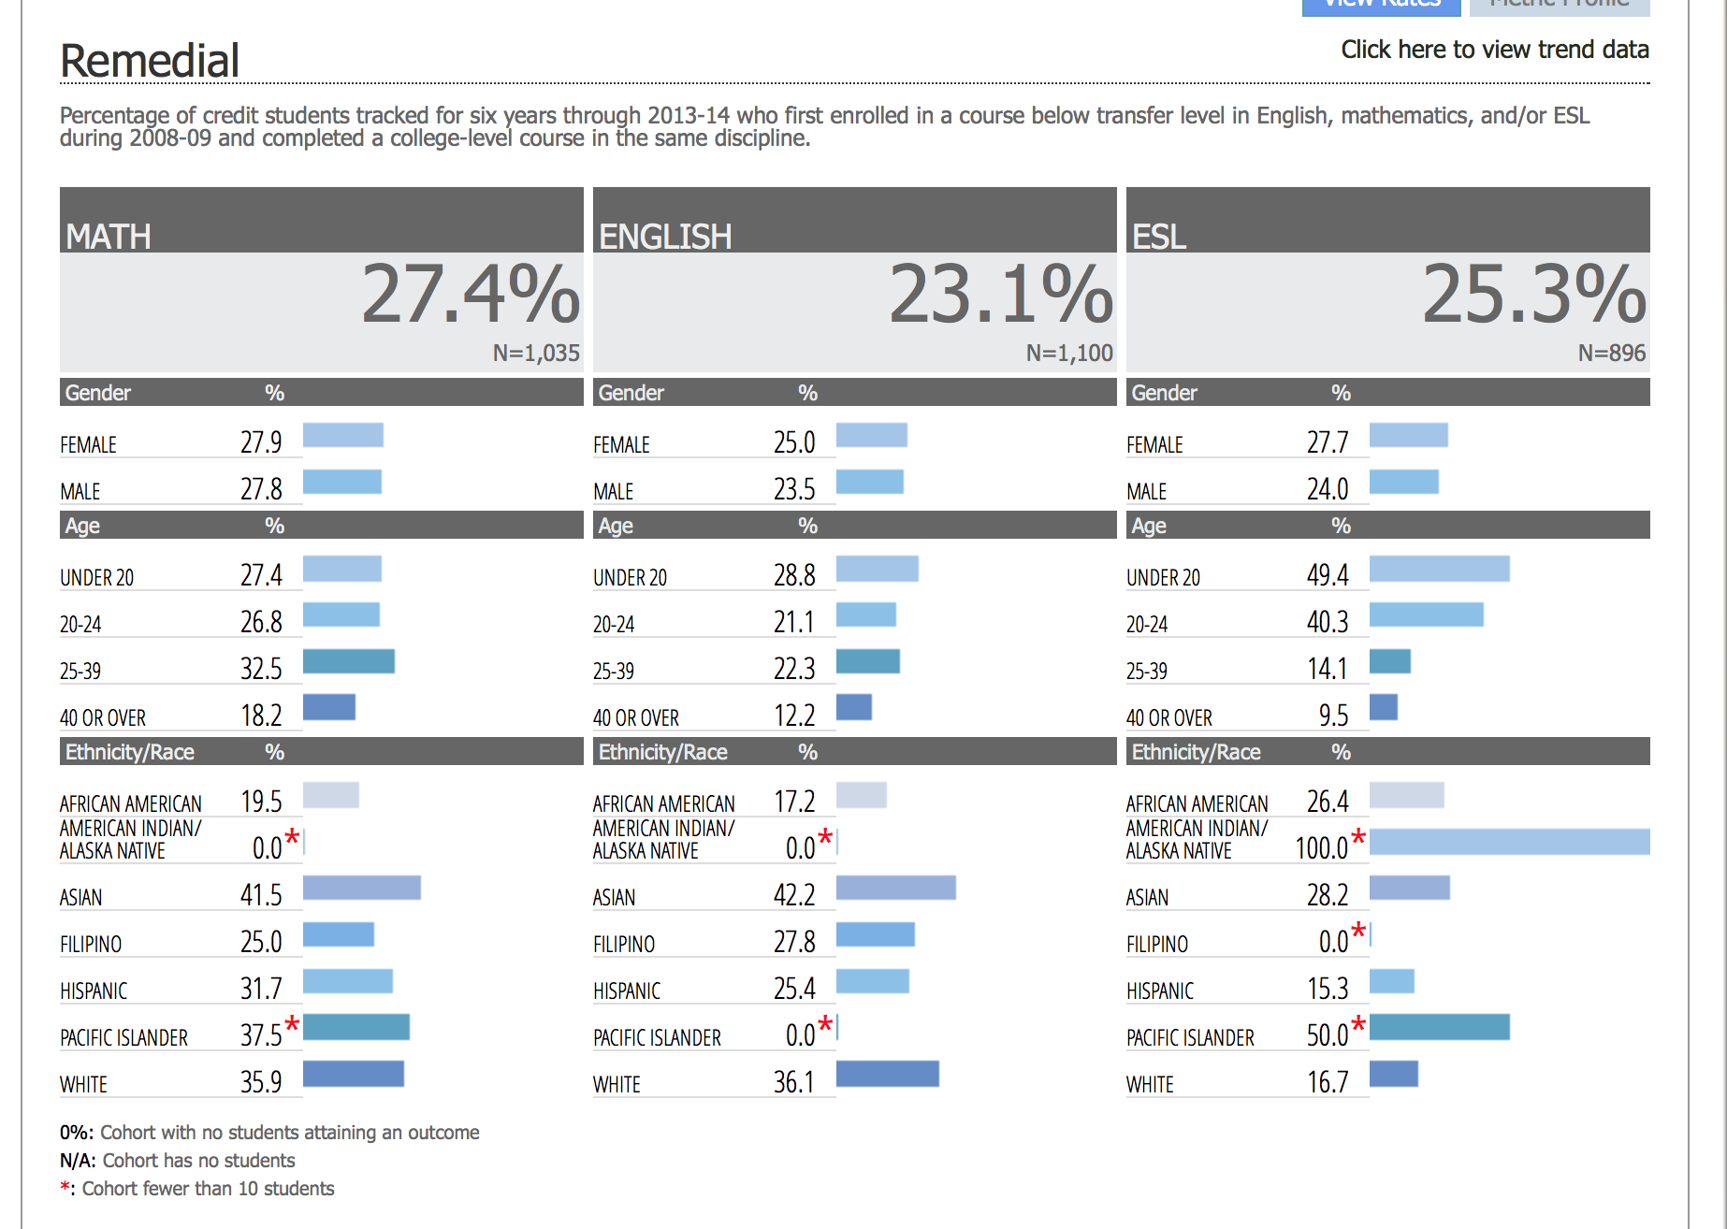

Slide 8
ESL Progress Rate Increases 6%
2014 Scorecard
19%
2015 Scorecard
25.3%

Slide 9
Peralta ESOL Alternative Structural Model
Fall 2012 implement alternative structural model for ESOL program:
Eliminate levels in course sequence from 6 to 4
Incorporate mechanism for flexible progression through course sequence
Notes:
Lisa: ten points

Slide 10
Acceleration
All students have the opportunity to complete the course sequence from high-beginning to advanced* in 4 semesters
*pre-requisite for college English

Slide 11
Curriculum Redesign
Integrate reading and writing
Engage students in more complex reading, writing and thinking tasks sooner
Prioritize the most essential skills needed for college and the workplace at all levels:
Critical Thinking
Information Literacy: Computer Skills/Research
Intercultural Communication/U.S. Culture
Comprehension (Reading & Listening) and Production (Writing & Speaking)
Sentence-Level Accuracy

Slide 12
Teach with a Reach
Design contextualized learning experiences to introduce and build upon meaningful practices rather than teach stacked discrete skills

Slide 13
Teach with a Reach
Create compelling contexts in which students and teachers interact with rich texts (rather than textbooks)
Engage students in learning practices that require them to synthesize, analyze and criticize early on in the ESOL course sequence

Slide 14
New Model for Professional Learning
Support teachers to make that reach. It’s a vulnerable place to be.

Slide 15
Laney ESOL Acceleration College
(Community of Practice)
Instructors engage one another in design and implementation of high-impact teaching and assessment practices aimed at accelerating students’ learning and progression through the course sequence

Slide 16
Inside the Accelerated
Intermediate-level ESOL Classroom
When we ask more of ourselves and more of our students at all levels, we surpass our expectations of teacher and student

Slide 17
Building a Compelling Context
Notes:
As I demonstrated in the beginning, before we even begin we start by building context. Here is the book we read with our intermediate students in reading/writing class.
At the intermediate level, we teach “Walk two Moons”
As we demonstrated in the beginning - before we even get started with the reading, we attempt to build a compelling context
We first mimic the natural book selection process - examine different aspects of the physical book before even reading it.
While it’s not new to build context, People build context but the challenge is to build a compelling context for students
Strategy
What’s the reach: getting students involved
Examples,
Exceeding Expectations
Intermediate level - we teach the novel “Walk Two Moons”
When we go to choose a book we mimic the natural book selection process
It’s the “why.”
Second slide: parts of the book to look at
what did you show - what did they do?
this is the first step in the classroom: where students go with it
the more you push you students, you realize they do more than you thought they could?
Build a compelling context and generate interest - introducing the book.
Looking at all aspects of the book without even reading it. Making predictions about themes and about the story line before even reading the book.
Look at the front cover, at the pictures at the title. What do you predict this book is going to be about?

Slide 18
What’s the Reach?
Building a context that is compelling and engaging for both students and the teacher
Setting students up to be actively involved with the reading
Helping students begin to build personal connections to the story
Notes:
While there’s nothing new about helping students activate prior knowledge before reading,
it’s not enough to provide a context, you have to make it compelling and engaging both for teacher and students
We do this in order to set students up for active involvement and help them build personal connections to the story to sustain their interest

Slide 19
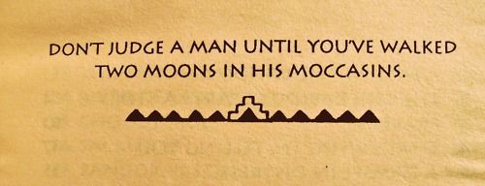
the author
the pictures
Newberry Medal
book reviews
the title meaning
the synopsis
table of contents
Notes:
Some ways in which we build a COMPELLING context is by mimicking the natural book selection process -
have students look at the author, pictures, synopsis.. decipher the title, read book reviews, predict outcomes of the story… We’ll ask them “what makes a good book” and based on their input, we’ll decide if the book meets the criteria as we read -
these strategies get the students involved as critics and helps form connections before they even read the first page
Strategies: We look at the cover, table of contents, the title, the back cover synopsis - students make predictions based on what they observe and we constantly refer back to these initial predictions, check them, modify them - This maintains a high level of engagement by allowing students to connect personally to the novel.
Suzan also collects student input for: What makes a good book? A good book has: suspense mystery humor adventure/ a journey romance a message. Then, as they read, refer back to this criteria and see if the novel matches us. They become involved as the critics.

Slide 20
Exceeding Expectations
From: Kate Jerome <kate@katejerome.com>
Date: February 20, 2015 at 6:10:36 PM PST
To: Brenda <godinezbrenda705@gmail.com>
Subject: Re: Question about who was Amelia Earhart
Dear Brenda,
I wrote about Amelia Earhart because she was an interesting woman who was not afraid to take risks. She was also curious ...and had a good sense of humor!
Amelia worked hard. I hope you do, too.
Good luck on your quiz!
Best,
Kate Jerome
Notes:
Another strategy is building interest in the author/author purpose
One example of an activity we will do is having students think up questions for the author of the book. I will pretend to be the author and answer their questions.
In a high beginning class, one student actually found the author on facebook and reached out to her. She wrote her back:
What is unique to this curriculum is that students are given the space to go above and beyond to develop thinking and language skills - in this case, the student was able to access the author and ask her own questions- she could go above and beyond with a real context -
whereas with a textbook, this isn’t possible
With this one activity, students can practice multiple skills: listening/speaking, writing, real context, sentence level accuracy, critical thinking (what should you know about this author to engage with what’s in the novel). The curriculum is built around the idea that we are doing so much more with just one activity… Anyway, the curriculum also allows students to go above and beyond what is expected.
A high beginning student emailed the author and received a response about why the author wrote the book
These kind of activities also help them establish personal connections to the book that will keep their interest sustained while reading

Slide 21
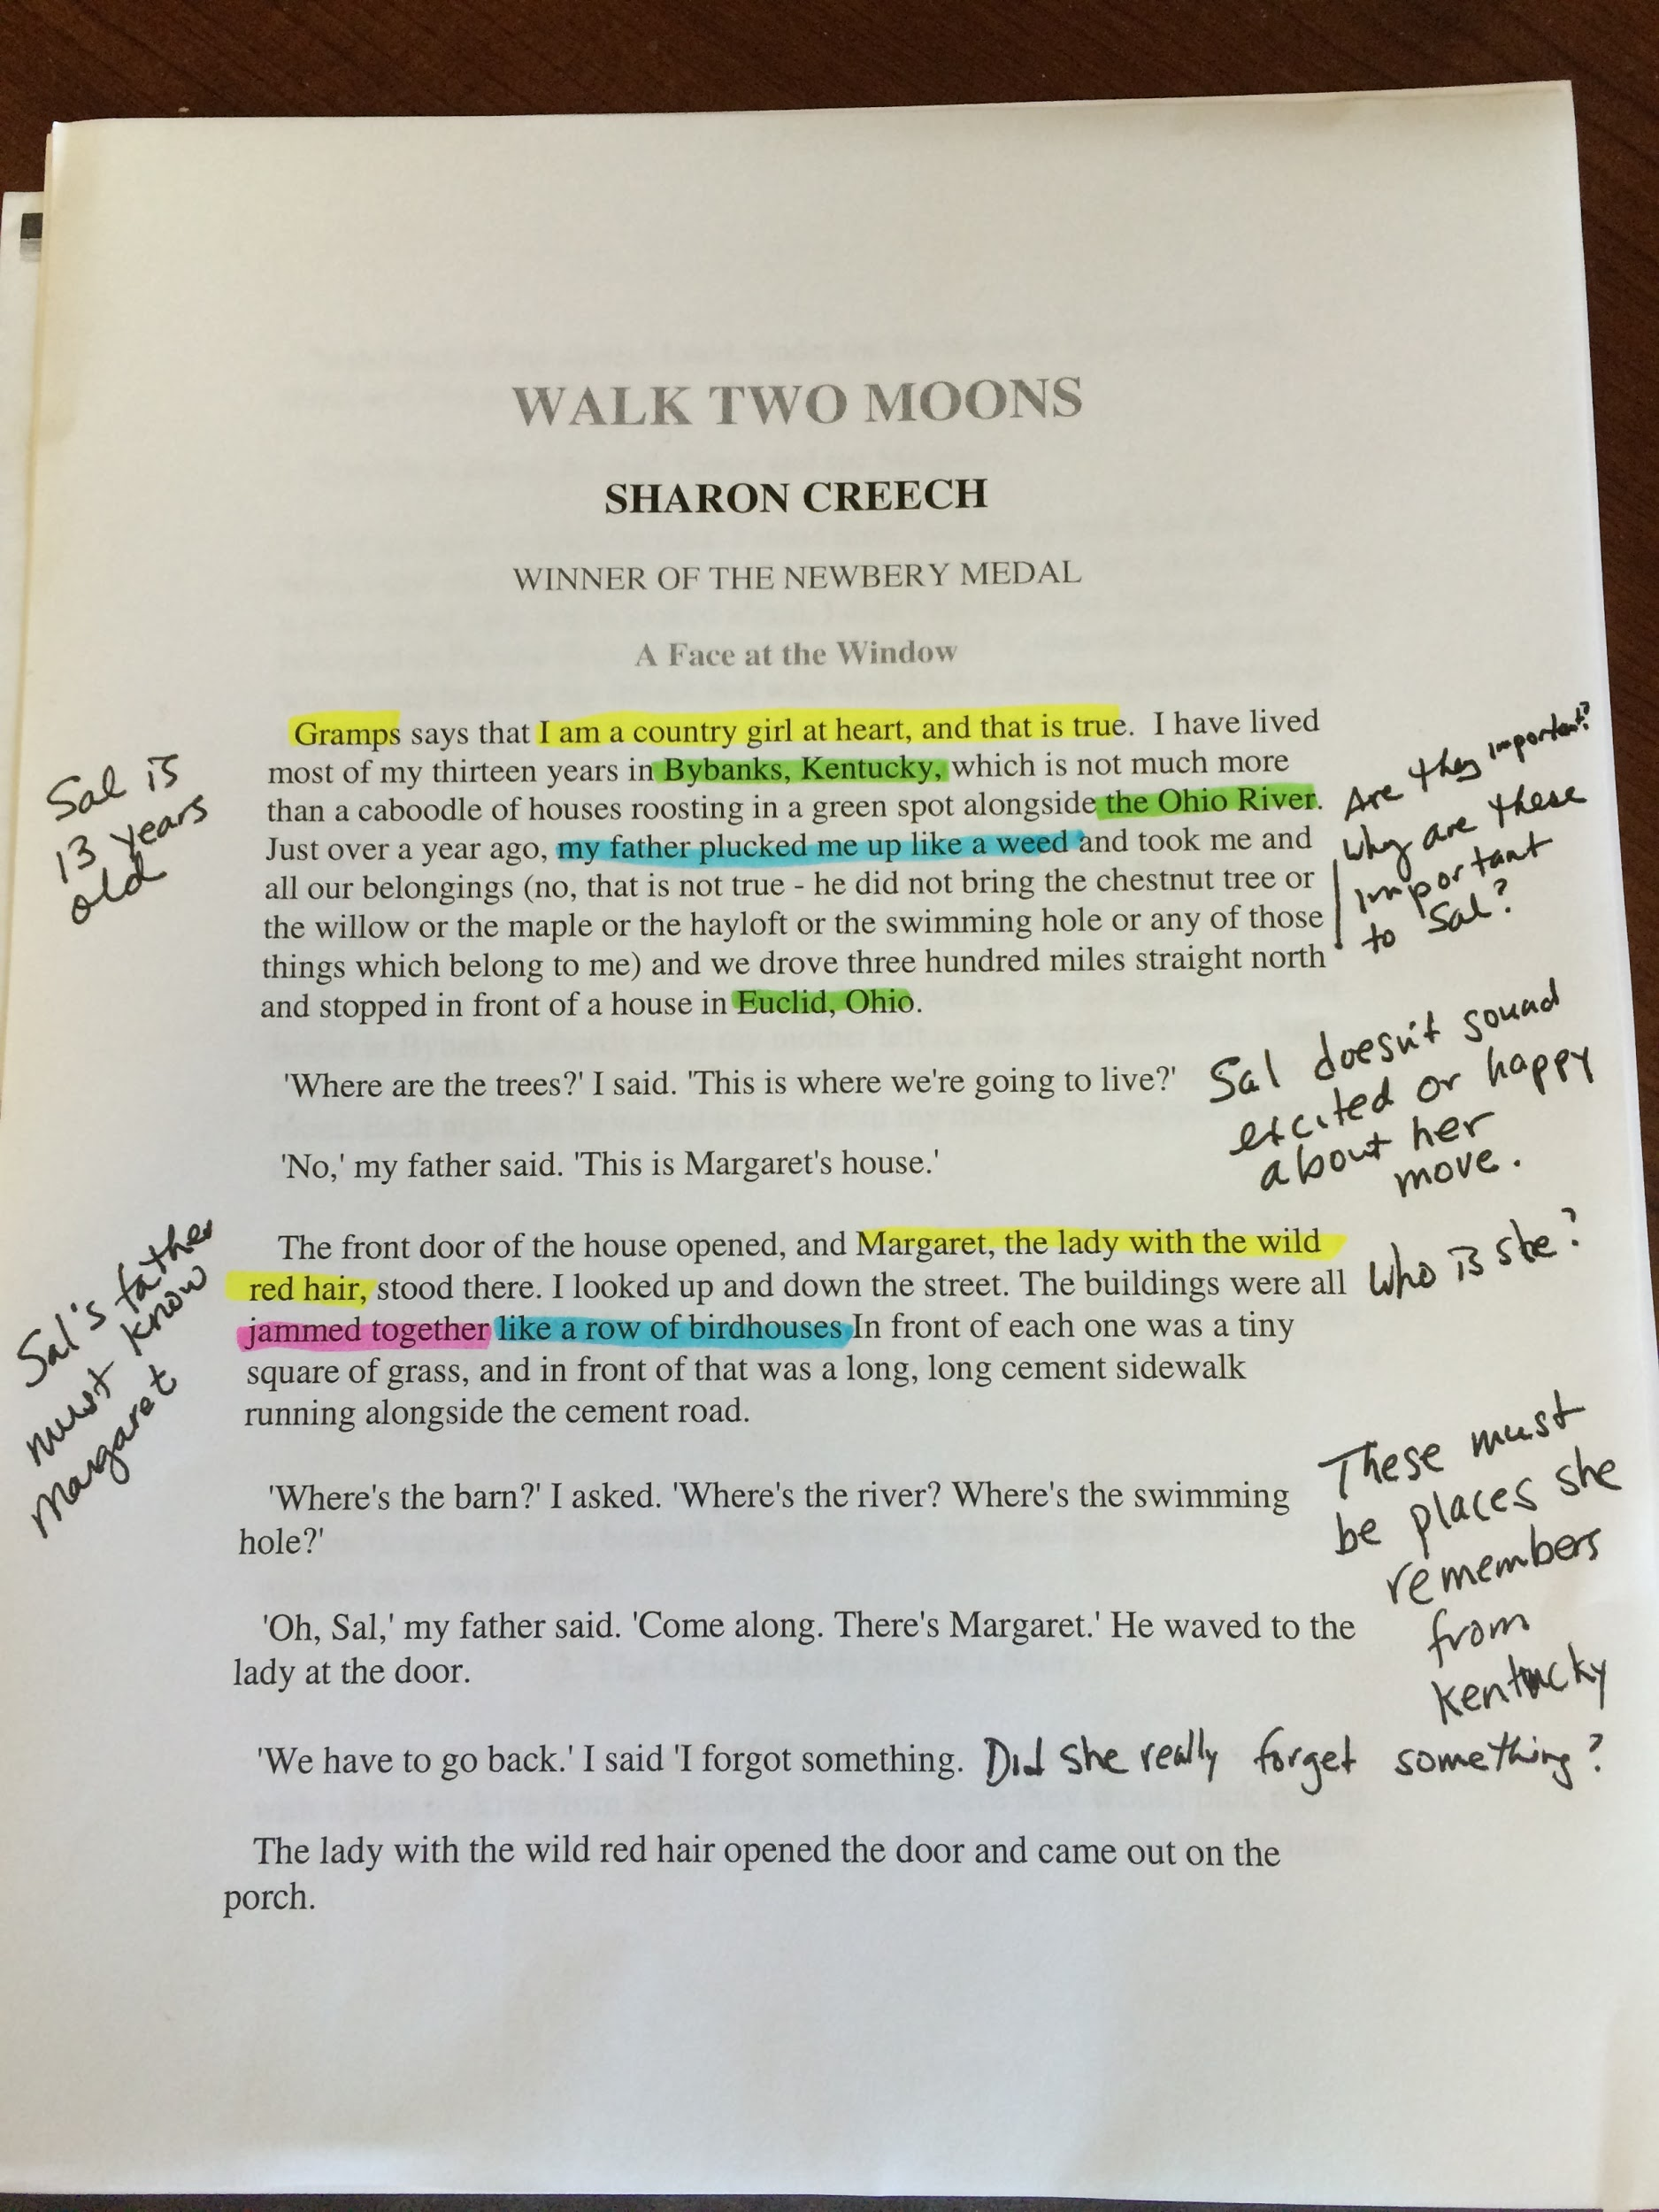
Annotation: We Love Messy Books
LEFT MARGIN
facts
key events
sequence of key events
dual story charting
RIGHT MARGIN
feelings
questions
reactions
connections
Notes:
Once we’ve created a compelling context, we need to engage them in active reading. Annotation is one element of active reading helps students make their thinking visible, track their thinking and continually engage with the text. So, we love messy books and here’s how we do it at this level to keep it simple. Reference the classroom visit… In our accelerated classroom, if you walk into one of our classrooms you’ll see every student with a messy book.
Other ideas for annotation lessons : Video?? I don’t love it, but it’s there for the exact page. Here is one activity I do:
3) Students would check their notes from their annotation and identify three stumbling blocks—questions they feel they really need the answers to in order to fully comprehend the reading. They will then write those questions on a piece of paper and get into assigned reading groups.
4) The reading groups will meet together and:
Step 1: Pass the papers in a round robin around the reading group of 4–5 members. Each member will write a short answer to the questions on the paper. If the student cannot answer the question, s/he will at least attempt to answer the questions. They can use their own annotation notes to do this.
Step 2: After all students have taken a stab at answering the questions, the groups will begin to discuss those questions and answers and take notes to add to their understanding of the chapter. As they discuss and consider the answers from their group members, they will begin to complete their understanding of the text.
Step 3: When they have finished, each group will identify questions that they STILL do not know the answers to. A group member will go to the board and write any remaining questions on the board and those questions will become the basis for the class discussion. Class time will be spent discussing and making sure students are ready to continue on with the novel.
The class will decide what information should be recorded on the class wiki for future reference.

Slide 22
Annotation: What’s the Reach?
Promote active reading skills
Teach reading with awareness and purpose
Help students track their thinking and connections they make while reading
Prepare students for discussion and writing activities
Help students incorporate evidence to their work
Notes:
-Annotation: describe this and lead students through it
-use color coding and marking up the text --add photo of example
SEE ANNA’S photo in slide 26.
-Skills this activity addresses
Students begin to incorporate these skills to everything they do. It becomes automatic.
How do we know they are thinking critically?
Annotations are a starting point for higher order activities
Push= thinking becomes visible
Questioning the text, summary/response, progression towards critical
Once you see your capacity to read and comprehend (student example)

Slide 23
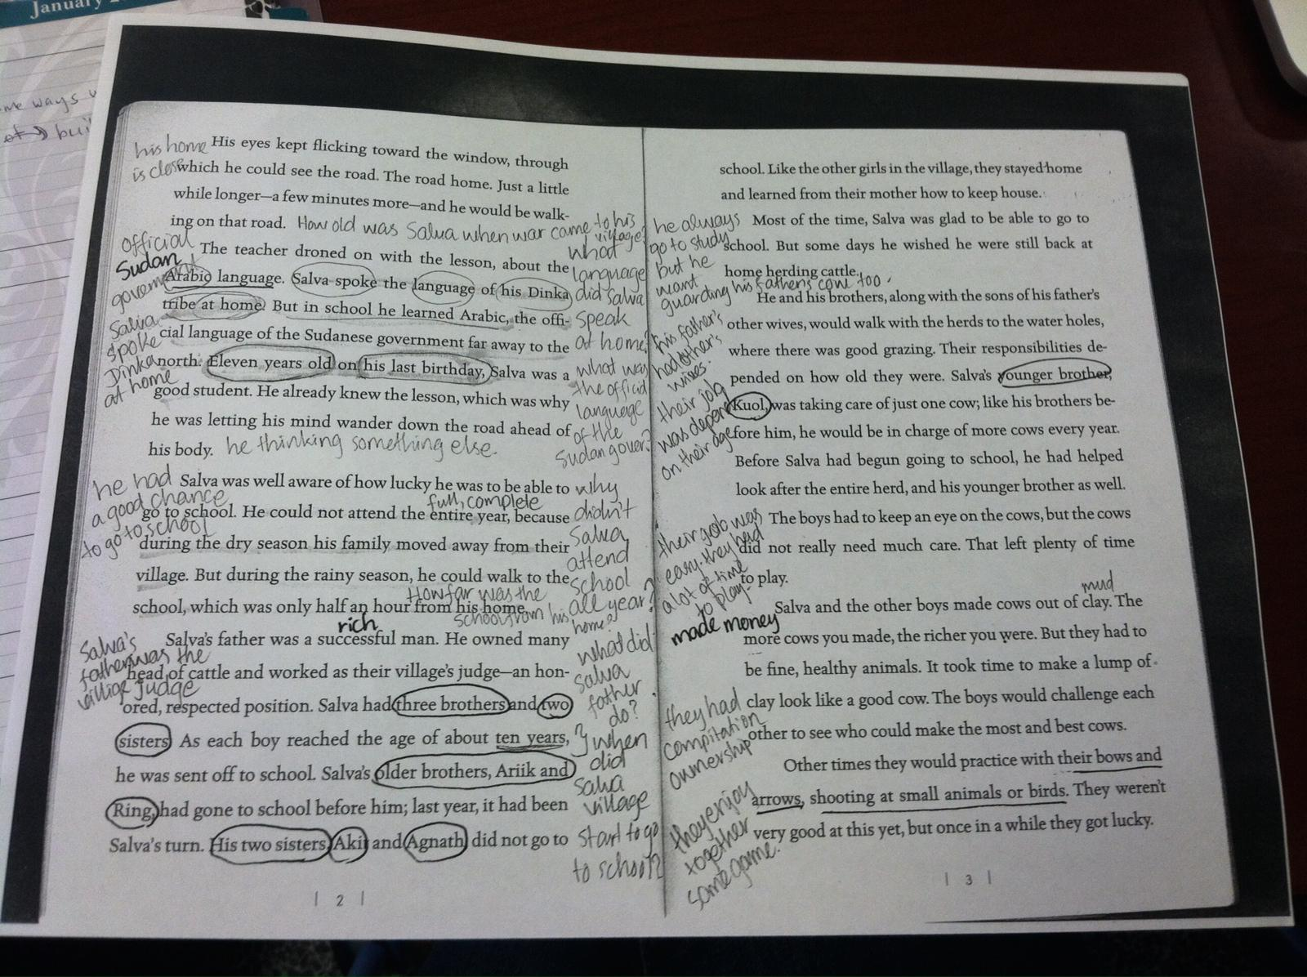
Exceeding Expectations
Student
example
Notes:
Exceeding expectations: Student who made his own color code, student who wrote a keyword about each chapter on the title page of each chapter.Pass out cleaned up copy-what do you notice? Facts. What do you think about it? Annotate

Slide 24
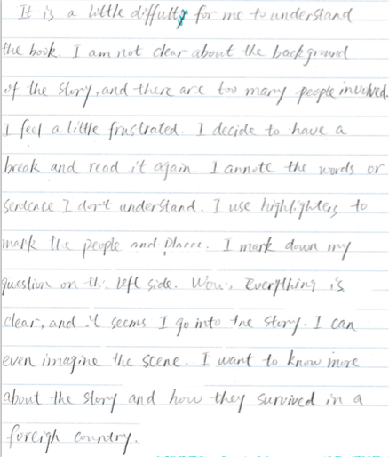
Exceeding
Expectations
Notes:
Amy reads student reflection about annotation
Suzan—Student who made his own color code, student who wrote a keyword about each chapter on the title page of each chapter.

Slide 25
Annotations as Building Blocks
Reading Group check-in: get help to answer remaining questions after reading a chapter
Generate discussion questions
Revisit a previous chapter to make connections
Trace character and theme development for essay support
Look at left side notes for summary creation
Look at right side notes for response ideas
Notes:
Amy’s anecdote - read student’s reflection on annotation: we try to refer back to the annotations so that students see the purpose of their work for future assignments. Study tips, really. I watched my students look back during group work to support the points they were trying to make.

Slide 26
Cultivating Critical Thinking
Notes:
This is where we ask our students to dig deep and use critical thinking skills in a whole new way.

Slide 27
Four Types of Questions
This idea of the four question types is adapted from
a reading apprenticeship technique called QAR
(question and answer relationships) by high school teachers
Christine Cziko and Lori Hurwitz.
http://www.dallastown.net/cms/lib6/PA01000011/Centricity/Domain/204/Microsoft_Word_-_QAR_NOTES_Teacher.pdf
http://readingapprenticeship.org/wp-content/uploads/2014/01/RFU-ch-7-QAR-intro.pdf
Notes:
We simplified the language, and introduced this technique to students early on in the semester. The set-up is important and takes time - s’s need the routine and need to know what to expect.

Slide 28
Four Types of Questions
These questions will:
Direct our discussions from basic comprehension to
critical thinking
Help us make connections between our own lives
and the novel
Prepare us for going deeper into a text
Notes:
Explaining the four question types: As we read, we learn about the characters, the setting and the story, and we also make connections to our own life experiences. This is a next step after annotation - one way to use the margin notes we made.

Slide 29
1. Right There Questions
A “right there!” question is a question whose answer
you can point to in one line of the book.
Notes:
Example: Which native American tribe did Sal’s great-great-grandmother belong to?

Slide 30
2. Here and There Questions
A “here and there” question is a question whose answer
is formed by assembling information from more than one place
in the book.
Notes:
Example: In what ways are the Pickford family and the Hiddle family different?

Slide 31
3. Inside/Outside Questions
Only part of the answer to an “inside/outside” question
can be found in the book. The other part of the answer
comes from you. What do you infer from what you read?
Notes:
Example: Sal doesn’t want to know anything about her father’s friend, Margaret. What does she do when her father tries to talk to her about Margaret? Why do you think she’s reacting this way?

Slide 32
4. Outside Questions
You won’t find the answer to an “outside” question
in the book. An “outside” question is related to an issue
in the story, but you’ll need to use what you know
about the world to answer this question.
Join a community of readers and citizens.
Notes:
Example: How long after a couple separates do you think it’s appropriate for one of them to begin a new relationship? Why?

Slide 33
What’s the Reach?
Right there / Here and there: Students write these questions based on what they want to know about the story as it unfolds.
Inside/Outside: These activities ask students to think critically about the text based on their inferences.
Outside: These questions help students to join the conversation as active readers and citizens in their
new language.
Notes:
The goal here is to give s’s a framework for going deeper, where they produce the content. To get s’s beyond basic comprehension to critical thinking. After knowing the facts of what happened and how those facts connect with the larger themes, they can then engage with the story and go deeper in more creative ways.
Right There / Here and There: S’s do the work to pick out the details they want answers to, and write questions that are later filled in as we find the answers. In groups, write unanswered question about the novel on big paper, post around room - maybe one per character.. Start early on, and periodically re-post the paper and have s’s fill in the answers as they are finding them out. Also add new questions, with room to fill in the answers (or not) later. This is very satisfying and empowers learners to ask questions that they actually want the answers to and is very different from an approach where a textbook tells you the questions to answer.Or, different groups can write questions for different chapters — put questions on the wall and have s’s walk around and write answers to other groups’ questions. All these “gallery walk” type of activities engage quieter voices.
Inside/Outside: “what’s in a character’s bag” or “act out the end of a scene or situation”. Here s’s are asked to demonstrate understanding of the text, then do something with it. Draw character names from a hat. Assume the char’s all carry a bag/purse - list what your char has in their bag on big paper around the room. One member of group is an artist, who draws the items. Presenter of the group reads to the class and class has to guess who’s bag it is and why. The object’s significance reveals the depth of thinking in a creative, engaging way. Note:
Outside: Assign students a chapter to summarize each weeks. In groups, other students have to form “Outside” questions to ask the presenter a thoughtful question. Presenter must answer orally on-the-spot with help from the class if needed.

Slide 34
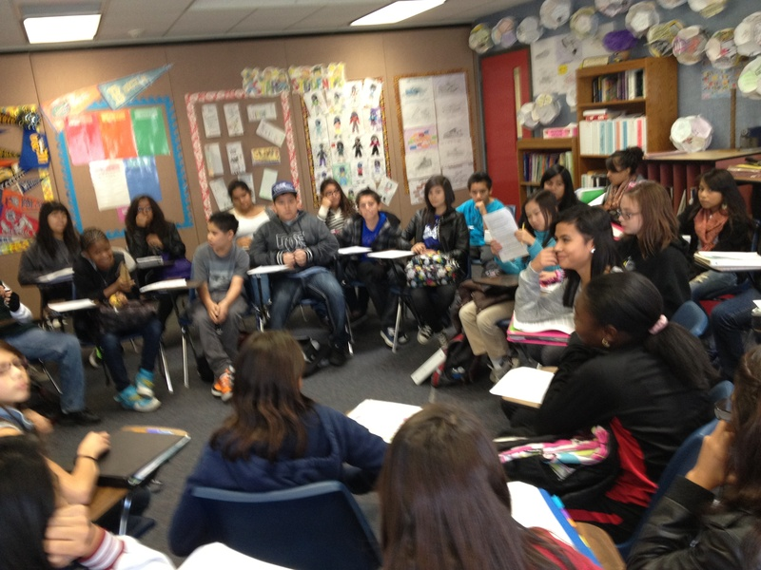
Exceeding Expectations:
The Socratic Seminar
Notes:
The push is to get those discussion skills going/
Then, once we set up a framework for discussion, we actually go ahead an have one.
(Chelsea’s story) Socratic seminar in High Beginning - from the four questions, guide students into a discussion based on student generated questions - there is a group of students in the middle, students circled around them - they are peer grading on the following: discussion skills, civility, and ability to probe deeper and keep the conversation going. I’ve had success with advanced levels, but was really doubting that the high beginning students would be able to do it.
-Students demonstrated ability to distinguish between questions that provoke deeper thinking and questions that require one word answers. Spendintg time on the four questions enabled them to do this. I pushed herself as a teacher to believe students had the capacity to pose these questions and provide meaningful responses.
Some questions asked during the seminar:
Do women have equal rights today (discussion about women in Afghanistan and Egypt). Would you risk your life the way Amelia did? How was Amelia an inspiration for women? How did Amelia prove herself? How did her actions show her character? What were Amelia's relationships like? Describe how Amelia's feelings towards marriage changed? Do you agree with her? Do you think the risks she took were “worth it?” Why or why not? Who were some of the people that influenced Amelia the most in her life? How did they influence her? Imagine you are Amelia’s parents. How do you feel about her decisions?

Slide 35
The next reach...
Accuracy!
Notes:
One more push is accuracy. It’s great they’re asking questions and going deep, but grammar does matter.

Slide 36
Example of errors collected from group work with 4 question types:
1. Why did Sal went to the psychiatric ward?
________________________________________________________
2. Is Ben mom have mental problem?
________________________________________________________
3. Why Phoebe’s mother kissed the lunatic?
________________________________________________________
4. Did Sal and Ben falling love to each other?
________________________________________________________
Notes:
There are typical problems at this level and in my class, they were questions, negative, and modals - but we respond to our s’s needs. We improve accuracy using language produced by the s’s, in this case language that students produced when they were asking the 4 types of questions in the previous activity. That way, the grammar of how to make a question is more meaningful, because s’s now have a reason to ask a question - the want to know what happens in the book! Here we are going for accuracy after production (meaning after s’s have already written 4 types of questions and tried to answer them) - not before they even need it. They’ll be asking questions over and over and get a little better each time.
So first teach grammar, using examples from the book, then practice within the context. One grammar cycle might be to do error correction, then write positive/negative statements about the characters, then write what the characters could/should/might do in given situations (that’s modals) then write questions on post-it notes to stick on student-generated chapter summaries around the room (show examples). I can then distribute the post-its and s’s have to fix each others’ grammar problems from the post-its.
IF TIME: put up posters from ESL222 class, and hand out post-its to participants. Have everyone gallery walk and write questions on post-its.

Slide 37
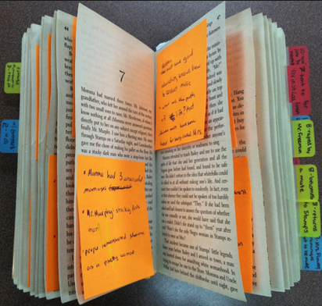
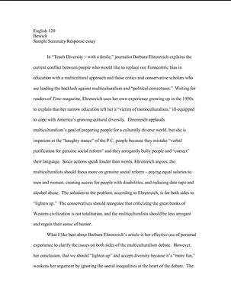
From Annotation to
Summary & Response and Essay
Notes:
Now that you’ve seen how our students annotate the text, and ask and answer questions about the story, you’ll see how we build off of those practices and integrate the reading and writing experience by summarizing and responding to the text. Summary and response is an important element of our curriculum. They are what we call low stakes writing assignments. We believe that providing students with ample opportunities to practice before a high stakes assessment helps emerging writers develop their skills as well as their confidence. Summary and response marks an interesting point in our curriculum where students take what they’ve learned through active reading to demonstrate their comprehension of the text and join the conversation while developing the skills for increasingly complex writing assignments.

Slide 38
Qualities of a Good Summary
Title and author
Background information
Main idea
Important Details
Concluding Sentence
Notes:
I initially teach summary and response separately and then bring them together once students are familiar with each element. When I introduce summary for the first time, I start with an example that I’ve written about a familiar text. We read it together as a class and use active reading strategies to identify the qualities of a good summary together before I ask students to write a summary of their own.

Slide 39
What is this chapter really about?
Notes:
This is a guiding question that we pose to our students as they work to distill the main idea of a text.

Slide 40
Qualities of a Good Response
Introduce an idea from the story
State your opinion about that idea
Give examples to support your opinion
Say something meaningful about the reading that the class could discuss
Notes:
I introduce response in the same way as I introduce summary, by providing students with an example of a response that I’ve written about a familiar text. We read it together and use active reading strategies to identify the qualities of a good response before they set out to write one of their own.

Slide 41
What do you have to say about that?
Notes:
Again, we pose a simple question to guide students as they join the conversation. We recognize that even our High Beginning students have a unique perspective and that there are ways for them to express their ideas at their current proficiency level—and we challenge them to do so.

Slide 42
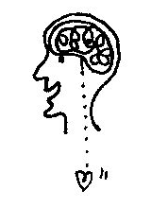
Where does the information we need
to write a summary come from?
Where does the information we need
to write a response come from?
Notes:
Much like the annotation practice that Suzan described, in which students distinguish between information derived from the text and original ideas as they annotate, these questions draw students’ awareness to the nature of summary and response.

Slide 43
Helping Students Join the Conversation
Expressing Your Opinion
I think… In my opinion… I imagine…
I believe… It seems to me that…
Making Connections
This makes me realize… This is important because…
This connects with… This reminds me of a time when…
This is similar to… I had a similar experience once…
Notes:
Sentence starters are one of the tools we offer students as they develop their voices as writers in English.

Slide 44
What’s the reach?
Demonstrate comprehension
Synthesize information
Skills with everyday applications
Join the conversation
Starting point for more complex writing
Notes:
Summary and response is the bridge between active reading and joining the conversation through integrated and contextualized reading and writing experiences.
All community college students are adults with life experiences to share and in their responses we challenge them to say something substantial.
Summary and response is a practice that prepares students for more complex writing assignments.

Slide 45
Exceeding Expectations:
A Letter From the Author

Slide 46
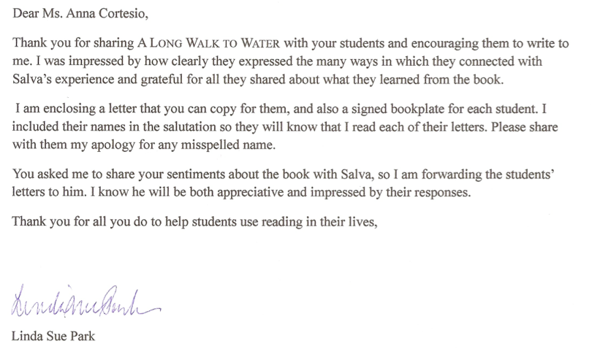
Notes:
To illustrate how my students have exceeded my expectations in terms of their summaries and responses, I’d like to read part of a letter I received from Linda Sue Park, the award-winning author of A Long Walk to Water, one of the novels my Intermediate Reading and Writing students read. Here’s what she wrote: (read the first paragraph and the third paragraph).

Slide 47
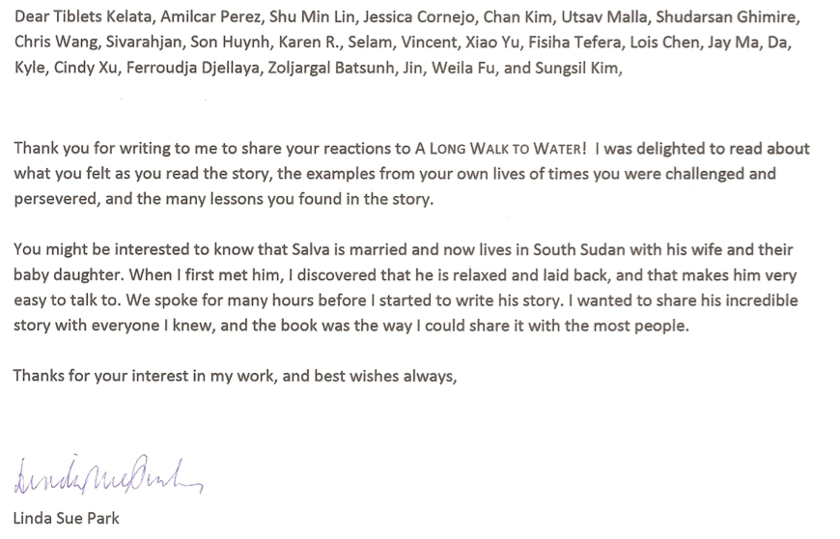
Exceeding Expectations
Notes:
...and here’s the letter that Linda Sue Park wrote to my students in response to their letters. They could not believe that their writing had been read and acknowledged by the author of the novel we had come to appreciate and connect with. They exceeded their own expectations as they truly joined the conversation.
This also was a very rewarding experience for me as an instructor. Teaching in an accelerated program gives me the flexibility to expand upon the familiar work of responding to a text by inviting my students to write for an audience beyond the classroom, and to join a conversation in a way that felt like a reach for these emerging writers.

Slide 48
Writing Essays
Notes:
I mentioned that we build up to more complex writing assignments, and I want to say a bit more about that. For example, when we read Walk Two Moons by Sharon Creech, our first essay assignment is a narrative. Inspired by a scene in the novel when a blackberry pie triggers a precious memory of happier times for one of the characters, students write about a sensory experience that brings back memories in their lives.
Later essays explore themes from the novel and tie in related nonfiction articles, which students handle well as they fit in with the context we’ve built and deepen our connections with the story. Now Amy will tell you about her students’ essay writing experience.

Slide 49
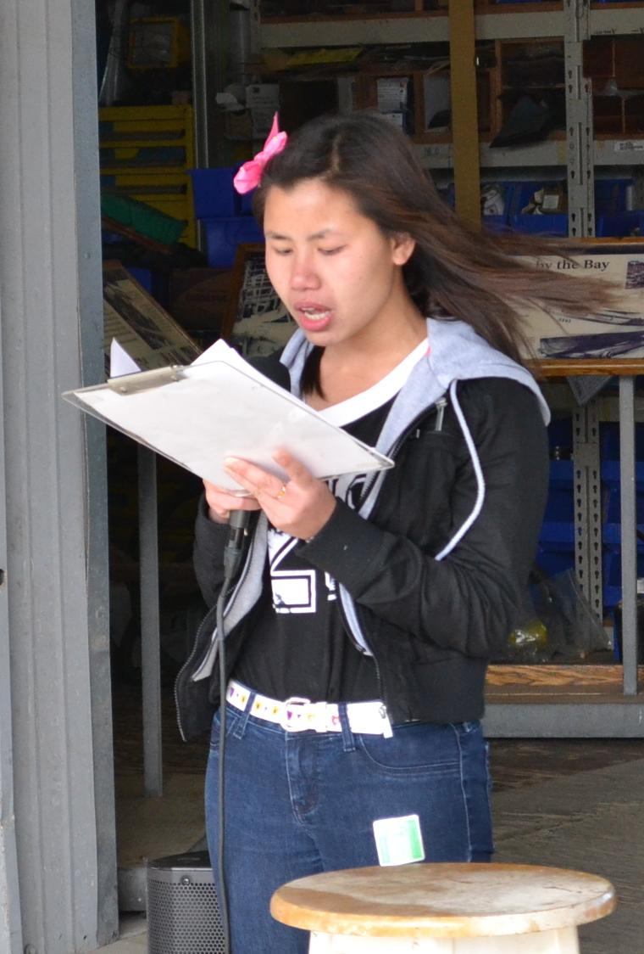
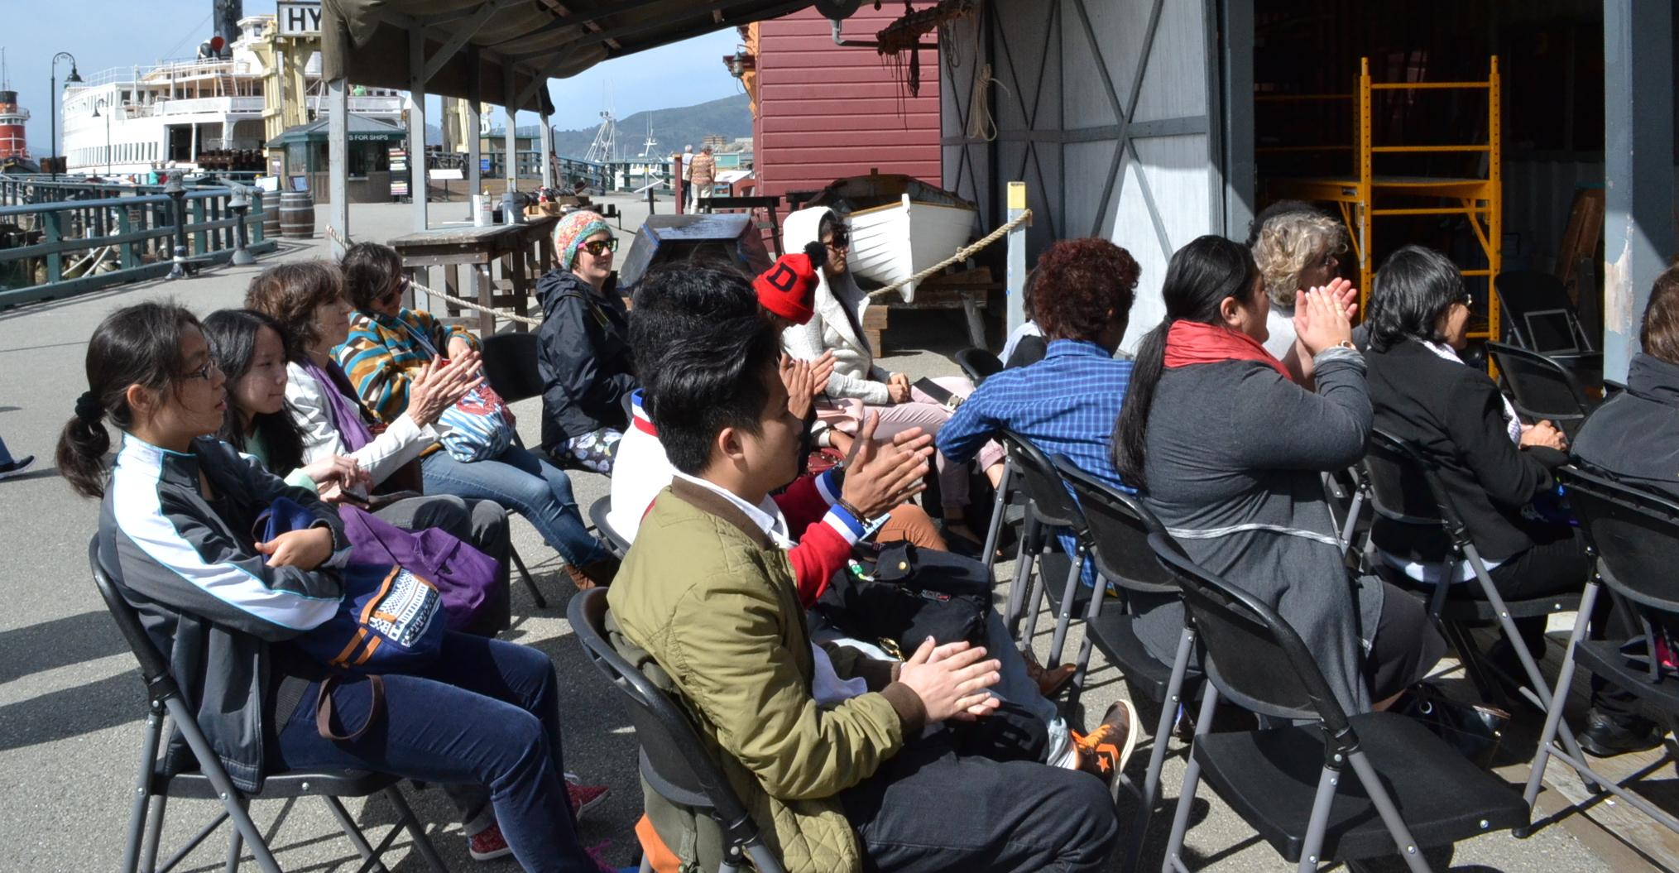
Exceeding
Expectations
Notes:
The first essay assignment was to write a narrative essay, thinking about what senses are connected with special memories, choose one significant memory, and write about it by summarizing the author’s memory of the delayed pleasure of eating an apple after it had been offered to Buddha. All students took off with this assignment with no trouble making connections from the memoir to their own lives, except one student who did not take my class last semester in the Acceleration College. She couldn’t think of anything to get started, and seemed frozen with indecision and confusion at the assignment. I was surprised, since she’s a bright student, smart and creative – then I realized she hadn’t been asked to think like this before, and all the others had. I think the “making connections” part of our packets prepared my students to think broadly, and it really showed on this assignment.
The next step after writing the essays, which pushed me as an educator as well as pushing my students beyond what they ever imagined, was to take advantage of an opportunity for an audience. We traveled as a class to World Storytelling Day at the San Francisco Maritime National Historical Park and joined other writers in reading their stories (narrative essays) in public. This experience pushed the students to do something they were admittedly quite nervous about, but the results were incredible. This is a photo of the student who had trouble getting started, reading her sensory memory about the first time she ate a hamburger in the U.S. (it was not a good memory, but very funny and thoughtful). After this event, we reached a different audience by showcasing the essays in the Laney gallery and hosting another public reading of student work. The excitement and joy of overcoming a fear of public speaking, in another language no less, was unforgettable for everyone. The curriculum gave us the space and the time to make that happen.

Slide 50
It’s Your Turn to
Join the Conversation
Takeaways and Q&A

Slide 51
Course Outline
Link to the course outline: http://www.curricunet.com/pccd/reports/course_outline_pdf.cfm?courses_id=10820
Notes:
Course outline
Includes activities will incorporate several skills

Slide 52
 |  |  |  |  |  |  | ADV B
 |  |  |  |  |  | ADV A
 |  |  |  |  | HIGH INT B
 |  |  |  | HIGH INT A
 |  |  | INT B
 |  | INT A
 | HIGH BEG B
HIGH BEG A
STUDENT ADVANCING FASTER

Slide 53
Visualization #2 of the A/B plan:Stairs
 |  |  |  |  |  |  | ADV B
 |  |  |  |  |  | ADV A
 |  |  |  |  | HIGH INT B
 |  |  |  | HIGH INT A
 |  |  | INT B
 |  | INT A
 | HIGH BEG B
HIGH BEG A
STUDENT ADVANCING SLOWER

Slide 54
Visualization #2 of the A/B plan: Stairs
 |  |  |  |  |  |  | ADV B
 |  |  |  |  |  | ADV A
 |  |  |  |  | HIGH INT B
 |  |  |  | HIGH INT A
 |  |  | INT B
 |  | INT A
 | HIGH BEG B
HIGH BEG A
STUDENT ADJUSTING TO PROGRESS

