Slide 1
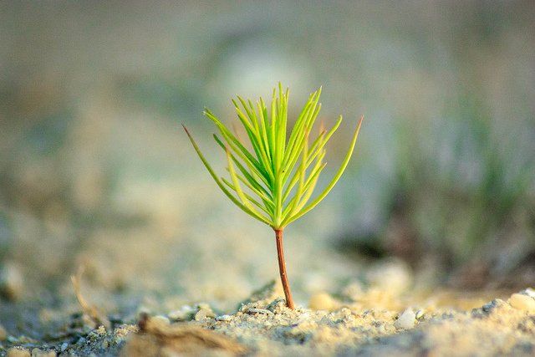
TOWARDS A GROWTH MINDSET
in grading

Slide 2
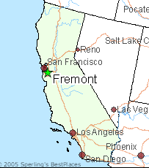
Introduction & COntext
Jennifer Hurley, Associate Professor of English,
Ohlone College, Fremont, CA
jhurley@ohlone.edu
For three semesters, I’ve been using a contract grading system in all of my classes, including a 5-unit IRW one-level-below class.
I don’t give any grades, points, or rubric scores on my students’ assignments. Instead, students’ grades are based on their learning process: on their sincere completion of reading, annotations, homework, quizzes, essays, and revisions.*
*Unfortunately, a few exceptions may apply.

Slide 3
False Assumption
Grades
Rigor and high standards
It’s counterintuitive, but a system of mostly “no grades” actually holds students to a higher level and pushes them more.

Slide 4
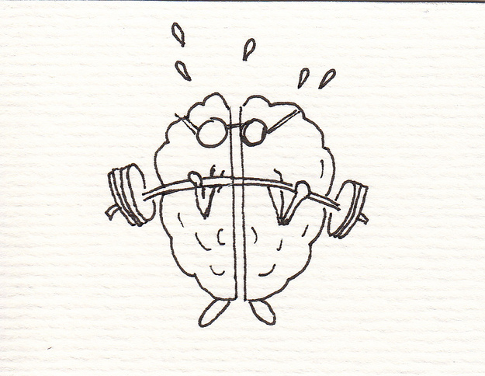
Fixed Mindset:
the belief that one’s level of intelligence is fixed and cannot be improved
Growth Mindset:
the belief that one’s level of intelligence can be endlessly improved through hard work and effort
This is how much intelligence I was born with, and it’s all I’ve got.
I can work hard and build my intelligence!

Slide 5
How Mindset affects Motivation
Students with a fixed mindset give up in the face of challenge because they feel they aren’t smart enough.
Students with a growth mindset persevere when they encounter a difficult task. They are not afraid to seek out challenge because they know they will learn more from it.

Slide 6
My Hypothesis:
If everything I did as a teacher supported my students’ growth mindset, then my students would thrive.

Slide 7
GRADES: The main cause of a fixed mindset?
89 out of 90 students taking an accelerated developmental class
said YES to the question:
Have grades caused you to have
a fixed mindset?

Slide 8
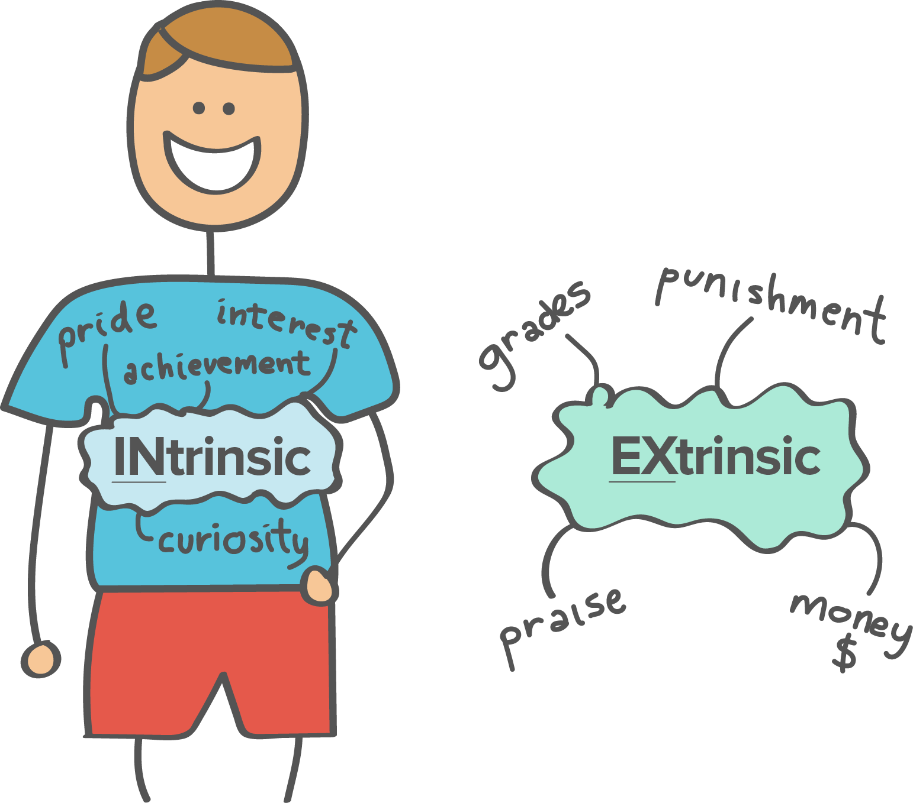
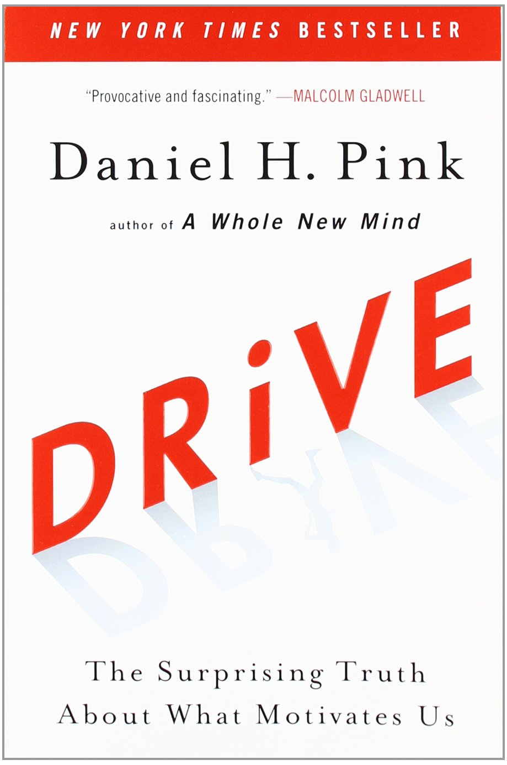
Intrinsic Vs. Extrinsic Motivation
Daniel Pink argues that extrinsic motivators such as grades may work in the short term but can destroy intrinsic interest over time.
Notes:
“The secret to high performance isn’t rewards and punishments, but that unseen intrinsic drive—the drive to do things for their own sake.”

Slide 9
Discuss with a Partner:
In your experience, how do grades affect developing students’ mindset and motivation?
If you’ve recently received a grade, how did that impact your mindset and motivation?

Slide 10
Student Comments About Grades
“Grades have caused me a fixed mindset because when I would receive a bad grade in my English class I would stop trying. My brain would tell me ‘Why even try if you’re going to get bad grades?’ Seeing a F, D, or C would bring my self-esteem down and that would make me stop trying.”

Slide 11
Student Comments About Grades
“Grades [make] kids think they’re only as good as the grade they get. And if they get a low grade that means they aren’t smart in that particular area. Grades have caused me to sometimes think I’ll never grasp a subject and that I’ll only be as good as a C grade or D grade. I feel like grades demoralize us and open the door for doubt and fear of certain subjects to set in.”

Slide 12
Student Comments About Grades
“I do believe that grades contribute to students having fixed mindsets. Throughout my [education], I looked at grades as something I need to move on to the next class. ‘What’s the lowest score I need on the final to pass the class?’ When I see my grades I can loosely estimate what assignments I can miss but still pass. It’s easy to loose focus on what is really important about your learning and rather make education one long series of tasks.”

Slide 13
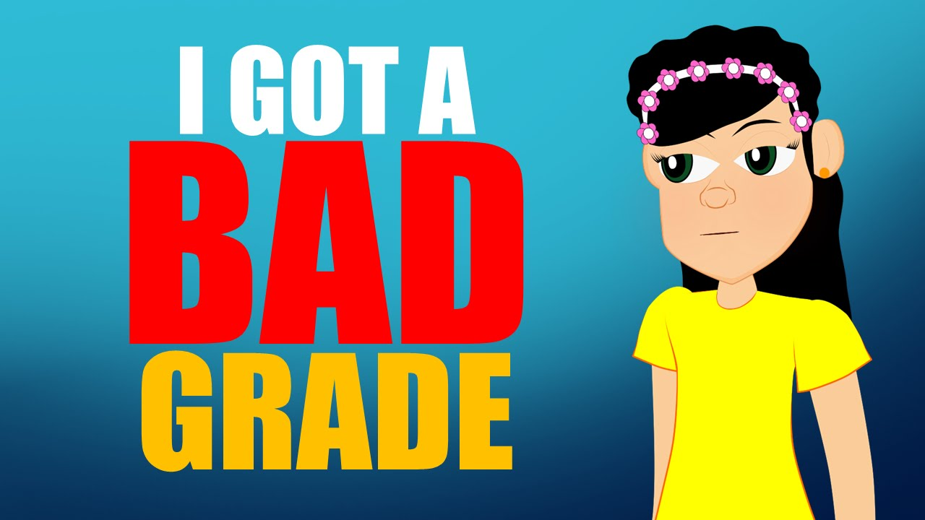
My Previous Approach
For at least fifteen years, I tried to pair a low grade with positive, encouraging comments.
I thought this was effective, but students said that they thought of the grade as the “real” comment about the quality of their work, while the positive comment was “fake.”

Slide 14
Grading with a growth mindset My First Steps
Eliminated all point-based grading to shift students away from “point-grubbing”
Graded essays and quizzes High Pass, Pass, Low Pass, or Not Yet Passing/Revise
Encouraged or required students to revise to improve their grade
Focused my feedback on “Here’s what’s working well and what you could do more of” instead of “Here’s what’s wrong”
Notes:
Specifications grading

Slide 15
Why I Decided to Take It Further
Students tried to “translate” High Pass, Pass, Low Pass, Not Yet Passing into A, B, C, and D.
Students still focused mainly on how I had labeled the essay rather than on the feedback.
Conversations about revisions were more about “How can I get a High Pass?” rather than on the learning process.

Slide 16
Feedback Only, No Grades
Three semesters ago, I made the leap:
No more grades or points on anything, only complete or revise
Instead of grading, I focused my energy and attention on providing my students with ample narrative feedback combined with conferencing
I tried as much as possible to make my feedback encouraging, personal, specific, content-oriented, and revision-oriented

Slide 17
Contract Grading: Process-Oriented Grading
Students will earn a B in the class if they do all the work in the class and have good attendance. If students turn in poor work, I ask them to redo or revise it.
Students who demonstrate excellence in their writing and/or their learning process earn an A.
Students who have a minor amount of missing work earn a C.
A significant amount of missing work = not passing. If students turn in an unacceptable essay at the end of the semester, or if their revisions are not up to standard, they will not pass.

Slide 18
What I Learned
Contract grading did not lessen my workload, but it did make my workload more pleasant. It was a huge relief to approach student work from the standpoint of “What can I say to help this student progress?” rather than “How should I judge this student’s work?”

Slide 19
What I Learned
Students overwhelmingly love contract grading, especially students who have typically earned low grades throughout school. The impact on motivation has been measurable, especially in terms of retention:
Spring 2016: no one withdrew
Fall 2016: no one withdrew
Spring 2017: one person withdrew

Slide 20
What I Learned
Student success has been high under this system.
Spring 2016: 29 out of 31 students succeeded (93.5%)
Fall 2016: 30 out of 30 students succeeded (100%)
Spring 2017: 27 out of 32 students succeeded (84%)
Notes:
Throughput data has been mixed (92% vs. 63%), so I’m continuing to track that.

Slide 21
What I Learned
I needed to tweak the system to give myself the power to fail unprepared students. This happened rarely, but it did happen.
Why did 5 students fail in Spring 2017?
3 students failed because they didn’t complete much homework,.
1 student did all of the written homework, but she “faked” doing the reading, which led to a poor final essay.
1 student did all of the reading and writing, but a learning disability made it hard for her to differentiate between using quotes as support and plagiarizing a reading.

Slide 22
What I Learned
Refining this system led me to question my own beliefs about what sort of work earned an A. Contract grading forced me to really figure out what I valued as a teacher and put it into writing for the students to see.
Students respected the fact that I was trying to be up front about what I valued rather than “coding” it through points or weighting.

Slide 23
Student Comment
“The thing that I think helped me the most this semester was the fact that we didn’t have a grade for the essays that you assigned us. This allowed me to focus more on my writing and ways in which I could improve it because when I was in high school, my teachers would just hand back the essays that we wrote and that would be it. I think that put me in a fixed mindset because whenever I got an essay back that had been graded, I wouldn’t try to improve it. I knew my grade wasn’t going to get better so I saw no point in trying to improve it.”

Slide 24
Student Comment
“In high school, all you really worry about is getting a passing grade. But in your class, I did not worry about what grade I was going to receive. I focused more on the feedback and how I could improve my essay. I did not have to worry about the stress of getting a bad grade or getting disappointed because I received a letter grade lower than I was expecting.”

Slide 25
Student Comment
“If I receive only feedback on an essay, it doesn’t feel like a judgment, but instead makes me feel like I can improve.”

Slide 26
Student Comment
“Before your class when I had been given an essay to write, I wrote my essay [how] I thought the teacher would want so that I got a good grade on it. Your class, however, doesn’t have a definitive grade until the very end, so it left me questioning how I should write my essays. At first I just wrote how I had done in high school but soon started to change my writing style. I started to write how I wanted, and I found that I actually don’t mind writing papers anymore.”

Slide 27
Affective Benefits of Contract Grading
Reduces feelings of fear and demoralization associated with grades; students feel encouraged and respected.
Because students know they can earn a grade of B if they do the work, they can let go of the stress associated with grades.
Students feel excited to work for their own learning rather than play the grade game.

Slide 28
Educational Benefits of Contract Grading
I know that students who earn a B in my class have a strong learning process. They read all assigned readings, annotate their readings, and do all assigned informal and formal writing.
Students feel free to take risks and make mistakes, which leads them to learn more. Assigned revisions give students a chance to immediately apply what they learned.
Students do better work when they feel motivated and supported. Students work way harder for me under contract grading than they ever did with traditional grades.

Slide 29
Benefits of Contract Grading for teachers
Simplifies grading (on Canvas, everything is marked complete/incomplete).
Students are more likely to read our feedback.
Grading becomes a more positive experience rather than something I face with dread.
Frees me up to focus on how I can help my students rather than justifying my grades to them. Helps build strong relationships between me and my students.

Slide 30
Downsides of Contract Grading
I’ve struggled to express to myself and to my students what the difference is between an A and a B.
Some students still don’t do all the assigned work. I do spend time tracking students down about their missing work.
Requires strong teacher/student communication, and a lot of following up with students about the status of revisions. It’s not neat and tidy.
In theory, it may lead to some students passing without being ready, or students may receive a B for doing C work.

Slide 31
Tips for Introducing Contract grading
Have students read “Brainology” and discuss growth/fixed mindsets.
Other potential curriculum tie-ins: intrinsic/extrinsic motivation, critiques of grading or the education system.
Consider introducing the grading system after a few weeks of the semester to avoid student overwhelm.
Don’t be afraid to share your own process with your students! The more honest I was with my students about why I was doing this and how I struggled with it, the more they supported me.

Slide 32
Conclusion: I could never go back!
Contract grading made me remember why I love teaching.

Slide 33
Further questions? Contact Me!
Jennifer Hurley
Associate Professor of English, Ohlone College
jhurley@ohlone.edu
Medium site where I blog about nontraditional grading:
https://medium.com/@profhurley
Facebook page on nontraditional grading: Teachers Throwing Out Grades

