Slide 1
Redesigning Developmental Mathematics Education:
A National Perspective – Part II
Accelerated Learning Project
Third Annual Acceleration Conference on Developmental Education
Community College of Baltimore County
June 17, 2011
Philip Uri Treisman and Tom Connolly Charles A. Dana Center The University of Texas at Austin

Slide 2
What is Statway?
A one-year pathway “to and through” Statistics…
Teach statistics with requisite arithmetic and algebra integrated and taught in the context of statistics
Developed through a partnership between The Charles A. Dana Center at The University of Texas at Austin and The Carnegie Foundation for the Advancement of Teaching

Slide 3
Benefits of Statway to Students
Open to students who place into Beginning Algebra.
Students interested in humanities or social sciences move directly to mathematics that is relevant to their educational and career goals.
Students who successfully complete the Statway course will receive credit for a college-level statistics course.
Students bypass the traditional three-semester developmental mathematics sequence.

Slide 4
Salient Statway Design Principles
The design of Statway curriculum materials and teaching routines is an evidence-driven process
grounded in research and practitioner experience.
Statistics is the focus of curriculum materials
mathematics topics are addressed as needed for students to conceptualize statistics.
Statway instruction stresses conceptual fluency over procedural fluency.

Slide 5
Salient Statway Design Principles
Statway instructional materials make use of authentic contexts and real data.
Struggling with problems – both large and small – is a core part of the instructional experience.
Statway materials are designed to allow for local flexibility.

Slide 6
Distinguishing Features of Statway Lessons
Initiating task
Students struggle with a problem that they may not yet know how to solve.
Students bring their prior knowledge and critical reasoning (in a group setting) to bear in its solution.
Scaffolded Subtasks
Related to the context of the initiating task; teachers provide direct instruction to make conceptual connections explicit.
Follow-up or culminating tasks
Worked on by the students (perhaps for homework) to solidify concepts and procedures covered in the lesson.

Slide 7
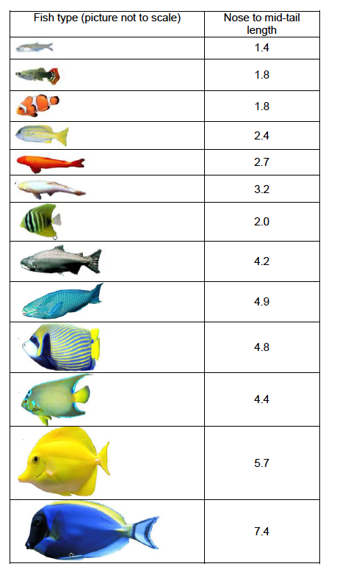
Statway Example 1: “Something Fishy Going On”
Context
Determine whether there is enough water in an aquarium to support a given population of fish.
The amount of water needed depends on the combined length of all the fish in the tank.
Student Learning Goals
Characteristics of good sampling plans
Identify possible sources of bias
Distinguish between a sample and a population
Summarize numerical data graphically
How poor sampling leads to misleading conclusions

Slide 8
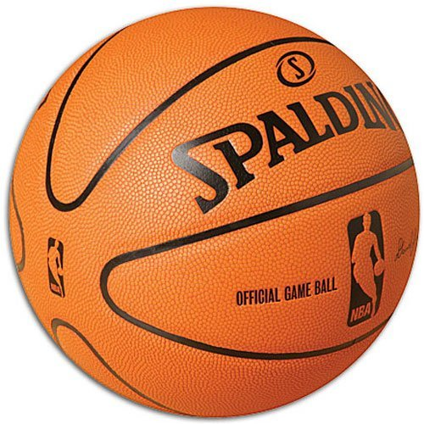
Statway Example 2: NBA Basketball Changes
Context
The NBA switched from leather to synthetic balls in 2007.
Players complained about ball handling and behavior
Investigate differences in final game scores to determine how this affected play
Student Learning Goals
Construct histograms: choose ranges for the bins, tally data values
Describe the important characteristics of histograms, such as center, shape, and spread
Compare two histograms to draw conclusions about hypotheses
leather basketball
synthetic basketball

Slide 9
What is Quantway?
A Quantitative Reasoning course
Accelerates students through “beginning algebra” and “intermediate algebra” in one-semester course.
Designed to prepare students to enter a non-algebra college math course such as Statistics, Mathematics for Liberal Arts, or a program-specific math course.
The Dana Center plans to develop a second course, Quantway II, that would meet all college math requirements.

Slide 10
Quantitative Reasoning in Quantway
Uses mathematics in service of context especially in reference to evaluation of information and decision-making
Three contextual themes: personal finance, citizenship, and medical fluency
Mathematical concepts emphasize conceptual understanding and interpretation of quantitative information and processes
Quantway mathematical outcomes focused around: proportional reasoning, statistics and modeling
Literacy focus on reading and writing about quantitative information
Quantway provides instructional scaffolding to support students to develop reading and writing skills.

Slide 11
Quantway Fast Facts
Quantway does not…
Cover all mathematical outcomes included in the traditional “beginning algebra” through “intermediate algebra” sequence
Emphasize algebraic manipulation
Quantway does…
Prepare students to:
Make sense of the quantitative information that is commonly used in today’s society
To think critically about that information
To make decisions based on their conclusions

Slide 12
Quantway Example 1:
Context
Students are presented with authentic excerpts from media reports regarding a particular crime statistic
Students are asked to determine and compare mathematical meanings
ORIGINAL STATEMENT
“The number of American children killed each year by guns has doubled since 1950.”
REWORDED STATEMENT (circa 1995) “Every year since 1950, the number of American children gunned down has doubled.”
Source: Best, J., Damned Lies and Statistics, University of California Press, Berkeley & Los Angeles (2001).
Student Learning Goals
Reading and interpreting quantitative information
Developing and applying “number sense”
Naming and estimating large numbers
Notes:
Exceeded US population by 1978
Exceeded world population by 1983
By 1995, the total number of children killed by gun violence would be about 35 TRILLION

Slide 13
Quantway Example 2: “The Credit Crunch”
Context
Students presented with credit card terms, written in accordance with the Credit Card Accountability, Responsibility, and Disclosure Act of 2009.
Exposure to terms such as creditworthiness, credit score, and interest rates.
Student Learning Goals
Reading quantitative information requires filtering out information
Writing about connections between mathematical processes and/or concepts and a context.

Slide 14
STEMway
A pathway course for Developmental Mathematics students whom aspire to STEM majors
(Science, Technology, Engineering, Mathematics)
Will prepare students to enter Calculus I
Will include learning objectives beyond mathematics, e.g., technology, engineering, science objectives.
Currently in the planning and conceptual phase

Slide 15
New Strategies to Support Student Success

Slide 16
Harnessing Motivation
A video from The Center for Community College Student Engagement (CCCSE)

Slide 17
Some Drivers of the Problems
Things that keep us from meeting the aim:
Course content in the first few weeks
pace too fast
does not catch students’ interest
few opportunities for early success
Little or no common expectations; absence of supportive classroom norms
language use
struggle norms
“doing math” norms
class expectations
Students’ limited “college knowledge”
effective learning practices
Institutional navigational “know how”
Students have few or no connections
to peers
to institution
to math faculty
Student mindsets undermine motivation
don’t see themselves as math learners
don’t see relevance of learning math
Faculty mindsets and understanding
not all believe all students can be successful
not all believe role is to teach productive persistence
not all have the dispositions, skills, or training to do productive persistence activities
not all understand their students’ cultural backgrounds

Slide 18
If you can’t see the faces of your students in the data, the data ain’t going to help you.

Slide 19
Questions and Answers

