Slide 1
Accelerated Pedagogy in English and Math: High Challenge, High Support Classrooms
Katie Hern & Myra Snell
The California Acceleration Project
Presentation at the National Conference on
Acceleration in Developmental Education
June 13-15, 2013
Notes:
Pass around sign up sheet – name, college, state, email address
Have Dweck video minimized on screen

Slide 2
CALIFORNIA ACCELERATION PROJECT http://cap.3csn.org
Supporting California’s 112 Community Colleges
To Redesign Developmental English and Math Curricula
And Increase Student Completion
An initiative of the California Community Colleges’ Success
Network (3CSN), funded through the Basic Skills Initiative of the
state Chancellor’s Office. Additional support from the
Walter S. Johnson Foundation, LearningWorks, and “Scaling
Innovation,” a project of the Community College Research Center
funded by the William and Flora Hewlett Foundation
Katie Hern, Director
khern@chabotcollege.edu
Myra Snell, Math Lead
msnell@losmedanos.edu
Notes:
More than 100 CA colleges have participated in workshops/conference presentations to date
42 colleges are receiving in-depth training and coaching to offer new accelerated English and pre-stats courses through the CAP Community of Practice in Acceleration

Slide 3
CAP Instructional Design Principles
In the California Acceleration Project, we argue that colleges need to shorten and fundamentally redesign English and math curricula, guided by five core principles:
Backwards design from college-level courses
Relevant, thinking-oriented curriculum
Just-in-time remediation
Low-stakes, collaborative practice
Intentional support for students’ affective needs
Notes:
Total for slides 1-3: 5 min

Slide 4
Backwards Design from College-Level Courses
To be “ready” for a college-level course in English or math, students need practice and guidance in the same things that these courses require:
Reading/writing: Providing the same tasks students will see in college English, with more support
Math: Tailoring developmental coursework to the specific curricular pathway students will pursue (e.g. more extensive algebra for students pursuing Calculus-based majors, pre-statistics courses for other paths). Remediation addresses only topics that are relevant to success in their chosen pathway.
Notes:
3 min slides 4-6

Slide 5
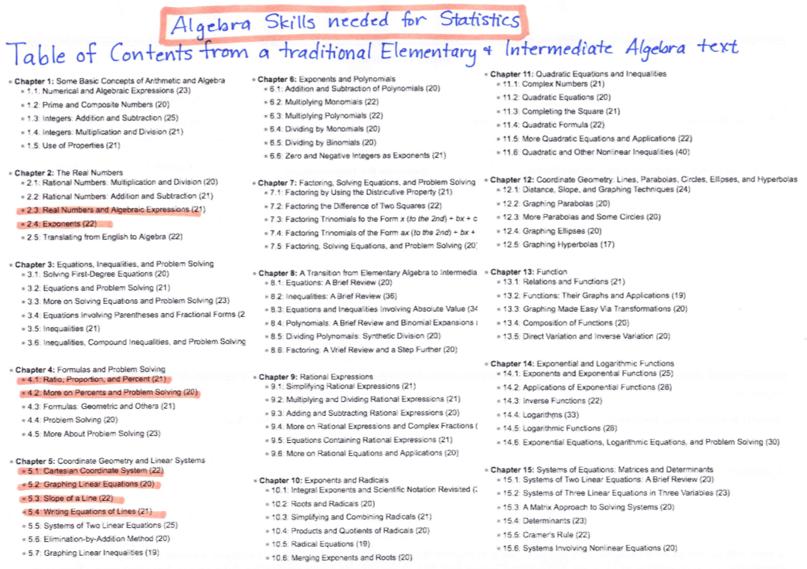
Why Backwards Design in Math: Misalignment of Algebra sequence and Statistics
Notes:
5

Slide 6
Faculty Voices from CAP
“I never ever want to introduce a topic by saying ‘I’m sorry, but we have to cover this. I know you will never use it again once you leave college,’ I don’t have to, when I teach pre-statistics.”
“With the right support, students are capable of doing great academic work! They don’t need to start with a simple paragraph. They can write complex essays from the start.”

Slide 7
Relevant, Thinking-Oriented Curriculum
Under-prepared students are best served by rigorous engagement with issues that matter – curricula that ask them to wrestle with open-ended problems and use resources from the class to reach their own conclusions. Our assignments should both invite – and help to develop – students’ sense of themselves as having something to contribute, a sense of their own agency.
Notes:
10 min -- pair share w handout of two examples – ask “what do you notice? How is this different from more traditional developmental curricula?”
katie

Slide 8
Faculty voices from CAP
“In the non-accelerated classroom, I think I focused more on teaching students to eliminate the superficial errors, so students in that class ended up producing a ‘prettier’ assignment; however, their writing did not illustrate complexity of thought….This was partly due to the formulaic nature of the assignments I used to give (topic sentence should look like this and be placed here, supporting details should go here, etc.) and mostly due to the lack of opportunity for critical thinking in my previous assignments.”

Slide 9
Just-in-Time Remediation
Remediation takes place as-needed as students grapple with challenging college-level tasks.
Grammar guidance occurs in response to students writing as they learn to edit their own work.
A review of relevant arithmetic or algebra grows out of students analyzing data to answer an intellectually engaging question.
Notes:
5 min
Myra

Slide 10
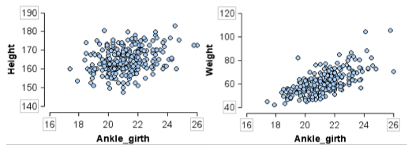
Forensic analysis: Can we estimate height & weight from an ankle bone?

Slide 11
Faculty Voices from CAP
“I put students in groups and simply asked them to write an organizational outline for their next paper assignment….what points would they make, what evidence would they use, in what order would information be presented? I resisted ‘telling’ them how I wanted it done. I didn’t lecture or give any handouts other than the essay assignment….The biggest thing this has taught me is that I do not need to ‘teach’ everything. Working as a sounding board and questioning their choices is more productive than a lecture or a handout.”

Slide 12
Intentional Support for Affective Needs
Students are placed into remedial courses based upon tests of their math, grammar, and reading comprehension skills. But teachers often find that – while students’ skills may need work – the bigger issue is whether they come to class consistently, complete the assigned homework, show up for tests, and turn in their papers.
How do we design our classes so that self-sabotaging behaviors don’t derail students?
Notes:
Katie
10 min – brief intro w my sustainability gap inquiry – walk through the affective practices handout, say we ask CAP faculty to commit to 1-2 new practices sustained through semester, what most people pick…share Dweck video + Dweck article/self-reflection as one thing almost everyone does

Slide 13
Faculty Voices from CAP
“I kind of started getting into this mindset, Well, if they don’t care, I can’t make them care…I really just thought it was laziness. Now I realize…it’s just that students are intimidated. They don’t want to act like they care because then they would be failures if they didn’t succeed.”
“I need to have a more ‘growth mindset’ about my students…. I need to realize that one low grade on a student paper does not mean that student cannot succeed or progress. This was a radical change for me.”

Slide 14
Low-Stakes Collaborative Practice
When teachers ask under-prepared students to do challenging, college-level assignments, they need to build in a lot of opportunities for practice. Students need space to grapple with ideas, try out new vocabulary, see how other students approach tasks, and receive targeted guidance from the teacher. Activities should:
Focus on meaningful high-priority skills that are well-aligned with graded assessments,
Require students to actively work with course concepts & materials in class. As they speak, write, or produce posters, the teacher sees what they understand and what needs clarification.
Notes:
Myra
25 min total –
3 min individual
10 min speed dating
5 min closure (Include: verbally say we give time to reflect & revise after)

Slide 15
Student Voices from CAP
Describing her instructor’s approach to the accelerated pre-statistics class:
“It’s kind of like…You dig in and get your hands dirty, however you feel you need to, and I’m here for you to help clarify, to help understand, help get you along better. I like that. It’s more like the instructor is a facilitator, as opposed to, I’m spewing out all this information that I need you to regurgitate on an exam.”

Slide 16
Hands-On Collaborative Practice
Case Study: Accelerated Classroom Gone Awry
Individual Reflection:
Review the handout “Attending to the Affective Domain,” think about how these practices might be relevant:
Which practices might help prevent the situation?
Which practices might help improve it once underway?
Do you have other ideas for addressing the situation?
Speed Dating:
In rapidly rotating pairs, share your ideas about addressing/preventing the problems in this case.
Notes:
Katie facilitate closure discussion
3 min individual
10 min speed dating
5 min closure (Include: verbally say we give time to reflect & revise after)

Slide 17
Further Discussion
The principles in this presentation are described at length in a forthcoming publication from LearningWorks:
Hern, K., with Snell, M. (2013). Toward a Vision of Accelerated Curriculum and Pedagogy: High Challenge, High Support Classrooms for Underprepared Students. Oakland, CA: LearningWorks.
Anticipated release: September 2013. Check the California Acceleration Project website for updates.
http://cap.3csn.org

