Slide 1
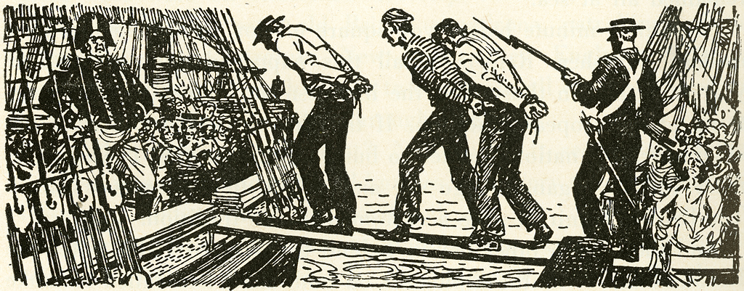
Pedagogy of the Impressed
The Freshmen arrive
for their required class in English Composition
Geoffrey Layton
Basic Writing Instructor
University of Oklahoma

Slide 2
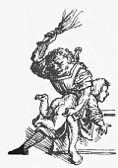
Teaching the “Boys in the Back Two Rows”

Slide 3
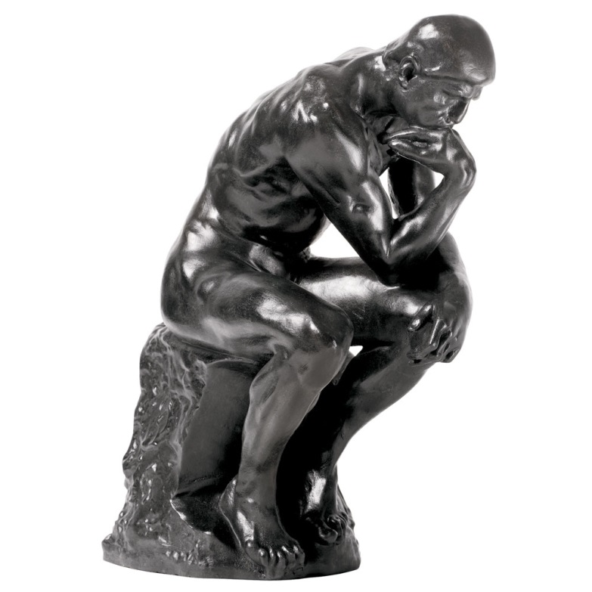
Our discipline…
What is it
that we do around here?

Slide 4
David Bartholomae, “Inventing the University”
The student has to appropriate (or be appropriated by) a specialized discourse… He has to invent the university by assembling and mimicking its language… He must learn to speak our language.”

Slide 5
How?

Slide 6
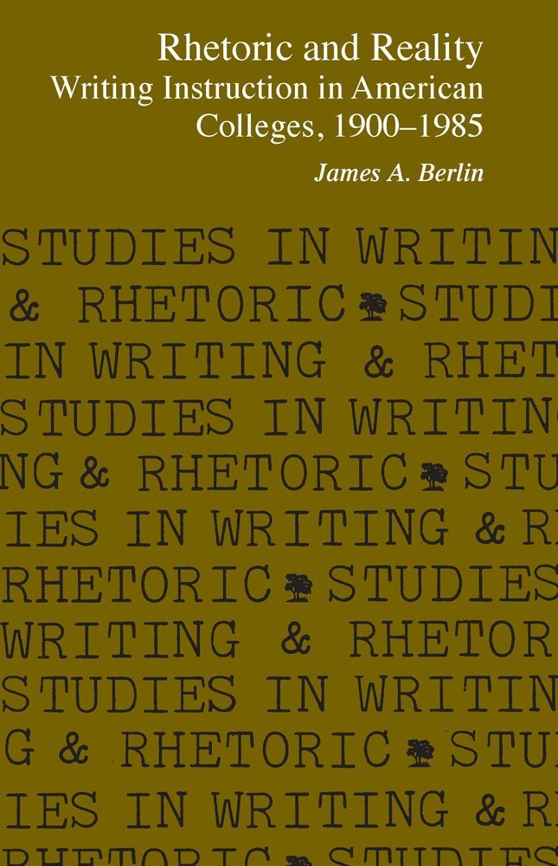
Current-Traditional
Grammar, Freire’s “Banking” Model
Expressivist
Write about yourself
Social
“Save the World”
IS THAT ALL THERE IS?
NO PLACE FOR LIT IN THE COMPOSITION CLASSROOM!

Slide 7
On one hand, there’s lit.
On the other there’s comp.

Slide 8
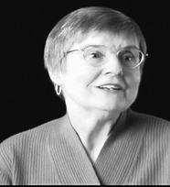
Teach Literature in the Freshman Composition Classroom?
No! Students assume a disembodied voice as they analyze the ingrown toenail motif in Beowulf… Teaching literature offers the writing teacher no model worth emulating. Erika Lindemann, University of North Carolina, Chapel Hill
Yes! We are very close to turning freshman composition into the ultimate ‘service course” for all the other disciplines. Does our discipline… exist in the cause of nothing more than producing better sociology and biology papers?
Gary Tate, Texas Christian University

Slide 9
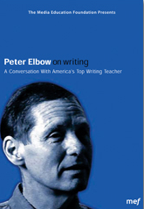
Peter Elbow:
“I miss literature. I miss having works of literature central in some of my teaching. I miss the comfort and pleasure of … trying to get inside of and be stretched or even transformed by a text that is miraculously good. College English, May 2002

Slide 10
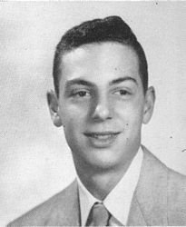
Gerald Graff, Famous “Developmental Student” –
“I disliked and feared books at an early age!”
Professor of English and Education, UIC
2008 President, Modern Language Association
Author, Poetic Statement and Critical Dogma, Literature Against Itself, Beyond the Culture Wars: Teaching the Conflicts, Clueless in Academe, and They Say/ I Say: The Moves that Matter in Academic Writing.
Rhetoric and Literature Do Go Together!

Slide 11
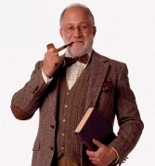
Door #1: Graff’s “Teaching the Conflicts”
Traditionalist Professor: Postcolonialist Professor is anachronistic, attributing modern political attitudes to works written centuries earlier.
Postcolonialist Professor: Even works centuries old are concerned with colonialism. We’re not the first to have these attitudes.
Not Appropriate for First Year Composition Students

Slide 12
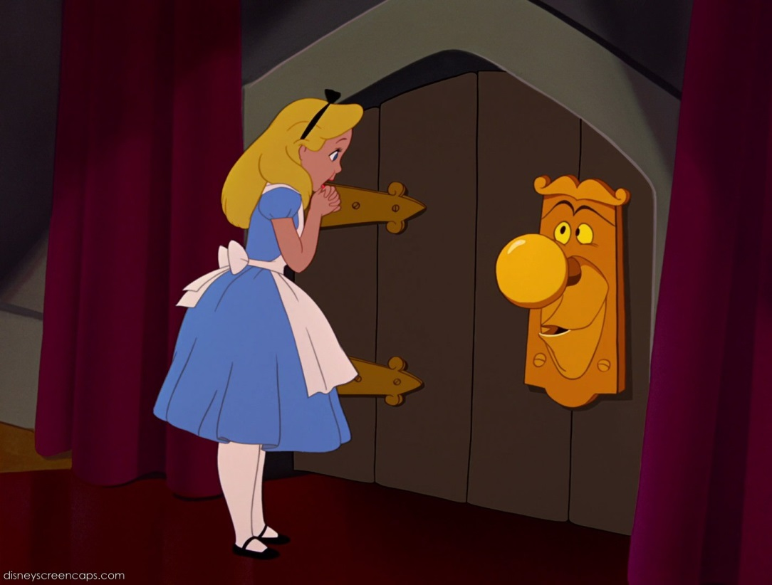
Door #2: Rhetorical Analysis
and Creation of Texts
Just drink the magic potion –
ethos, pathos, and logos.

Slide 13
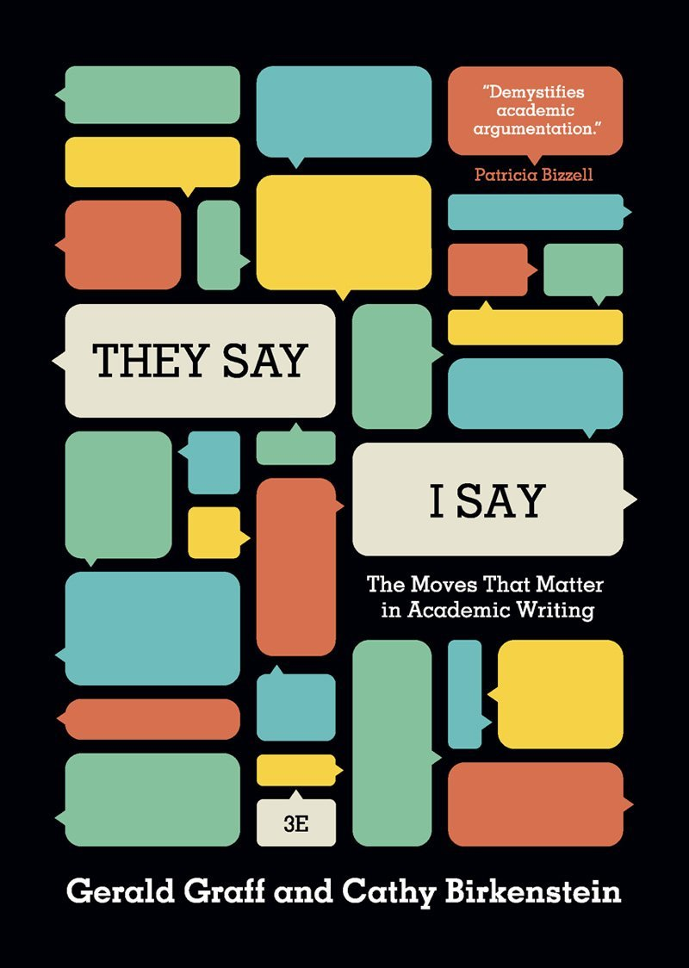
Academic Argument
Templates infuse rhetoric into literature

Slide 14
Apply templates to fiction
Use academic argument
to teach literature…
…and literature
to teach academic argument

Slide 15
Use “They say/I Say” templates to write a rhetorical analysis:
Situate the essay (see question #6 from the homework for 9/25) The rhetorical situation that prompts the essay – the “They say” – is …
What is the “I say”? A closer look, however, reveals that …
Expand the “closer look” (restate/confirm): In other words, the basic argument seems to be the counter-intuitive position that …
Construct a rhetorical analysis: At first glance, we are convinced that … because of the effective use of ethos, pathos, and logos. The author is able to make the characters believable and credible (ethos) because … Also, the author makes effective use of pathos – stirring up the emotions of his audience when he … Finally, the logos or logic of the story is inescapable – namely, that …

Slide 16
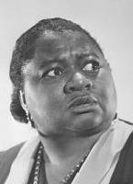
“Thank you, Ma’am!”
By Langston Hughes

Slide 17
Maylinh Cruz, “Thank you, Ma’am” Rhetorical Analysis
Common sense seems to indicate that when a street thug tries to steal a woman’s purse late at night in the street she should let go and give into the attacker’s demands. Therefore, in the situation that Mrs. Luella Bates Washington Jones finds herself, it is surprising that she fights back. She kicks and grabs the boy by the shirt, demands that he pick up her pocketbook, and takes him to her home.
Hughes is able to make both characters believable because at the beginning of the story he describes Mrs. Jones as a “...large woman with a large purse that had everything in it but a hammer and nails.” Hughes also then describes the boy as frail and a willow-wild; this makes the readers believe that the story could happen as Hughes describes it.

Slide 18
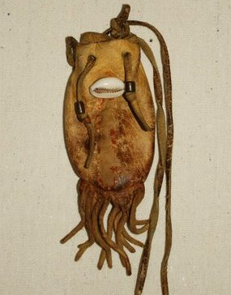
The Medicine Bag
By Virginia Driving Hawk Sneve

Slide 19
Kelly Ferster, “Medicine Bag” Rhetorical Analysis
We are convinced that Sneve proves that children who are coming of age encounter problems of self-identity with her effective use of ethos, pathos, and logos. First, Sneve is able to make her characters believable and credible through the use of ethos. Also, she makes effective use of pathos – stirring up the emotions of her audience – when she has the grandpa faint and then explains that he is lonely all the way up in Iowa. Last but not least, the logos or logic of the story also supports the commonplace. When you come of age, you start to have problems with self-identity. For example, when grandpa comes to visit the family, the great-grandson becomes embarrassed that his grandpa does not live up to how he presented him to his friends.

Slide 20
The Scarlet Ibis
By James Hurst

Slide 21
Gerald Wilson, “Scarlet Ibis” Rhetorical Analysis
A Brother and His Keeper: It’s often said that brothers should get along and take care of each other. However, a closer look reveals that the bond the two brothers have in the “Scarlet Ibis” is not the stereotypical one that most people might believe brothers should have. First Doodle gets to live only after his brother sees a slight smile on his face while contemplating smothering him. He then gets the name “Doodle” only after his brother decides William Alexander is not good enough. And he finally learns to walk and run only after his brother feels ashamed and embarrassed to have a crippled brother.

Slide 22
Can rhetoric give students the power
to determine the quality of the literature they’re reading?

Slide 23
Use rhetorical analysis to synthesize the three stories – “Thank You Ma’am,” “The Medicine Bag,” and “The Scarlet Ibis”
PROMPT:
Using the three rhetorical appeals of Ethos, Pathos, and Logos as the basis of comparison, compare and contrast how the authors persuade us regarding the effectiveness of their stories. Then, come to a conclusion about which story is the most effective rhetorically.
FIRST, ESTABLISH THE COMMONPLACE/THESIS:
It seems like it’s only common sense to say that all stories are different, that they have different characters, settings, plots, and themes. But a closer look reveals that in many ways all stories are the same in that they all use rhetorical appeals – ethos, pathos, and logos – to persuade us that they are real and true. Looking at stories as rhetoric, then, enables us to evaluate them because not all efforts at persuasion are equally as effective, so we should be able to rate the three stories we have read in terms of their rhetorical effectiveness.

Slide 24
SECTION #1: First let’s examine how each author uses ethos to develop the believability of their characters because if the characters aren’t believable, no one would read the stories. Compare and contrast the “Ethos” of the characters in each story to those in the other stories.
SECTION #2: Certainly just as important as ethos is the pathos the writer uses to stir up our emotions, usually about the characters, to make us care about them and what happens to them. Compare and contrast the “pathos” of the characters in each story to those in the other stories.
SECTION #3: Sometimes the logic of a story is not given as careful attention as ethos and pathos because it relates more to the workings of the plot and the believability of the setting – in other words, we care more about people than places, things, and ideas. However, if the plot doesn’t work, then it really doesn't matter how deeply we care about characters because if the plot of the story doesn’t work then all is for naught. Compare and contrast the “logos” or logic of the plot and setting in each story to those in the other stories.
CONCLUSION: After comparing each story based on how well the author uses ethos, pathos, and logos to persuade us of their story’s authenticity, it seems clear that ___________________ is the best story because __________________________.

Slide 25
Connor Vasa, Using Rhetorical Analysis to Evaluate the 3 Stories
CONCLUSION: After comparing each story based on how well the author uses ethos, pathos, and logos to persuade us of their story’s authenticity, it seems clear that Scarlet Ibis is the best story because how effective the author uses Aristotle’s appeals. The author leaves no doubt that his characters are not one hundred percent believable unlike the other two stories. This proves the authenticity of the pathos we felt throughout the story were real. Lastly he has a strong moral that is applicable throughout the story. It is qualities like these that make this story more genuine then the rest.

Slide 26
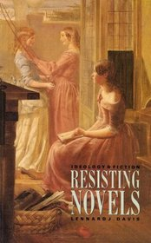
Is Literature Itself a Rhetorical Construction?

Slide 27
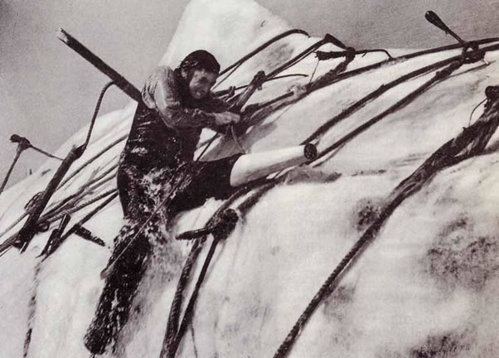
The Whale Didn’t Kill Ahab…

Slide 28
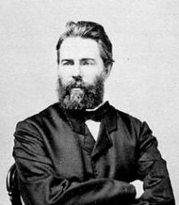
…Melville Did!
Jerry Cleaver, Immediate Fiction

Slide 29
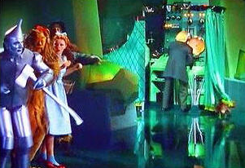
Students have power over text!
Pay no attention to the man behind the curtain!

Slide 30
Use Grammar and Rhetoric
to Construct a Story
WHEN meaning
WHERE meaning
WHY meaning
WHO meaning
WHAT meaning
HOW meaning
Adverbs, Prepositional and Infinitive Phrases, and Dependent Clauses

Slide 31
Create your own “kernel sentence.”
Then create WHEN, WHERE, and WHY meaning.
Example: Late Friday afternoon while we were walking home after school, my friend and I decided (KERNAL SENTENCE) to take off together for Las Vegas over the weekend where we didn’t know a soul, just to get away because we were bored and couldn’t think of anything else to do.

Slide 32
Example: The sentence begins with WHEN information – first, a triple-word adverb (Late Friday afternoon), followed by a dependent clause (while we were walking home) and finally a prepositional phrase (after school). This deviates slightly from the “standard” construction in that the prepositional phrase follows rather than precedes the dependent clause, but this is necessary because the prepositional phrase is part of the clause rather than a separate piece of information. However, just like the recommended structure, all of the WHEN information does precede the Subject-Verb-Object of the kernel sentence—my friend and I decided to take off.

Slide 33
Expand on the sentence you have created using the same formulas for creating WHEN, WHERE and WHY meaning in your new sentences. The trick to this part is to create New Information based on what is now Known.

Slide 34
Halloween Nightmare by Maylinh Cruz
Late last night in the middle of the Halloween Nightmare party while everyone was dancing, a man in a grim reaper costume made his way through the crowd and into the basement to grab another case of beer. There the man realized that he was not alone and turned to see a scrawny young boy named Fred, who he recognized. Fred was facing the back wall where the decorations were kept; he was wearing a cowboy hat, brown boots, and a rope hanging from his side. The grim reaper slowly approached Fred and with a tight grip grabbed the back of his shirt. Stunned, Fred just stood frozen, and the grim reaper spoke in a deep strong voice, “Where’s my money Fred?” With a high-pitched voice, Fred began to explain and tried to make an excuse, but they both knew that Fred would never be able to pay. Without any mercy he grab Fred, turned him around, looked him straight in the eye, and snapped his neck.

Slide 35
Grammatical Analysis
At the beginning of the sentence are three WHEN adverbs (“Late last night”), followed by a WHEN preposition “in the middle of the Halloween Nightmare party”, and finally a WHEN dependent clause “while everyone was dancing.” This follows the WHEN recommended structure and fits in well with the sentence. The WHERE preposition are three words in the sentence, “The grim reaper had been following them all along and was watching their every move from outside near the tree”. The words along, from, and outside all help establish the sentence. This information is then followed by a WHERE subordinating conjunction “where he was planning to capture his next victims”. Although the sentence does not have a WHERE adverb like the recommended structure, the sentence still works and it is not needed.

Slide 36
Rhetorical Analysis
From the very beginning “Halloween Nightmare,” the readers know that this is not going to be a happily ever after story. The story begins with a young boy named Fred being killed without mercy. Shorty after, three girls find his body and consequently lose their lives because of the crime they walked into. The story is able to be credible by using ethos, pathos, and logos.

Slide 37
CONCLUSION – LITERATURE IN THE COMPOSITION CLASSROOM
Does it help students “appropriate and be appropriated be a specialized discourse”?
Does it help them “invent the university by assembling and mimicking its language”?
Does it help them “learn and speak our language”?
In other words, does it support “what we do around here”?

Slide 38
YES!

