Slide 1
A Framework within a Framework:
Addressing Reading Outcomes within the ALP model

Slide 2
Framework within a Framework: Addressing Reading Outcomes within the ALP model
Francie Woodford, Ph.D.
Community College of Philadelphia
fwoodford@ccp.edu
ALP Pilot Spring 2018: ESL and Developmental

Slide 3
Reading is the Key
Xijun Huang
Apr 17, 2018 Apr 17 at 11:47pm
Hi Siarhei
Could you tell me how do you know that much about paraphrase, because I still confusing about it?

Slide 4
Siarhei Starasvetski Apr 21, 2018 Apr 21 at 2:33pm
Thank you Xijun. Alright, let me tell you my little secret: I read a lot. First of all, reading helps me to expand vocabulary and secondly, unconsciously I memorize how other writers structure their sentences. As a result of this practice, I developed a sense what is right and what is not. If you are asking me how I do that, my answer is I don't know. I use my inner feelings which I believe were developed through the reading. Moreover, I have not attended any schools in the US and have never written in English more than one sentence in my life, until this semester in the school of course. Reading is the key to your question.

Slide 5
Pre-College Reading Outcomes: Literal vs. Implied Meaning
Comprehension
Summary
Paraphrase
Annotation
Vocabulary

Slide 6
Reassessment of Teaching and Learning
Rethink pre-college reading (Hayes et al., 2018)
Revise teaching and learning based on cognitive science research (Brown et al., 2014)
Revive Bloom’s Taxonomy (Bloom, 1956)

Slide 7
Rethinking Developmental Reading (adapted from Hayes et al., 2018)
Skill-Embedded Curriculum: backward design and authentic academic (whole) texts, mini-lessons as needed or requested, segmented (engaging) questions with Bloom’s taxonomy and critical thinking as hierarchical goals
Thinking-based Pedagogy: Thematic approach with active learning techniques, growth mindset (lose assumptions about order of learning), “triage” (aka “just in time remediation”)
Growth-Centered Assessment: multiple low-risk writing opportunities before larger tests and essays (holistic, progressive approach to grading), reflective and metacognitive, (self, peer and teacher) meta-cognitive reflection and evaluation

Slide 8
Cognitive Research (Brown et al., 2014)
Use Testing as a Tool for Learning
(aka formative vs. summative testing)
“Testing not only measures knowledge but changes it….this is one of the most powerful learning tools we have.” –Roediger

Slide 9
Dynamic Testing (Brown et al., 2014, p. 152)
Step 1: A test of some kind—perhaps an experience or a paper exam—shows me where I come up short in knowledge or a skill.
Step 2: I dedicate myself to becoming more competent, using reflection, practice, spacing, and other techniques of effective learning (where, when and how I study for deliberate practice).
Step 3: I test myself again, paying attention to what works better now but also, and especially, to where I still need more work.

Slide 10
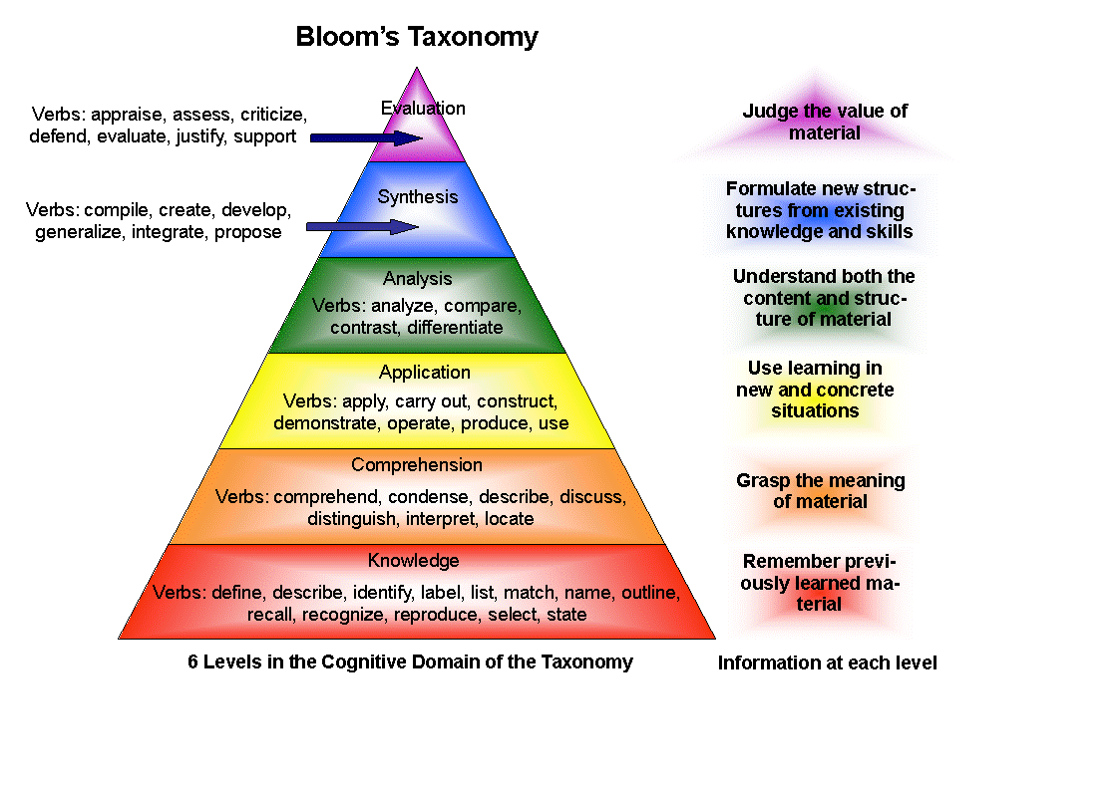

Slide 11
Weekly Schedule for a class meeting twice a week
Day 1
Due: Annotation of longer reading (content / page-turner) and Video post paragraph 7-10 sentences
In Class: Discuss, debate, present reading before short-essay test
Short-essay tests: graded, rewritten and posted on Day 1 every week
Day 2
Due: Shorter reading, on-line quiz (5 T/F or multiple choice questions), blogging to Day 1 video post, writing (peer review/essay drafts)
In Class: Go over T/F quiz, group work / peer review or workshop on drafts
Return: short-essay tests from Day 1 to be rewritten and posted before next class

Slide 12
Grade Breakdown
Freshman Composition (101)
Pre-College English (098)
Interactive Learning: in class and on line (discussions, blogging and surveys) | 10 points (Extra Credit possible)
10 online quizzes | 10 points
10 in-class short-essay tests | 10 points
4 Essays: | 55 points:
Essay 1: Informative | 10 points
Essay 2 Midterm: Analysis / Argument | 15 points
Essay 3: Research | 20 points
Essay 4 Final: Persuasive | 10 points
3 Peer review letters (5 points each) | 15 points
Portfolio Cover Letter | Extra Credit
Total Points | 100 points
Interactive Learning: discussions, blogging and surveys (activities both in class and online) | 50 points
Rewrite 101 short-essay tests (Posted on Canvas) | 50 points
Total points | 100 points

Slide 13
Freshman Composition (101)
Interactive Learning: in class and on line (discussions, blogging and surveys) | 10 points (Extra Credit possible)
10 online quizzes (5 T/F questions) | 10 points
10 in-class short-essay tests | 10 points
4 Essays: | 55 points:
Essay 1: Informative | 10 points
Essay 2 Midterm: Analysis / Argument | 15 points
Essay 3: Research | 20 points
Essay 4: Persuasive (In-class writing) | 10 points
3 Peer review letters | 15 points
Portfolio Cover Letter | Extra Credit
Total Points | 100 points

Slide 14
Pre-College English (098)
Interactive Learning: discussions, blogging, and surveys (activities both in class and online) | 50 points
Rewrite 101 short-essay tests (Posted on Canvas) | 50 points
Total points | 100 points

Slide 15
References
Bloom’s Taxonomy (1956): Image retrieved from https://www.google.com/search?q=bloom%27s+taxonomy+image
Brown, P.C., Roediger III, H.L., & McDaniel, M.A. (2014). Make it stick: The science of successful learning. Cambridge: The Belknap Press of Harvard University Press.
Hayes, S.M., Lassen, L., Parker, D., & Parker, N. (2018). Amping Up Developmental Reading, Writing, and Critical Thinking for Academic Success [PowerPoint slides]. CADE 2018 website.

Slide 16
Appendix
SLOs and Sample Assignments

Slide 17
Reading SLOs
ESL and Developmental English

Slide 18
SLOs: Comprehension
ESL
Developmental English
Answer comprehension questions eliciting both literal and implied meaning of the author.
Draw conclusions about the meaning(s) of a text.
Discuss interpretative issues.

Slide 19
Directions: Comprehension Questions
Choose ONE questions to answer (or both for extra credit). Do not copy from the text. Your answer must be in your own words. Give your interpretation, not your opinion.
Write a complete paragraph (7-10 sentences) following academic format. First, answer the question directly in the first sentence, introducing the title and the author; then, explain your answer based on the context of the reading, and conclude by returning to your answer and connecting it to the support you provided. Finally, remember to re-read your answer carefully to check your grammar, spelling and punctuation.

Slide 20
Sample Questions: Comprehension / Interpretation / Inference
Explain the meaning of the title “Lost in the Middle” based on your understanding of the reading.
In “Marita’s Bargain,” what is Malcolm Gladwell suggesting that we do to improve education in the U.S.?

Slide 21
SLOs: Summary
ESL
Developmental English
Write a coherent summary with minimal grammatical errors.
Summarize a variety of texts to develop and demonstrate comprehension.

Slide 22
Sample Directions: Interpretive Summary
Interpretive summaries test your ability to interpret the main point of the author. A summary includes an explanation of the author’s main points, not your opinion. An interpretive summary is short, so do not include details or examples. Write the summary as one paragraph (7-10 sentences).
Choose ONE question to answer (or both for extra credit). Do not copy from the text. It’s VERY important that you use the context of the reading. Also, if you copy too much from the reading or the dictionary, your answer will not receive any credit. Explain your answers in your own words. Always remember to re-reading checking your grammar, spelling and punctuation.

Slide 23
Sample Question / Outline
1) Introductory Sentence(s): In chapter three of Outliers, “The Trouble with Geniuses, Part 2,” Malcolm Gladwell … (Choose a verb from Graff and Birkenstein (39-40) to complete the first sentence with your interpretation of the main point.)
2) Body Sentences: Explain your interpretation of the main point without going into detail or examples.
3) Concluding Sentence(s): Synthesize your interpretation of the main point with your explanation in the body.

Slide 24
SLOs: Paraphrase in Context
ESL
Developmental English
Paraphrase ideas in reading texts without altering meaning.
Demonstrate ability to use vocabulary from the readings in original sentences.
Paraphrase a short passage to develop and demonstrate comprehension.

Slide 25
Sample Directions: Paraphrase in Context
A paraphrase is a translation in your own words using third person. Introduce your paraphrase by introducing the author and the context. “Context” is another way of saying the “situation” or the paragraph of the reading. Ask yourself questions (e.g., who, what, where, why and how) to help guide you. Remember not to copy from the reading or the dictionary; otherwise, your answer will not receive any credit. Always remember to re-read your answers to check for grammar, spelling and punctuation.

Slide 26
Sample Questions: Paraphrase in Context
Introduce your paraphrase following in the models in Graff and Birkenstein (47):
1) “We pretend that success is exclusively a matter of individual merit” (Gladwell, Outliers, 67).
2) “…there is a reproducible correlation between the time required to pronounce numbers in a given language and the memory span of its speakers” (Gladwell, Outliers, 228).

Slide 27
SLOs: Annotation
ESL
Developmental English
Annotate a given text to summarize main ideas and supporting details and express responses.
Employ active reading strategies to demonstrate understanding of a variety of texts, including differentiating between main ideas and supporting details.

Slide 28
Annotation Directions
Annotation means taking notes on the page (in pencil so that you can erase it). If you highlight or underline main points, you write a note in the margins to remind yourself why you think this point is important. As you read, ask yourself, “What did I learn?” and “How can I apply this knowledge to what I already know?” Think of the words on the page as the author talking to you and your comments in the margin represent your response. Symbols (e.g., ! @ # $ % ^ & * ( ) [ ] { }) can be used to indicate your responses. Also, circling words (e.g., names, dates, places and unknown vocabulary) will also help to highlight context. Write comments to help you remember the reading.

Slide 29
SLOs: Vocabulary
ESL
Developmental English
Discern word meaning via dictionary use, context clues and identification of word parts.
Discern word meaning, using vocabulary development strategies, to increase understanding of a text.

Slide 30
Sample Directions: Vocabulary in Context
First, if necessary, choose the correct meaning from the dictionary for the context in the reading.
Second, notice how the words are used in the sentence: What part of speech are they (e.g., noun, verb, adjective)? If you don’t know, look in the dictionary.
Third, introduce your paraphrase by identifying the context, the referent and the person who is saying the quote. Use your own words in third person. In other words, what does this word mean in this sentence? Finally, paraphrase the sentence focusing on the meaning of this word in the context.
Finally, check your grammar, spelling and punctuation for full credit.

Slide 31
Sample Questions: Vocabulary in Context
In chapter one of Outliers, Gladwell describes the notions of (individual) meritocracy (16-17) vs. “accumulative advantage” (30). Explain the literal meaning of these words and Gladwell’s main point in this chapter.
Anomalies (Gladwell, Outliers, 197): “Mitigation explains one of the great anomalies of plane crashes.”
Indelible (Gladwell, Outliers, 219): “But he didn’t assume that legacies are an indelible part of who we are.”

