Slide 1
Taking it to the
Next Level
Asset-model Accelerated ESOL as
Global / Anti-xenophobia Education
David Hewitt, Community College of Baltimore County

Slide 2
Quick Survey
How many have taught an accelerated / co-requisite ESOL writing course?
Slated to teach one?

Slide 3
Brief History of ALP-ESOL (I)
Created by Robert Miller, a founding father of ALP (Essex campus)
2012: I developed course at Catonsville, in consultation with Bob and with our ESOL dept.; 12 semesters and counting
Refinements: Culturally Responsive Teaching, Global Distinction (certified), Contemplative Pedagogy

Slide 4
Brief History of ALP-ESOL (II)
Discussion: Difficult to scale up; eliminate?
All-ELL Composition sections instead?
My contention: In this era more than ever, American-born students and immigrant / Gen 1.5 / international students need to be shoulder to shoulder in the same classroom.

Slide 5
ALP-ESOL: Structure
Cohort of 10 non-native speakers takes ESOL Writing (6 hrs.) and College Composition (3 hrs.) concurrently.
College Comp. section also includes 10 conventional English 101 students.
Diversity is baked right into the course!

Slide 6
My two questions:
1) How can I best help students
master academic and professional
English?
2) How can I maximize multicultural learning
and help vanquish xenophobia, using
both curriculum and the diversity
present in the classroom?

Slide 7

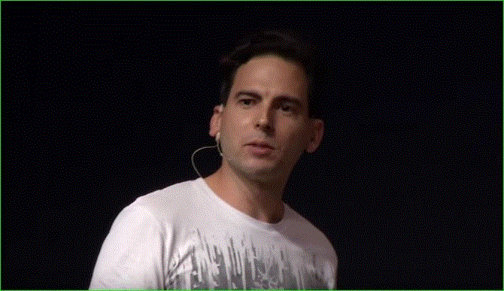
Readings/Texts as Global/
Anti-xenophobia Education (consider both content
and messenger)
Note: This
and some
other sources
mentioned
are hyperlinked
in this PPT
Eduardo Briceño
(mindset / how we
shape ourselves)

Slide 8
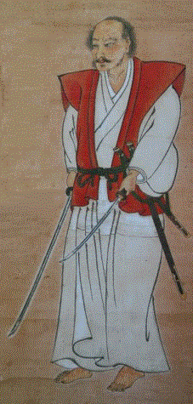
Readings/Texts
“Today is victory
over myself of
yesterday.”
—Miyamoto Musashi
Japanese master swordsman;
author of The Book of Five
Rings
(mindset / how we shape
ourselves)

Slide 9
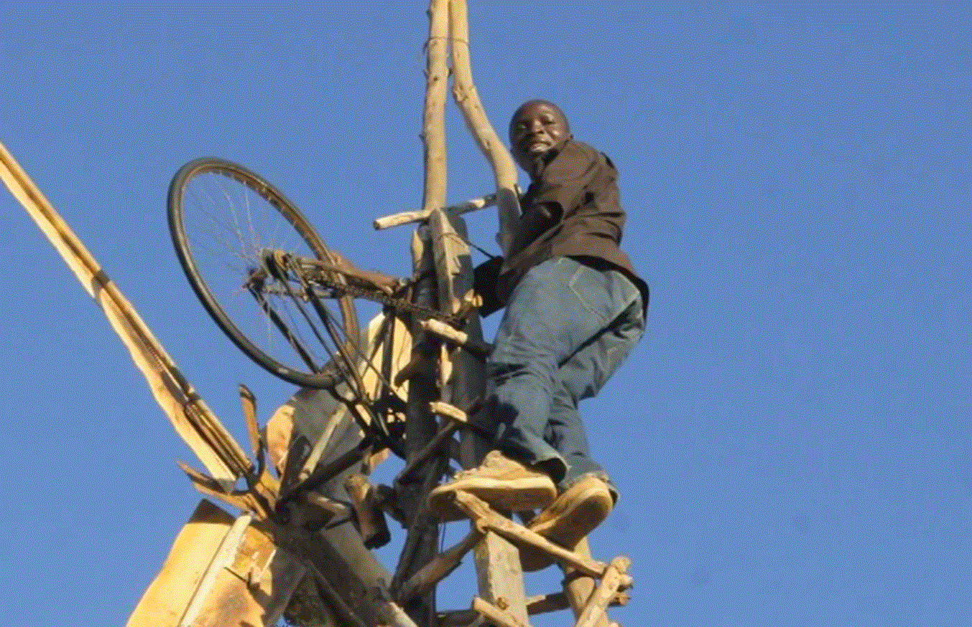
Readings/Texts
William Kamkwamba
(how we shape
ourselves /
our world)

Slide 10
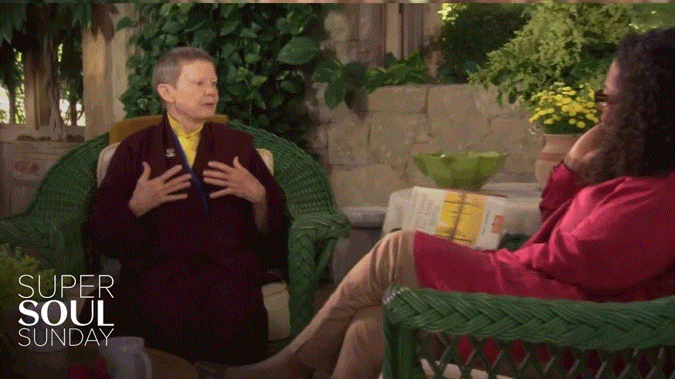
Readings/Texts
Pema Chödrön, interviewed
by Oprah
(how we shape ourselves)

Slide 11


Readings/Texts
(how we shape ourselves / our world)

Slide 12



Readings/
Texts
(how we
shape our
world)

Slide 13

Readings/
Texts
(how we shape
ourselves /
our world)

Slide 14
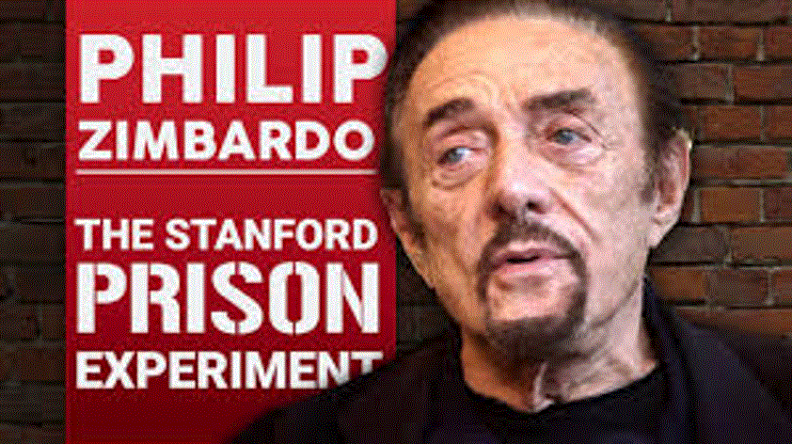
Readings/Texts
final essay: mindset/impact on world

Slide 15

Writing as Global / Anti-xenophobia
Education
Interview Essay
Instructor-assigned partners, chosen for diversity and (fingers crossed) compatibility
Preliminary pair work: partner, not obstacle
Interview time in class, but not enough − they communicate outside class too
Peer edit together

Slide 16
Writing
Research groups
Library instruction session: group activities (bonus: non-native speaker library specialist)
Grouped by related topics (as much as possible)

Slide 17

Classroom Diversity
as Anti-xenophobia / Global Education
Welcoming, friendly atmosphere
Introductions / icebreakers
Know (preferred) names and where they’re from--ASAP
Instructor’s pro-active efforts to connect

Slide 18

Classroom Diversity
Classwork points for speaking up
In discussions, mix of voluntary
and randomly selected participation
“Breathing room” / time to think (pace)
Pair or group work on low-stakes or no-stakes assignments
Discussion / collaboration over debate

Slide 19

Classroom Diversity
Level playing field via
topics / texts / authors
Model a growth mindset toward diverse cultures by asking questions, deferring to students as authorities on their cultures
Model admiration, not judgment or patronizing sympathy, toward those striving to use (academic) English as a 2nd, or 3rd, or 4th language

Slide 20
Other tips regarding the ESOL cohort:
As safeguard against cheating /
“too much help”: in-class essays for Comp.
Strongly encourage use of office hrs./tutoring support
Non-cognitive / personal challenges: use institutional support services, but follow up (esp. w/small class size). Also: no substitute for approachability, camaraderie, and the grapevine

Slide 21

That’s my spiel . . .
What about yours?
What methods have you used to
turn diversity into learning?
What has worked well? What
hasn’t?
What methods are you considering
trying in the future?

Slide 22
Contact/About Me
Please feel free to contact me with any questions about ALP-ESOL: dhewitt@ccbcmd.edu
My background:
M.F.A. Creative Writing, Univ. of Southern Maine; B.A. East Asian Studies, Wittenberg University
Asst. Prof. of English, CCBC - Catonsville
Have taught ESOL at various levels for Carroll Community College (MD) and Community College of Baltimore County
Taught English to various age groups/levels for 8 years in Japan
Worked for 7 years as a Japanese-English interpreter/translator
Taught Japanese: magnet middle school, community college continuing ed., private tutor

