Slide 1
DEVELOPMENTAL EDUCATION MEETS DUAL ENROLLMENT: ALP FOR HIGH SCHOOL STUDENTS
PRESENTERS FROM NEW JERSEY
Denise Coulter: Dean of Liberal Studies, Atlantic Cape Community College
Henry Jackson: Executive Director of Academic Success, Ocean County College
Heather Jennings: Professor of Psychology, Mercer County Community College
Marva Mack: Associate Dean Pre-College Readiness Programs and Initiatives, Essex County College
Jennifer Martin: Associate Professor of English, Salem Community College
Donna Rogalski: Assistant Director, NJ Center for Student Success

Slide 2
DONNA ROGALSKI ASSISTANT DIRECTOR NJ CENTER FOR STUDENT SUCCESS
NJ Center for Student Success Overview
College Readiness Now grant Overview
Introductions of panelists
Notes:
ALP design in the high school (which model did you choose – ensuring the developmental part is the high school graduation requirement and not the 100 level course)
curriculum design (implementing the co-req part = hybrid, NROC, cross training, ; student success strategies infused into curriculum)
establishing college and high school partnerships (challenges to establishing; new vs. strengthening and how did you do this – grant was catalyst – capitalize on those who already are working with your high schools - meeting the needs of the high school)
managing transportation logistics (location - high school vs college; and busses or public transportation)
assessing multiple measures for course placement (who gets to take the course – Accuplacer, GPA, PARCC, SAT, PSAT, ACT, teacher/guidance recs, test-prep before determining course placement)
credentialing of teachers (who can teach which part of the course and when do they teach it)
Preliminary Success Data (enrollment numbers in general, Grades/Credits/College Ready; enrollment to your college – enrollment into ENG 2; persistence data – comparison of High School ALP vs. college ALP)

Slide 3
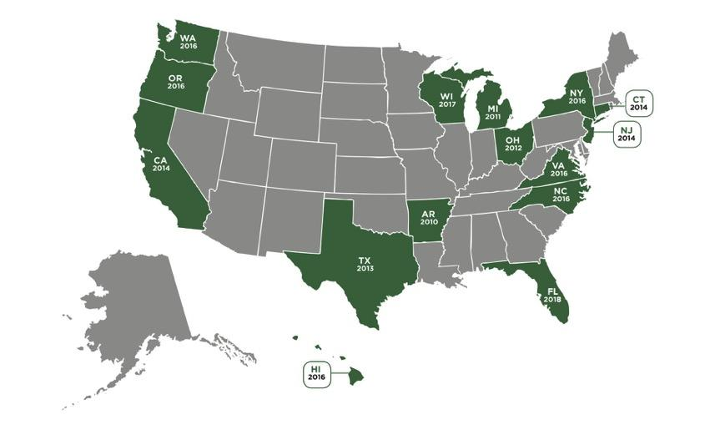
https://www.jff.org
Notes:
Mapping pathways
Helping students choose and enter a path
Keeping students on the path
Ensuring that students are learning

Slide 4
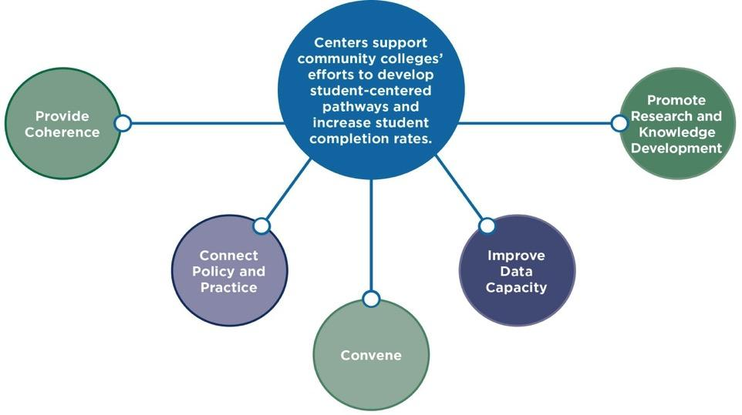

Slide 5
COLLEGE READINESS NOW IV
4th year of the non-competitive grant - fiscal year cycle
Serves current 11th and 12th grade high school students
Primarily for those living below the poverty line
Should be at no cost to the student
To get students college ready in math and/or English (eliminate developmental ed)
Must show a collaboration with the high school
Must also include a student success component
Can take place at high school or college
Can use multiple measures to decide eligibility
Can be delivered in any format: traditional dev. ed. options or ALP

Slide 6
Panelists
Denise-Marie Coulter: Dean of Liberal Studies, Atlantic Cape Community College
Henry Jackson: Executive Director of Academic Success, Ocean County College
Heather Jennings: Professor of Psychology, Mercer County Community College
Marva Mack: Associate Dean Pre-College Readiness Programs and Initiatives, Essex County College
Jennifer Martin: Associate Professor of English, Salem Community College

Slide 7
Challenges:
College English Faculty Reservations:
Could ALP be authentically replicated at the high school?
Could students be placed via multiple measures?
High School Worries
Once the HS year is programmed, it’s difficult to make adjustments
“Jump Start” testing didn’t take place until January/February
Students engaged in extracurricular activities could not participate
Resolutions:
Dyad hybrid. ALP met on Tues. & ENGL101 met on Thurs. Additional assignments completed through CMS
Met after school on the HS campus for 12 weeks (March through May)

Slide 8
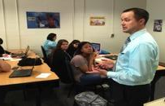
Held Information Session for Students and Parents
Instructor: current English adjunct
Trained in delivering ALP courses
Former HS Special Education Teacher
Periodic visits from college representatives:
Library/Tutoring Services
Student Activities
Career Counselor
Financial Aid
Rutgers University
Afton Koontz, Instructor.
Jason Jankowski of Rutgers University discusses transfer options with HS students.
Dr. Denise-Marie Coulter
Dean of Liberal Studies

Slide 9
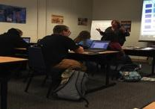
17 students successfully completed: 12 ALP/5 ENGL101
Feedback from HS counselor:
“The kids got a much needed dose of what lies ahead for them as college students and I couldn’t have asked for a more professional and patient professor to introduce them to a college-type setting.”
Dr. Tammy DeFranco, Director of CMCC Student Services, leads HS students through a career exploration workshop.
Notes:
How many were enrolled?

Slide 10
Survey Results:
86% of students pursued this opportunity to save money; 79% were interested in earning college credits in HS
92% reported they planned to attend Atlantic Cape in the fall
Reported benefits from students:
“I learned responsibility, making study groups, and basic college skills.”
“It saved time and money”
“I had a good professor to teach this course, and the ALP program should stick around for other students to benefit from earning college credits ahead of time.”

Slide 11
Henry Jackson, Ed.D. Executive Director of Academic Success Ocean County College

Slide 12
ALP design in the high school
OCC offered two English ALP courses:
District one embedded the course and the workshop into the students regular school day;
District two offered the course once a week after school and the workshop was offered once a week after school.
District two contained two high schools and allowed students from both high schools in the district an opportunity to participate.

Slide 13
Establishing college and high school partnerships
Year one of the College Readiness Now Grant we started with three schools
Year two we moved from three schools to seven schools
To date we have established and sustained partnerships with 16 Ocean County High School Districts and two Ocean County Vocational and Technical Schools

Slide 14
Managing transportation logistics
For district one: transportation was not a problem because the course was held during the regular school day;
For district two: the course took place after school at one of the district’s high schools;
Since students from both district high schools were able to participate, students were provided transportation to the high school by the district, however; students had to find there own transportation home.

Slide 15
Assessing multiple measures for course placement
A variety of measures were used to determine college readiness (ACT, SAT, PSAT, PARCC, OCC Accuplacer). In some instances performance in high school was also used.

Slide 16
Curriculum design
OCC offered two ALP courses and used the ALP Model where half the class was college ready and the other half were developmental students (i.e. not college ready).
All students attended a 3-hour per week course and the students who were not college ready also attended a reading/writing workshop for two hours a week.

Slide 17
Credentialing of teachers
The hiring Dean shall be responsible for reviewing, analyzing, and verifying applicant transcripts and related degrees, teaching history, professional experience, and certifications. A Faculty Credentials Audit and Verification Form (Attachment A) and related formal analysis must be completed for each candidate recommended for hire. These analyses are finalized via approval of the Provost and President (or designee). Educational Criteria
Master’s degree from a regionally accredited institution of higher education in the field of specialization for which he/she is making application; or
A Master’s degree from a regionally accredited institution of higher education in a different field from the one for which the candidate is making application plus 18 graduate credits in the field for which he/she is making application; or
A Master’s degree from a regionally accredited institution of higher education in a different field from the one for which the candidate is making application plus related professional field experience and/or certification/licensure in the field for which he/she is making application; or
A Bachelor’s degree from a regionally accredited institution of higher education plus five years full-time teaching experience in the field of specialization for which he/she is making application may be accepted as equivalent provided a written rationale, including superior teaching evaluations, is submitted by the hiring Dean for approval by the Provost and the President (or designee). Applicants hired without a Master’s degree will be required to obtain 18 graduate credits in the field of specialization within five years of hire and to obtain a Master’s degree in the field of specialization within nine years of hire.

Slide 18
Success Data
District one had 21 students
One withdrew, One received a grade of “D”, 19 received a “C” or better.
District two had 23 students
Seven never attended, Two received a grade of “F”, 14 received a “C” or better.

Slide 19
Student Feedback
Q: Anything else you would like to comment about the course:
“The instructor was amazing and taught me more than I ever learned in one semester.”
“I am glad I took the course because I learned so much information that I know I am going to remember.”
Q: What did you like about the course:
“That it was structured and taught important topics needed to be successful in college.”
“I liked that this course used important and valuable lessons from the textbook to help us write better essays. Everything tied together nicely and made sense.”

Slide 20
Teacher Feedback
Dr. Jackson,
“I had a wonderful experience teaching the ENG 151 ALP course this semester. I wholeheartedly believe in the ALP model because I witnessed the progress made by all students, especially those who participated in the writing lab portion. These students, at the beginning of the semester, lacked many of the skills needed to be successful in college. For example, they struggled with reading the assigned chapters and taking notes. As most of the students are struggling readers, for first few writing workshop classes, I concentrated on close reading, organization, and annotation. Quiz grades increased almost immediately. I cannot say enough about the benefit of the writing lab. It allowed me to reinforce concepts and to help students to master skills. I was able to differentiate instruction to cater to individual needs, and I believe this increased both student commitment and engagement in the course.”

Slide 21
HEATHER JENNINGS, Ph.D. Professor of Psychology
Chair, Social Science Department Mercer County Community College
Summer XL Program

Slide 22
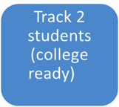
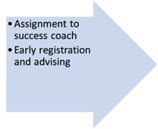
Summer XL
Track 1 students
(non-college ready)
Receive two-week Developmental Seminar
Accuplacer post-test
Mandatory success coaching sessions
Additional in-class resources and support
ENG 101 (ALP)
Summer B Session
Accuplacer Preparation Module (Bb)
Accuplacer testing
PHASE 1
PHASE 3
PHASE 2

Slide 23
Resources to increase success outside the classroom!
Individual success coaching sessions (2+ hours/student)
Additional in-class support
Success navigator assessment (non-cognitive domains)
College orientation
Early registration and advisement

Slide 24
Sample (n = 36)
Current high school juniors and seniors recruited from 13 local area high schools
19 juniors(54%)
16 seniors (45%)
47% female
53% male
Majority of students represent low SES communities
Trenton district (economic disadvantage = 73%)
Trenton Central High school
Trenton West
Daylight/Twilight alternative school

Slide 26
Our biggest challenge was recruitment
Which highlighted the importance of community partnerships and increased communication with high school staff/administrators.

Slide 27
@ESSEX COUNTY COLLEGE
the SATURDAY ACADEMY
Marva R. Mack Associate Dean
Pre-College Readiness
Essex County College
Newark, NJ

Slide 28
Enhance Standing of “AVERAGE” High School Students

Slide 29
DE
DEVELOPMENTAL
COMPLETED ENG 085
PROGRAM RECOMMENDATION

Slide 30
SATURDAY ACADEMY SCHEDULE
8-8:25 BREAKFAST
8:30 – 11:00 ENG 101
11:00 – 12:00 RDG LAB
12:00 – 1:00 LUNCH
1:00 – 2:00 WRTG LAB
March 9 – Jun 23

Slide 31
INDIVIDUALIZED PROGRAM SUPPORT
TUTOR
WRITING SPECIALIST (ENG 096)
TUTOR
ENG 101 INSTRUCTOR
WRITING SPECIALIST (ENG 096)
TUTOR
15:1
8:1
5:1
Program Coord. Site Manager. Associate Dean

Slide 32
PROGRAM OUTCOMES
RETENTION 80% 12/15
ATTENDANCE No one is 100%. Everyone misses with a “note”
AVG GRADE: 101 Take Home: A Timed In-Class B-C
AVG GRADE: 096 A
Extended Course into July

Slide 33
NEXT STEPS
Keep Saturday English Class
Keep Saturday Reading Lab
Add Wednesday Study Zone (Mandatory)
Add ENG 096 Bootcamp prior to ENG 101
Enhance Persistence Components
Add Social Worker

Slide 35
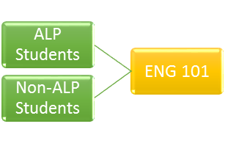
JENNIFER MARTIN ASSOCIATE PROFESSOR OF ENGLISH SALEM COMMUNITY COLLEGE
alp piloted in two high schools (eng 050)
penns grove high school: 14 students
attended classes on scc campus - bus
same instructor taught alp and eng101 classes (ft faculty)
2. salem county votech: 9 students
attended classes at votech
same instructor taught alp and eng 101 classes (adjunct, principal)
Notes:
ALP design in the high school
establishing college and high school partnerships
managing transportation logistics
assessing multiple measures for course placement
curriculum design
credentialing of teachers
Preliminary Success Data

Slide 36
CURRICULUM DESIGN OF ENG 050
2 credit course met immediately after eng 101
placement based on h.s. gpa, accuplacer scores, and/or guidance counselor recommendation
focus on 16 “success strategies”
Using course schedules and calendars to keep track of assignment due dates
Getting organized (creating course binders)
Creating a master study schedule
Taking effective notes in college courses
Building a growth mindset
Using textbook resources
Utilizing the resources at SCC (e.g. library, Academic Support Lab, instructor office hours)
Regularly checking course grades (using Canvas)
Building an academic vocabulary
Managing stress (also, taking effective notes on videos)
“Chunking” larger projects into subtasks
Staying focused on goals (Part I): establishing long-term career goals
Staying focused on goals (Part II): vision boarding
Eliminating distractions and avoiding procrastination
Seeking out supplemental resources
Preparing for final exams
Notes:
ALP design in the high school
establishing college and high school partnerships
managing transportation logistics
assessing multiple measures for course placement
curriculum design
credentialing of teachers
Preliminary Success Data

Slide 37
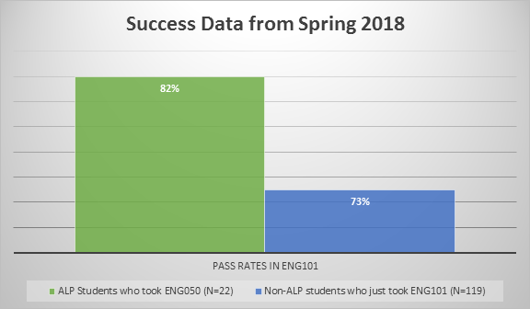
PRELIMINARY OUTCOMES
Notes:
ALP design in the high school
establishing college and high school partnerships
managing transportation logistics
assessing multiple measures for course placement
curriculum design
credentialing of teachers
Preliminary Success Data

Slide 38
FEEDBACK FROM HIGH SCHOOL STUDENTS
“I chose to take English Composition I at Salem Community College this semester because I knew that taking this course would be a great opportunity to get it out of the way. Taking this course is showing me what to expect when I actually begin college.”
“I learned so many new terms I was were not familiar with. I learned how to format papers and become a better [writer]; this class has made me find my passion as a future preschool teacher and I look forward to coming back for my associates degree.”
“I now understand how to write, how to understand questions behind reading, and how to research things thoroughly. Not only that, but it helped me develop time management skills.”
“I'd recommend doing this for any senior to go to a college class during their senior year. Yes it can be a little stressful at times, but I absolutely loved this course! I'm glad I had the opportunity to take it!”
Add in quote from jason
Notes:
ALP design in the high school
establishing college and high school partnerships
managing transportation logistics
assessing multiple measures for course placement
curriculum design
credentialing of teachers
Preliminary Success Data

Slide 39
QUESTIONS FOR THE PANEL

Slide 40
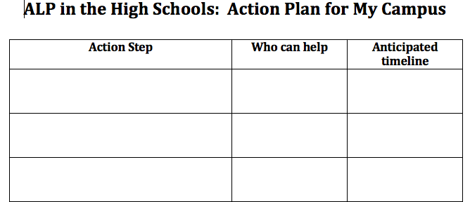
Notes:
Donna

Slide 41
Possible steps to consider:
Create the curriculum to incorporate the co-requisite
Develop job description for the position that will teach this course
Review college level ALP data
Contact local high schools to see if they wish to participate
Work with Admissions/School Relations department on campus to determine via high school partners
Investigate transportation options
Locate space on campus/high school
Find financial resources to help with this idea
Decide what measures can be used to determine who qualifies to participate
Investigate what credentials are possible for those who can teach the course
Investigate any software that can be used in this setting
Determine additional interventions that can be incorporated to help students succeed
Find out what the needs are of the local high schools
Work with Marketing to develop program materials
Determine where at the college this program should be housed
Develop an application and determine what data/information should be collected
Decide who should serve on the college’s strategic team to create this program
Determine who can help champion this initiative
Decide how to register students for the course (are they an official student with your college or not?)
Determine how to bill for the course
Determine how you will collect success data
Create a plan to show college departments the need for such a program (buy-in/ROI)

Slide 42
THANK YOU
Denise-Marie Coulter: Dean of Liberal Studies, Atlantic Cape Community College dcoulter@atlantic.edu
Henry Jackson: Executive Director of Academic Success, Ocean County College hjackson@ocean.edu
Heather Jennings: Professor of Psychology, Mercer County Community College jenningh@mccc.edu
Marva Mack: Associate Dean Pre-College Readiness Programs and Initiatives, Essex County College mack@essex.edu
Jennifer Martin: Associate Professor of English, Salem Community College jmartin@salemcc.edu
Donna Rogalski: Assistant Director, NJ Center for Student Success drogalski@njccc.org

