Slide 1
The Story of a Scale-Up: IRW, Faculty Development, & Framing
Cathy Colton and Tessa Aquino, College of Lake County English Department
CADE Conference, June 7, 2019

Slide 2
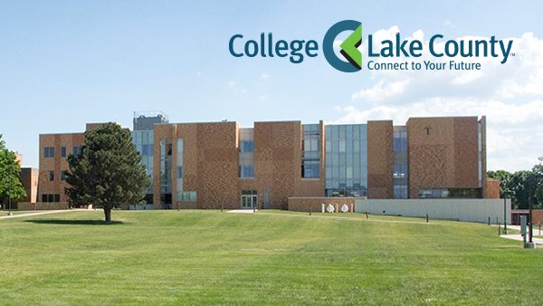
COLLEGE OF LAKE COUNTY
Community college in the northern suburbs of Chicago
Vast disparities in wealth
Approximately 16,000 students
Roughly 75% are part-time
Hispanic Serving Institution
The college has three campuses

Slide 3
DEVELOPMENTAL ENGLISH
Roughly 1/3 of our students place into developmental English
What we call College Reading and Writing Readiness (CRWR) can be determined in multiple ways: ACT score, class rank, GPA, Accuplacer
ENG 108 is a six-hour IRW course
ENG 109 is a three-hour IRW course
Each has the same learning outcomes designed to lead students to CRWR
ENG 121/100 is the ALP alternative to ENG 109, first piloted in 2011
Beginning in Spring, 2020, our ENG 100 scale-up will be complete, and ENG 109 will no longer exist

Slide 4
WHO ARE OUR DEVELOPMENTAL STUDENTS?
Depending on the semester, 65-80% are part-time students
The majority work, with an increasing number working full-time
15-20% are parents
For 40-45%, English is not their first language
~70% are first generation,
Parents of ~ 30% did not complete high school

Slide 5
ENGLISH 100
Since our pilot in Fall, 2011, a one-hour support class for five ENG 109 students taking Comp I (ENG 121)
Each section of ENG 100 is linked with a section of ENG 121, and the two courses are taught by the same instructor
Work on developing, revising, and editing papers assigned in ENG 121, strategies for reading challenging course texts, academic support, and increasingly a focus on non-cognitive issues
“I can ask questions about my assignments and what I can do [with them].”
ENG 100 “gives me an idea of how to become a better writer.”

Slide 6
A successful program
Our data show that 121/100 leads more students both to achieve College Reading and Writing Readiness and to succeed at college composition, getting them one step closer to their goals of a certificate or degree.
The achievement gap for Hispanic and African-American students is lessened with 121/100.

Slide 7
Success data, continued
Fall, 2014 through Spring, 2018:
33% of students who took ENG 109 went on to succeed in ENG 121 (45.4% of those students moved on to take ENG 121, and 69.5% of those who took ENG 121 achieved a C or better)
But, 100% of the 109-placed students who entered the ENG 100 program took ENG 121—by design. 73.5% of them achieved a grade of C or better in ENG 121. So, on average, 270 more students/year would have succeeded at ENG 121 had they taken 121/100 instead of 109.
Notes:
Caveat: We do not know how many of the 109-takers were in a certificate program that does not require ENG 121, and presumably some of those who made it through ENG 109 will take 121 eventually.

Slide 8
Number of sections of ENG 100 since pilot
Fall 11 6 Fall 16 12
Spring 12 5 Spring 17 14
Fall 12 12 Fall 17 21
Spring 13 16 Spring 18 19
Fall 13 19 Fall 18 27
Spring 14 16 Spring 19 25
Fall 14 16 Summer 19 2
Spring 15 17 Fall 19 48
Fall 15 14 In Fall 19, the first hybrid section will
Spring 16 12 be offered

Slide 9
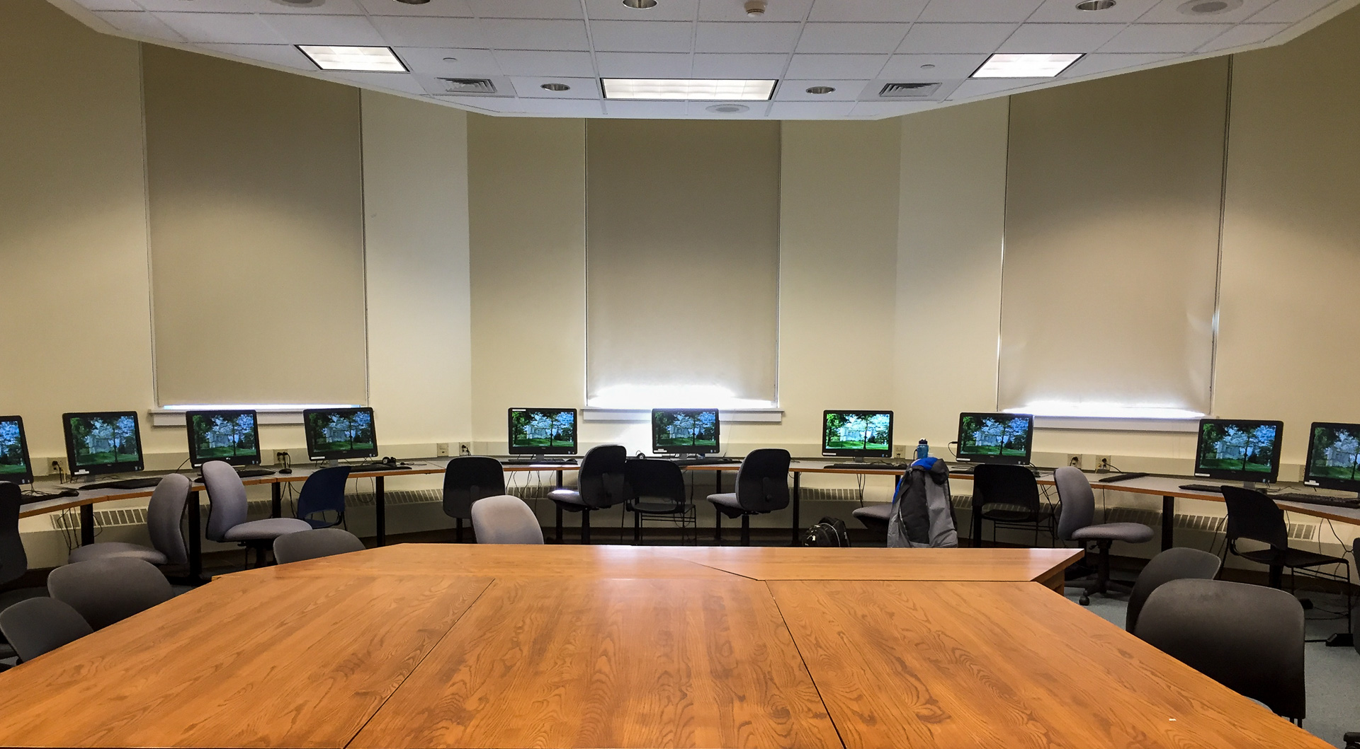
Challenges to scaling-up
Space for small group classes—tensions over competing priorities
People Soft issues with allowing students to self-register for the classes—tensions over technology
Enough faculty qualified to/willing to teach 121/100—tension over views of students
Notes:
especially since our main campus has been undergoing an extensive make-over and construction of new space in recent years; from roughly Fall, 2014 through Summer, 2018, numerous classrooms were undergoing reconstruction each semester, putting them out of commission

Slide 10
Working with faculty
Expanding qualifications to teach Comp I
Summer training of ENG 100 faculty
Financial barriers
This year’s expanded training with grant
Notes:
Half-day workshops with focuses on backward design, scaffolding, growth mindset, non-cognitive issues, Reading Apprenticeship practices, habits of mind, building in college support services, a bit of theory and more practical class activity building.
Fitting in follow-ups during Teaching and Learning orientation week workshops
Online one summer
Collection of resources in our department’s Blackboard site

Slide 11
What is happening?
By Spring semester, 2020, the English Department’s scale-up of ENG 100 will be complete, and there will no longer be ENG 109
The scale-up entails adding an additional hour to ENG 100, the better to prepare the full range of students who will be entering ENG 100.

Slide 12
Proposed curricular changes
To better support all of the students who will now be in 100, we created additional learning outcomes for instructors to focus on in a second hour of each week. These proposed new learning outcomes focus on the development of effective habits of mind for succeeding in college reading, writing, and thinking and on more integration of support services at the College.
English 100 “has helped me a lot to write better. I feel more confident…”
”English 100 is helping me with my time management so I know what needs to get done when so I can plan.”

Slide 13
New learning outcomes
Develop a community of support;
Demonstrate the ability to effectively plan study time;
Develop a repertoire of effective student strategies;
Identify campus resources most helpful to their educational goals at CLC and explain how they will make use of these resources;
Demonstrate the ability to reflect, in writing, on the development of their thinking, reading, writing, and performance in ENG 121 assignments

Slide 14
Data supporting changes
25% of students with an ENG 109 placement now self-select or are recommended for ENG 100
Success in 121 is higher if 100 is taken rather than 109, but, we found that ENG 109 + 121 prepares students better for ENG 122, by 15-16% points.
Those who start in 109 are also more likely to earn an A or B in 122.
Notes:
the 109-121-122 route is comparable to the general ENG 122 success rates.

Slide 15
Framing
Commercial frame: “where each element of the educational experience . . . has a clear commercial role,” in which “students and parents are consumers of educational products rather than beneficiaries of a public good” (Johnson 6).
Growth frame: in which “the primary purpose of education is forming citizens, and although the skills and virtues developed in the formation process exist to be used, they do not exist to be exchanged” (Johnson 11).

Slide 16
Tension: Growth v. Commercial Frames
TWO CHALLENGES:
Irrelevance and ineffectiveness
“…growth frame affirms our disciplinary values, but it creates at least two challenges…” (Johnson 17).

Slide 17
We believe in the intrinsic value of writing.
Economic & “Exchange Value”?
“Civic & Personal Beyond”?

Slide 18
Retention and Student Success
“Retention as a topic is especially well-suited to the ideological work of the market-driven university, because the discourse is amorphous enough to conflate sincere concerns about student success and the budget concerns about keeping butts in their seats”
(Reichert-Powell, Retention 144).

Slide 19
CHRONOS VS. KAIROS
MORE POROUS FOR STUDENTS
STUDENTS’ TRANSIENT & COMPLEX PATHS
“…dominated by chronos, by a concern about one intellectual skill leading predictably to the next” (Reichert-Powell, Retention 29).
“…compels us to reframe our goals in terms of Kairos…opportunities that exist right now in our classrooms” (Reichert-Powell, Retention 30).

Slide 20
WHO ARE OUR DEVELOPMENTAL STUDENTS?
Depending on the semester, 65-80% are part-time students
The majority work, with an increasing number working full-time
15-20% are parents
For 40-45%, English is not their first language
~70% are first generation,
Parents of ~ 30% did not complete high school

Slide 21
KAIROTIC PEDAGOGY
According to Pegeen Reichert-Powell “[a] pedagogy that confronts the porous nature of higher education is a kairotic pedagogy. We are not preparing for some future context; we are taking advantage of the moment we are in…to invite the student to participate now as reader and writer of the world…” (Retention 118).

Slide 22
…embracing the concept of kairos…[recognizing] the opportunities that arise does not dictate a specific kind of curriculum but instead encourages an attitude toward course design”
(Reichert-Powell, Retention 118)
“the ability to respond to emerging situations dexterously…a language
with which to explore the possibilities inherent in the crises…in students’ lives”
(Reichert-Powell, “Absolute Hospitality” 140)

Slide 23
“Basic Writing as Cultural Conflict”
“No doubt, the language of basic writers differs from academic discourse (no matter how we define it). But the pedagogy of initiation makes it more difficult for basic writers to succeed. They not only have to master ‘skills’ (as in the service course), but they have to acquire a new way of understanding, knowing, arguing, reflecting” (75). “[P]erceived (and often real) conflicts best define basic writers. A basic writing pedagogy ought to help students explore the cultural conflicts and continuities that attend their entrance into university” (Fox 84).
Notes:
Tom Fox’s 1999 essay shows that these tensions between extrinsic “success” and internal ”growth” frames, between “chronos-based“ and “kairotic” pedagogies have existed for a long time, though under different terminology:

Slide 24
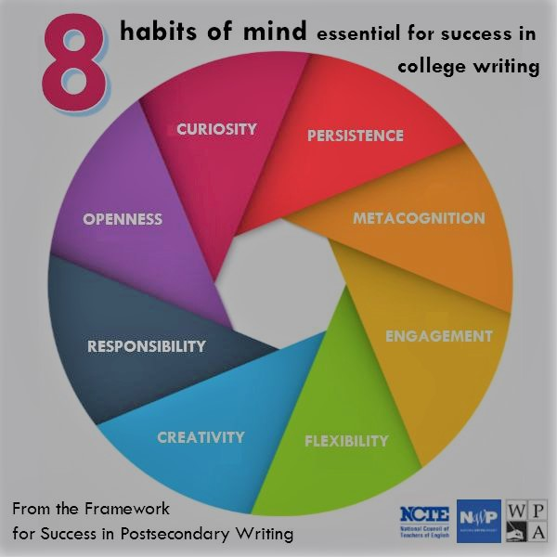
From the Framework for Success in Postsecondary Writing: 8 Habits of Mind
“These dispositional characteristics do, in fact, transfer and can be of great value to students across their entire life span---at home, at work, in their communities” (Sullivan 2).
“I argue that these habits also contribute to success in college reading and…by extension, reading-writing connections” (Carillo qtd. in Behm et al. 39).

Slide 25
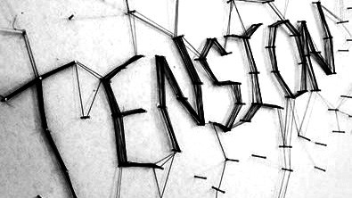
Crossing borders
“By focusing on habits of mind rather than discrete outcomes, the Framework suggests that college and career readiness in writing depends on broader understandings of those activities…a border-crossing kind of document” (O’Neill et al. xi).

Slide 26
No easy answers to this
“…what reading and writing and research practices, what habits of mind are most relevant to this group of people in front of me right now?”
“This approach requires a shift in how we frame our course goals and assignments…that our course goals---the habits and practices we intend to teach---are relevant to real problems and questions that circulate in our students’ lives” (Reichert-Powell,, Retention 119)

Slide 27
Two more voices
“…at the very least writing teachers…can attempt to equip students with skills, habits of mind, and orientations toward the world that will help them productively engage new discourses, genres, and fields of knowledge”
(Sullivan 49)
“…students do not learn to write simply by reading. Instead, it is the instructor’s job to deliberately and consistently ‘foreground and teach’ the connections between reading and writing”
(Carillo qtd. in Behm et al. 39)

Slide 28
Patrick Sullivan:
“Students have to focus carefully and thoughtfully on the readings, and on the complexity, nuance, and subtlety that is built in the assignment…reading and writing as…tools for thinking, learning, and inquiry, and not just vehicles to communicate ready-made assertions and beliefs” (71).

Slide 29
Ellen C. Carillo:
“When we think about reading as an act of creation, we might imagine a reader who brings her background, previous reading experiences, culture, religion, and worldview with her to the reading. All of this contributes to how that reader creates meaning from the text” (xii).

Slide 30
How might that look like?

Slide 31
Small group chats then regroup for a closing reflection and questions
Switch after 10 mins.
MetacognitiveLabor logs
with Cathy
Reading Logs & Discussion prompts
with Tessa

Slide 32
Borders and Liminal Spaces
“Hospitality seems a particularly apt notion to pursue for composition studies…if hospitality is about border crossing, we are situated in a liminal space at the nexus of several borders---the literal border of classrooms, the border between home and school and between high school and college, the border between disciplines” (Reichert-Powell, “Absolute Hospitality” 2017).

Slide 33
Kairotic pedagocy & hospitality in the writing classroom
“A writing classroom that embraces a kairotic pedagogy…become[s] a small space for absolute hospitality. Even when students don’t leave, the course assumes that all writing tasks, and all classrooms, have the potential to be upset---by arrivals and departures, by readers and other writers, by exigencies that shape the situations themselves, and by technologies that dominate our practices in the twenty-first century” (Reichert-Powell, “Absolute Hospitality” 148).

Slide 34
How might that look like in my classroom?

Slide 35
Works Cited
Carillo, Ellen. “A Place for Reading in the Framework for Success in Postsecondary Writing: Recontextualizing the Habits of Mind.” The Framework for Success in Postsecondary Writing: Scholarship and Applications, edited by Nicholas N. Behm, Sherry Rankins- Robertson, & Duane Roen, Parlor Press, 2017, pp. 38-53.
Fox, Tom. “Basic Writing as Cultural Conflict.” Critical Literacy in Action: Writing Words, Changing Worlds, edited by Ira Shor and Caroline Pari, Heinemann, 1999, pp. 68- 86.
Johnson, Kristine. “Framing the Framework.” The Framework for Success in Postsecondary Writing: Scholarship and Applications, edited by Nicholas N. Behm, Sherry Rankins- Robertson, & Duane Roen, Parlor Press, 2017, pp. 3-20.
O’Neill, Peggy, Linda Adler-Kassner, Cathy Fleischer, and Anne-Marie Hall. “Foreword: Then and Now, Reflections on the Framework Six Years Out.” The Framework for Success in Postsecondary Writing: Scholarship and Applications, edited by Nicholas N. Behm, Sherry Rankins-Robertson, & Duane Roen, Parlor Press, 2017, pp. ix-xix.

Slide 36
Works Cited
Reichert-Powell, Pegeen. Retention & Resistance: Writing Instruction and Students Who Leave, Utah State University Press. 2013, pp. 17-144.
Reichert-Powell, Pegeen. “Absolute Hospitality in the Writing Program.” Retention, Persistence, and Writing Programs, edited by Todd Ruecker, Dawn Shepher, Heidi Estrem, and Beth Brunk-Chavez, Utah State University Press, 2017, pp. 136- 150.
Sullivan, Patrick. A New Writing Classroom: Listening, Motivation, and Habits of Mind. Utah State University Press, 2014, pp. 2-71.

