Slide 1
Nuts and Bolts of ALP (PLUS DATA)!
Haleh Azimi Elsbeth Mantler Patrick Kelleher
ALP, Co-Director ALP, Co-Director Planning, Director
Pre-Conference Workshop
CADE 2019

Slide 2
Who are we…Who are you?
Name
Teaching Experience
What do you know about ALP?
What do you hope to get out of today?

Slide 3
Workshop Agenda
Overview of ALP at CCBC
ALP Structure & Logistics
Acknowledging effects of non-cognitive issues on student success: productive persistence
Backward curriculum design
True Integration of Reading, Writing, &Critical Thinking
Active, Collaborative, low-stakes activities
Aligning the co-requisite courses
Grading
Ongoing professional development

Slide 4
Overview of ALP at CCBC

Slide 5
CCBC Demographics 2018-2019
Number of credit students: 27,792
Average age: 28
Female/male ratio: 58%/42%
Students of color: 57%
48% work 20 hours or more per week
Full/Part time ratio: 11/89%
46% receive some form of financial aid
Fall 2018 – 3,618 First Time College Students
1,025 Need Developmental English (28%)
881 Need Reading Developmental (24%)
2,275 Need Math Developmental (63%)
Notes:
Three main campuses; 3 extension centers.
For CCBC, it’s not just the percentage of students who need developmental help, but the total volume of students who enter each year. Most students who need English also need Reading developmental help. For Fall 2018, 796 students needed both Reading and English.

Slide 6
Why CCBC integrated reading and writing in ALP
ALP had reached 80% scale-up system-wide, but had stalled.
After studying the problem, the main obstacles to full scale were:
Requirement that students with a dev. reading placement take a 4-hr (nonrelated, stand-alone) reading course in addition to the 6-hr ALP sequence (Total of 10 hrs.)
Part-time students were affected the most by this—89% of our students are part-time. Most part-time students take 9 or fewer credit hours each semester.
Notes:
After discussing this slide, Peter turns it back to Sarah.
In Fall 2018, 796 of the 1,110 students with a developmental needed both English and Reading (72%)

Slide 7
Details of the new ALP IRW model
Default placement for students with the following Accuplacer scores:
Reading: 61-78 and/or English: 58-89
Other placement measures are now currently in place
Taught by ACLT (formerly Reading) and English faculty
Students with lower-level placements (Reading: 36-60; English 0-57) take ACLT 052, a 5-hour IRW class.
All stand-alone sections of developmental reading and developmental writing have been eliminated.

Slide 8
What are the pass rates in the co-requisite model?
Notes:
After discussing this slide, Peter turns it back to Sarah.

Slide 9
ALP Term Analysis
ALP
Traditional
Students in an ALP section of ENGL052
Passing grade in ENGL052
Passing grade in associated ENGL101 section
Students in a non-ALP section of ENGL052
Passing grade in ENGL052
Passing grade in ENGL101 within one year of ENGL052
Notes:
How do I do Alp analysis. For each fall term, I select the students who have taken ENGL052. I know which sections are ALP and which are not. So the initial step is to divide the students into ALP and non-Alp students. I then analyze the ENGL052 grades. At CCBC, passing grades are A,B,C.
Analyzing ENGL101 grades is a little different. For ALP students, I identify the associated section of ENGL101 and use those grades. For Traditional students, I select the best grade they received in ENGL101 within 1 year of taking ENGL052. That gives Traditional students a small advantage, since they have three terms to be successful (winter, spring, summer).

Slide 10
Path to Success
Fall 2014 students attempting ENGL052.
Notes:
ALP works for two reasons. First, ALP students have a higher pass rate for ENGL052. Second, they attempt ENGL101 in higher numbers. By definition, an ALP student is attempting ENGL101. In the traditional model, students who failed ENGL052 could not attempt ENGL101. But even some students who did pass ENGL052 do not attempt ENGL101. They most likely dropped out.

Slide 11
Path to Success
Fall 2014 students attempting ENGL052.
Notes:
If we look at the number of students instead of the percentages, we can see the real impact of ALP. We were able to get far more students to complete ENGL101 thru our ALP model than we can thru the traditional model.

Slide 12
ENGL052 Pass Rates
ENGL052 success rates are always higher for ALP.
Notes:
This is a look at our historical pass rate for ENGL052. ALP students consistently pass at a higher rate.

Slide 13
ENGL101 Pass Rates
ENGL101 success rates are close between traditional and ALP.
Notes:
ENGL101 pass rate have been much closer. But since more ALP students are attempting ENGL101, we get more students to complete ENGL101.

Slide 14
Cohort Completion Rate – ENGL101
Because more ALP students attempt ENGL101, more of the ALP cohort complete ENGL101, which is our goal
Notes:
This is our historical cohort completion rate. ALP is consistently 2X more successful at getting ENGL052 students to complete ENGL101.

Slide 15
ALP Ramps Up
Notes:
Over time, CCBC has made ALP the predominate model for English developmental students.

Slide 16
Cohort Completion Rate – ENGL102
ALP students are also more likely to complete ENGL102.
Notes:
ALP students are more likely to complete the next course, ENGL102.

Slide 17
12 or More Earned Credits
When students complete ENGL101, more courses are available to them.
Notes:
ALP students are likely to go to earn 12 credits or more.

Slide 18
Degree or Certificate Earned
ALP students are more likely to graduate within 4 years.
Notes:
ALP students are also more likely to graduate within 4 years of taking the ALP course.

Slide 19
African-American Completion Rate
ALP has helped our African-American students, who are more likely to be developmental.

Slide 20
Completion Rate by Race – ALP Only
But ALP has not closed the race gap at CCBC.

Slide 21
What are the costs associated with an ALP?
Notes:
After discussing this slide, Peter turns it back to Sarah.

Slide 22
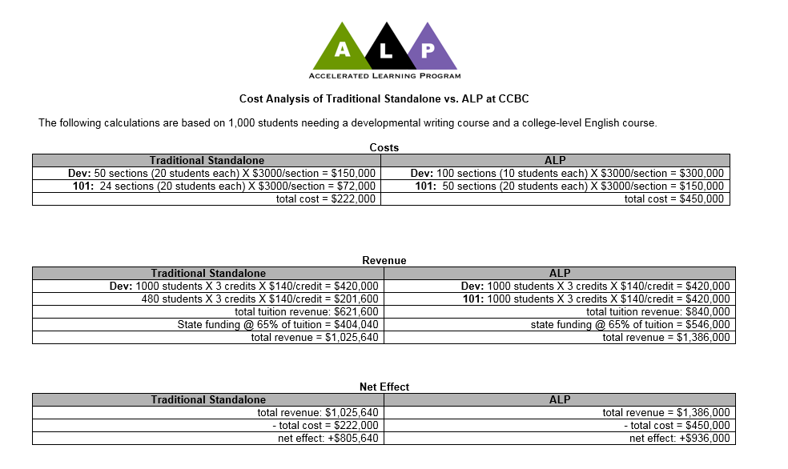

Slide 23
Costs Analysis for 1000 students
Traditional
ALP
Dev: 50 sections X $3000 = $150,000
Dev: 100 sections X $3000 = $300,000
101: 24 sections X $3000 = $ 72,000
101: 50 sections X $3000 = $150,000
total cost = $222,000
total cost = $450,000
Number of successful students = 333
Number of successful students = 740
Cost per successful student: $667
Cost per successful student: $581

Slide 24
Cost/Revenue Analysis
Traditional
ALP
revenue from tuition = $621,600
revenue from tuition = $840,000
revenue from state/county = $404,040
revenue from state/county = $546,000
total revenue = $1,025,640
total revenue = $1,386,000
total cost = $220,000
total cost = $450,000
net = +$805,640
net = +$936,000

Slide 25
Cost/Revenue Analysis
$1,500,000
1386K
$1,250,000
$1,000,000
1025K
936K
$750,000
805K
$500,000
450K
$250,000
225K
0
cost
revenue
net
cost
revenue
net

Slide 26
Cost/Revenue Analysis
$1,500,000
1386K
$1,250,000
$1,000,000
$130,360
936K
$750,000
805K
$500,000
450K
$250,000
0
cost
revenue
net
cost
revenue
net

Slide 27
ALP Structure & Logistics

Slide 28
CCBC’s Dev Ed Reading and English Courses Pre-Acceleration
Most General Education courses
RDG
051
5 hr
RDG
052
4 hr
ENGL
051
4 hr
ENGL
052
3 hr
ENG
101
ENG
102
Total developmental hours for Reading and English = 16

Slide 29
ALP at CCBC: Our New IRW
Co-Requisite Model
ENG 101
ACLT 053
(The ALP Class)
Reduces stigma
Improves attachment
Provides stronger role models
Encourages cohort effect
Changes attitude toward the developmental course
Allows more individual attention
Allows time for dealing with non-cognitive issues
Allows students with dev. placements in writing and reading to enroll
A
L
P
The Accelerated Learning Program

Slide 30
What do we do in the ALP class (ACLT 053)?
The goal for ALP instructors: Maximize the ALP students’probability of success in the English 101 class. Strategies include:
Conducting class as an extension/supplement to the 101 class—think of it as a 6-hour 101 class, “Triage for English 101”
Answering questions left over from the 101 class
Providing opportunities for closer analysis of the readings, more writing practice using low-stakes, short papers to reinforce concepts from the readings and from the 101 class or to prepare for upcoming assignments in the 101 class—scaffolding
Discussing/brainstorming ideas for the next essay in 101
Reviewing drafts of essays the students are working on for 101
Helping students to be aware of their sentence-level errors and to become better self-editors
Addressing non-cognitive issues (life issues, affective issues)
Notes:
After discussing this slide, Peter turns it back to Sarah.

Slide 31
What an ALP class is not
A study hall: students working on their own
A class mainly focused on grammar
A class focused on isolated reading skills
A class consisting only of computer- assisted learning
Notes:
After discussing this slide, Peter turns it back to Sarah.

Slide 32
ALP Course Formats and Plans
Evening classes
Late-start classes
Saturday classes
Summer classes
On-line classes
New initiatives being planned
Revamp and scale-up of ALP-ESOL
Multiple Measures placement reform
“Certified ALP Instructor” (continued, meaningful professional development)
ALP Concurrent Pilot

Slide 33
ALP Essential Elements: Addressing Non-Cognitive Issues

Slide 34
Why Do Students Drop Out?
A
L
P

Slide 35
no concrete examples
can’t write a thesis
subject-verb agreement
sentence fragments
none of the above
mla format
confusing words

Slide 36
student becomes discouraged
changes at work
financial problems
laid off
student loses confidence
problems with children
student fears she isn’t “college material”
affective issues
life issues
legal problems
car trouble
student becomes depressed
abusive situation at home
stress becomes too great
eviction
medical problems
student feels isolated

Slide 37
non-
cognitive
issues
life
issues
affective
issues

Slide 38
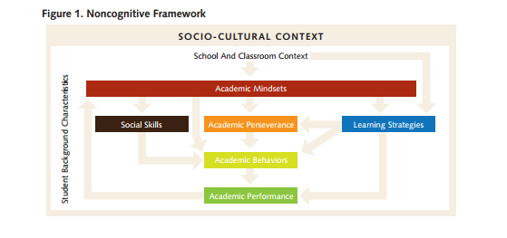
Research on Non-Cognitive Issues
Farrington, Camille A. et al. "Readiness for College: The Role of Noncognitive Factors and Context"

Slide 40
What is ‘Just in Time Support?’

Slide 41
Non-cognitive Barriers with Students at your institution
Make of list of things you have seen in the past as barriers to success for your students that are not academically related.
Share in your small group these issues.
Brainstorm:
What resources are available at your institution to address some of these issues?
How can you address some of these issues within your curriculum?
How have you offered “just in time” support to your students?

Slide 42
ALP Essential Elements: Backward Curriculum Design

Slide 43
Former Curriculum Approach in Developmental Writing and Reading Courses
Level-one developmental writing and reading textbook focus on _____?
Sentences
Isolated reading activities
Level-two developmental writing textbooks focus on _____?
Paragraphs
More isolated reading activities
Reading level often 6th grade
“Skill and drill” approach
Students feel as though they’re back in middle school, not in college.

Slide 44
Backward Curriculum Approach in Developmental Writing and Reading Courses
Begin by:
Assigning college-level essays
Using complex, college-level texts as sources (common readings)
Creating scaffolded assignments and activities to support student success with these challenges

Slide 45
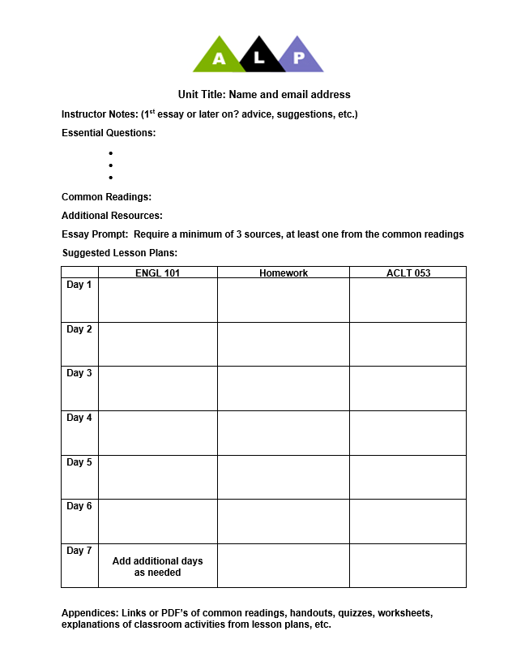
ALP Thematic Unit Teaching Template

Slide 46
Start at the End (Backward Design): ● What is the essay topic? ● What are the essential questions?
Unit 1: “Education”
5 weeks, English 101 and ACLT 053 (ALP)

Slide 47
The Essay
Overview: Tell me the story of your educational history – the journey you’ve been on, the good, the bad, how you have felt about yourself as a learner in your past schooling. Relate your story to at least two texts we have read so far in class.

Slide 48
Essential Questions
1. Can educational experiences be transformative? (What might these look like?)
2. What are the policies in place that may have large impacts on our local educational systems? On us personally?
3.How can K-12 educational experience impact a person into adulthood (their families, children, relationships, neighborhoods…)?
**These are just a jumping off point. Students will come up with their own questions as we read, write and talk about the topic.**

Slide 49
Non-cognitive Issues
Many of the writing activities you will see are intended to scaffold the major writing assignment and to engage with texts, but they are also addressing non-cognitive issues in some ways. I take these non-cognitive issues into consideration when planning a unit.
Questions I ask myself:
--How can I get the students to feel they “belong”?
--How can the students feel the ACLT 053 is needed and helpful?
--What are barriers to success for these particular students?

Slide 50
Text 1
The Other Wes Moore by Wes Moore

Slide 51
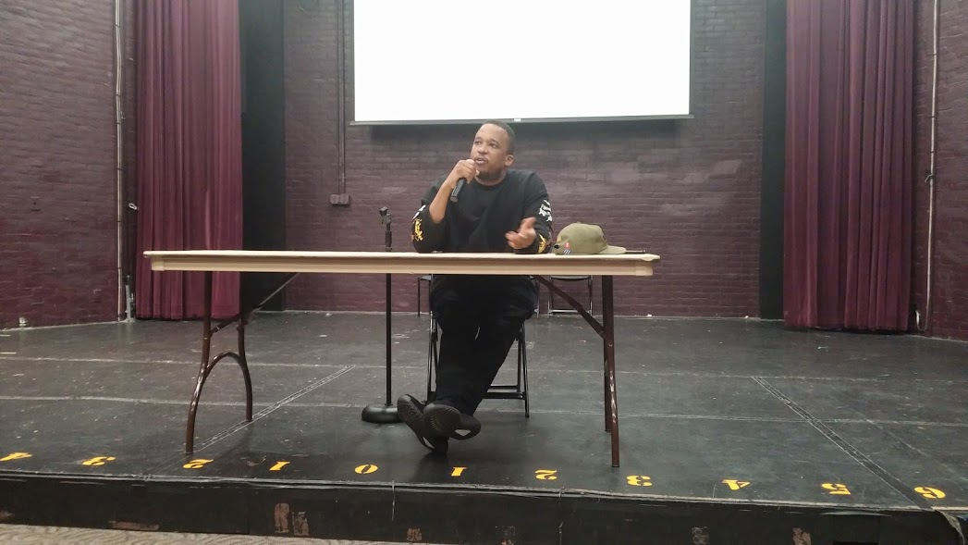
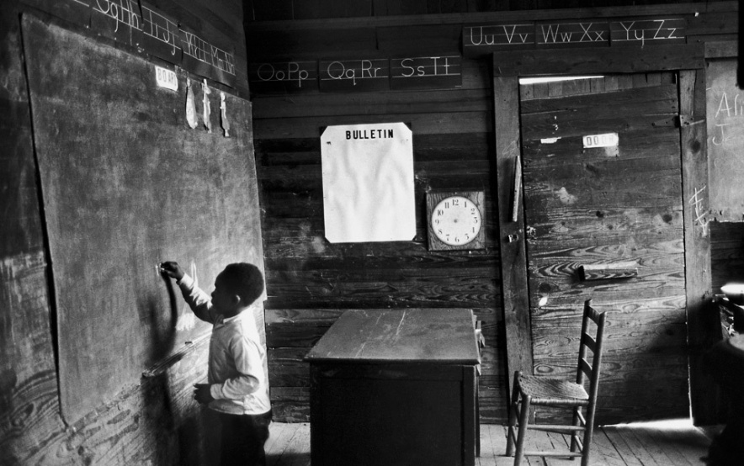
Text 2
“The School of Failure:
How Schools Groom African Americans for the Underclass”
by D. Watkins

Slide 52
Text 3 (end of unit and bridging into second unit)
All the Difference —POV PBS (documentary)

Slide 53
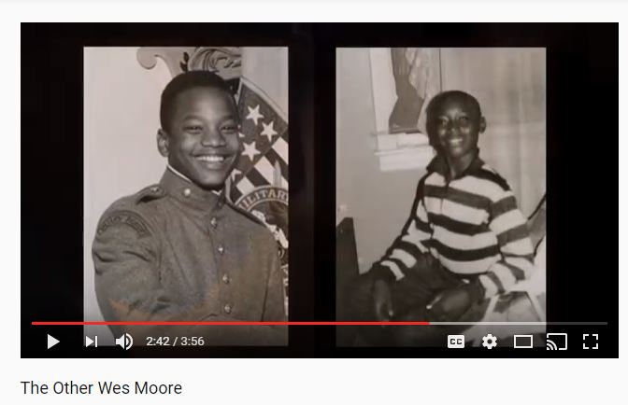
Week 1
ENGL 101
ACLT 053
Diagnostic essay: Write an Educational Autobiography
Wes Moore trailer video.. Access prior knowledge: “What might be major things in people’s lives that lead them in different directions?”
Comic Strip Story “How did you get here to this seat today?”
Feelings About Writing Survey
Journal #1: Pre-reading
1. Where are places you hear people referred to as “other”?
2. After watching the video in 101, think of three questions you expect to answer as you read this book.
Notes:
Comic strip??

Slide 54
Week 2
ENGL 101
ACLT 053
Short low-stakes quiz on Chapter 1 in TOWM
Discussion questions in small groups for Chapter 1
Discussions about academic writing
Read and annotate an academic student essay
Journal 2: Reader to text
Journal 3 Describe one particularly good experience you had in your past education and tell me about why it was good. (This might be in an English class or in a different subject.) Describe one bad experience you have had in the same way and explain. (pre-writing)
“Group Text” with quote from TOWM
Reconstruct an essay that has been broken apart

Slide 55
Week 3
ENGL 101
ACLT 053
Essay 1 instructions and expectations
Quiz on Chapter 2 in TOWM
Pre-reading for “The School of Failure” (watch videos of Watkins on CNN panel)
Pre-writing techniques
Go over citations and MLA
Group pre-writing in class (brainstorm & informal outline, share with class)
Focused citation & MLA instruction if needed
Journal 4 & 5: reader to text
Begin to read “The School of Failure” and annotate together

Slide 56
Week 4
ENGL 101
ACLT 053
Quiz on Chapter 3 in TOWM
Peer review of fully formed rough draft of Essay #1
Small group discussions about “The School of Failure”
One on one conferences with me with draft of Essay #1
Share annotated article with a partner & present with partner 2 questions you have for D. Watkins
Journal 6 (text to text): How do you interpret the quote: "In third grade I was reading at second-grade reading level. Later in life I learned that the way many governors projected the numbers of beds they'd need for prison facilities was by examining the reading scores of third graders" ( Moore 54)? How can you relate this to any ideas in The School of Failure?
Research and present some of the historical references in article

Slide 57
Week 5
ENGL 101
ACLT 053
Quiz Chapter 4 in TOWM
Final copy Essay #1 due
“Take Temperature”-- discuss the guiding questions, Essay #1, and the unit overall.
Start watching All the Difference
In-class Reflective Essay about the writing process (meta-cognitive)
Journal 7 student to text TOWM
Conduct research about All The Difference in small groups and present to class

Slide 58
Unit 2: Social Capital and Mindset
Essay Topic: How do mindsets and social capital operate in both The Other Wes Moore and All the Difference? Trace how growth and fixed mindset were present in the lives of these men and how this affected them. How did social capital impact their lives? Along with the two texts, you must also include one outside source that helps support the theoretical aspects of the essay.
Essential Questions:
How can a social network impact a person’s education and future?
How can the mindset contribute to a result in someone’s life?
What are other factors that determine our futures?

Slide 59
ALP Essential Elements: True Integration of Reading, Writing, & Critical Thinking

Slide 60
The Power of Integrating Reading and Writing for Developmental Students
Susan Bickerstaff, Community College Research Center
Alison Kuehner, Ohlone College

Slide 61
Strategies Used in “Integrative” Courses
Metacognition | Invites students to explicitly reflect on the relationship between reading and writing in order to promote self-awareness of literacy processes.
Course Design by Theme | All/most texts and assignments are connected to a theme. An “anchor text” may be used as the basis for a variety of assignments and activities.
Text-Based Writing | Examples include summaries, journal or personal responses, and critical response essays.
Embedded Skill and Strategy Instruction | Skills and strategies are reinforced or taught in the context of thematic and text-based activities.
Notes:
SECOND, AND PERHAPS MORE IMPORTANTLY, SOME INSTRUCTORS SAW THAT STUDENTS DIDN’T PERFORM WELL WTH THIS APPROACH:
WHILE THE ADDITIVE APPROACH IS COMMON, OUR SENSE FROM OUR DATA IS THAT IT DOES NOT OPTIMIZE AN INTEGRATED CONTEXT.

Slide 62
An “Additive” Approach to Integration (not IRW)
“I thought, well, I’ll just keep the comp quizzes. They used to be grammar and punctuation, and I can throw the reading in. So you are just kind of throwing things in where they fit.”
“I think the idea of integrating the two, whether [as a] reading ‘week’ or ‘session’ or ‘class,’ will help the adjuncts. Certainly it would help me to be able to approach reading as a separate task but also relate it, perhaps the next day, as a writing opportunity.

Slide 63
The “Additive” Approach (not IRW)
Integrated Reading and Writing
Reading
Writing

Slide 64
Components of Additive Approach
Discrete learning objectives—”skill and drill” approach
Inadequate curricular materials
Limited confidence in the new discipline
“Cross training” predominant professional development approach
“We took all the writing instructors and then I gave them a crash course in terms of reading. How they could take an existing activity that they already did, and add a little more reading to it?”
Notes:
Many instructors have inclination to take an additive approach to integration

Slide 65
Challenge of Additive Approach
Including all of the content and activities that were included in the old reading and writing developmental courses:
“It was a massive amount of material that they wanted us to put into one semester’s worth of work. It was extremely difficult and my primary concern during that time was to touch upon all that I was told we had to include.”
“The way it is now, I basically teach two skills a week, one reading skill, one writing skill. We have two days on that skill and if they don't get it then there is no backtracking or trying to help them understand it. We are moving on from there.”
Notes:
Many instructors have inclination to take an additive approach to integration

Slide 66
An “Integrative” Approach to Course Design (IRW)
Integrated Reading and Writing
Integrated Reading and Writing

Slide 67
What does an integrative course look like?
Notes:
SECOND, AND PERHAPS MORE IMPORTANTLY, SOME INSTRUCTORS SAW THAT STUDENTS DIDN’T PERFORM WELL WTH THIS APPROACH:
WHILE THE ADDITIVE APPROACH IS COMMON, OUR SENSE FROM OUR DATA IS THAT IT DOES NOT OPTIMIZE AN INTEGRATED CONTEXT.

Slide 68
Principles of IRW
True Integration of Reading and Writing
College-level Material
Intensive Writing and Extensive Reading
Low-stakes, Collaborative Practice
Intentional Support for Affective Needs
Individualized Instruction

Slide 69
ALP Essential Elements: Active,
Collaborative, low-stakes activities

Slide 70
Principles of Andragogy
What is the difference between Pedagogy and Andragogy?
"Andragogy" refers to the art/science of teaching adults.
Malcolm Knowles and others theorized that methods used to teach children are often not the most effective means of teaching adults.
Pedagogy is "teacher-centered or directive" learning, and andragogy is "learner-centered/directed."
Notes:
After discussing this slide, Peter turns it back to Sarah.

Slide 71
Six assumptions related to adult learners
Adults need to know the reason for learning something.
Experience (including error) provides the basis for learning activities
Adults need to be involved in the planning and evaluation of their instruction.
Adults are most interested in learning subjects having immediate relevance to their work and/or personal lives.
Adult learning is problem-centered rather than content-oriented.
Adults respond better to internal versus external motivators.
Your thoughts?
Notes:
After discussing this slide, Peter turns it back to Sarah.

Slide 72
Active/Collaborative Learning: Best Strategies
Low-stakes, active/collaborative activities are the keystone to the ALP model, and all of these activities should:
Employ backwards design to support the major essays
Connect from one assignment (major and minor) to the next
Employ the theory of Andragogy

Slide 73
Active/Collaborative Learning: Scaffolding
Think about one reading or writing assignment that you have used in class. How might you prepare your students for this reading or writing using a low-stakes, active, collaborative activity that follows Knowles’ theory? Make sure to develop the activity around your essay prompt and EQs.

Slide 74
Resources to Help with Alignment

Slide 75
Resources to Help with Alignment
Partnering with library personnel
Open Educational Resources (OER’s)
Shared Learning Management System (LMS) page with units available for all faculty
Continued professional development

Slide 76
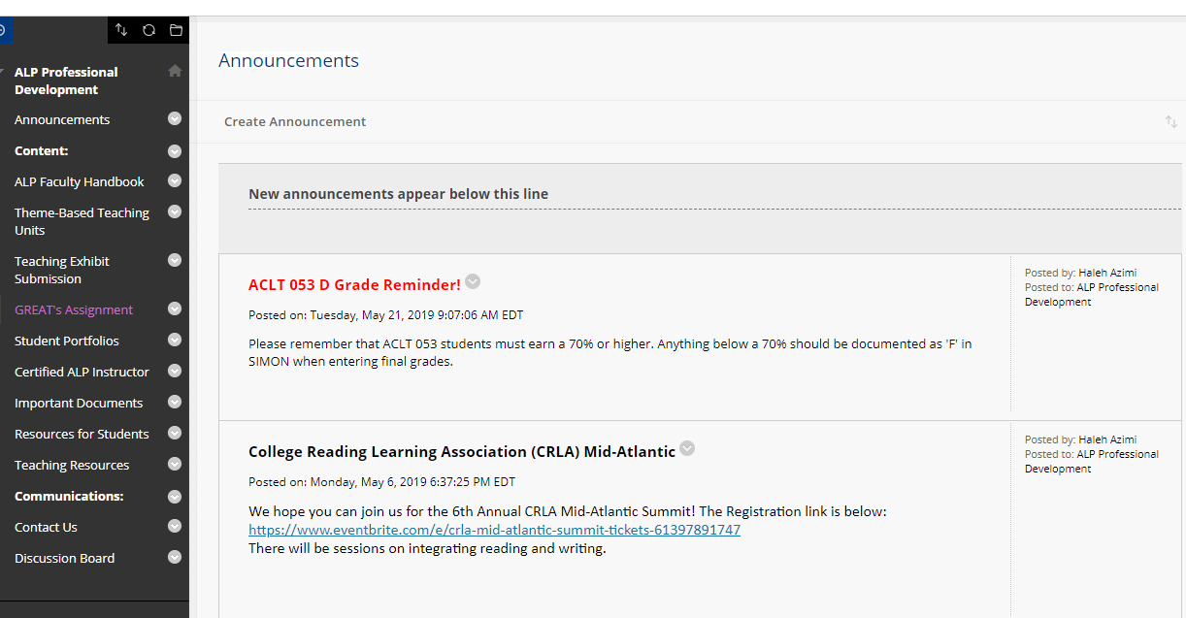
CCBC ALP Professional Development Bb Site
CCBC ALP Professional Development Site

Slide 77
Grading

Slide 78
ALP Essentials: Grading
English 101
Essay 1: 15%
Essay 2: 20%
Essay 3: 20%
Essay 4: 20%
Assignments: 25%
Academic Literacy 053 (ALP)
Metacognitive reflection 1/revisions: 15%
Metacognitive reflection 2/revisions : 15%
Metacognitive reflection 3/revisions : 15%
Metacognitive reflection 4/revisions : 15%
Scaffolded assignments: 15%
Final Portfolio: 25%
*ACLT is a graded course given A,B,C, or F.
*This is a sample grading breakdown.

Slide 79
Ongoing Professional Development

Slide 80
ALP Faculty Development Going Forward
ALP Faculty Development: Possible Formats
Multi-day seminars
Face-to-face or on-line sessions
On-going training throughout a semester/academic year
FIG’s (Faculty Inquiry Groups)
Coach or mentor system
ALP Faculty Development: Logistics
Learning Management System (LMS) for sharing classroom materials
Team of trainers to plan and oversee faculty development (reassigned time?)
Stipends or other incentives (i.e. certification for participants)
Feedback and follow-ups: data and program review
Grant opportunities

Slide 81
Final Thoughts and Questions

Slide 82
hazimi@ccbcmd.edu
emantler@ccbcmd.edu
pkelleher@ccbcmd.edu
ALP Website:
http://alp-deved.org
Enjoy the conference!

