Slide 1
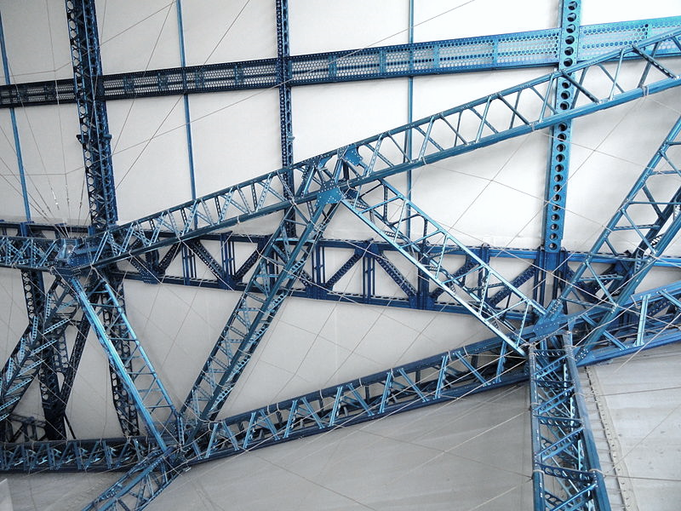
A Framework for ALP Implementation & Scale-up
Dawn Coleman, EdS
University of South Carolina

Slide 2
When colleges adopt reforms (especially those with research to support them), they expect these reforms to yield better outcomes.
This is the assumption:
Effective Innovations
Improved
Outcomes

Slide 3
The Reality
Colleges often face extensive challenges in adopting new programs and policies, struggle to scale-up and sustain their programs, and fail to experience the anticipated improved outcomes.
Saying you’re going to improve student outcomes by implementing a particular program or policy doesn’t make it so.

Slide 4
The Reality
Too often, we fail to focus on the actual process of implementation…
And it is a process, not an event.
Colleges cannot expect to successfully scale up and sustain programs that are built on shaky foundations and have not actually been fully implemented.

Slide 5
This doesn’t work:
Effective Innovations
Improved
Outcomes
This is what works:
Effective Innovations
Effective Implementation
Enabling Contexts
Improved
Outcomes
Which is where the field of implementation science comes in.

Slide 6
Implementation Science is
“the missing link between research and practice”¹
Notes:
n.pag.
Fixsen, D. L. and Blase, K. A. (2009, January). Implementation: The missing link between research and practice. NIRN Implementation Brief #1. Chapel Hill: The University of North Carolina, FPG, NIRN.

Slide 7
Implementation science
is the interdisciplinary study of the methods used to translate research into practice, including identifying barriers and facilitators (drivers) related to the successful implementation of policies, programs, practices, interventions, and innovations.

Slide 8
Implementation
“is the means by which an intervention is assimilated into an organization. Implementation is the critical gateway between an organizational decision to adopt an intervention and the routine use of that intervention.”²
Notes:
n.pag.
Damschroder, L.J., Aron, D.C., Keith, R.E., Kirsh, S.R., Alexander, J.A., & Lowery, J.C. (2009). Fostering implementation of health services research findings into practice: A consolidated framework for advancing implementation science. Implementation Science, 4(50).

Slide 9
Implementation
is a process, not an event, with multiple stages before a program is truly implemented.
“We began implementing ALP in Fall 2015”
NOT
“We implemented ALP in Fall 2015.”

Slide 10
4 Stages of Implementation
Exploration
Needs assessment, identify programs to meet those needs, weigh the pros and cons, choose one to implement, create buy-in
Pre-Planning
Assess resources, establish structural supports, choose initial implementers and begin training them, proactively identify potential challenges and solutions
Note: these two stages are supposed to occur before you ever start changing your practices (does that reflect your reality?)

Slide 11
4 Stages of Implementation
Initial Implementation
The program begins operation – sometimes referred to as the “initial awkward stage”³ when you’re getting used to this new way of doing things
Full Implementation
The new program/policy has become business as usual and is fully integrated into the organization and can still be sustained even with changes in staff, resources, and policy environments
Note: Researchers suggest full implementation takes 3-5 years to achieve.
Notes:
p. 16
Fixsen, D. L., Naoom, S. F., Blase, K. A., Friedman, R. M., & Wallace, F. (2005). Implementation research: A synthesis of the literature. Tampa: University of South Florida, Louis de la Parte Florida Mental Health Institute, The National Implementation Research Network.

Slide 12
4 Stages of Implementation
There is no “pilot” stage (unless you’re talking about the initial implementation stage).
When most people talk about piloting a program, they’re referring to testing it, working out the kinks, seeing if they like it, seeing if it will work in their environment, etc.

Slide 13
Please try to build the plane first.
They’re building the plane as they fly it.

Slide 14
Again with the reality…
Chances are you’re trying to do the Exploration, Pre-Planning, and Initial Implementation stages all at once while also wondering how you’re going to scale-up and sustain your program.
Possibly you were told to implement a program, given the start date, and just expected to make it happen (and then questioned when your results weren’t stellar).

Slide 15
The good news…
We can draw on IS frameworks and models to help us understand the critical components of successful implementations (regardless of the program you’re adopting).
We can also draw on the collective wisdom of those who are further along in implementing the same program (like ALP) to learn from their successes and challenges and to proactively address roadblocks.

Slide 16
The Irony
Implementation Science is focused on bridging the gap between research and practice, often caused by research not being accessible or digestible for practitioners.
The problem is that IS models, designed to help practitioners better understand how to successfully implement programs, are themselves not very user friendly.
So now we have a gap between implementation research and practice.

Slide 17
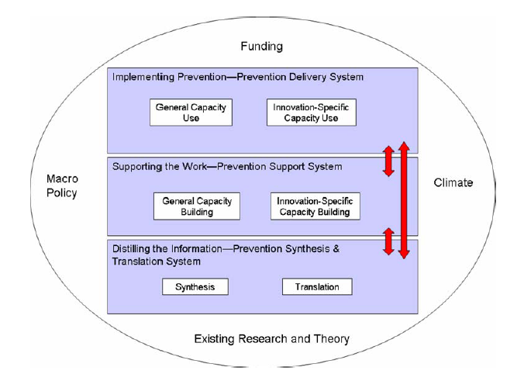
A few examples of IS models
Integrated Systems Framework
Notes:
Wandersman A, Duffy J, Flaspohler P, Noonan R, Lubell K, Stillman L, Blachman M, Dunville R, & Saul J. (2008). Bridging the gap between prevention research and practice: The Interactive Systems Framework for Dissemination and Implementation. American Journal of Community Psychology, 41(3-4):171-81.

Slide 18
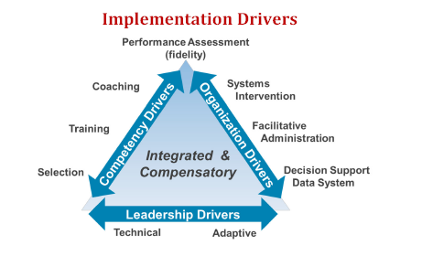
A few examples of IS models
National Implementation Research Network
Notes:
Fixsen, D., Blase, K., Naoom, S., and Duda, M. (2015). Implementation Drivers: Assessing best practices. Chapel Hill, NC: National Implementation Research Network, FPG Child Development Institute, University of North Carolina at Chapel Hill.
For more, see NIRN website: http://nirn.fpg.unc.edu/learn-implementation

Slide 19
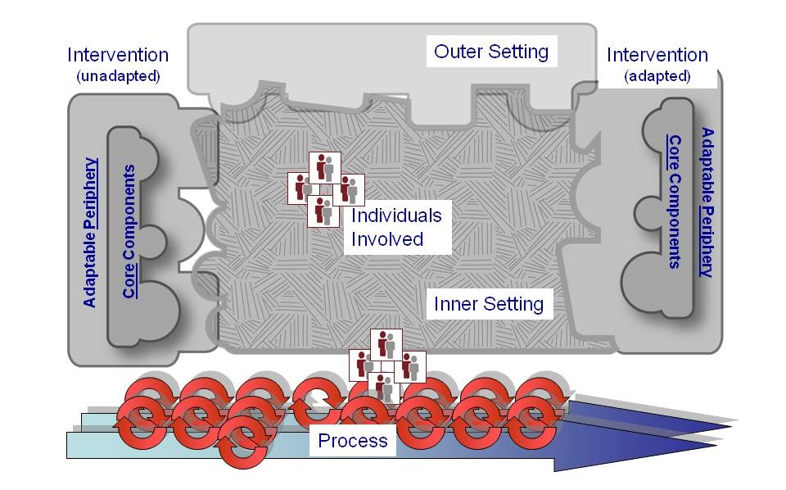
A few examples of IS models
Consolidated Framework for Implementation Research
Notes:
CFIR Wiki: http://cfirwiki.net/wiki/index.php?title=Talk:Main_Page
For more on the CFIR see: http://cfirguide.org/

Slide 20
I wanted to develop a simplified model that was customized for developmental education initiatives (ALP in particular). The goal is to build an implementation toolkit to help colleges consider critical implementation components, assess where they are currently strong or weak, anticipate challenges, prioritize which components need the most attention, and use resources wisely during the implementation process.
A New Framework

Slide 21
A New Framework
I need your help because I want this to be useful for practitioners (otherwise, what’s the point?)
Feel free to make lots of suggestions about the framework and think about what else needs to be done for this to be more helpful.
The framework consists of 4 broad domains with a total of 21 implementation components.

Slide 22
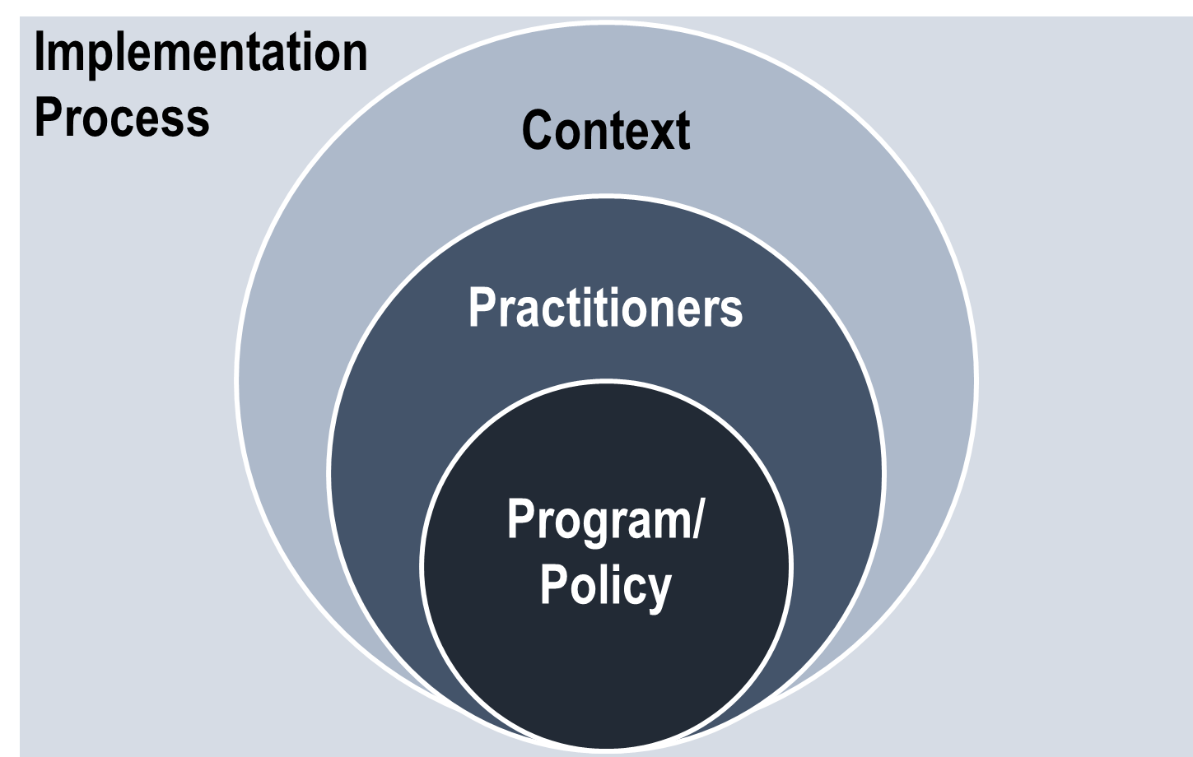
Implementation Framework

Slide 23
Program
1. Problem being solved 2. Theory/Philosophy 3. Core components/characteristics 4. Expected outcomes
Before you can implement something, you need to know what that something is (this might seem like a no brainer but it’s not).
Some colleges are “implementing ALP” without fully understanding what ALP is (this is true of other programs as well).

Slide 24
Program: ALP
Are you familiar with and can you explain to others the concept of exponential attrition?
Have you looked at the resources on the ALP website?
Can you identify the core features of ALP?
Are you familiar with ALP data from other colleges and the level of success you can expect?

Slide 25
Thoughts on the PROGRAM domain? 1. Problem being solved 2. Theory/Philosophy 3. Core components/characteristics 4. Expected outcomes Is any of the language/terminology unclear? Does it make sense why these are important to successful implementations? Is anything missing?

Slide 26
Practitioners
1. Attributes 2. Perceptions about the program 3. Training (before & during implementation) 4. Coaching/technical assistance (ongoing)
Training should address gaps in personal attributes and perceptions. So if faculty don’t buy into the basic theory of the program, the focus of training could initially be less on what to do in the classroom and more on the rationale behind the program

Slide 27
Coaching is a critical implementation component that is often neglected. The importance of coaching/TA is strongly supported by IS research. Training is not enough. According to IS research, training focused on sharing information (like most conference presentations) leads to minimal changes in knowledge and almost no change in skills.
Practitioners

Slide 28
Training that included demonstrations produced more gains in knowledge but still very little change in skills/classroom practices. Only when classroom based coaching was added was there a meaningful change in skills/classroom practices.
Practitioners

Slide 29
Practitioners: ALP
Do your faculty recognize (and accept) the need to address non-cognitive issues?
Do they have the needed credentials to teach both courses?
What are their attitudes towards ALP?
Do all faculty receive training on the theory behind ALP, its components, results, and strategies?
Are there opportunities for classroom based coaching or mentoring from more experienced ALP instructors?

Slide 30
Thoughts on the PRACTITIONER domain? 1. Attributes 2. Perceptions 3. Training 4. Coaching/technical assistance Is any of the language/terminology unclear? Does it make sense why these are important to successful implementations? Is anything missing?

Slide 31
No one will be strong in all areas.
Components are integrated & compensatory.
Strategically assess the 4 domains and 21 components to find opportunities for growth.

Slide 32
Context
1. Urgency for change 2. Supportive infrastructure 3. Leadership (managerial and visionary) 4. Buy-in from other stakeholders 5. Learning climate 6. External supports
A learning climate is one where practitioners feel they are valued members of a change process, feel safe to try new things, and are allowed time for reflection and evaluation.

Slide 33
Context: ALP
Does your registration system allow students to self-register for ALP? If you have to manually register ALP students, that is not a fully implemented or sustainable program.
Do advisors understand and enthusiastically support ALP?
Do you face resistance from your administration to keep the ALP class small?
What is the larger policy environment for ALP that affects you?

Slide 34
Thoughts on the CONTEXT domain? 1. Urgency for change 2. Supportive infrastructure 3. Leadership (managerial and visionary) 4. Buy-in from other stakeholders 5. Learning climate 6. External supports Is any of the language/terminology unclear? Does it make sense why these are important to successful implementations? Is anything missing?

Slide 35
Implementation Process
1. Implementation Team 2. Implementation Plan 3. Implementation Documentation 4. Program Champion 5. Recruitment strategies 6. Feedback mechanism/evaluation 7. Time for reflection (self and group)
This is where we actually practice what we preach.

Slide 36
Implementation Process
We tell students to plan for success, consider their strengths and weaknesses, proactively identify possible challenges and solutions, and have back up plans.
Yet, we are often horribly bad at doing this planning ourselves both as individuals and as organizations.

Slide 37
Implementation Process
According to implementation research, having an implementation team (3-5 members) with a plan increases the likelihood of successful implementation from just 14% to 80% and does so more quickly.
More research is emerging about the importance of program champions and implementation documentation/tools.

Slide 38
Implementation Process
If applicable, you need a recruitment strategy (ALPs regularly struggle to fill sections).
You need a feedback mechanism/evaluation along the way and it should include more than just student outcome data. TALK to your students. TALK to your practitioners.
You need to allow time and space for reflection both individually and as a group. Implementation is a collaborative process (even if some of us don’t like “group work”) and practitioners need to take the time to gather and learn from each other.

Slide 39
Implementation Process: ALP
Is there a plan for ALP implementation (including scale up and sustainability) at your college and is it shepherded by an implementation team? Are you documenting this process?
Do you have an ALP champion/cheerleader?
Do you have a strategy for filling all of the ALP sections you offer?
Does your college gather data about ALP (that includes more than just course pass rates?)
Do ALP instructors regularly meet to discuss means of improving the program?

Slide 40
Thoughts on the PROCESS domain? 1. Implementation Team 2. Implementation Plan 3. Implementation Documentation 4. Program Champion 5. Recruitment strategies 6. Feedback mechanism/evaluation 7. Time for reflection (self and group) Is any of the language/terminology unclear? Does it make sense why these are important to successful implementations? Is anything missing?

Slide 41
What next?
In its current form, the framework can provide a structure for colleges to consider the components of successful implementations and identify their own strengths and weaknesses.
This can be done no matter where you are in the implementation process (just thinking about ALP, planning for implementation, offering just a few sections, planning to scale up, or thinking about sustaining the program).

Slide 42
What next?
In some fields, researchers are developing more specific rubrics or checklists that programs can use to assess themselves. Would something like this be helpful?
The implementation process would be facilitated by not having to constantly reinvent the wheel so how can we better utilize our collective wisdom? For example, almost all ALPs struggle with their registration systems. Some colleges have already solved this problem and yet new ALPs continue to struggle because the knowledge isn’t shared widely.

Slide 43
Other thoughts or suggestions?

Slide 44
Program 1. Problem being solved 2. Theory/Philosophy 3. Core components 4. Expected outcomes | Practitioners 1. Attributes 2. Perceptions 3. Training 4. Coaching/TA
Context 1. Urgency for change 2. Supportive infrastructure 3. Leadership 4. Buy-in from stakeholders 5. Learning climate 6. External supports | Process 1. Implementation Team 2. Implementation Plan 3. Implementation Docs 4. Program Champion 5. Recruitment strategies 6. Feedback/evaluation 7. Time for reflection

Slide 45
Questions?
ColemanEvaluation@outlook.com

