Slide 1
Pathways for Success Non-Cognitive Issues and their impact on Student Retention and Success
Accelerated Learning Program / Conference / Costa Mesa, CA. 2015
Asst. Professor Berry

Slide 2
Presentation Rationale & Outline:
This presentation is simply a few of the things that I do in my ALP classes, how I do them, and why. It’s not meant to be a guide or a systematic approach in dealing with the issues that inhibit student success and retention.
Outline: Four Parts
The Foundations of Success
The Resources for Success
The Habits of Success
The Measures of Success

Slide 3
Non-cognitive Issues: Rationale & Reversal
My Story -- A Non-Cognitive Issue Skeptic
I didn’t buy into the the whole “non-cognitive” idea at first. I considered much of it beyond what I felt I was competent to do and trained to do—which was, simply, to teach students how to write well and that, essentially, is done through presentations, modeling, and practice—lots of practice.
What Changed? – My Perspective
First, I attended the AlP Institute in January of 2012, and there I was exposed to the various reasons and rationale for including this “touchy-feely” material. Why were students not completing the class? Why were they dropping out? Why weren’t students, ultimately, being successful? The answers were often that “life” intervened. Jobs, marriages, relationships, a lack of confidence, and a lack of experience at just being students were enough to knock them off-track, and once they were gone, they often did not return.
Notes:
My Story -- A Non-Cognitive Issue Skeptic
I didn’t buy into the the whole “non-cognitive” idea at first. I considered much of it a waste of time—and, I was not the only one. Many academicians, like myself, consider their job to be fairly straight-forward---teach students how to write well and that, essentially, is done through presentations and practice—lots of practice.
What Changed? – My Perspective
First, I attended the AlP Institute in January of 2012, and there I was exposed to the various reasons and rationale for including this “touchy-feely” material. Why were students not completing the class? Why were they dropping out? Why weren’t students, ultimately, being successful? The answers were often that “life” intervened. Jobs, marriages, relationships, a lack of confidence, and a lack of experience at just being students were enough to knock them off-track, and once they were gone, they often did not return.

Slide 4
Developmental Writing: Challenges and Opportunities
Questions for the Audience:
What are some of the challenges that developmental students present to us as teachers?
Preparation – they are often ill-prepared in different ways for the type or analytical writing required at the college level.
Motivation – they often lack the motivation (drive) needed to remedy their lack of preparation because they’re discouraged, frustrated, and distracted.
Which of the two, preparation and motivation is a better predictor of student success?
Motivation – and here’s why. If a students are both prepared and motivated, then they’ll likely do well. However, if a students are prepared but not motivated then they “might” do well, but if students are motivated but not prepared, then that motivation can often become the spark that can propel to prepare and often quite quickly.
Notes:
Questions for the Audience:
What are some of the challenges that developmental students present to us as teachers?
Preparation – they are often ill-prepared in different ways for the type or analytical writing required at the college level.
Motivation – they often lack the motivation (drive) needed to remedy their lack of preparation.
Which of the two issues above is a better predictor of student success and retention?
Motivation – and here’s why. If a students are both prepared and motivated, then they’ll likely do well. However, if a students are prepared but not motivated then they “might” do well, but if students are motivated but not prepared, then that motivation can often become the spark that can propel to prepare and often quite quickly.

Slide 5
The Foundations of Success:
Students often do not know who they are or what they want to do with their lives.
Socrates said that the foundation of all knowledge begins with a knowledge of one’s self. Therefore, when students have a firmer understanding of who they are, they are more likely to understand what they want to do. In other words, identity precedes action. So this is where we start.
Exploring Issues Associated with Identity and Direction (action)
Writing Prompts: Questions of Identity
Who Have I Been? / Who Am I Now? / Who Do I Want to Be?
Writing Prompts: Questions of Direction (end of the semester)
What Do I Want to Do? / Where Do I Want to Go? / How Do I Get There?

Slide 6
The Foundation of Success
Student Identity Collage
Once the students have written their journal responses to the three identity questions, they move on to the “identity collage.” They complete this in one of two ways: they can do it the old fashioned way by cutting or pasting, or they can do it all online. In addition, once they finish, they must do a five minute presentation of their collage for the class and answer questions from the class.
The collage is divided into three segments:
Who I was
Who I am
Who I want to be
This exercise gives them a chance to visualize their past, present, and future, and also supports an important metaphor (truth?) about life, that “life is journey” and all the sub-themes associated with that concept.

Slide 7
Foundations for Success
Assignment Specifics:
Students should select photos that display something in their own experience that shaped their past lives. Though they are allowed to use their own photos, they are not required to do so. Students should be prepared to discuss each picture they include and indicate what significant life experience is being depicted.
Each section of the collage is different. The Who I Was is the easiest since it has already happened, the Who I AM and the Who I Want to Be, are more difficult to visualize, but the students have fun trying to imagine what they could be. It is really an exercise in dreaming and imagination and also quite a lot of fun.

Slide 8
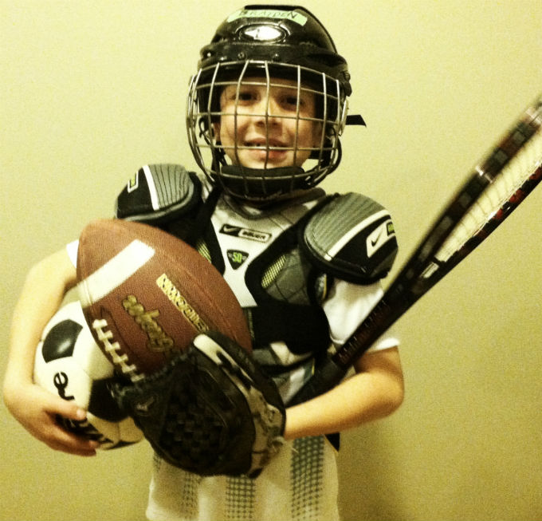
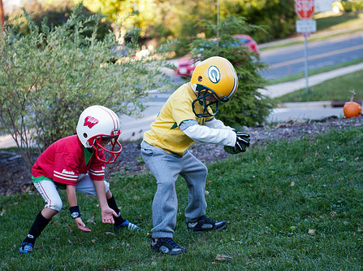
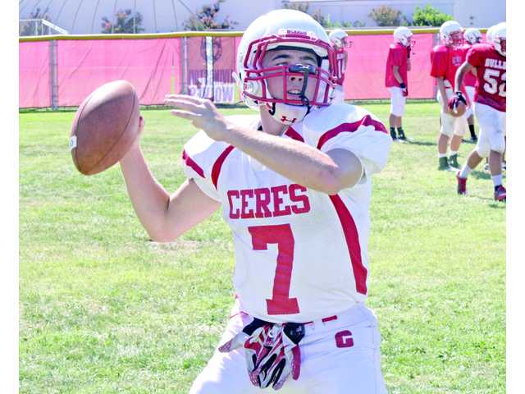
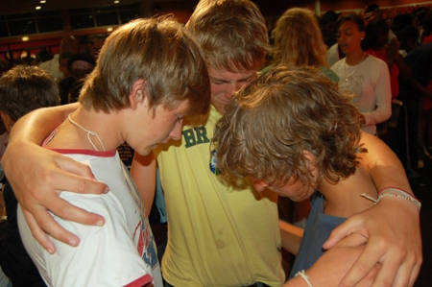
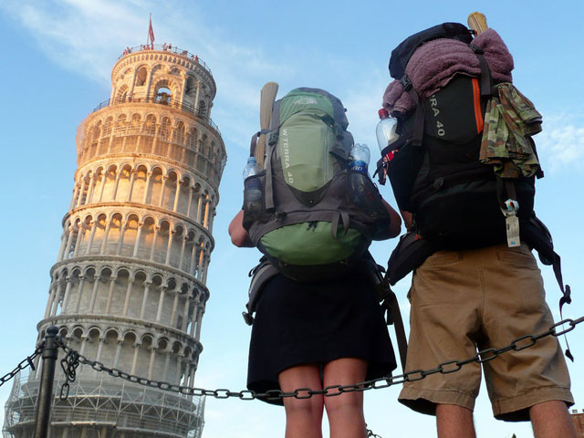
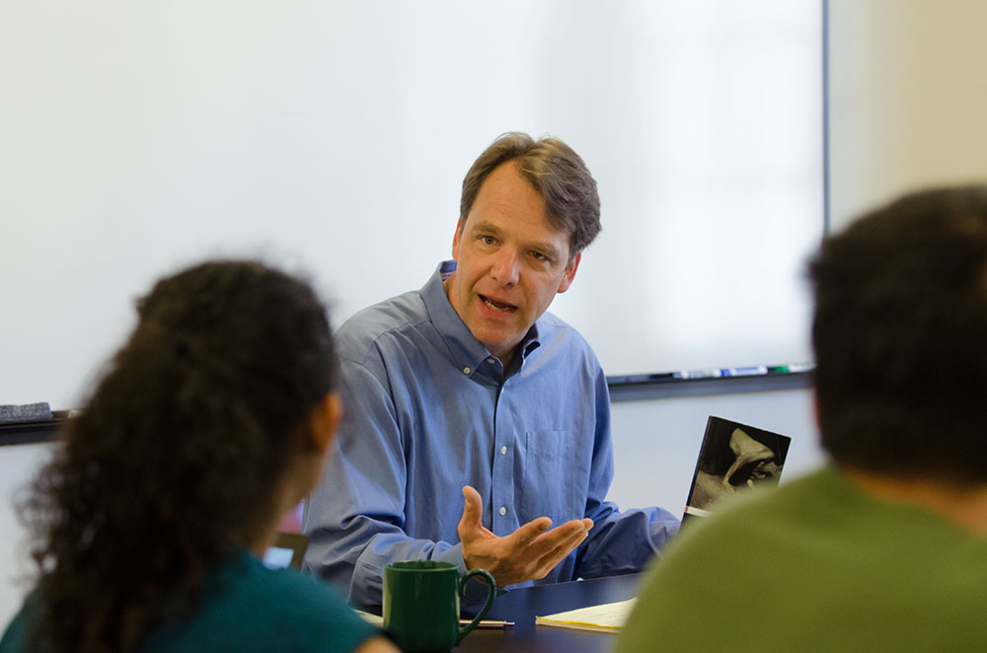
Melvin Berry - Identity Collage Who I Have Been

Slide 9
The Foundations of Success:
Meyers Briggs Personality Assessment
The Career Center at CCBC offers this personality assessment to students free-of-charge.
Online versions are also offered at HumanMetrics.com
Students make an appointment and take the assessment outside of class time.
Students meet with a counselor in the career center to discuss the results
Students then write about what they learned in their journal – answering specific questions that I pose about the test.
Students then discuss their findings in class = both pros and cons and how it has impacted their understanding of themselves.
This exercise provides another valuable insight into who the student is and is often correlated with possible work options that might be appropriate for their personality. It is not fool-proof, however, and people do change, so this is only one possibility in a vast range of possibilities that students can use to enhance their own self-knowledge.

Slide 10
The Resources of Success
First Question I Asked Myself… “How can I expect students to succeed if they are not familiar with and know how to access the materials, organizations, and people that are integral to their success?” Simply saying to them, “it’s up to you,” or “go do it.” isn’t enough.
School Tour – Walking the Campus, meeting people, asking questions, and collecting information
Library
Student Success Center
Writing Center
Counseling Center (academic and personal)
Student Life
Child Care Center
Career Center

Slide 11
The Resources of Success: The Campus Tour
Library
How the library is organized – reference materials, periodicals, special-collections, e-books, study areas, and online databases.
Library Treasure Hunt
Sometimes I do the above and sometimes I have had a librarian do it. It has worked both ways—much of it just depends on how much time we have as a class.
Student Success Center
The Student Success Center offers a wealth of material for students—much of which we use in the class during the “Habits of Success” portion of the class.
Tutoring within different subject areas

Slide 12
The Resources of Success: The Campus Tour
The Writing Center
How it functions—what it does and doesn’t do, appointments, materials, and hours of operation, etc.
OWL = the Online Writing Lab
The Counseling Center
Personal issues such as family and relationship counseling
Mental / Social Issues that may affect student learning
Advice on housing, transportation, finances, etc.

Slide 13
The Resources of Success: The Campus Tour
Student Life
Student Organizations – Academic & Social - Phi Theta Kappa, Black Student Union, Student Ambassadors, and the Honors Program as well as the many social clubs that students can join.
Student Government – if students aspire to have a part in the organization of the school, they can become student officers
Service Projects – trips to NYC and Central America, etc.
Grants, scholarships, and other awards that are often available to students who are involved in campus activities
The Child-care Center
This is an important area since students are often also parents and do not know that CCBC has a child-care facility on campus that is dedicated to caring for student, faculty, and staff children.
The Career Center
Career planning and job portal resource
Resume writing and evaluation
Tips on interviewing for a job

Slide 14
The Habits of Success
The “Ka” – Egyptian Religion
The spiritual entity that lives inside all of us and which survives the death of the body. In other words, it is our essence, our soul, and that to which we must be true.
Shakespeare’s Hamlet – Know thyself and to thine own self be true.
KAE = Kappa Alpha Epsilon, the Fraternity of High Achievers and establishing Habits of Mind / Habits of Action / Habits of Evaluation
K = Knowledge – Good information – reading, understanding, and comprehending
A = Action – acting on the information, applying what you know
E = Evaluation – evaluating the action, i.e. “did it work?” and if not, how can I make it better?
I ask students if they want to join this fraternity? If they will commit to being students who will take charge of their lives—their whole lives—including those non-cognitive areas as well as their academic areas.

Slide 15
The Habits of Success
What is a Habit?
From Dictionary.com – “An acquired behavior pattern regularly followed until it has become almost involuntary.” In other words, it is simply consistency.
Aristotle said: “We are what we repeatedly do. Excellence then, is not an act, but a habit.”
Class Discussions on the nature of habits—good habits, poor habits, constructive vs. destructive habits, how habits are formed, and how we can take charge of our own habit patterns.
Practice developing positive habits = start small
Make your bed / Brush your teeth before bedtime / Set-out tomorrow’s clothes / pack a lunch
Select a habit to build and chart the success
Two Journal entries:
What is a habit you would like to break?
What is a habit you would like to build?

Slide 16
The Habits of Success
CCBC’s Student Success Center Materials:
Academic Success:
Motivating Yourself to Study, i.e. “self-discipline”
Managing Your Time to Study
Filling Out the Academic Success Plan
Time Management & Planning: Calendars
Famous saying, “Those who fail to plan should plan to fail.”
Preparing and Using Calendars
Semester Calendar, Monthly Calendar, Weekly, and Daily
Show them my calendars and system (modeling)
Importance vs. Urgency – coding activities/ actions: A1, B2, C3
Do the Hardest Jobs first – working “downhill”
Assess & Reward – A’s = 3 pts, B’s 2 pts. , C’s 1pt.

Slide 17
The Measures of Success
Goal Setting: Dream Big / Start Small / Be Specific
Visualizing what you want to be and where you want to go
Realizing that nothing is impossible for those willing to hard, consistently, and to never quit. / Tortoise & the Hare
My Sayings: “Make it Happen” & “Finish it”
“SMART” Goals
S – Specific (or Significant)
M – Measurable (or Meaningful)
A – Attainable (or Action-Oriented)
R – Relevant (or Rewarding)
T – Time-bound (or Track-able)

Slide 18
The Measurements of Success
Goal Setting: Short-term, Mid-term, and long-term
Making life better, more manageable, and enjoyable
Modeling: Goal Portfolio 2009 to 2015 / Eight Areas:
1. Physical – losing 10lbs., eating a better, getting more exercise
2. Social – family & friends, groups and individuals
3. Mental – Reading, Learning something (abstract or concrete)
4. Financial – Budgeting, Saving, and Investing
5. Vocational – Teaching & Writing
6. Institutional – CCBC related goals
7. Avocation – Becoming a better sailor, etc
8. Recreational – Traveling to a new country, etc
Goal setting is about getting the most out of life. It is about directing your life. The “Horse” analogy, “Life is like a galloping horse…”

Slide 19
In Conclusion… students speak
Class Evaluation / Assessment: (portfolio entries)
“My favorite part of the class was when I got to think about myself and where I wanted to go and who I wanted to be. It was hard, but it made me think deeply about myself—my kah!”
“I am a better at planning than before. I never used a calandar before but now I use it all the time. It has helped [me] a lot to not miss classwork and be on time, to be more disciplined, but I know I can be better.”
Non-cognitive material enhances student retention and directly contributes to student success.

