Slide 1
What Am I Going to Do in Class?: Translating Pedagogical Principles into Classroom Activities
Rebecca Kaminsky
Summer Serpas
Irvine Valley College
CADE 2016

Slide 2
About US
Summer Serpas
  Assistant Prof. of English
  IVC’s Accelerated Program Developer/Guru/Hero
  Teaching accelerated classes for 4 years
  Course Coordinator/Faculty Trainer (F2013-SP2016)
  Curriculum Director (“Habits”)
  CAP Coach (SU2016)
sserpas@ivc.edu
Rebecca Kaminsky
  Assistant Prof. of English
  Teaching accelerated classes for 3 years
  Curriculum Director (“Success”)
  Course Coordinator/Faculty Trainer (SU2016)
rkaminsky@ivc.edu
Notes:
10:30-10:33
Summer then RK

Slide 3
The History of IVC’s Writing Sequences
Traditional
Sequence
(since long ago)
Accelerated Sequence
(since Fall 2015)
ESL Sequence
(since Fall 2015)
Reading 370:
3 units plus a .5 unit lab
Writing 301:
3 units plus a .5 unit lab
Writing 201:
3 units plus a .5 unit lab
Writing 1:
College-Level Writing
(4 units--.5 unit lab optional)
Reading 370:
3 unit class plus a .5 lab
WR 399
(Formerly EXP 389):
A 5 unit, one-semester course plus a .5 unit lab
Writing 1:
College Level Writing
(4 units--.5 unit lab optional)
ESL 370:
5 units
ESL 301:
5 units plus a .5 unit lab
ESL 201:
5 units plus a .5 unit lab
Writing 1:
College-Level Writing
(4 units--.5 unit lab optional)
Notes:
10:34-10:39 SS

Slide 4
The Current (F2016) Writing Sequence at IVC
Writing 1
Transfer-Level Writing
4 units
Optional .5 unit Writing Center
Writing 201
One-Level-Below
(Placement Test)
3 units
.5 unit Writing Center
co-requisite
Writing 399
Two-Levels-Below
(Open Access)
5 units
.5 unit Writing Center
co-requisite
Notes:
10:34 – 10:39
SS

Slide 5
California Acceleration Project’s
Five Principles of Acceleration
Backwards Design:
Instruction should be aligned with students’ educational pathways, with pre-college writing courses focused on teaching the same kinds of reading, writing, and thinking skills students will use in college-level writing.
Relevant, Thinking-Oriented Curriculum:
Curriculum should engage students with issues that matter and provide thought-provoking, open-ended problems.
Notes:
10:40 – 10:43
RK

Slide 6
California Acceleration Project’s
Five Principles of Acceleration
Just-In-Time Remediation:
Instructors should provide help for students when the need arises as they work through college-level reading and writing assignments.
Low-Stakes, Collaborative Practice:
Students should participate in in-class activities
that give them practice with the most high
priority skills and content needed for the later
graded assignments.
Support for Student’s Affective Needs:
Instructors should help students through emotional or psychological barriers that block learning and have nothing to do with their cognitive ability
Taken from “Toward a Vision of Accelerated Curriculum & Pedagogy: High Challenge, High Support Classrooms for Underprepared Students” by Katie Hern and Myra Snell
Notes:
10:40 – 10:43
RK

Slide 7
IVC’s
Instructional
Cycle
Pre-Reading Activities: In-class activities or discussions to activate the students' background knowledge on the topic. The teacher provides guidance regarding what to pay attention to, key terms that may be unfamiliar, and portions of the text that students may find challenging.
At-Home Reading Activities: Students complete guided practices to increase their awareness of strategies for approaching academic reading, reasoning, and writing. These include writing directed summaries, completing double-entry journals, and annotating text.
Post-Reading Activities: In-class group activities for students to process, clarify, and engage with ideas from the readings. These practices include group discussions, debates, and games, such as “speed-dating” and poster presentations.
Open Book Quiz: Students move from informal and oral discussions to explaining key ideas in their own writing. The quiz also provides incentive and accountability for completing the reading.
Essay Writing Workshops: Students move from explaining discrete portions of the reading to integrating, synthesizing and building arguments. Students must articulate and support their own perspective while demonstrating a clear understanding of the readings. Students perform peer evaluations and self-evaluations while the teacher conducts one-on-one conferences to discuss preliminary drafts.
Final Draft: On the day the students submit the essays, the teacher initiates just-in-time remediation activities, allowing students time to edit their essays and write self-reflections on their writing process. As the next cycle begins, the teacher uses the common rubric to evaluate the essays, using a high pass, pass, low pass, and no pass model.
Notes:
10:40 – 10:43
RK

Slide 8
Preview Activities
Pre-Reading Activities:
In-class activities or discussions to activate the students' background knowledge on the topic. The teacher provides guidance regarding what to pay attention to, key terms that may be unfamiliar, and portions of the text that students may find challenging.
Notes:
10:44 – 10:47 RK

Slide 9
Preview Activities
What are they?
Methods of introducing material, topics, and readings to students to help them anticipate possible challenges, or to help them begin to think about the topics on their own prior to reading.
Why should we use them?
The preview activities help students:
  Reduce fear of difficult texts and topics
  Discover tools to navigate challenging texts
  Think about how the larger issues in the text might impact their lives
Notes:
10:44 – 10:47 RK

Slide 10
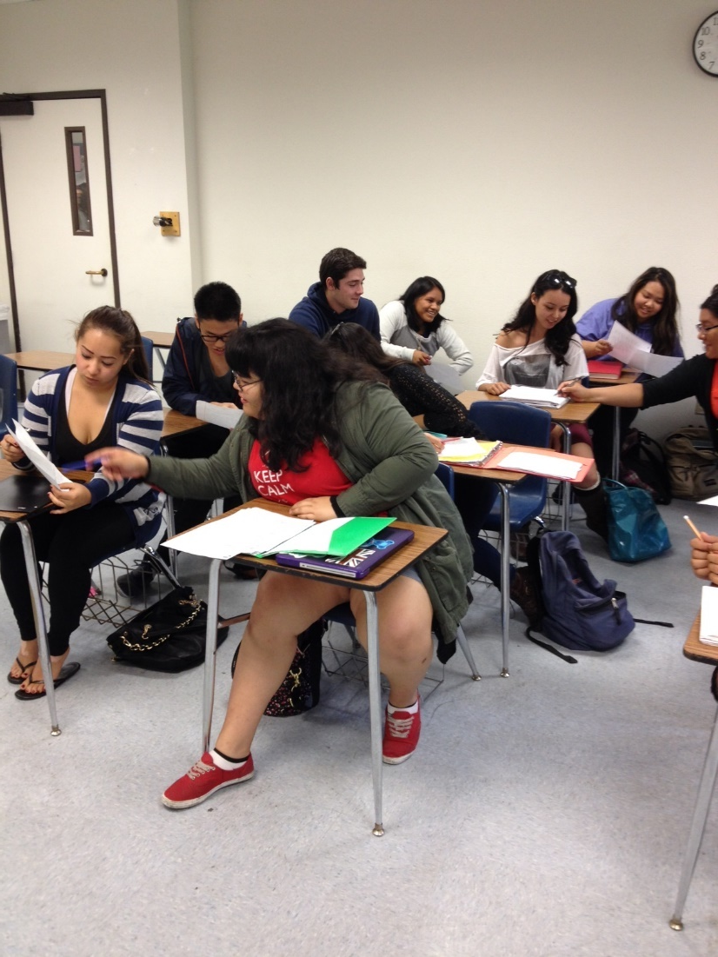
Preview Activities
What are some activities that can be used?
  Journaling
  Videos
  Group discussions
  Discussion Questions
  Quick “heads up”
Notes:
10:44 – 10:47 RK
Regardless of activity, keep it simple. Activities are meant to prep students, nothing more.

Slide 11
At-Home Reading Activities
At-Home Reading Activities:
Students complete guided activities to increase their awareness of strategies for approaching academic reading, reasoning, and writing. These include writing directed summaries, completing double-entry journals, and annotating text.
Notes:
10:48 – 10:58 SS

Slide 12
At-Home Reading Activities
What are they?
Assignments that allow students to try out various active reading strategies to help them learn how to engage with the text.
Why should we use them?
The at-home reading activities help students:
  Process difficult reading assignments
  Gain exposure to different reading strategies
  Evaluate which reading strategies work for them personally and for different texts
  Find the “big picture” ideas in the text
Notes:
10:48 – 10:58 SS

Slide 13
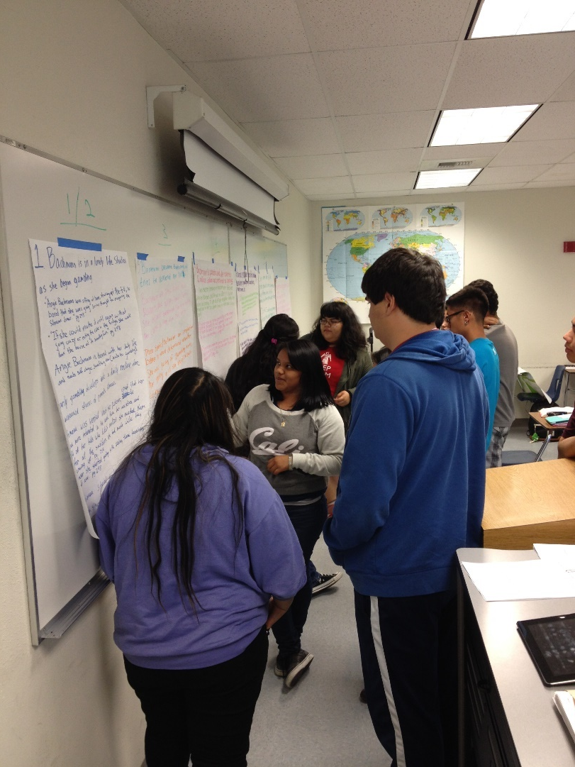
Practice!
Please read the section of “Brainology” assigned to you.
As you read, highlight one “golden line”–a passage that you found particularly important in the section.
Note the golden line on your worksheet and explain why you chose that passage.
Notes:
10:48 – 10:58 SS

Slide 14
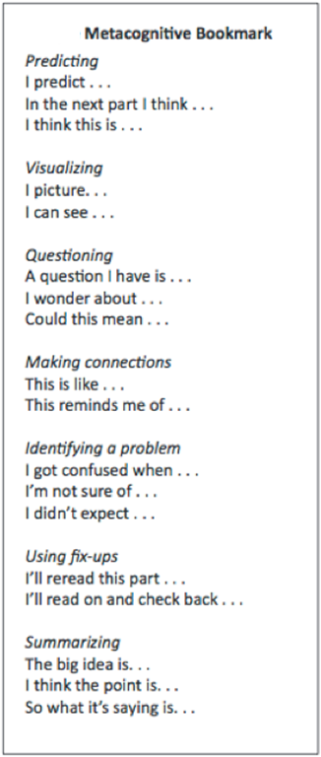
Ideas for At-Home
Reading Activities
Evidence charts/double-sided notes
Guided annotations
Summary
Defining key terms
Answering a focus question
Finding Golden Lines
Outlining
Student choice
Notes:
10:48 – 10:58 SS

Slide 15
In-Class Reading Activities
(Processing Texts)
Post-Reading Activities:
In-class group activities for students to process, clarify, and engage with ideas from the readings. These practices include group discussions, debates, and games, such as “speed-dating” and poster presentations.
Notes:
10:59- 11:09 SS

Slide 16
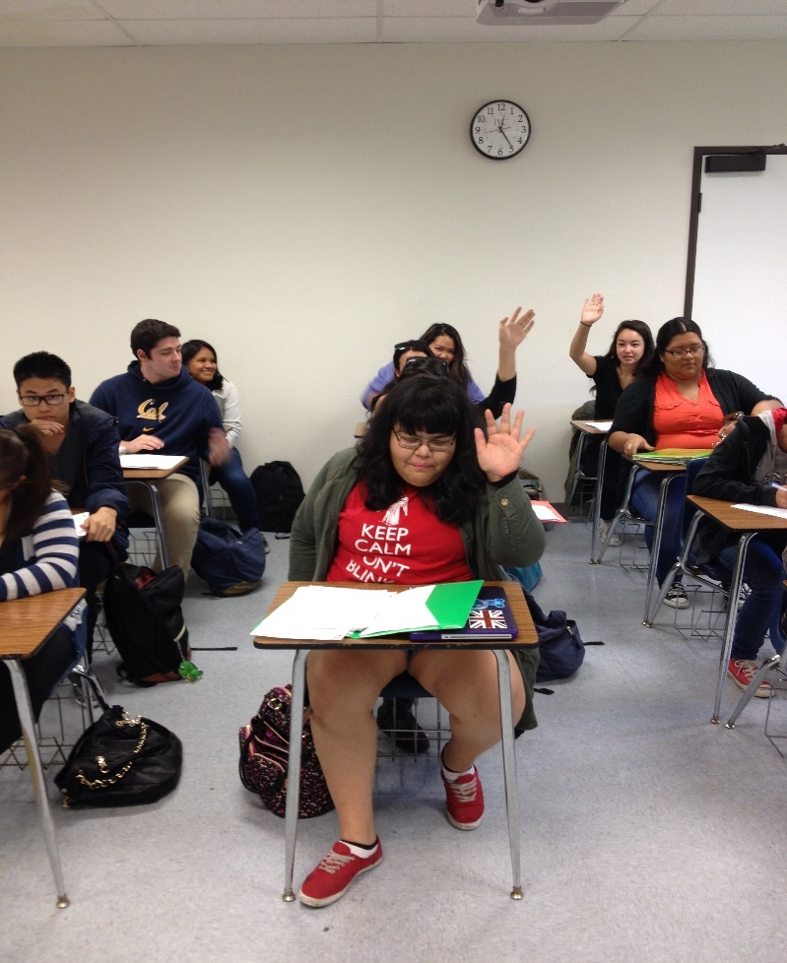
The Fess Up
Is there anyone who was unable to complete the reading?
Notes:
10:59- 11:09 SS

Slide 17
In-Class Reading Activities
(Processing Texts)
What are they?
In class, we should facilitate “low-stakes, collaborative practice” activities that help students process, clarify, and engage with the reading.
Why should we use them?
The in-class reading activities help students:
  Clarify confusion and model reading strategies
  Use their own knowledge and vocabulary to help them understand texts
  Provide peer-to-peer support and community-building in the classroom
  Make the invisible visible
  Reduce their fear of reading
  Find an incentive for completing the reading assignments
  Prepare to write better essays
Notes:
10:59- 11:09 SS

Slide 18
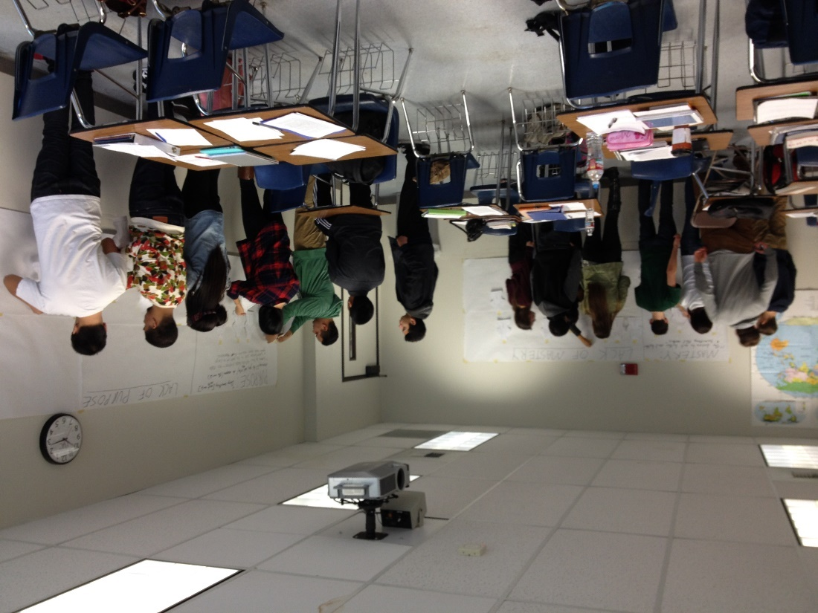
Practice!
Find the other people who were assigned the same number as you.
In your groups, each person should share the golden line he or she selected and why he or she chose it.
As a group, chose the one best golden line from your group.
Write the group’s golden line on your worksheet and explain why you chose that line.
Notes:
10:59- 11:09 SS

Slide 19
If we had more time…
In class, we would have students go back to their original groups, which would include one person from each section, and share out the golden lines.
All group members would fill in the worksheet for each section, making additional notes as needed.
We would also encourage students to write down additional golden lines for each section, and explain how having more choices might benefit them when they get to the drafting stage.
Notes:
10:59- 11:09 SS

Slide 20
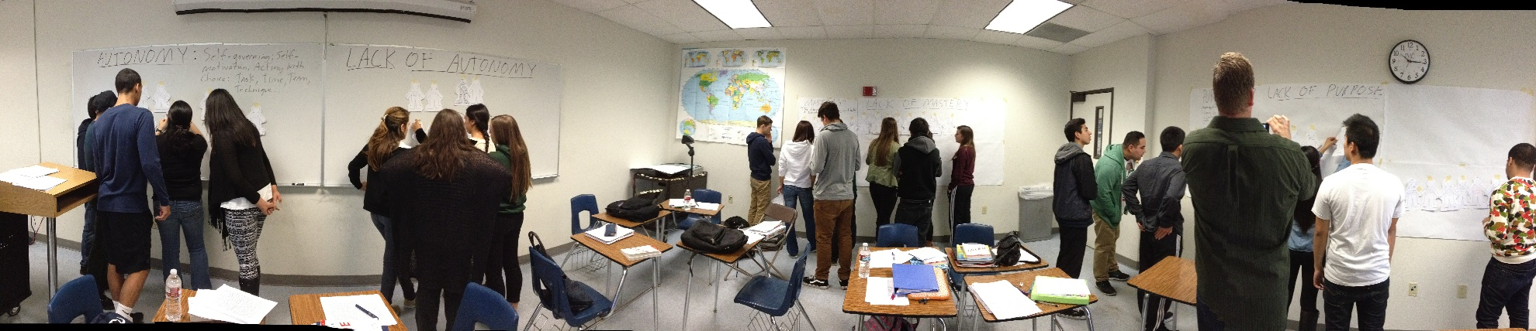
In-Class Reading Activities
Be sure to create activities that:
  make space for comprehension
  do not allow students to bypass the reading thereby creating accountability
  require participation from all students
  connect directly to the essay prompt thereby creating relevance
  ask students to work with different partners periodically to create additional community in the classroom
Notes:
SS

Slide 21
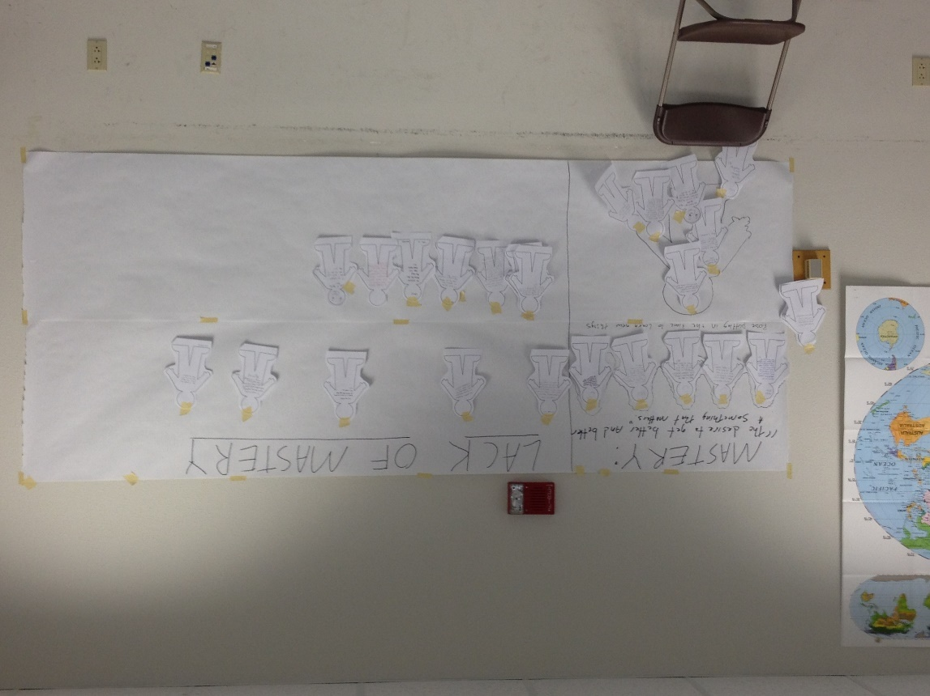
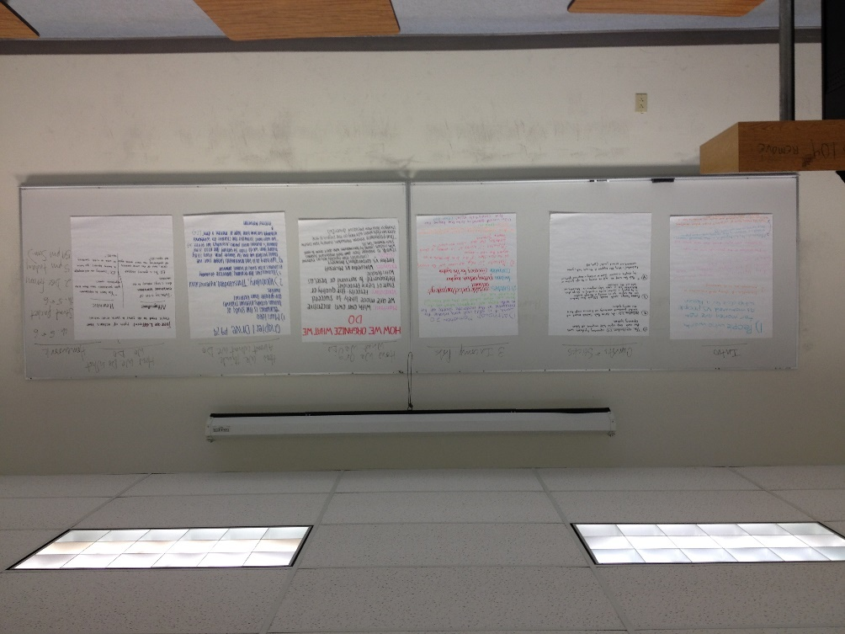
In-Class Reading activities
Worksheets with focus questions
Graphic organizers
Poster sessions
Post-It note sessions
Debates
Speed Dating
Jigsaws
Think-Pair-Share
Notes:
10:59- 11:09 SS

Slide 22
The Reading Quiz
Open Book Quiz:
Students move from informal and oral discussions to explaining key ideas in their own writing. The quiz also provides incentive and accountability for completing the reading.
What is it?
After reading all texts for an essay assignment, students take an “open book, open note, closed neighbor” (often take home) reading quiz.
Why should we use it?
The reading quiz helps students:
  bridge from reading to writing, acting as a prewriting activity
  practice explaining the big picture ideas from the text
  prepare for essay writing in a slightly higher (but still relatively low) stakes assignment, helping the instructor check for understanding early on in the writing process
  be accountable for the reading assignments
Notes:
10:59- 11:09 SS

Slide 23
The Essay Prompt/In-Class Writing Activities
Essay Writing Workshops:
Students move from explaining discrete portions of the reading to integrating, synthesizing and building arguments. Students must articulate and support their own perspective while demonstrating a clear understanding of the readings. Students perform peer evaluations and self-evaluations while the teacher conducts one-on-one conferences to discuss preliminary drafts.
Notes:
11:10 – 11:13 RK

Slide 24
Essay 1: Text-to-Personal Examples
Essay 1 Prompt:
For this assignment, we have read about several traits and concepts that can influence how students perform in the classroom: grit, fixed and growth mindset, habits of mind, and how teachers affect learning. For this assignment, I would like you to choose two of these traits or concepts, explain it for your readers by using information from the text that explains that trait or concept, and discuss how this trait or concept has impacted your ability to be a successful student.
Some things I’d like you to include:
Explain your chosen traits or concepts for readers who are not in this class and have not read the text. This means you’ll need to spend some time summarizing key ideas, defining any terms that might be unfamiliar, and choosing short quotations from the texts to help your reader get a sense of what the author is talking about.
Choose at least two specific incidents from your educational history to illustrate the impact of these traits or concepts on your success as a student. Try to make a connection to writing or reading in at least one of your examples. You should choose at least 1 extended example per trait or concept.
Please close by bringing me up to the present—How do you think you can use or develop these traits in this specific writing class? Is there anything you’d like me to know so that I can better support you and help you succeed? Is there anything you’re concerned about? Is there anything you feel excited about?
To give me as full and detailed of a story as possible, shoot for at least three (3) full pages.
Notes:
10:59- 11:09 RK

Slide 25
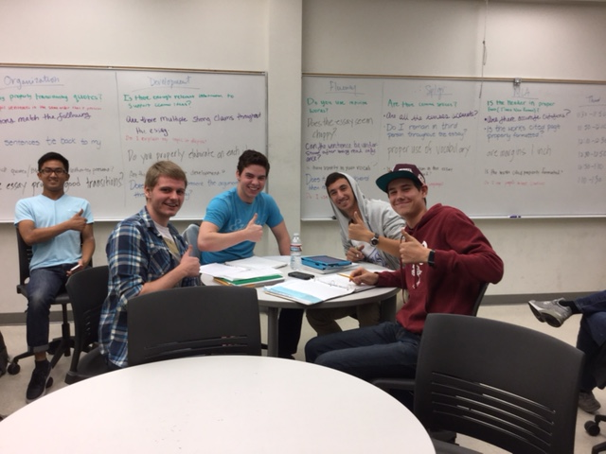
Writing Activities
What are they?
Prewriting, drafting, peer review, conferencing, self-evaluation, and revision.
Why should we use them?
The writing activities help students:
  Become familiar with the writing process required for college-level essays
  Practice skills in a low-stakes environment
  Reduce fear of the writing process and receiving feedback on their work
  Learn to evaluate and provide feedback to others
Notes:
11:10 – 11:20 RK

Slide 26
Writing Activity:
The “Summary Challenge”
Writer’s Initials: ______
Directions: Review your notes on how to write a complete summary paragraph, and using the space below, write a summary paragraph of “Brainology” by Carol Dweck.
_________________________________________________________________________________________________________________________________________________________________________________________________________________________________________________________________________________________________________________________________________________________________________________________________________________________________________________________________________________________
Writer’s Initials: ______
Row: _____
Score (1-7) Things Done Well Needs Improvement
Notes:
11:10 – 11:20 RK

Slide 27
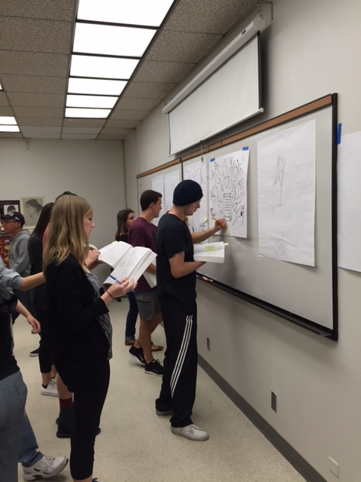
Practice!
Go to page 15 in your packet for a scorecard.
Assume you have already reviewed what a summary is, and when to use one
With a partner, review two of your classmates’ summaries, and score them, based on the criteria discussed about summary writing, so the total points between the two is seven (i.e. one might score a 3 and the other a 4)
Notes:
11:10 – 11:20 RK

Slide 28
If we had more time…
We would complete 5 rounds
Students with high scores (usually top two or three) read their summaries to the class, and the class discusses why those summary paragraphs earned the most points
Have students review their own summary paragraphs, what they learned, and the comments from their peers and have them revise the paragraphs
They may use these paragraphs in their essays, or simply use them for reference in the future
Notes:
11:10 – 11:20 RK

Slide 29
Final Draft
Final Draft:
On the day the students submit the essays, the teacher initiates just-in-time remediation activities, allowing students time to edit their essays and write self-reflections on their writing process. As the next cycle begins, the teacher uses the common rubric to evaluate the essays, using a high pass, pass, low pass, and no pass model.
Notes:
11:20 – 11:25 SS

Slide 30
On the day the paper is due…
The students complete the essay reflection questions and turn in their final drafts.
Notes:
11:20 – 11:25 SS

Slide 31
Just-in-Time Remediation:
Editing Workshop
What is it?
Students bring in their final draft and complete a workshop focused on editing. The instructor circulates, providing just-in-time remediation to help students edit their essays.
Why should we use it?
The editing workshop helps students:
  focus on editing as the last step in the writing process
  realize why grammar and mechanics are important for reader understanding in a final draft
  get help tailored to their individual grammatical challenges
  see grammar/spelling/mechanics as part of the whole rather than separate in a vacuum
Notes:
11:20 – 11:25 SS

Slide 32
Essay Reflection
What is it?
A series of metacognitive questions that help students reflect on the writing process as a whole and their individual process of writing.
Why should we use it?
The essay reflection helps students:
  think about how they completed their assignment
  determine their strengths and weaknesses in the writing and reading process
  establish reading and writing goals for themselves by looking both backward and forward
Ps. This helps instructors better understand where student confusion took place, what was happening in the lives of students as they completed the unit, and how to plan activities for future assignments.
Notes:
11:20 – 11:25 SS

Slide 33
Sample Essay Reflection Questions
What did you find easy about this essay, and what did you find challenging? Explain.
What specific item did you try to improve upon from the last essay in this essay? Why did you focus on this item? Explain.
What one item do you believe you still need to work on? Why?
What did you learn about your process of writing by working on this assignment? Explain.
What did you learn about the writing process in general by working on this assignment? Explain.
What was the most important thing you learned about yourself while working on this essay? Explain.
On a scale of 1 to 5, 1 being too easy and 5 being too hard, how would you rate the difficulty of this writing project? Explain.
Do you have any questions about this assignment? Please do not include questions about grammar.
Is there anything else you would like me to know about this assignment, or about how class is going?
Please share with me anything you would like me to know about your writing experience.
Notes:
11:20 – 11:25 SS

Slide 34

Q & A
Notes:
Any leftover time - SS and RK

