Slide 1
AVID AND AlP
At Butler Community College in Kansas

Slide 2
Sources of ALP’s Success at Butler
Structural Changes
Eliminating “Exit Points”
Backward Design
Simplified course track
Integration of dev. ed. students
Institutional Support
Incorporated into BCC long-term planning
Advising buy-in
Measurement team
Relevent Conferences (CADE, NADE, even CCHA!)
Professional Development
Robust faculty development system in place
Dev. Ed. Institute
Lead teacher and two “deputy” understudies
Conferences
Peter Adams visit
Pedagogical Growth
Active-learning push on campus
Invigorated attention to non-cognitive domain
AVID grant

Slide 3
What is AVID?

Slide 4
What Does Learning Look Like?

Slide 5
Let’s Take 2 Minutes to “Think Pair Share” with Someone Nearby

Slide 6
Who Wants to “Share Out” What You and Your Partner Discussed?

Slide 7
Overview of a Few Active Learning Strategies

Slide 8
Let’s Try Out a Strategy!

Slide 9
Reciprocal Viewing

Slide 10
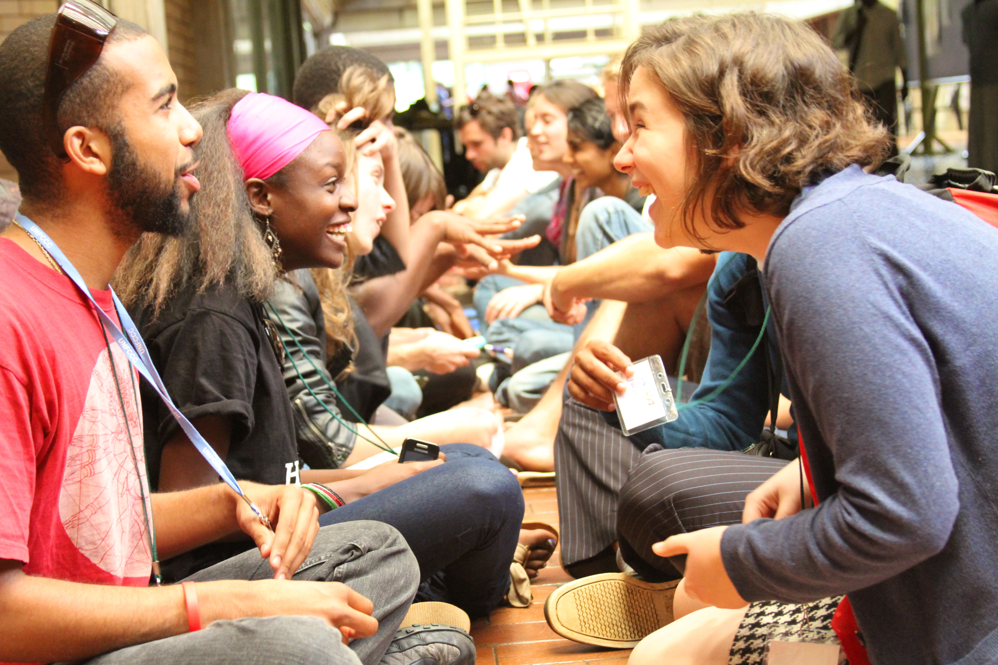
Paired Discussions: Speed Dating

Slide 11
Jigsaw

Slide 12
Four Corners

Slide 13
World Cafe

