Slide 1
Transforming Mathematics from a Gatekeeper to a Gateway – Carnegie’s Quantway
Aaron J. Altose
Cuyahoga Community College
Aaron.Altose@tri-c.edu
Notes:
Personal intro
History and future of Math 0990

Slide 2
Today’s Session
Overview of the Carnegie Pathways
Impact at Cuyahoga CC & UNG-Gainesville
Results: National Data
The Student Experience
A Quantway Lesson & the Learning Opportunities
Moving forward
Q & A
Get Involved?
Notes:
Total: 2 - 2.5 hours

Slide 3
The Problem
60-70%
Students assigned to developmental math course.
80%
Percent of these students that never get past
this gate.
500,000 students
in every cohort will never complete college math requirement.
If we continue to do what we have always done, we will continue to get what we have always gotten.
Notes:
The Problem: Almost half of our nation’s post-secondary students are enrolled in community college. Between 60 to 70 percent of incoming community college students typically must take at least one developmental math course before they can enroll in college-credit courses Upwards of 80 percent of these students never get out.
Over 500,000 new students each year enter into this system who will never complete a college math course. A classic case of…

Slide 4
Institutional Structures and Leadership are aligned in support of the initiative.
A Networked Improvement Community Approach
Instructional System combines a) ambitious learning goals, 2) a curriculum with relevant, authentic contexts, and 3) a research-based pedagogy supporting collaborative, problem centered learning
Change math from Gatekeeper to Gateway
Productive Persistence student interventions and faculty actions address socio-emotional factors such as mindset, stereotype threat, sense of belonging.
Language and Literacy supports ensure students can engage in authentic context and communicate complex ideas, so that language is not a barrier to learning mathematics.
Comprehensive Professional Development programs enables faculty to change mindset and practice.
Notes:
So, how does it work?
Structural Change
Accelerated cohort experience – reducing time and transitions
College level mathematics focus with developmental math supports
Must maintain rigor – UC statistics transferability + meets pre-college mathematics requirement
Pedagogical and Content Shift
Authentic contexts
Aligned with specific programs of study
Active and collaborative learning
Integrated Student Supports
Student and faculty resources for addressing non-cognitive factors and language and literacy barriers that can hinder mathematics learning
Network Improvement Community
Space for shared learning – common curriculum, pedagogy, and assessments
Evidence base for continuous improvement

Slide 5
Institutional Structures and Leadership are aligned in support of the initiative.
A Networked Improvement Community Approach
Change math from Gatekeeper to Gateway
Notes:
So, how does it work?
Structural Change
Accelerated cohort experience – reducing time and transitions
College level mathematics focus with developmental math supports
Must maintain rigor – UC statistics transferability + meets pre-college mathematics requirement
Developed in the first year by Carnegie in consultation with experts – it guides and disciplines our work

Slide 6
A New Way: Coherent, Intensive, Accelerated Learning
Quantway 1
Quantway 2 or College Level QR Course
College Math
Credit
Bridge to STEM
Statway
College Math
Credit
Elem Alg
Int Alg
College Math
College Math
Credit
Semester 1
Semester 2
Semester 3
Notes:
An Ambitious, Coherent Alternative: The program is organized around two structured pathways, known as Statway and Quantway. Rather than a seeming random walk through a maze of possible course options, students and faculty are now joined in a common, intensive year-long experience toward a shared goal—achieve college math credit in one year. Statistics and Quantitative Literacy, respectively, are the core college-level content and conceptual organizers for the Pathways. Developmental mathematics learning goals are integrated throughout.

Slide 7
Institutional Structures and Leadership are aligned in support of the initiative.
A Networked Improvement Community Approach
Instructional System combines a) ambitious learning goals, 2) a curriculum with relevant, authentic contexts, and 3) a research-based pedagogy supporting collaborative, problem centered learning
Change math from Gatekeeper to Gateway
Notes:
So, how does it work?
Pedagogical and Content Shift
Authentic contexts
Aligned with specific programs of study
Active and collaborative learning
Multiple drivers – we need to affect all of them, if we are going to have meaningful change
A) pathways structure – lose more students between than within; b) engage students immediately in meaningful content – start by teaching college level statistics to dev math students (and then fill in the dev math needed) – need support with internal/external articulation; c) need commitment to trying something new
Relevant and engaging content – these students have failed at math repeatedly. We needed to teach something new and teach it in a new way. We wouldn’t ask students to master algebraic procedures that are disconnected from authentic use – no more factoring of trinomials. Math would be used to solve REAL problems, within authentic contexts, using real data.
We’d enable students to engage differently – no more sitting and watching a lecture and then trying to replicate a procedure. Rather students actively work to solve a problem, bringing their own experiences to bear. The teacher serves as a facilitator.
This means we have to prepare teachers differently – large area of work is faculty professional development
There are things besides math that affect student’s learning in mathematics:
Psycho-social factors: mindset, sense of belonging, anxiety – we need to intervene on each of these to improve success – this has implications for the role of faculty
Don’t want language to be a barrier to learning math. Students are working with authentic contexts, being asked to make arguments with quantitative data, to explain their reasoning. Demands not part of a typical math class. So we have to pay attention to how we support students in reading and expressing themselves. Again, new demands on faculty.
Aim:
first, double success rate
Then 5% to 50%
Next…
Common theory of action
Developed in the first year by Carnegie in consultation with experts – it guides and disciplines our work
Unlike other reform efforts we’re tackeling all these drivers simultaneoulsy
We knew we had to improve enrollment (we’ve even updated the driver diagrams over time as we better understand the system)
We knew we needed a cohesive instructional system and that was tied with how we supported faculty
We also knew we had to support/meet the needs of students – language and literacy and productive persistence

Slide 8
Pathways Instructional System
Learning Opportunities
Productive Struggle
Explicit Connections
Deliberate Practice
Statway/ Quantway Curricula
Pathways Pedagogy
Ambitious learning goals
and curricular materials
designed around authentic
and relevant problem
situations
Research-based collaborative and student-centered pedagogical practices that support deep and long lasting understanding
Productive Persistence
Language & Literacy Supports
Notes:
As I’ve mentioned, the Pathways approach is a systemic reform effort. The curriculum and pedagogy of the Pathways courses are central to the system.
Ambitious learning goals and curricular materials designed around problem situations that are authentic and relevant to students;
Research-based collaborative and student-centered pedagogical practices that support deep and long lasting understanding;
Evidence-based supports for promoting students’ productive persistence that are integrated throughout the instructional system to increase student motivation, tenacity, and skills for success;
Language and literacy supports in instructional materials and classroom activities so that learning is accessible to all

Slide 9
Institutional Structures and Leadership are aligned in support of the initiative.
A Networked Improvement Community Approach
Instructional System combines a) ambitious learning goals, 2) a curriculum with relevant, authentic contexts, and 3) a research-based pedagogy supporting collaborative, problem centered learning
Change math from Gatekeeper to Gateway
Productive Persistence student interventions and faculty actions address socio-emotional factors such as mindset, stereotype threat, sense of belonging.
Notes:
So, how does it work?
Integrated Student Supports
Student and faculty resources for addressing non-cognitive factors and language and literacy barriers that can hinder mathematics learning

Slide 10
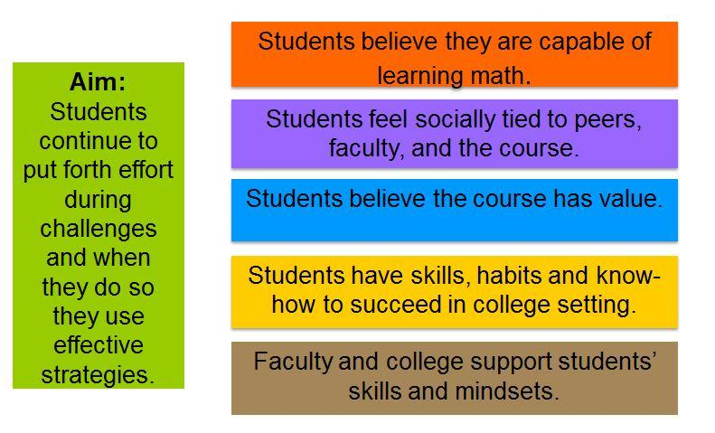
Productive Persistence
Notes:
Rachel says… Getting together researchers and practitioners and CF staff and interview students, scan lit., current research, student interviews----identified ~90 factors whittles down to 5 drivers.
Not comprehensive, but malleable and high impact

Slide 11
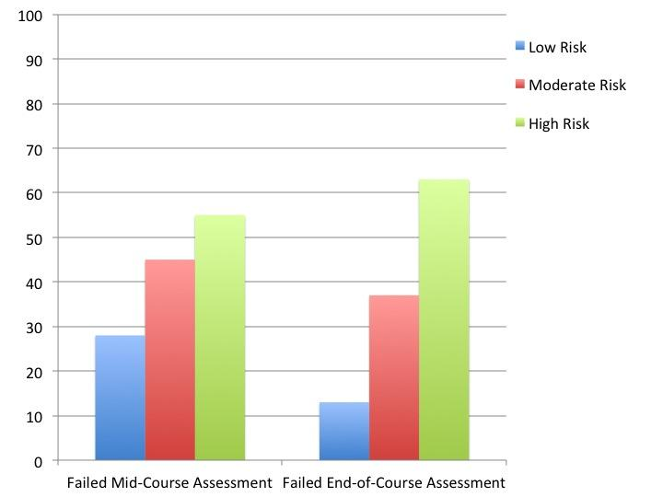
Do students’ mindsets matter?
Based on survey with developmental math students.
Categorized students as “at risk” or not in terms of the four drivers during week 1
Notes:
How do we know these really matter? Based on constructs from previous slides, categorize by risk, show they do matter---predictive of performance --- just as important is those who are low risk do well, high risk do worse...widen the gap.
...but good news, we can do something about it….next slide

Slide 12
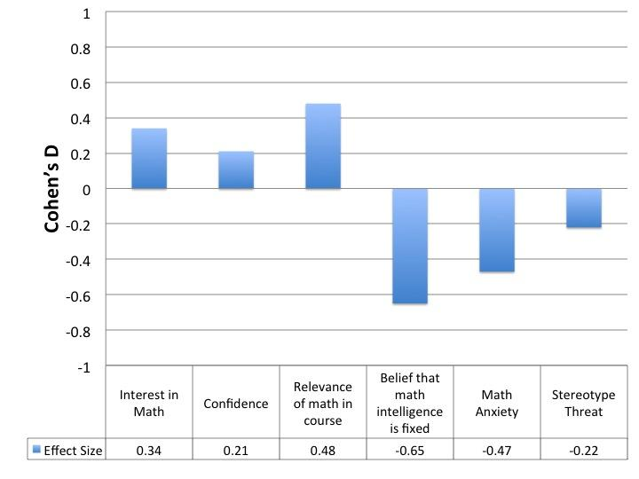
Can we change students’ mindsets in the first 4 weeks of class?
Notes:
we do high impact things in the first 4 weeks of course that impact the constructs and drivers … feedback loop with mindset and thinking

Slide 14
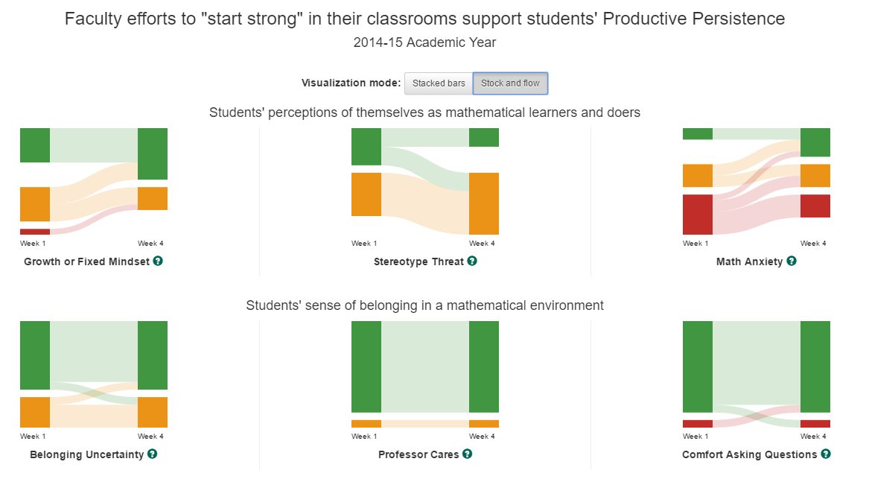

Slide 15
Institutional Structures and Leadership are aligned in support of the initiative.
A Networked Improvement Community Approach
Instructional System combines a) ambitious learning goals, 2) a curriculum with relevant, authentic contexts, and 3) a research-based pedagogy supporting collaborative, problem centered learning
Change math from Gatekeeper to Gateway
Productive Persistence student interventions and faculty actions address socio-emotional factors such as mindset, stereotype threat, sense of belonging.
Language and Literacy supports ensure students can engage in authentic context and communicate complex ideas, so that language is not a barrier to learning mathematics.
Notes:
So, how does it work?
Integrated Student Supports
Student and faculty resources for addressing non-cognitive factors and language and literacy barriers that can hinder mathematics learning

Slide 16
Institutional Structures and Leadership are aligned in support of the initiative.
A Networked Improvement Community Approach
Instructional System combines a) ambitious learning goals, 2) a curriculum with relevant, authentic contexts, and 3) a research-based pedagogy supporting collaborative, problem centered learning
Change math from Gatekeeper to Gateway
Productive Persistence student interventions and faculty actions address socio-emotional factors such as mindset, stereotype threat, sense of belonging.
Language and Literacy supports ensure students can engage in authentic context and communicate complex ideas, so that language is not a barrier to learning mathematics.
Comprehensive Professional Development programs enables faculty to change mindset and practice.
Notes:
So, how does it work?
Network Improvement Community
Space for shared learning – common curriculum, pedagogy, and assessments
Evidence base for continuous improvement
Multiple drivers – we need to affect all of them, if we are going to have meaningful change
A) pathways structure – lose more students between than within; b) engage students immediately in meaningful content – start by teaching college level statistics to dev math students (and then fill in the dev math needed) – need support with internal/external articulation; c) need commitment to trying something new
Relevant and engaging content – these students have failed at math repeatedly. We needed to teach something new and teach it in a new way. We wouldn’t ask students to master algebraic procedures that are disconnected from authentic use – no more factoring of trinomials. Math would be used to solve REAL problems, within authentic contexts, using real data.
We’d enable students to engage differently – no more sitting and watching a lecture and then trying to replicate a procedure. Rather students actively work to solve a problem, bringing their own experiences to bear. The teacher serves as a facilitator.
This means we have to prepare teachers differently – large area of work is faculty professional development
There are things besides math that affect student’s learning in mathematics:
Psycho-social factors: mindset, sense of belonging, anxiety – we need to intervene on each of these to improve success – this has implications for the role of faculty
Don’t want language to be a barrier to learning math. Students are working with authentic contexts, being asked to make arguments with quantitative data, to explain their reasoning. Demands not part of a typical math class. So we have to pay attention to how we support students in reading and expressing themselves. Again, new demands on faculty.
Aim:
first, double success rate
Then 5% to 50%
Next…
Common theory of action
Developed in the first year by Carnegie in consultation with experts – it guides and disciplines our work
Unlike other reform efforts we’re tackling all these drivers simultaneously
We knew we had to improve enrollment (we’ve even updated the driver diagrams over time as we better understand the system)
We knew we needed a cohesive instructional system and that was tied with how we supported faculty
We also knew we had to support/meet the needs of students – language and literacy and productive persistence

Slide 17
Advancing Quality Teaching System
Recruiting faculty
Preparation: Faculty Support Program
Professional learning opportunities for instructional improvement in Year 2+
Ongoing mentoring from experienced instructors

Slide 18
Faculty Support Program
Pre-teaching
1st Year of Teaching
12 – 18 months of support
Ongoing Faculty Mentor support
Online mini-course & resources
Intensive face-to-face workshops
(in coordination with local faculty supports)
Notes:
Launched in spring 2014
By the fall start, we had identified approx 35 new faculty who were invited to participate.

Slide 19
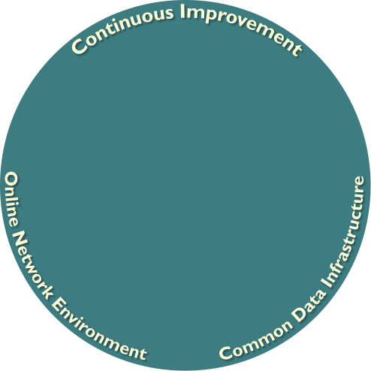
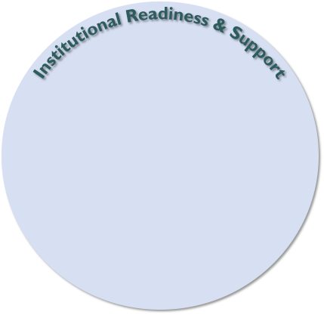
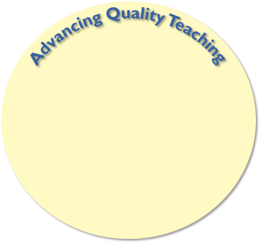
Learning Opportunities
Productive Struggle
Explicit Connections
Deliberate Practice
Statway/
Quantway Curricula
Pathways Pedagogy
Productive Persistence
Language & Literacy Supports

Slide 20
Statway and Quantway
In classrooms since 2011
Now in over 50 institutions across the country
More than 20,000 students served
Notes:
We began this initiative with 1500 students in 2011.
Including Cal State campuses
QUESTIONS???????

Slide 23
University of North Georgia
MATH PLACEMENT INDEX – STEM-path
SCORE | COURSE
1174 or below | Foundations-Level Math (MATH 0989)
1175-1299 | Co-Requisite-Level Math (MATH 0999+ MATH 1111)
1300 and higher | Gateway: College Algebra (MATH 1111)
MATH PLACEMENT INDEX – Non-STEM-path
SCORE | COURSE
1074 or below | Foundations-Level Math (MATH 0987)
1075-1199 | Co-Requisite-Level Math (MATH 0997+ MATH 1001)
1200 and higher | Gateway: Quantitative Skills & Reasoning (MATH 1001)
Notes:
Discuss STEM path versus non-STEM path. Then, “noting your MPI and which majors you’re considering, determine which pathway is most appropriate for you. Who isn’t certain? Please ask.” Talk through what the undecided group should take into consideration. “If you’re on the STEM-path side of the room and your MPI is 1174 or below, you will write MATH 0989 and 4 credit hours on your sheet. If your MPI is 1175-1299, you’ll write MATH 0999 and MATH 1111. Each is 3 credits. If you’re on the non-STEM side of the room and your MPI is 1074 or below, you will write MATH 0987 on your sheet, and 4 credit hours. If your MPI is 1075-1199, you will write MATH 0997-2 credit hours and MATH 1001-3 credit hours. If your MPI is 1200-1299, write MATH 1001. You still have a LS requirement, but are not required to take the Co-Requisite coursework. Questions? Please note, if you indicate MATH 0997, you’ll look for just that course. The section of MATH 1001 tied to it is listed as a placeholder, but it’s closed and I’ll be the one to put you in it. If you indicate MATH 0999 (different on each campus).

Slide 24
Quantway 1 Course Content
Module 1
Working with and Understanding Large Numbers
Estimation and Calculation
Percentages and Ratios
Module 2
Using Ratios
Applications of Percentages
Graphical Displays
Measures of Central Tendency
Module 3
Making Conversions
Geometric Reasoning
Using Formulas and Algebraic Expressions
Using Graphical Displays
Creating and Solving Equations
Module 4
Linear Models
Exponential Models

Slide 25
Results

Slide 26
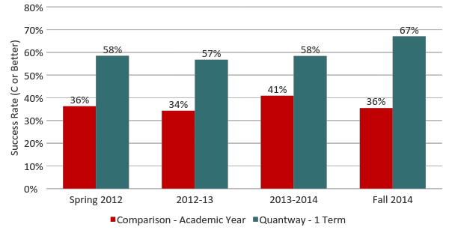
Quantway Success in the First Term: Almost Double the Success in Half the Time
Propensity Score Analysis compares the success of students in a single term of Quantway with matched students in the year long traditional sequence.

Slide 27
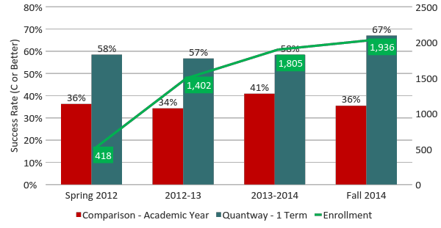
Quantway Success: Sustaining Success While Growing

Slide 28
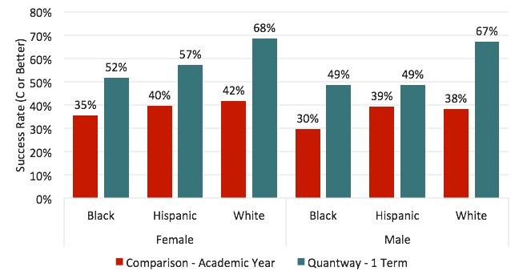
Advancing Equity: Quantway Delivers Major Gains for Hispanics and African Americans and Women*
*Average success rates – from Spring 2012 through Fall 2014
Notes:
QUESTIONS???

Slide 29
Let’s get ready to collaborate!
Instructions:
Form groups of 4 - preferably with people you do not know.
When you are in your group, introduce yourselves and then work together to find three non-obvious things that you have in common.
Then, each group member needs to share one unique fact about themselves.
Create a team name.

Slide 30
Starting Strong
Classroom norms and responsibilities
Language Script
Contract Activity
Syllabus Activity
Reflecting on Purpose for Learning
Growth Mindset Activity
Engaging in Productive Struggle

Slide 31
Productive Persistence

Slide 32
Lesson 1.8: Interpreting Statements about Percentages

Slide 33
What Do We Want Our Students to Learn?
Flexible vs. routine expertise (Hatano & Inagaki)
What is flexible/adaptive expertise?
Procedural fluency
Conceptual understanding
Disposition to think/make sense of mathematics
Ability to nimbly bring knowledge to bear across a wide array of new situations
Notes:
Routine—knowing how to do a procedure to solve a problem and being able to do it reliably – get really good at doing it
Flexible—know not only how to do a procedure but also what situations in which you use what procedures and carefully adapt those procedures to be responsive to those situations—you need to know WHY you are doing what you are doing so that you CAN adapt

Slide 34
Research Indicates Three Critical Learning Opportunities
To achieve flexible expertise, students need recurring and sustained opportunities for:
Productive struggle – with important mathematics
Explicit connections – between concepts, procedures, problems, situations
Deliberate practice – increasing variation and complexity over time

Slide 35
Productive Struggle (Hiebert & Grouws, 2007)
“We use the word struggle to mean that students expend effort to make sense of mathematics, to figure something out that is not immediately apparent.
We do not use struggle to mean needless frustration or extreme levels of challenge created by nonsensical or overly difficult problems.
We do not mean the feelings of despair that some students can experience when little of the material makes sense.
The struggle we have in mind comes from solving problems that are within reach and grappling with key mathematical ideas that are comprehendible but not yet well formed.”
Notes:
DISCUSSION

Slide 36
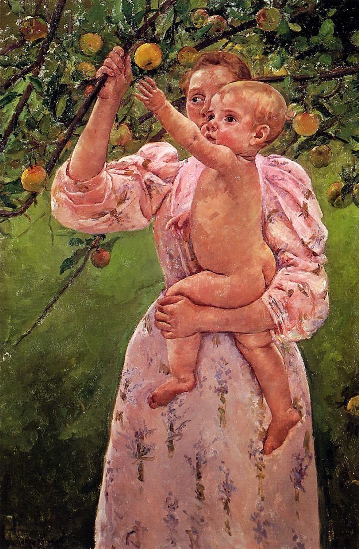
Mary Cassatt
Baby Reaching for an Apple 1893
Notes:
Thanks to Karen Givvin

Slide 37
The Power of Connections
Few Connections
Many Connections
B
B
C
C
A
A
D
D
F
F
E
E
G
H
G
H
Notes:
This is what makes knowledge flexible—understandings are connected—known as relational understanding
Not E is NOT helpful—connections to help him get there is what is key

Slide 38
Deliberate Practice
Different from repetitive practice
Constantly increasing variation, complexity, challenge
With feedback
Staving off premature automaticity
Notes:
The hard part is not doing the same thing over and over. The hard part is knowing and being able to do in different situations.

Slide 40
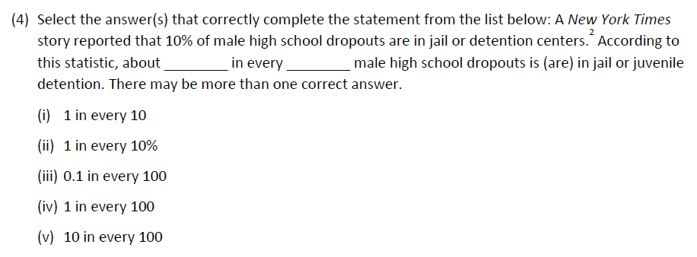

Slide 41
Learning Opportunities
Explicit Connections
− +
Step-By-Step Procedures | Well-Formed Lecture
Discovery Learning | ✪
−
+
Productive
Struggle

Slide 42
Learning Opportunities
Deliberate Practice
✪
✪
Explicit Connections
− +
✪
Step-By-Step Procedures | Well-Formed Lecture
Discovery Learning | ✪
−
+
✪
Maintaining
struggle and connections
through time
Productive
Struggle
✪

Slide 43
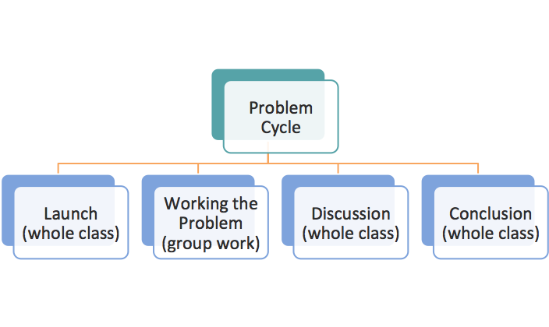
The Problem Cycle Routine
Designed to support productive struggle
Collaborative learning is critical component
Makes student thinking/reasoning visible
Builds key mathematical ideas from student thinking
Leaves students with key takeaways from problem

Slide 44
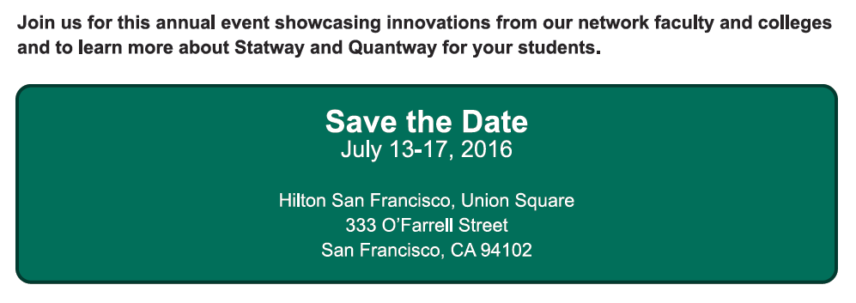
The National Forum will include:
A two-day Pre-conference training event on Thursday,
July 14th and Friday, July 15th for faculty who will start
teaching in Fall 2016 or Spring 2017.
A main conference event from Friday, July 15th to
Sunday, July 17th with sessions highlighting learning and
successes from faculty and colleges in network.
A special half day session on Friday, July 15th for
faculty and administrators interested in learning more about
the Pathways.

Slide 45
Pathways.carnegiehub.org/explore
pathways@carnegiefoundation.org
burns@carnegiefoundation.org
We will connect you with experienced faculty and administrators who are offering Statway and Quantway.
Carnegie’s work on Quantway and Statway is supported by The William and Flora Hewlett Foundation, the Bill & Melinda Gates Foundation, the Lumina Foundation, The Kresge Foundation, the Carnegie Corporation of New York, the Great Lakes Higher Education Corporation, and the National Science Foundation's grant DUE-1322844.
Notes:
Summer Forum – July 15 – 19 in South San Francisco

Slide 46
Carnegie’s work on Quantway and Statway is supported by The William and Flora Hewlett Foundation, the Bill & Melinda Gates Foundation, the Lumina Foundation, The Kresge Foundation, the Carnegie Corporation of New York, the Great Lakes Higher Education Corporation, and the National Science Foundation's grant DUE-1322844.

