Slide 1
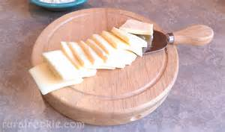
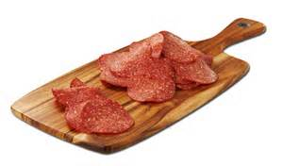
SALAMI AND HAVARTI CHEESE:
EMBEDDING CRITICAL THINKING ACTIVITY ARCS IN AN ACCELERATED MATHEMATICS PROGRAM
El Camino College
Lars Kjeseth, Sue Bickford, Susan Taylor, Art Martinez, Ambika Silva – Conference on Acceleration on Developmental Education 2015

Slide 2
Roland S. Barth, Beyond Instructional Leadership
Reculturing
“To change a school’s culture requires mustering the courage and skill not to remain victimized by toxic elements of the school’s culture but to address them instead”

Slide 3
The Challenge -
Redesign of the El Camino College developmental math sequence began in Fall of 2010 with this mission:
Redesign our curriculum so that all developmental math students at ECC have a pathway to be ready for a transfer-level mathematics course after at most two semesters.

Slide 4
Our Response
Basic Accelerated Math (BAM) and General Education Algebra (GEA)
These two courses, along with the traditional algebra sequence, provide any student a pathway to proceed to transfer in two semesters.

Slide 5
Design
The DESIGN of BAM and GEA reflects research, consultation, and our personal experience:
Students develop arithmetic and algebra skills more easily when they are contextualized and intertwined.
Students need not be proficient at basic arithmetic before they can successfully solve algebra problems.
Basic skills students do better with plentiful structured contact hours.
Algebra and Basic skills students benefit when college-readiness skills are embedded in the course.
Students have the capacity to read complex text about the applications of mathematics.

Slide 6
Design Refinement
Our experiences
Outcome data
Ongoing research
Informal student feedback.
Similar work is going on in both BAM and GEA. Today we will focus on BAM.

Slide 7
Changing Structural Design
Previous design: spiraled content learning in contextualized scenarios enhanced by affective skills.
Emerging design: spiraled content wrapped in affective domain structures that not only deliver the content, but provide for critical thinking, communication skills, and, ultimately, lifelong learning skills.

Slide 8
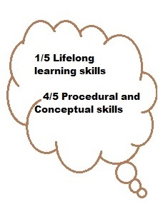
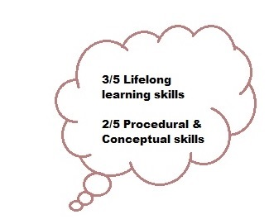



Changing Design

Slide 9
New Idea: Critical Thinking Arcs
Critical Thinking Arcs are collections of loosely connected activities, which are united by some theme and which thread together key ideas and skills throughout a course and, perhaps, even across courses.

Slide 10
Why Critical Thinking Activity Arcs?
Aha! Analogy
Practice with the activity arcs is like learning to ride a bicycle. Both call on previous knowledge applied to a new situation
In both math and bicycle riding, flying like the wind comes from integrating and extending previous experiences.

Slide 11

Activity Arcs are like riding a bike. Once you learn how, you have an approach to ride any bike

Slide 12
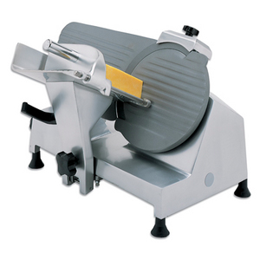
Salami and Havarti cheese
(the part you have all been waiting for)

Slide 13
Two Parts of an Activity Arc
Investigate and Report
You will work one of two activities from the “Fjords of Flavor” Activity Arc:
  1. Playground Parking Lot
  2. Slicing Hard Salami and Havarti Cheese
Directions: (You have 35 minutes)
    Pretend you are students
    After you finish:
      Sketch out an activity you might create to follow this activity
      Sketch out an activity you might create to precede this activity

Slide 14
Two Parts of an Activity Arc
Critical Thinking Critique and Discussion
Share your experience with the Investigate and Report activities.
Using either the Paul Elder model for critical thinking or AMATYC’s Standards for Intellectual Development, critique the activities. (Handout)
Share your follow-up or preceding activity design

Slide 15
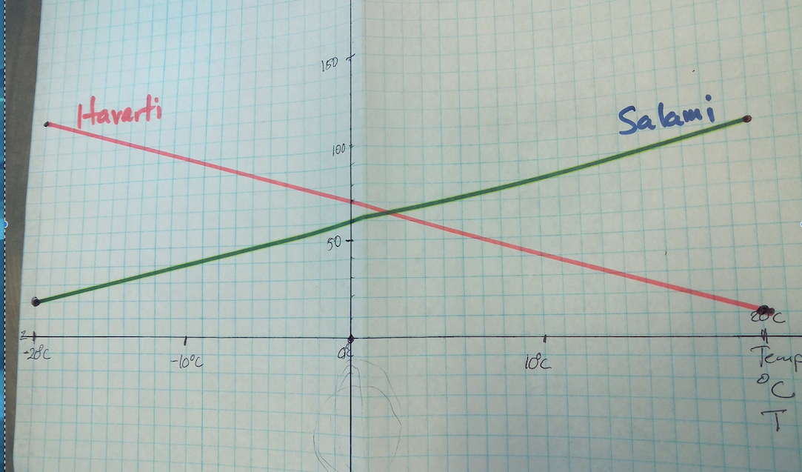
Student Solution

Slide 16
Two Parts of an Activity Arc
Where they line up in the BAM modules
Fjords of Flavor Activity Arc
I & R*: Playground Parking Lot
I & R*: Slicing Hard Salami and Havarti Cheese
* Investigate and Report

Slide 17
Two Parts of an Activity Arc
Where they fall in the arc
Fjords of Flavor Activity Arc
I & R: Parking Lot
Tables and Graphs and the Parking Lots
I & R: Playground Parking Lot
Variables and Formulas and Parking Lots
Playground Parking Lots: Possible or Not?
I & R: Sven Buys a Bag of Chips
I & R: Slicing Hard Salami and Havarti Cheese
Salami and Havarti: Working with Formulas
Salami and Havarti: Orders
Salami and Havarti: Impossible or Not?

Slide 18
Two Follow-Up Activities
For your review, we have two follow-up activities for the Salami and Havarti Cheese:
  Salami and Havarti: Working with Formulas
  Salami and Havarti: Orders

Slide 19

Affective domain

Slide 20
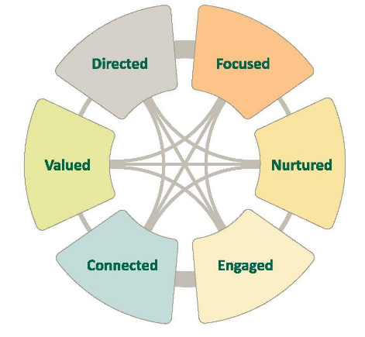
Affective Domain
Directed: clear and achievable goals established
Focused: stay on track - eyes on the prize
Nurtured: people want to help them succeed
Engaged: active participation in/out of class
Connected: part of the college community
Valued: they are recognized and their contributions are appreciated
Student Success Factors
Student Support (Re)defined Study
RPGgroup

Slide 21
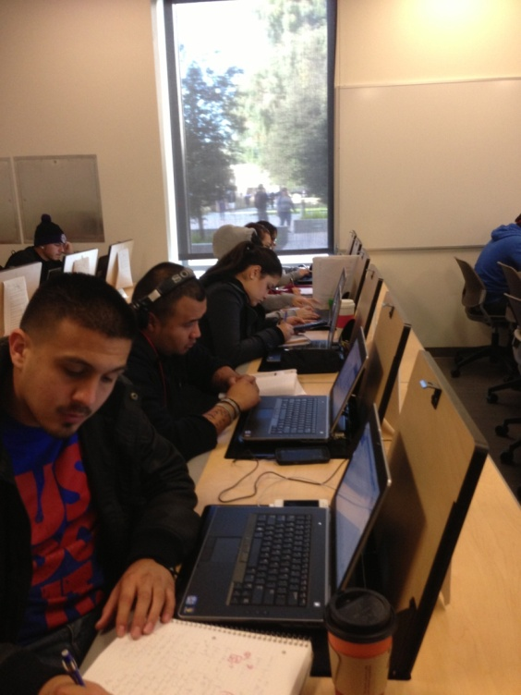
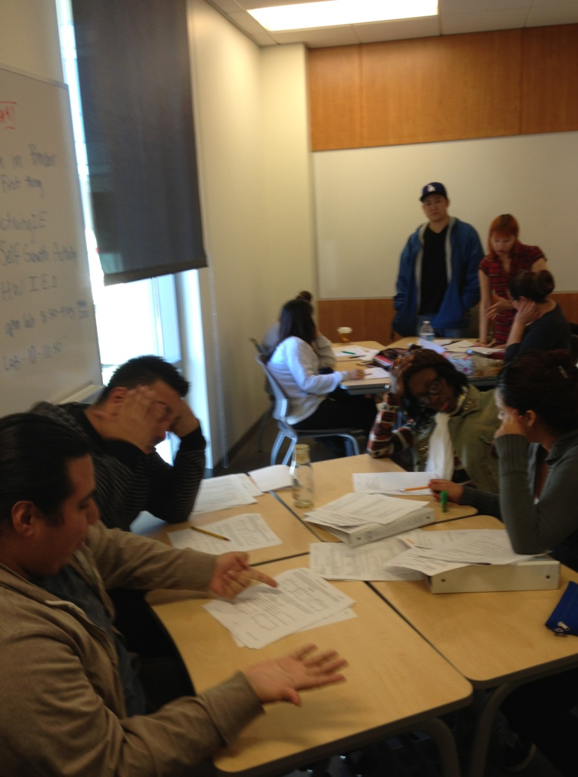
BAM
Focused and Engaged
Connected and Valued

Slide 22
Affective Domain
What do we do in BAM?
Daily schedule with instructor and TA support in class/lab
Daily schedule with exam dates;
Self reflection/Metacognition
Instructors motivate and inspire with affective domain activities.
Instructors and group members acknowledge student work, contributions
Group work, supplemental Instruction, Counselor Intervention
Cooperative group activities, final projects to share

Slide 23

Affective activity: Creator/Victim

Slide 24
Affective activity: Creator-Victim
Victims Focus on Their Weaknesses I’m terrible in this subject. | Creators Focus on How to Improve I find this course challenging, so I’ll start a study group and ask more questions in class.
Victims Make Excuses The instructor is so boring he puts me to sleep. | Creators Seek Solutions I’m having difficulty staying awake in this class, so I’m going to ask permission to record the lectures. Then I’ll listen to them a little at a time and take detailed notes.
Victims Complain This course is stupid requirement. | Creators Turn Complaints into Requests I don’t understand why this course is required, so I’m going to ask my instructor to help me see how it will benefit me in the future.
Victims Compare Themselves Unfavorably to Others I’ll never do as well as John; he’s a genius. | Creators Seek Help From Those More Skilled I need help in this course, so I’m going to ask John if he’ll help me study for the exams.
Victims See Problems as Permanent Posting comments on our class’s internet discussion course in impossible, I’ll never understand how to do it. | Creators Treat Problems as Temporary I’ve been trying to post comments on our class’s internet discussion board without carefully reading the instructor’s directions. I’ll read the directions again and follow them one step at a time.

Slide 25

NEW DIRECTIONS
Notes:
So where do we go from here?

Slide 26
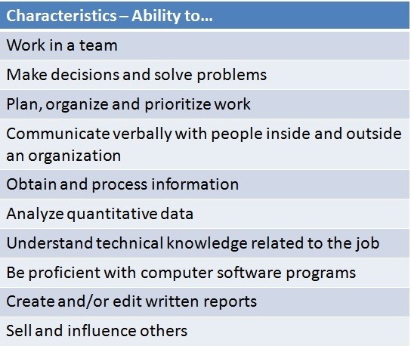
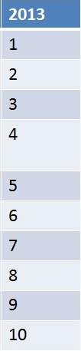
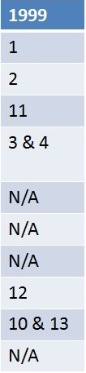
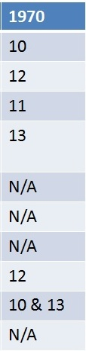
Changing views of the Most Valued Characteristics in an Employee
Sources:
1970 & 1999 Data: https://benoxley.wordpress.com/leadership/re-imagining-21st-century-schooling
http://www.forbes.com/sites/susanadams/2013/10/11/the-10-skills-employers-most-want-in-20-something-employees/
http://www.forbes.com/sites/susanadams/2013/10/11/the-10-skills-employers-most-want-in-20-something-employees/ling

Slide 27
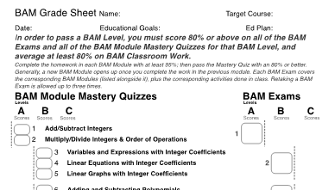

The Past
One project done at the end of the semester.
Notes:
When we created BAM we wanted to include a project. This means students would work together or separately, and present their project to the class. This gives us a chance for students to communicate both verbally and written

Slide 28
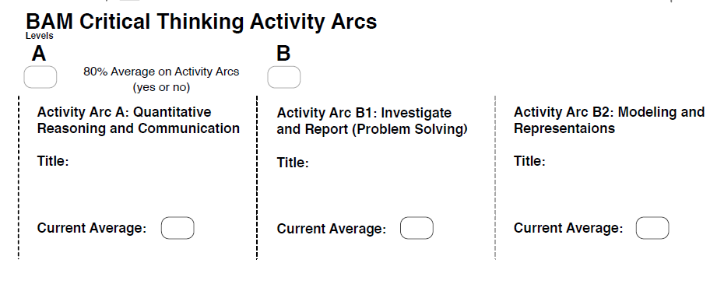
The Present
We have added Activity Arcs to the requirements
Notes:
Previously we have one project, the linear modeling project. This gives two projects, one completed by 8 weeks, the 2nd by 16 weeks. We have a few projects/arcs in mind. This includes the culminating project, with previous activities that lead up to the project. The activities don’t always relate to the project topic, but rather the goals of the project

Slide 29
Other arcs: Linear Project
Students obtain data and plot either by hand or by using Excel.
Students find the best fit line and make predictions using the linear model
In class: Collect random data on Excel spreadsheet and have the model generated for the class to make predictions. For example we would collect shoe size and height

Slide 30
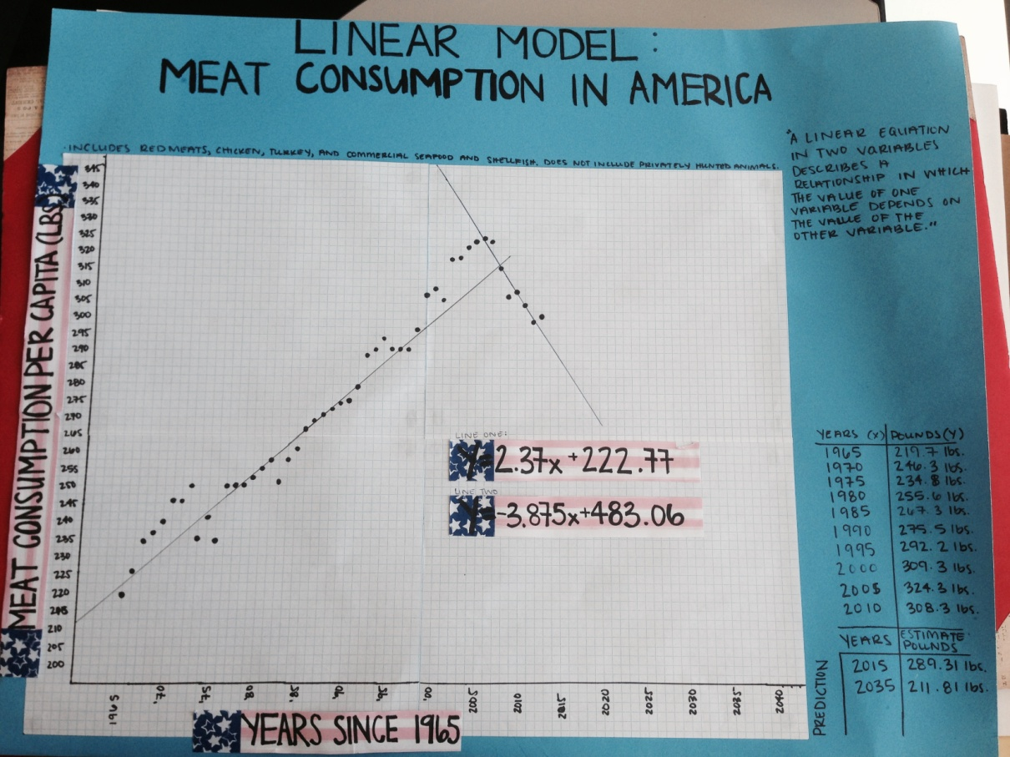
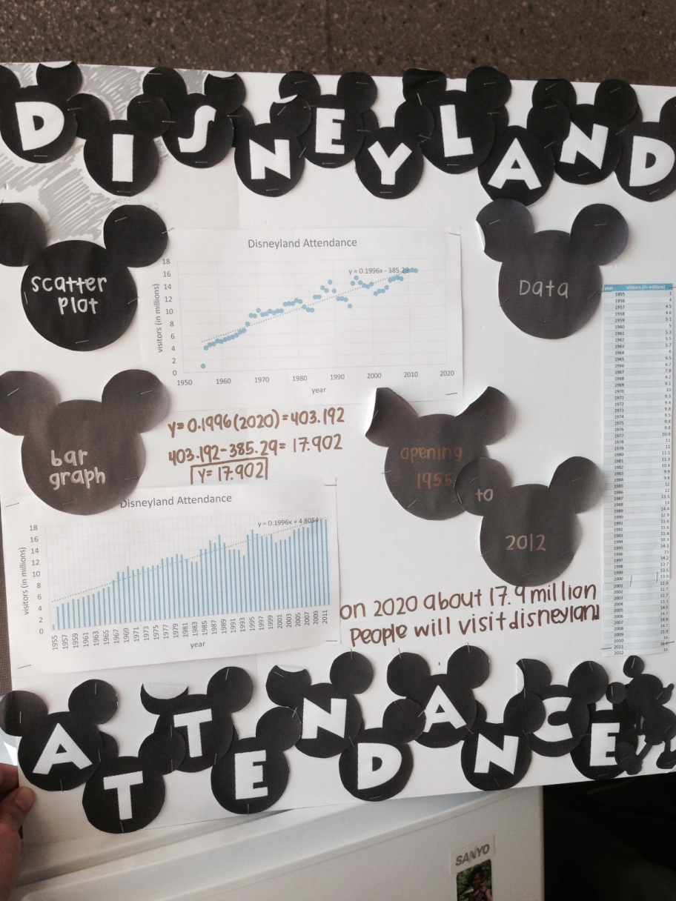
Linear Projects

Slide 31

Other arcs: Covered CA
(Health Care)
Students are assigned a client who is trying to decide what level of coverage he or she should purchase from Covered California. Students are given a description of his or her medical history over that last year.
Using the Covered California 2015 Standard Benefit for Individuals and excerpts from the Covered California Health Insurance Companies for 2015 booklet, students find the total annual medical costs for your person at each of the available levels of coverage: Bronze, Silver, Gold, Platinum.
Notes:
This is a valuable lesson for students to see how much health care costs. This also shows our students how deductibles work.

Slide 32
The Future
BAM
Arc to
GEA
Notes:
How can we spread arcs from one class to the next? This is a challenge, especially considering that not all GEA students are coming from BAM, although a majority are.

Slide 33

RESULTS

Slide 34
Success:
BAM students complete the developmental program at four times the rate of arithmetic students;
GEA students complete a transfer-level course at twice the rate of elementary algebra students.

Slide 36
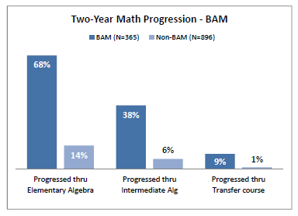
BAM Comparison Study

Slide 38
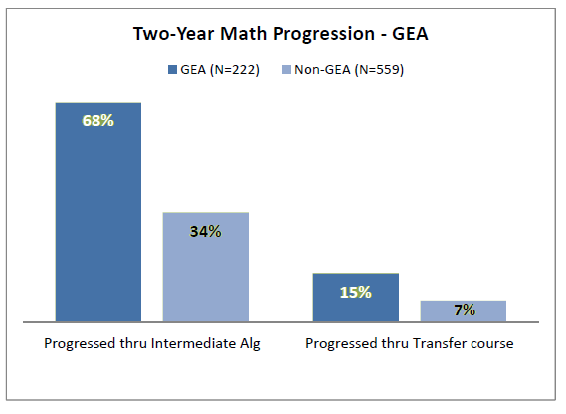
GEA Comparison Study

Slide 39
Cost
The total cost of BAM students is about 1.3 times the arithmetic students.
The cost of the successful BAM student is less than one-third of the successful arithmetic student.

Slide 40
COST ANALYSIS | Students starting in arithmetic | Students starting in BAM
Two-Year BAM and Arithmetic Cohort
New Students in Cohort | 1,234 | 221
FTEF per 100 Beginning Students (counts repeat rates) | 1.7 | 2.3
FTEF per 100 Transfer-Level-Ready Students | 20.0 | 6.0
Three-Year BAM and Arithmetic Cohort
New Students in Cohort | 333 | 40
FTEF per 100 Beginning Students (counts repeat rates) | 1.9 | 2.4
FTEF per 100 Transfer-Level-Ready Students | 18.4 | 5.0

Slide 41
Acceptability:
UC reviewed and approved ECC’s transfer-level statistics course with GEA as a prerequisite.

Slide 42

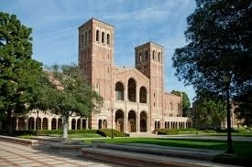
GEA is OK with us!

Slide 43

Presenters:
Sue Bickford: sbickford@elcamino.edu
Lars Kjeseth: lkjeseth@elcamino.edu
Art Martinez: afmartinez@elcamino.edu
Ambika Silva: asilva@elcamino.edu
Susan Taylor: staylor@elcamino.edu
More detailed information on how BAM and GEA work is outlined in the pamphlet entitled “Transforming and Accelerating Developmental Mathematics at El Camino College”

