Slide 1
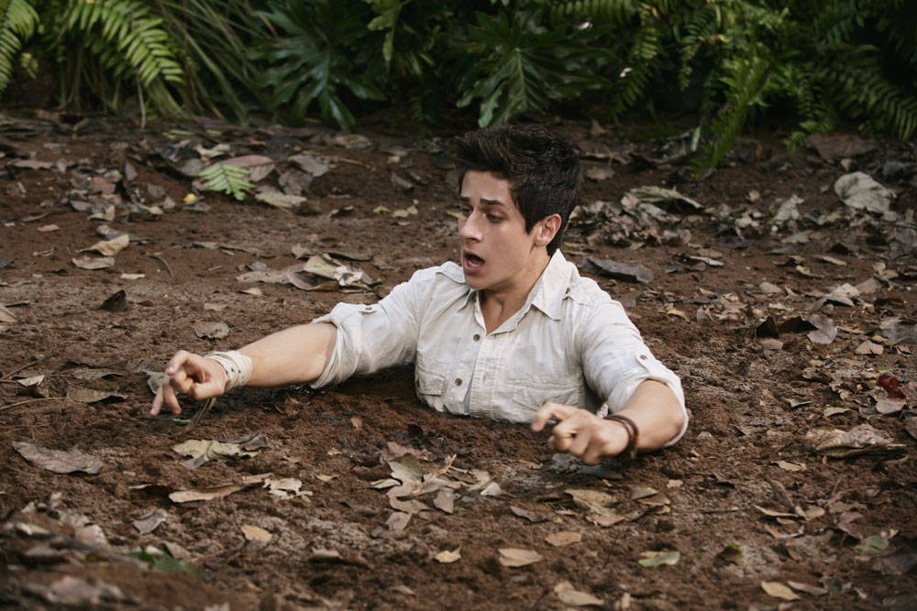
Pinnacles and Pitfalls
How to Navigate an Accelerated Writing Course
Stephanie Bridges, Pamela Dunsmore, and Danelle Huggett

Slide 2
Proposal:
As adjunct instructors at Irvine Valley College, we started teaching an open-access accelerated writing course that is one level below transfer level and has an established curriculum built upon the practices of the California Acceleration Project, but we have since learned which strategies and activities work best for our individual teaching styles and how to engage diverse learners, such as students with learning disabilities and students with affective issues. Full-time instructors who are starting acceleration programs in writing and adjuncts who are teaching accelerated writing will be interested in listening to our experiences--the pinnacles and the pitfalls.
In this workshop, participants will be able to hear about IVC’s program and our teaching experiences as well as receive activities that they can use in their own accelerated classrooms. Participants also will complete an interactive exercise that will introduce them to various students they may encounter and discuss strategies for helping those students succeed. Our goal for this workshop is to share our experiences and to provide our colleagues with useful activities that can motivate diverse learners.
Table of Contents
Introductions
Adjunct Experiences
Activities for the Accelerated Classroom
Student Profiles—An Interactive Exercise

Slide 3
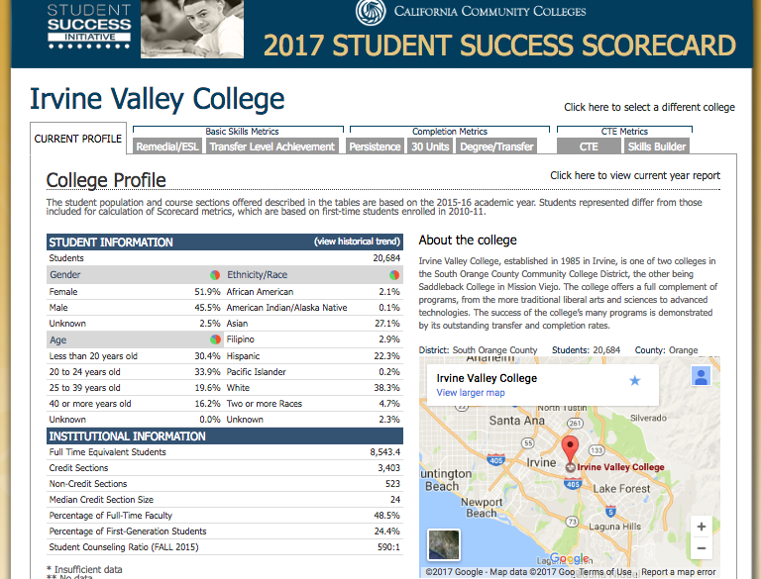
Introductions
About Irvine Valley College
Notes:
About Irvine Valley College (IVC)
Irvine Valley College, established in 1985 in Irvine, is one of two colleges in the South Orange County Community College District, the other being Saddleback College in Mission Viejo. The college offers a full complement of programs, from the more traditional liberal arts and sciences to advanced technologies. The success of the college’s many programs is demonstrated by its outstanding transfer and completion rates (2017 Student Success Scorecard).

Slide 4
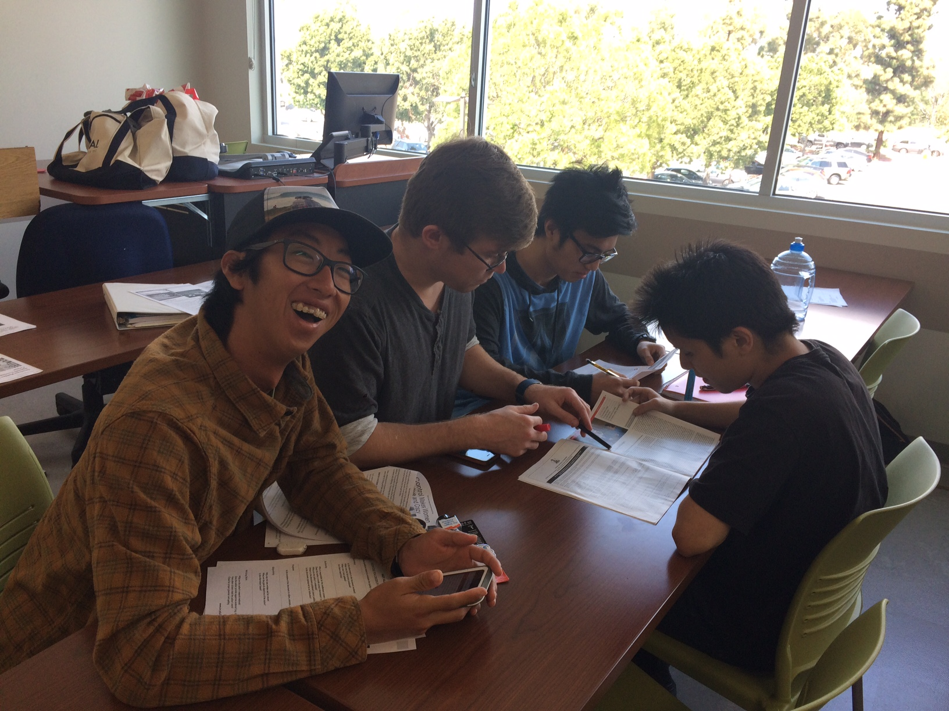
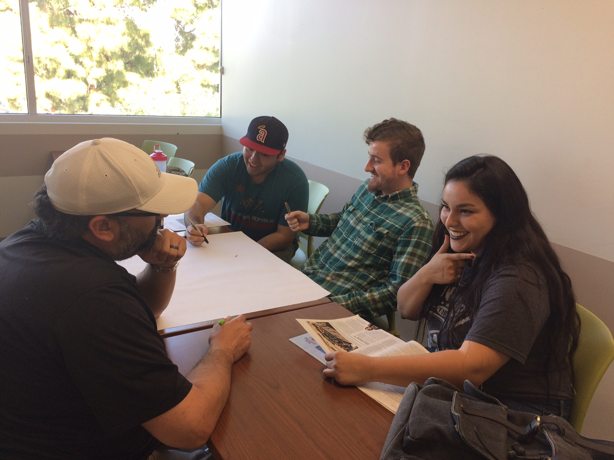
1. Introductions
IVC’s Accelerated Writing Program:
IVC’s accelerated writing class, which is called Writing 399, is an open-access course designed to bring motivated basic skills students up to college-level English (Writing 1) in one semester or summer session.
The Writing 399 course coordinator, Rebecca Kaminsky, is in charge of training all full-time and part-time instructors teaching the course, placing them on a curriculum track for their first semester, and holding monthly meetings so that instructors can exchange ideas about pedagogy and best practices.
The main curriculum tracks, named according to their central theme, are Habits, Success, and Self-Control.

Slide 5
1. Introductions
Who We Are:
Stephanie Bridges
Adjunct Instructor at Irvine Valley College, Norco College, and Golden West College
Full-time Instructor at Coastline Community College in Fall 2017
Pamela Dunsmore
Adjunct Instructor at Irvine Valley College and Cypress College
Full-time Instructor at Fullerton College in Fall 2017
Danelle Huggett
Adjunct Instructor at Irvine Valley College, Santiago Canyon College, and Santa Ana College
Contributed to presentation but could not attend conference

Slide 6
2. Adjunct Experiences
Jamie Dingman
Danelle Huggett
Allison Schmitendorf
Stephanie Bridges and Pamela Dunsmore (panel format)

Slide 7
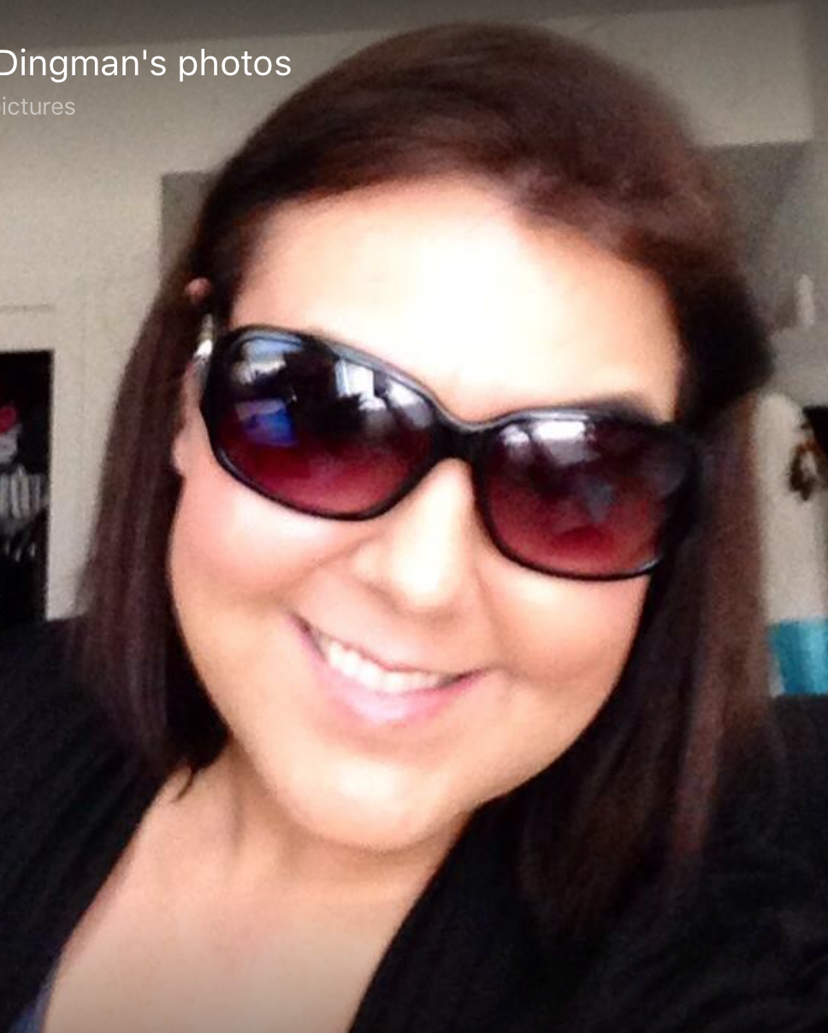
English Instructor Jamie Dingman
-A Little about Our Curriculum:
Since our acceleration program is reading and writing based, the classes are heavily loaded with carefully chosen material that fits a theme or track for the semester. Our current themes are “Success,” “Habits,” and “Self Control.” The Acceleration Coordinators at Irvine Valley College encourage all 399 instructors, full and part time, to not only give feedback about existing curriculum, but also to develop new and engaging material for the offered courses. This semester, adjunct professor Jamie Dingman has developed and introduced a new theme based on relationships.
Veteran Acceleration Instructor
and New Curriculum Developer
-Jamie’s “Relationships” Curriculum:
This theme follows and explores different kinds of relationships one might encounter in their life.
Units start with readings focusing on self-relationships with readings about Fixed and Growth Mindsets and “How the Karate Kid Ruined the Modern World” by David Wong to romantic relationships that are interrupted by technology with readings from Anziz Ansari’s “Modern Romance” and “Understanding Jean Baudrillard With Pumpkin Spice Lattes.”
-Motivation for the “Relationships” Theme:
Jamie wanted to challenge students with material that forced them to think about seemingly simple, everyday happenings. The readings were chosen with the idea that the material could easily be connected to aspects of the students’ lives. Since personal connections foster better reading comprehension, Jamie wanted students to be able to push through the fact that the reading was difficult and focus on how they could relate to and synthesize the information presented. After making these personal connections and gaining comprehension, students would be able to write with a mindset that was more at ease, flowing from a place of deeper understanding.
Biggest Challenges of the Semester:
Getting students to have the confidence to understand the difficult material, rather than self-sabotaging their reading, writing, and connecting abilities. The key was to constantly encourage discussion of the material, provide accessible forums in class and through blog posts, to openly acknowledge that the material was indeed difficult, and to facilitate multiple peer review drafts and one-on-one conferencing.
So, How Did it Go?
Better than expected! This is said half-jokingly, but since it was a pilot run, hiccups were to be expected. Like any other curriculum, seeing what worked and what needs to be adapted for future classes is key. The students responded well to the material and by the end, felt more prepared for transfer level material and analysis.

Slide 8
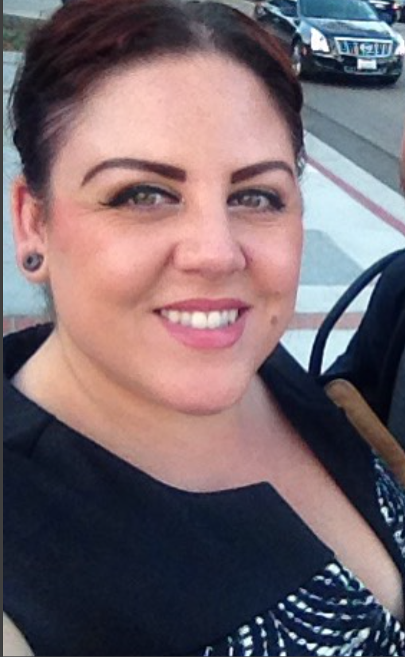
English Instructor Danelle Huggett
-Since IVC’s accelerated classes follow set themes/curriculum, what is the best way you have found to make this work for you? How have you modified the curriculum to fit your teaching style/class’ needs?
One of the ways I have adapted the curriculum is by making sure that the more difficult assignments get more time/instruction. When there are 6-7 essays to write during a semester, each one may only allot for 2.5-3 weeks. Knowing when the more difficult assignments are coming up, I am able to speed up the assignments that require less critical thinking and really dig into analysis for the harder ones. This not only prepares students for future writing courses, but also gives them a sense of confidence in their writing when they have a firm grasp of the content. I have also been able to incorporate more interactive assignments and mixed media to present information to my students in new and exciting ways. Gallery walks, debates, and blogging have been favorites in my classes.
2nd Semester
Acceleration Instructor
-Have you ever had a problem/difficult/unique student while teaching acceleration, and how did you help that student or resolve their problem or issue?
One of the largest issues we face in acceleration is catering to the needs of the different levels of writing that appear in the classroom. It has been SO important to recognize those levels from the very beginning in order to plan for just-in-time remediation and provide instruction to the areas that need it most. Also, on an individual basis, making sure to recognize possible learning disabilities, emotional distress, and other outside influences has been so helpful. I have been able to personally walk students over to DSPS and Psychological Services to aid in them seeking the help they need in order to be successful. I always tell my students that it is dang near impossible to write well if there are other things clouding your train of thought. One student in particular this past semester could not make connections from the readings to his own writing and always came to me panicked. Together we were able to seek help for his anxiety disorder and set up a class plan that he was comfortable with.
-What has been the best experience teaching accelerated classes? Either a particular standout moment or an overall feeling of accomplishment in a semester or with a group of students.
In one particular class this past semester, 90% of the students received A’s on their final papers! They were all so proud of themselves, and being able to see the looks of accomplishment on their faces was the best feeling. So many of these students have been told how bad their writing is, and after hearing that for so long, they come into these writing classes believing that with their confidence and abilities broken. One of my teaching philosophies is to mend the skills that students innately possess and get them to recognize that they have had them all along! Content based writing is so important in these courses and allowing students to see that “perfect” writing doesn’t exist, but effort does, has helped so much.

Slide 9
English Instructor Allison Schmitendorf
-Since IVC’s accelerated classes follow set themes/curriculum, what is the best way you have found to make this work for you? How have you modified the curriculum to fit your teaching style/class’ needs?
It is really difficult the first semester to adapt, as all the information and material is brand new. Toward the end of the semester, however, I had more of an "ah-ha!" moment, and understood the connection between ideas and assignments more clearly. Once I had completed the set curriculum the first semester, I was able to modify it more to my own style. I ended up removing one of the seven essays entirely, and I incorporated more specific writing activities on peer review days. Just like my students, I believe that the more I practice teaching the course, the better I'll get at adapting it to my needs.
2nd Semester
Acceleration Instructor
-Have you ever had a problem/difficult/unique student while teaching acceleration, and how did you help that student or resolve their problem or issue?
I have had several students this semester who have really struggled with family issues at home, and their struggles greatly impacted their performance in the classroom. For each of these students, I made it a point to reach out at least twice and tried to set up an atmosphere of trust and camaraderie in the classroom. Several of these students then felt comfortable enough to talk to me about their home struggles, and I was able to refer them to on-campus resources like the counseling center. One particular student, really tried to work through his problems and kept me up-to-date on his at-home progress; however, there were many circumstances outside his control that began to escalate. I reached out to the dean to ask for advice and resources I could further give this student. In the end, with these additional resources, I was able to help the student help his mother recognize domestic abuse and file for a restraining order. These classes go beyond the mere act of writing; being accessible in the classroom is not just about teaching, but also about creating a positive environment for the students to learn.
-What has been the best experience teaching accelerated classes? Either a particular standout moment or an overall feeling of accomplishment in a semester or with a group of students.
By far the best experience each semester are the days (later in the semester) when I hand back their essays. So many of the students start with such a low level of confidence in their writing, but when they finally see a "High Pass" or even a "Pass" for the first time, they get SO excited, and you can see their confidence grow in front of you.

Slide 10
Our Teaching Experiences
Since IVC’s accelerated classes follow set curriculum, what is the best way you have found to make this work for you? How have you modified the curriculum to fit your teaching style and the class’s needs?
Have you ever had a difficult or unique student while teaching acceleration, and how did you help that student or resolve their problem?
What has been your best experience teaching accelerated classes? Do you have a particular stand-out moment or an overall feeling of accomplishment with a group of students?

Slide 11
3. Activities for the Accelerated Classroom
Stephanie’s Summary Activity
Worksheet that helps students visualize the elements of an effective summary
Pamela’s Memoir Presentations
Group presentations in which students lead class discussion on memoir

Slide 12
4. Student Profiles—An Interactive Exercise
On the next few slides, we have some examples of students that we have encountered in our accelerated writing classes. Let’s get into groups and discuss our approaches for dealing with these students’ affective issues.

Slide 13
4. Student Profiles—An Interactive Exercise
Student A is a returning student who is a single parent to three teenaged children. Student A also works a full-time job during the day and struggles to find time to work on her assignments. You notice that Student A’s attendance become erratic, and Student A rarely has completed the reading assignment. What do you do?

Slide 14
4. Student Profiles—An Interactive Exercise
Student B graduated from high school, and this is Student B’s first college class. Student B attends every class session and completes all homework and in-class assignments, but Student B does not submit any summative assignments. When you ask Student B why she did not turn in the latest essay, Student B replies that she thinks that it is pointless because she has always received poor marks and doesn’t want to “waste your time” reading her work. What do you do?

Slide 15
4. Student Profiles—An Interactive Exercise
Student C is also a recent high-school graduate. You notice that Student C’s papers have frequent spelling and usage errors and strange syntax, all of which impede your ability to understand his meaning. When he struggles to find his homework in his backpack, you notice that he does not use folders or binders to organize his papers--they are floating around freely. What do you do?

Slide 16
Thank you for attending our presentation! Any questions?
If you’d like to get in touch, here are our email addresses:
Stephanie Bridges—profbridges@gmail.com
Pamela Dunsmore—psachiye@gmail.com

