Slide 1
Are Developmental Education Reforms Generating Equitable Outcomes for All Students?
CADE 2016
Nikki Edgecombe
Senior Research Associate
Jessica Brathwaite
Postdoctoral Research Associate

Slide 2
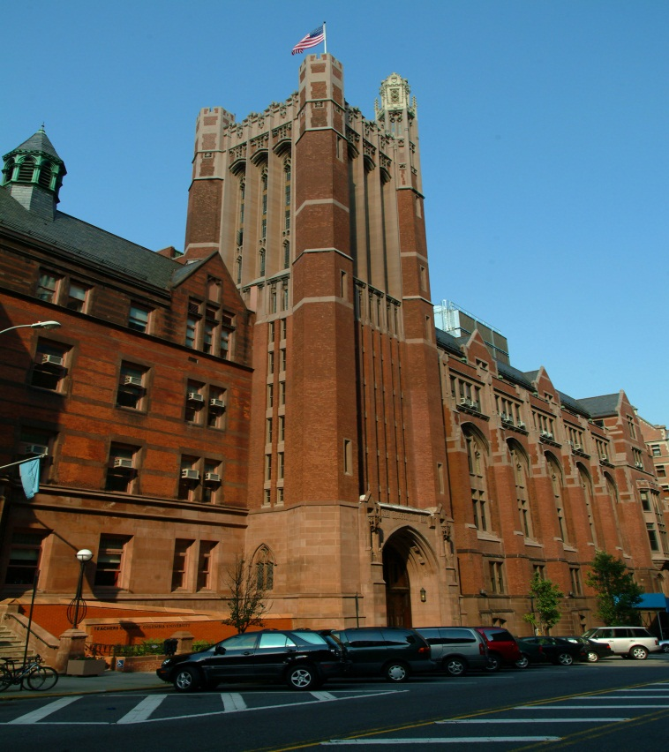
Community College Research Center
A leading independent authority on two-year colleges based at Teachers College, Columbia University. Founded in 1996, CCRC conducts research on the issues affecting community colleges and works with colleges and states to improve student success and institutional performance.
Areas of research include:
The role of the community college
High school to college transitions
Developmental education & adult basic skills
Student services and financial aid
Online learning and instructional technology
Student persistence, completion, & transfer
College to career and workforce education
Improving institutional performance

Slide 3
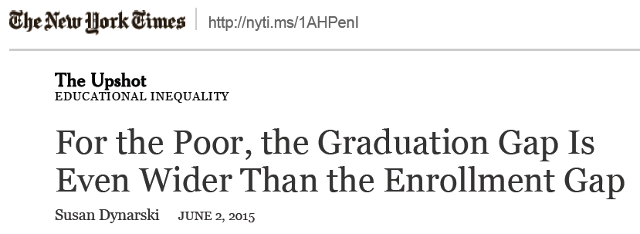
Increased attention to outcomes generates more focus on equity

Slide 4
Between 2012 and 2023, postsecondary enrollment is projected to increase 15 percent – 7 percent for Whites, 25 percent for Blacks, and 34 percent for Hispanics.
Source: Projections of Education Statistics to 2023

Slide 5
Differences in degree attainment by race/ ethnicity raise troubling questions
25- to 29-year-olds who have completed at least a bachelor’s degree, by race/ethnicity and sex: 2013
Source: The Condition of Education 2015, NCES

Slide 6
Bachelor’s degree completion rates unchanged for Black males over time
Source: The Condition of Education 2015, NCES
Notes:
Postsecondary enrollment rates for the same period for 18-24 year old males:
2003 – 38.5% for whites, 28.2% for blacks, 18.3% for hispanics
2012 – 38.3% for whites, 33.9% for blacks, 15.2% for hispanics

Slide 7
3-year community college graduation rates (2010)
Source: Digest of Education Statistics, NCES

Slide 8
Recap of findings presented at 2015 CADE

Slide 9
More Students Have Access to College English
Notes:
Broadened access to college English via Direct and Co-Requisite English placements
Pre-Reform 53% of the cohort has access to college English: 43% directly placed into college English, an additional 10% had access to college English via a co-requisite course.
Post Reform 81 % of the cohort has access to college English: 58% directly placed into college English, an additional 23% had access to college English via a co-requisite course.
Post-reform developmental English placements comprise less than 20% of all first time students after the reform to assessment and placement, compared to 47% pre-reform.
Important to note that prior to the reform, the co-requisite course was only offered at one institution, after the reform the course was offered at all colleges across the state.

Slide 10
More Students Enroll in College English
Scaling co-requisite course statewide more than quadrupled enrollment in co-requisite.
Notes:
Enrollments in college English increased after the implementation of the assessment and placement reform:
Pre-Reform 53% of the cohort was eligible for college English--40% of the cohort enrolled in college English or Co-Req within 3 terms as a result of placement, this results in a 75% enrollment rate among those who are college English eligible.
Post-Reform 81% of the cohort was eligible for college English--70% of the cohort enrolled in college English or Co-Req within 3 terms as a result of placement, this results in a 86% enrollment rate among those who are college English eligible.
As expected, expanding the co-requisite course across the state increased enrollment in the course.

Slide 11
College English pass rates unchanged, but decline for co-requisite college English
Among the students who placed into college English and who enrolled in a college English course within one year, average pass rates (defined as earning a C or better) remained virtually unchanged after the reform; but declined for the co-requisite English course.
Notes:
We find that among those who placed and enrolled, average pass rates for College English were similar after the reform was implemented. However, we find pass rates for the co-requisite course declined.

Slide 12
College English completion rate increases
Half of the first-time cohort successfully completed college English after directly placing into college English or into the co-requisite course after the reform, compared to less than one one-third (30%) prior to the reform.
Notes:
ENG 111 pass/completion rates for the entire cohort.
Remind that dev ed sample is now only 20% of cohort – include 111 completion of dev ed placed studnets.
When we look at successful completions as a share of the full cohort, not just at those who enrolled in college English or the co-requisite course, we find that increasing access to college English resulted in significantly more students successfully completing college English with a C or better:
Pre-Reform 30% of the cohort successfully completed college English within 3 terms as a result of placing into college English and the co-requisite course. this results in a 57% completion rate among college-eligible students (30%/53%)
Post-Reform 50% of the cohort successfully completed college English within 3 terms as a result of placing into college English and the co-requisite course. This results in a 62% completion rate among college-eligible students (50/81)

Slide 13
How do pre-reform and post-reform outcomes differ by various combinations of race/ethnicity, gender, socioeconomic status, and level of placement?

Slide 14
Post-reform lowest placed students 2x less likely to pass College English, by race and gender

Slide 15
Post-reform lowest placed students 2x less likely to pass College English, by SES and gender

Slide 16
College English completion gaps between blacks and whites modestly reduced …
^{14%}
^{20%}
^{37%}
^{15 % pts (post)}
^{19 % pts (pre)}
Notes:
THE COLLEGE ENGLISH COMPLETION GAP IS SHRINKING..WHY?

Slide 17
… likely due to higher college English placement and enrollment rates

Slide 18
On average all groups accrue about 1.4 more post reform. The percent increase is greatest for lowest placed black students.

Slide 19
Are these trends consistent across disciplines?

Slide 20
Math achievement gaps by race expand post-reform
^{35%}
^{41%}
^{40%}
^{40%}
^{17 % pts (post)}
^{13 % pts (pre)}

Slide 21
Math achievement gaps by income expand post-reform
^{32%}
^{27%}
^{18%}
^{15 % pts (post)}
^{9 % pts (pre)}

Slide 22
Discussion
What issues does this analysis raise for you?
What other student characteristics and outcomes would you like to see included?
What strategies have you employed to improve outcomes for subgroups with lower achievement?

Slide 23
For more information
Please visit us on the web at
http://ccrc.tc.columbia.edu
where you can download presentations, reports,
and briefs, and sign-up for news announcements.
We’re also on Facebook and Twitter.
Community College Research Center Teachers College, Columbia University 525 West 120th Street, Box 174, New York, NY 10027 E-mail: ccrc@columbia.edu Telephone: 212.678.3091

