Slide 1
Acceleration with Aloha
Accelerated Learning Program, Leeward CC
CADE 2017

Slide 2
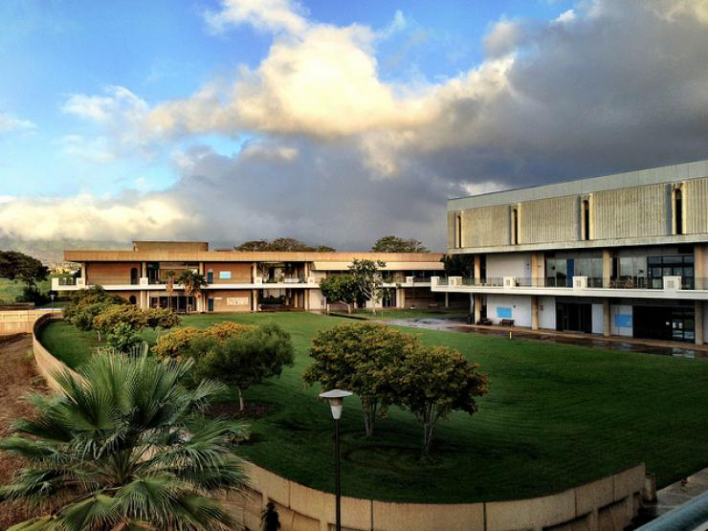

Slide 3
Founded in 1969

Slide 4
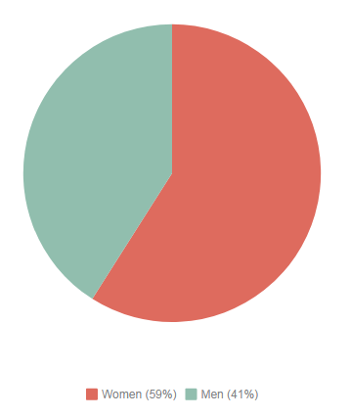
Enrollment, Student Demographics
Fall 2016 Enrollment:
approx 7,300 students Student Demographics: 59% women 41% men average age is 24

Slide 5
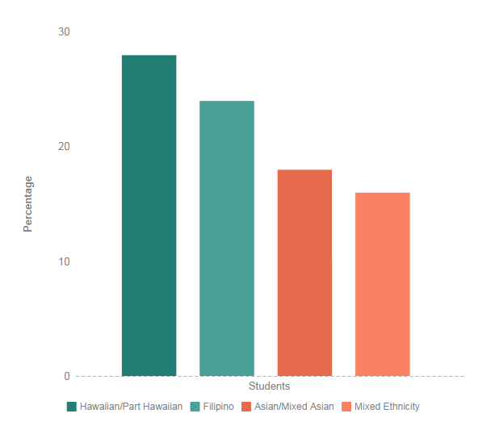
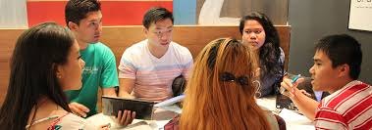
Student Diversity
28%
24%
18%
16%

Slide 6
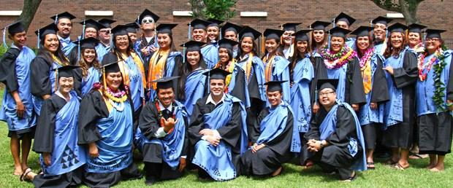
ALP at Leeward
Started with 6 sections in Fall 2011
Highest number of sections: 33
Recent offerings: 20-25 sections

Slide 7
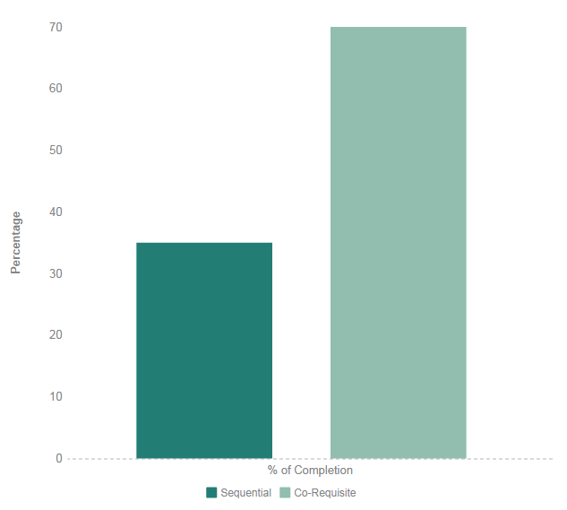
Results
More students get TO ENG 100 and get THROUGH ENG 100 successfully.
Approximately 70% pass both courses in one semester.
70%
35%

Slide 8
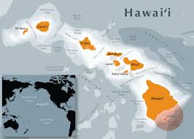
Benefits of Place-Based Literature
Select poems and stories that accurately represent communities that students are familiar with.
Select literature by local authors.

Slide 9
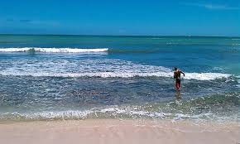
Benefits of Place-Based Literature
Students identify with characters and settings in the story.
Empowers students and improves self-efficacy.
Discuss code switching and use of appropriate language.

Slide 10
Benefits of Place-Based Literature
Students have the freedom to keep their own identity.
Most students are interested in local literature of Hawaiʻi.

Slide 11
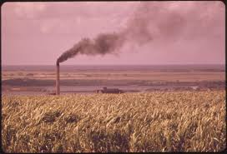
Language: Pidgin
Hawaiʻi is the most diverse state in the United States.
In Hawaiʻi’s past, many people immigrated to work on the plantations.
To communicate with each other, the Pidgin language emerged.
Besides English, the Pidgin language and other languages are spoken.

Slide 12
Language: Pidgin
Pidgin is a language acknowledged by the U.S. Census.
It is common for Hawaiʻi residents to code-switch between English and Pidgin.

Slide 13
Language: Pidgin
When pidgin is written, authors may use the standard English spelling or a phonetic spelling of a word.
Where you stay? (meaning: where are you?)
Wea you stay?

Slide 14
TV by Ann Inoshita
Going come dark so my madda call me
fo go back inside da house.
Can smell tonkatsu from da kitchen
and my madda turn on da TV.
“Dinner going be ready soon.”

Slide 15
Discussion and Readings
We discuss place-based poems and short stories.
We discuss code-switching and language expectations for English courses.
The short story, “Kōloa,” by Lee Cataluna has a theme of persistence and perspective.
Students write a summary of this story.

Slide 16
Discussion and Readings
Students also write a summary of “A Bite of Kimchee” by Nora Okja Keller.
This story is about family, identity, and food culture.

Slide 17
Discussion and Readings
The short story, “Born-Again Hawaiian,”
by Lisa Linn Kanae has a theme of identity.
Students write a literary analysis of this story.

Slide 18
Summary Assignment for “Kōloa”
The short story, “Kōloa,” by Lee Cataluna has a theme of persistence and perspective.
Summary Exercise:
Write a summary of Cataluna’s short story, “Kōloa.” This summary should be one or more paragraphs and include the main idea of the story in your own words.

Slide 19
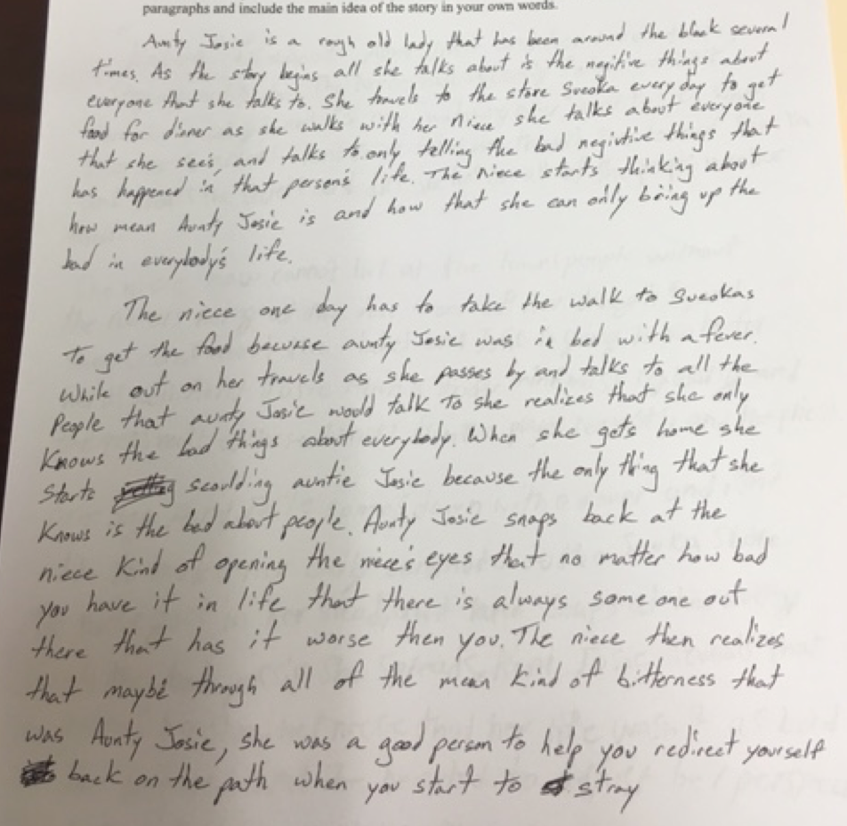

Slide 20
Student Sample
“Aunty Josie snaps back at the niece kind of opening the niece’s eyes that no matter how bad you have it in life that there is always someone out there that has it worse than you.”
Students get the message of perspective and persistence in this story early in the semester.

Slide 21
Identified Needs for ALP students
Non-cognitive
Motivation
Time-management
Teamwork skills
Confidence

Slide 22
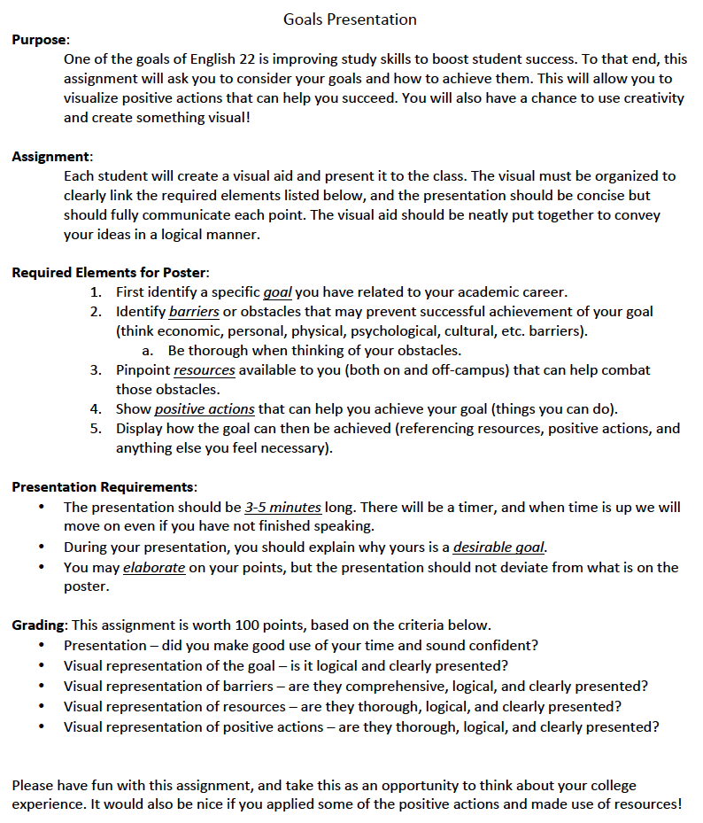
Goal Presentation
Skills Addressed:
Written communication (conciseness, clarity)
Oral communication
Time management (completion, presentation)
Benefits:
Knowledge of individual needs and motivations
Team-building (commiserate, offer advice, questions to fill time)
Foundation for later reflections
Photo via <ahref="https://visualhunt.com/re/e84f8e">Visualhunt.com</a>
Notes:
Link to previous slide on needs. Overview of when the assignment is given and how it works. Why it has worked.

Slide 23
Student Example

Slide 24
Goal: Improve ENG 100 Debates with ALP Practice
Positive Actions:
Clear score sheets
Familiar topics
Supervise research
Collect outlines
Barriers:
Research Skills
Intimidation / Unfamiliarity
Speaking Skills
Resources:
Computer lab
Library
Notes:
Students aren’t the only ones who have goals, of course. As instructors, we work to constantly reevaluate our approaches, and it can be helpful for us to set our own goals so we can work towards them.

Slide 25
Activity: Now you try it!
Directions:
Identify one activity or assignment you would like to implement in your ALP class.
In a presentation, visually depict:
The goal (assignment outcome, skills addressed)
Barriers to achieve it
Resources that can help
Positive actions you can take

Slide 26
For More Information
Ann Inoshita: ati@hawaii.edu
Brandi Reyes: blreyes@hawaii.edu
Lani Uyeno: luyeno@hawaii.edu

