Slide 1
Three High Leverage Strategies in English Conference on Acceleration in Developmental Education Baltimore, MD June 18, 2016
Katie Hern
Co-Founder, California Acceleration Project
English Instructor, Chabot College
khern@chabotcollege.edu
http://cap.3csn.org
Notes:
Things to have open & minimized on screen –
http://video.butte.edu/media/ENG-118/Simpsons_OnlyMoveTwice.html
CAP website at Freire video
Summary of guidelines for choosing reading

Slide 2
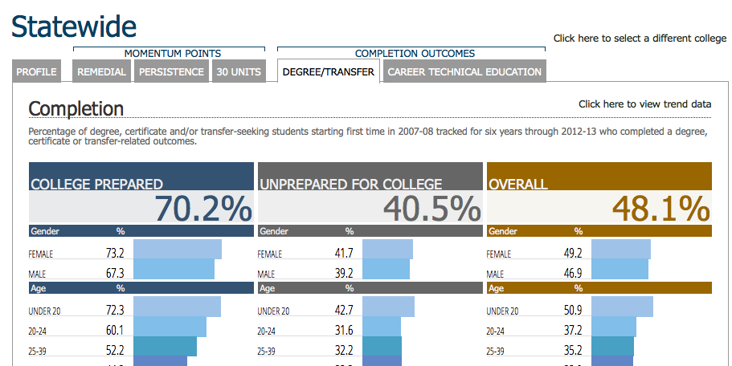
Student Success Scorecard
Statewide, more than three-quarters of incoming students are classified “unprepared”

Slide 3
Traditional Remediation
Standardized tests are used to identify students who need additional preparation
Students scoring below “college-level” are required to enroll in 1-4 remedial courses in math and/or English and/or Reading (possibly more if ESL)
In lower-level remedial classes, tasks are more basic, less challenging than in higher levels
Notes:
Research over the last five years has yielded surprising some insights about the limitations of this approach. We are going to start by sharing a few stories with you, from colleges that are breaking down these assumptions and getting much better and more equitable results.

Slide 4
Butte: What if we let more students into college English?
While setting cut scores for a new placement test, Butte College discovered that twice as many students were now assessing as “college ready” in English.
Placement into college English:
Increased from 23% to 48% of incoming students
One-Year Completion of College English
Tripled for African American students
Doubled for Hispanic and Asian students
1.6 times higher for white students
Achievement Gaps:
The gap between White and Black students’ completion of college English was cut nearly in half.
Under-Estimation of Students:
40% of the students who previously would have been placed into remediation earned As and Bs in college English
Notes:
After giving info on increased placement into college level, talk about the fears this raised – students will struggle in 1A, experience high failure rates, Butte should return to the old ratios out of concern for under-prepared students

Slide 5
Las Positas: What if we provided only one level of remediation below the college level?
At Las Positas College, most students take just a single semester of integrated reading and writing instruction below college English, with only the lowest-scoring 8% taking more.
Fall 2014 Pilot:
The lowest scoring group can take the one-level-below English course if they enroll in an additional 2 hour/week workshop with the same instructor
Eligibility for College English:
More than doubled in half the time.
67% passed & were eligible for college English in one semester
vs. 29% who took the two-semester sequence the year before

Slide 6
What if colleges & universities offered only co-requisite models of remediation? Fall 2015 Statewide Data: Tennessee

Slide 7
The Unintended Consequence of Remediation Policies
The more levels of developmental courses a student must take, the less likely that student is to ever complete college English or Math.
Bailey, Thomas. (February 2009). Rethinking Developmental Education. CCRC Brief. Community College Research Center. Teachers College, Columbia University.

Slide 8
Disappearing Students:
English-Writing in California
Students’ Starting Placement English-Writing | % Completing Transfer-Level English in 3 Years
One Level Below | 48%
Two Levels Below | 34%
Three or more Levels Below | 19%
Across CA, students of color 2-3 times more likely to begin in lowest levels than white students
Statewide data, Basic Skills Cohort Tracker, Fall 2009-Spring 2012
Notes:
Data on racial demographics from: Perry, M.; Bahr, P.R.; Rosin, M.; & Woodward, K.M. (2010). Course-taking patterns, policies, and practices in developmental education in the California Community Colleges. Mountain View, CA: EdSource.

Slide 9
Disappearing Students:
Mathematics in California
Students’ Starting Placement Mathematics | % Completing Transfer-Level Math in 3 Years
One Level Below | 35%
Two Levels Below | 15%
Three or more Levels Below | 6%
Across CA, more than half of Black and Hispanic students in remedial math begin here
Statewide data, Basic Skills Cohort Tracker, Fall 2009-Spring 2012
Notes:
Initial placement really determines your destiny – your likelihood of EVER completing a bachelor’s degree determined right here.

Slide 10
Placement as Destiny
Mt. San Jacinto College Data – Fall 2015 – English
White students were 2x more likely to be placed into transfer-level English than Hispanics and nearly 4x more likely than African Americans
Chance of passing college English in 2 years: 73%
African American and Hispanic students were more than 2x more likely that white students to have to take multiple semesters of remediation in English
Chance of passing college English in 2 years: 23%-38%

Slide 11
How do we determine who is “college ready”?
Sample Item: Accuplacer “Sentence Skills” Test
Writing a best seller had earned the author a sum of money and had freed him from the necessity of selling his pen for the political purposes of others.
Rewrite, beginning with The author was not obliged
The new sentence will include
A) consequently he earned
B) because he had earned
C) by earning
D) as a means of earning
Notes:
CCRC analysis has shown that both Accuplacer and Compass are incredibly weak predictors of students’ abilities – and just a couple months ago, the company that makes Compass acknowledged this and announced that they would no longer be offering the test.

Slide 12
Are you college ready?

Slide 13
Attrition among Students Placed into Remediation: A Structural Problem
Students placed 2 levels below college English/Math face 6 “exit points” where they fall away:
Do they enroll in the first course?
If they enroll, do they pass the first course?
If they pass, do they enroll in the next course?
If they enroll, do they pass the second course?
If they pass, do they enroll in the college-level course?
If they enroll, do they pass the college-level course?
Students placed 3 levels down face 8 exit points.

Slide 14
Illustration: Chabot College
Students beginning two levels below College English:
Do they enroll in the first course? ??%
If they enroll, do they pass the first course? 66%
If they pass, do they enroll in the next course? 93%
If they enroll, do they pass the second course? 75%
If they pass, do they enroll in the college-level course? 91%
If they enroll, do they pass the college-level course? 78%
(0.66)(0.93)(0.75)(0.91)(0.78)= 33%
Fall 2006 Cohort. Students tracked from their first developmental English enrollment and followed for all subsequent English enrollments for 3 years. Pass rates includes students passing on first or repeated attempts within timeframe. Basic Skills Cohort Tracker, DataMart.

Slide 15
A Thought experiment: What if more students passed the first course?
How many would complete the college level course?
(0.66)(0.93)(0.75)(0.91)(0.78 ) = 33%
If 75% passed the first course…
37%
If 80% passed the first course…
40%
If 90% passed the first course…
45%
What if 90% passed and persisted at each point?
(0.90)(0.90)(0.90)(0.90)(0.90) = 59%
Notes:
75% = 37%
80% = 40%
90% = 45%
After reporting out from group, Myra tell story re: her own stupiphany.

Slide 16
BOTTOM LINE
Improving our results within the existing multi-level system will never be enough – we must eliminate or significantly reduce the exit points where we lose students in remediation.

Slide 17
Three High-Leverage Strategies
Changing Placement Policies:
Colleges broaden access to transfer-level courses, and make access more equitable, by adjusting cut scores, using robust multiple measures, and requiring algebra-based testing and remediation only for access to courses that require substantial algebra.
Implementing Co-requisite Models:
Students classified as “below transfer level” are allowed to enroll in a transfer-level course with extra concurrent support, saving them at least a semester of stand-alone remediation and reducing their chances of dropping out (e.g., “1A-plus” models: students co-enroll in English 1A and 2 additional units with the same instructor).
Redesigning Remedial Courses:
Multi-level sequences in English and math are replaced with accelerated courses that are well aligned with the transfer-level requirements in students’ chosen pathway.
Notes:
Talking points – these strategies have two things in common:
they shorten students path through transfer-level courses and eliminate exit points, and
all are grounded in the belief that students are capable of doing higher level work than we have traditionally assumed

Slide 18
Acceleration
Not Just Teaching
the Same Things Faster
The structural changes of acceleration
call upon us to consider what and how
we are teaching

Slide 19
A window into A CAP classroom
Away from …
Traditional remediation front-loads sub-skills, on the assumption that before students can do a more complex task, they must have mastery of its component parts:
In reading: workbook exercises on recognizing main ideas, building vocabulary
In writing: grammar exercises before paragraph writing, personal essays before text-based essays

Slide 20
A window into A CAP classroom
Toward …
In the CAP English classroom, accelerated pedagogy gives under-prepared students experience with college-level reading, reasoning, and writing, with more in-class scaffolding and support than in a regular college course. Sub-skills in reading and writing are addressed as needed in the context of the more challenging work.

Slide 21
Before and After CAP Redesign: Irvine Valley College
Assignment in traditional course two levels below college English | Assignment in single-semester course for students placed two levels below
In her essay “Friends, Good Friends, and Very Good Friends,” Judith Viorst categorizes the various types of friends she has … For this assignment you will write 3 paragraphs. The first paragraph will be a summary of Viorst’s essay. This paragraph will serve as an introduction and should end with a thesis statement in which you mention the two types of friends you plan to discuss in your subsequent paragraphs. The next two paragraphs should each describe one type of friend and provide an example from your experience. You must choose one of Viorst’s categories and create one of your own. | In this essay, you will argue whether Angie Bachmann, whose story is described in Chapter 9 “The Neurology of Free Will: Are We Responsible for Our Habits?” should be held accountable for her gambling debts based on what you know about addictions from “Rat Park: the Radical Addiction Experiment” by Lauren Slater and habits from the The Power of Habit by Charles Duhigg.

Slide 22
CAP Instructional Design Principles
Streamlined developmental curricula should reflect:
Backward design from college-level courses
Relevant, thinking-oriented curriculum
Just-in-time remediation
Low-stakes, collaborative practice
Intentional support for students’ affective needs
Illustrated in depth in Toward a Vision of Accelerated Curricula & Pedagogy (Hern & Snell, 2013). http://www.learningworksca.org/accelerated-pedagogy/

