Slide 1
Inside an Accelerated,
Integrated Reading & Writing Classroom
Pre-Conference Workshop
Conference on Acceleration in Developmental Education
Denver, CO -- June 14, 2017
Katie Hern, EdD
Co-Founder, California Acceleration Project
English Instructor, Chabot College
khern@chabotcollege.edu
www.AccelerationProject.org
Notes:
Things to have open & minimized on screen –
http://video.butte.edu/media/ENG-118/Simpsons_OnlyMoveTwice.html
CAP website at Freire video
Summary of guidelines for choosing reading

Slide 2
http://video.butte.edu/media/ENG-118/Simpsons_OnlyMoveTwice.html

Slide 3
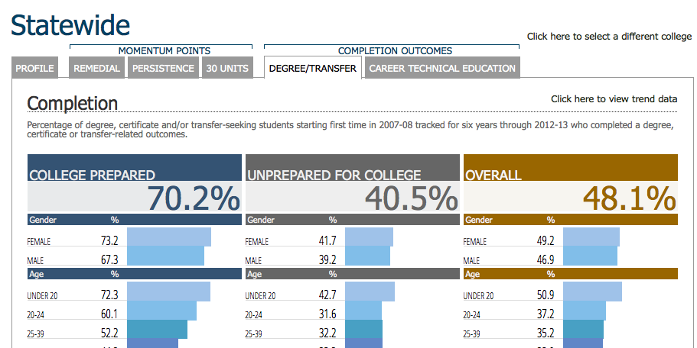
Student Success Scorecard
Statewide, more than three-quarters of incoming students are classified “unprepared”

Slide 4
Placement Is Destiny
Students’ Starting Placement English-Writing | % Completing College English in 3 Years
One Level Below | 48%
Two Levels Below | 34%
Three or more Levels Below | 19%
Across CA, students of color 2-3 times more likely to begin in lowest levels than white students
Statewide data, Basic Skills Cohort Tracker, Fall 2009-Spring 2012
Notes:
Data on racial demographics from: Perry, M.; Bahr, P.R.; Rosin, M.; & Woodward, K.M. (2010). Course-taking patterns, policies, and practices in developmental education in the California Community Colleges. Mountain View, CA: EdSource.
Ask people to take our their data – how does their completion rate vary by starting placement?

Slide 5
Placement Is Destiny
Students’ Starting Placement Mathematics | % Completing College Math in 3 Years
One Level Below | 35%
Two Levels Below | 15%
Three or more Levels Below | 6%
Across CA, more than half of Black and Hispanic students in remedial math begin here
Statewide data, Basic Skills Cohort Tracker, Fall ‘09-Spring ‘12
Notes:
LOOK AT YOUR DATA

Slide 6
A 2015 study of the three colleges in Contra Costa County estimates that 50-60% of racial inequities in degree completion and transfer-readiness is explained by initial placement.
Greg Stoup
President, RP Group

Slide 7
Placement Is Destiny
Mt. San Jacinto College Data – Fall 2015 – English
White students were 2x more likely to be placed into transfer-level English than Hispanics and nearly 4x more likely than African Americans
  Chance of passing college English in 2 years: 73%
African American and Hispanic students were more than 2x more likely that white students to have to take multiple semesters of remediation in English
  Chance of passing college English in 2 years: 23%-38%

Slide 8
Three High-Leverage Strategies
Revised Placement Policies:
Colleges broaden access to college-level courses, and make access more equitable, by adjusting cut scores, using high school grades in placement, and requiring algebra-based testing and remediation only for access to courses that require substantial algebra.
Co-requisite Models:
Students classified as “below college level” are allowed to enroll in a college-level course with extra concurrent support, saving them at least a semester of stand-alone remediation and reducing their chances of dropping out (e.g., “1A-plus” models: students co-enroll in English 1A and 2 additional units with the same instructor).
Accelerated Remedial Courses:
Multi-level sequences in English and math are replaced with accelerated courses that are well aligned with the college-level requirements in students’ chosen pathway.
Notes:
Talking points – these strategies have two things in common:
they shorten students path through transfer-level courses and eliminate exit points, and
all are grounded in the belief that students are capable of doing higher level work than we have traditionally assumed

Slide 9
Revised Placement Policies:
Colleges broaden access to college-level courses, and make access more equitable, by adjusting cut scores, using high school grades in placement, and requiring algebra-based testing and remediation only for access to courses that require substantial algebra.

Slide 10

Luis Sanchez,
Las Positas College
Accuplacer Result: Not College Ready
First-generation college student
Generation 1.5: U.S. born & educated, parents do not speak English
Bilingual: feels most comfortable & most himself in English
High school GPA: Above 2.5, allowed to enroll directly in College English
Earned Bs on all four essays, turned in all other assignments
Perfect attendance
Grade in Class: A-

Slide 11
Las Positas College
High School GPA for Placement in English – Fall 2016
Eligibility for college English more than doubled - increasing from 35% to 78% of incoming students
Students qualify for college English by test OR high school GPA of 2.5 or higher (self report – no transcript required)
No changes to curriculum, no co-requisite support provided -- students were simply allowed to enroll in the existing course
Success rates in college English held steady
Among students who previously would have been placed into remediation (N=348), 77% passed college English and 58% earned As or Bs
Completion of college English was 1.75 times higher than among students who started in remediation one year earlier (77% in one semester vs. 44% in one year)

Slide 12
Las Positas College
English 1A Course Success Rates – Fall 2016
By Assessment Method
N = 593
N = 220
N = 348
N = 25

Slide 13
N = 144
N = 155
N = 52

Slide 14
Co-requisite Models:
Students classified as “below college level” are allowed to enroll in a college-level course with extra concurrent support, saving them at least a semester of stand-alone remediation and reducing their chances of dropping out (e.g., “1A-plus” models: students co-enroll in English 1A and 2 additional units with the same instructor).

Slide 15

Alex Arguello, Solano College
Goal: Degree in Fire Technology
High School:
C and D student
Skipped school regularly because of personal difficulties Had to attend 5 months of Saturday school to graduate
Initial Course Placement (Accuplacer):
3-Levels-Below College English
Passed, found it too easy
Co-requisite Remediation:
At teacher recommendation, skipped two remedial courses and enrolled in a section of College English with extra support (3 hours of additional instruction)
Grade in College English: B
Grade in Subsequent Composition Course: A

Slide 16
Solano College
High School Grades for Placement & Co-Requisite
Eligibility for college English increased from 18% to over 70%
Students qualify by test OR high school GPA or English grades, whichever is higher (self report – no transcript required)
Students who don’t qualify for regular college English can enroll in sections that have 3 additional hours with instructor
Course success rates held steady
Among students enrolled in college English plus co-requisite support (n=205), 65% succeeded in college English
Completion of college English was twice that of students who started in English remediation a year earlier (65% in one semester vs. 31% in one year)

Slide 17
The Power of Co-Requisite Models: Tennessee
Tennessee has stopped offering traditional remedial courses at all public colleges and universities. Students assessed as “not college ready” enrolled in college English and math with additional concurrent support.

Slide 18
Statewide Co-Requisite Implementation
2015-2016: Tennessee Board of Regents (TBR)
4x higher overall,
7x higher for minority students

Slide 19
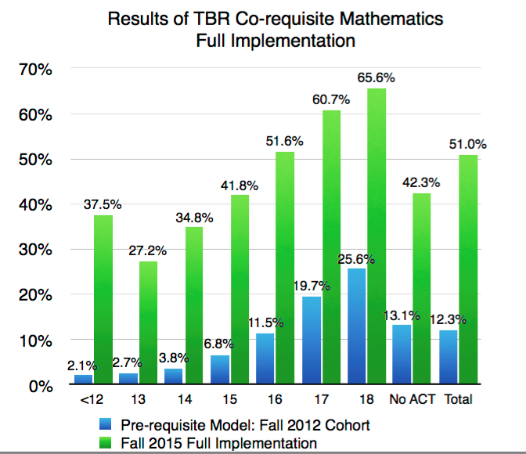
Co-Requisites for everyone?
What about low-scoring students?

Slide 20
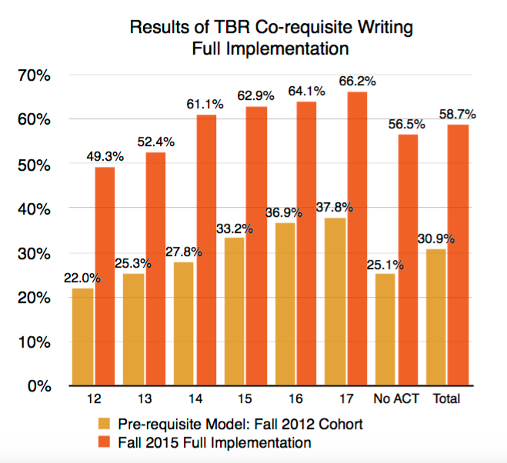
Co-Requisites for everyone?
What about low-scoring students?

Slide 21
Accelerated Remedial Courses:
Multi-level sequences in English and math are replaced with accelerated courses that are well aligned with the college-level requirements in students’ chosen pathway.

Slide 22
Chabot College
Accelerated Developmental English
4-unit integrated reading and writing course, one-level-below college English, open to any student
Students who don’t qualify for college English self-place into accelerated course or two-semester, 8-unit sequence
Students engage in the same kinds of reading, thinking, and writing of college English, with more scaffolding and support
Offered since mid-1990s; college has expanded accelerated offerings in last decade so that the course now represents 66%-’75% of entry-level developmental sections
Accelerated students are 1.6-1.9 times more likely to complete college English in than non-accelerated students

Slide 23
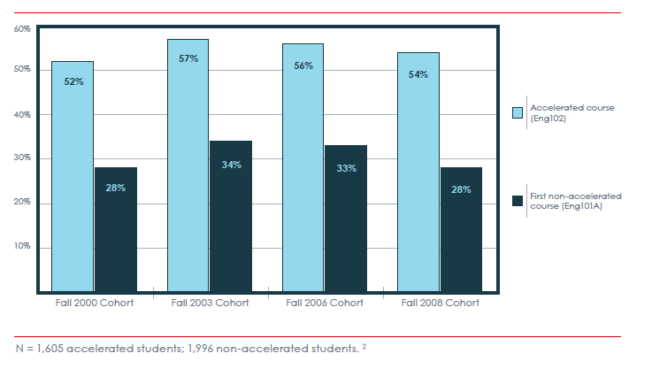
Chabot College
Completion of College English within Three Years
Accelerated vs. Non-Accelerated Developmental English

Slide 24
Why do these strategies work?

Slide 25
Reason #1:
The limitations of standardized placement tests
Sample Item: Accuplacer “Sentence Skills” Test
Writing a best seller had earned the author a sum of money and had freed him from the necessity of selling his pen for the political purposes of others.
Rewrite, beginning with The author was not obliged
The new sentence will include
A) consequently he earned
B) because he had earned
C) by earning
D) as a means of earning
Notes:
CCRC analysis has shown that both Accuplacer and Compass are incredibly weak predictors of students’ abilities – and just a couple months ago, the company that makes Compass acknowledged this and announced that they would no longer be offering the test.

Slide 26
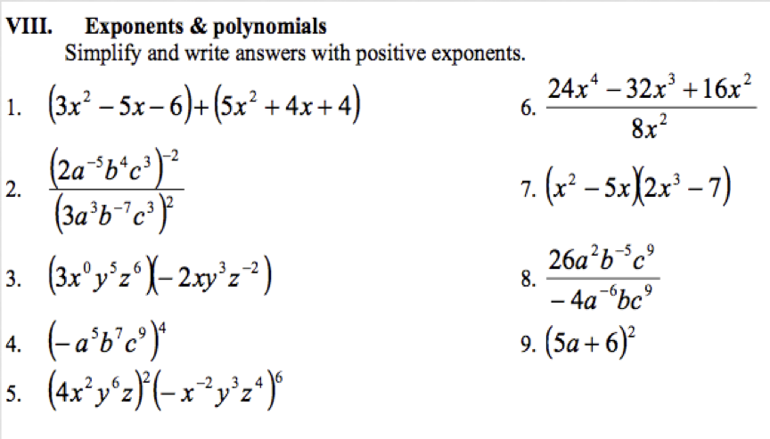
Are you college ready?

Slide 27
Placement tests do a poor job identifying who will – and will not – do well in college.
Accuplacer scores in English explain about 1% of the variation in course grades; in math less than 4% (Cal-Pass data).
Severe under-placement error is three times more prevalent than over-placement error (those placed into remediation who could have earned a B or better in a college course vs. those placed into college course who fail) (Scott-Clayton, 2012).
Fewer than 10% of the topics in Elementary and Intermediate Algebra are needed for the study of Statistics, yet tests of these skills block students’ access to college-level Statistics courses.

Slide 28
Reason #2:
Attrition Is Guaranteed in Traditional Remediation
Students placed 2 levels below college English/Math face 6 “exit points” where they fall away:
  Do they enroll in the first course?
  If they enroll, do they pass the first course?
  If they pass, do they enroll in the next course?
  If they enroll, do they pass the second course?
  If they pass, do they enroll in the college-level course?
  If they enroll, do they pass the college-level course?
  Students placed 3 levels down face 8 exit points.

Slide 29
Illustration: Chabot College
Students beginning two levels below College English:
  Do they enroll in the first course? ??%
  If they enroll, do they pass the first course? 66%
  If they pass, do they enroll in the next course? 93%
  If they enroll, do they pass the second course? 75%
  If they pass, do they enroll in the college-level course? 91%
  If they enroll, do they pass the college-level course? 78%
(0.66)(0.93)(0.75)(0.91)(0.78)= 33%
Fall 2006 Cohort. Students tracked from their first developmental English enrollment and followed for all subsequent English enrollments for 3 years. Pass rates includes students passing on first or repeated attempts within timeframe. Basic Skills Cohort Tracker, DataMart.

Slide 30
Thought experiment:
What if more students passed the first course?
  How many would complete the college level course?
  (0.66)(0.93)(0.75)(0.91)(0.78 ) = 33%
If 75% passed the first course…
37%
If 80% passed the first course…
40%
If 90% passed the first course…
45%
What if 90% passed and persisted at each point?
(0.90)(0.90)(0.90)(0.90)(0.90) = 59%
Notes:
75% = 37%
80% = 40%
90% = 45%
After reporting out from group, Myra tell story re: her own stupiphany.

Slide 31
BOTTOM LINE
Improving our results within existing multi-level course sequences will never be enough – we must eliminate or significantly reduce the exit points where we lose students.

Slide 32
Window into an accelerated classroom
Integrated Reading and Writing Course One-Level-Below College, open to all students (no min. placement score)
Footage from Katie Hern’s class, Chabot College, Fall ’09, week two of the semester
Students working collaboratively to understand an excerpt from Paolo Freire’s Pedagogy of the Oppressed. Discussion builds on earlier readings by Malcolm X, Mike Rose, & Jean Anyon.

Slide 33
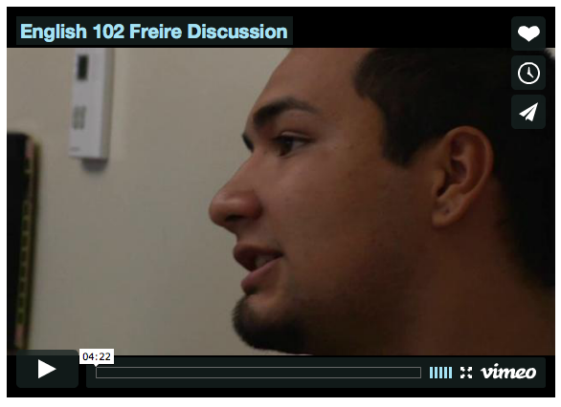
https://vimeo.com/16983253

Slide 34
Window into a Classroom
Look through the handout “Window into an Accelerated Classroom,” then talk in groups:
  What stands out to you as you look through these course materials?
  What excites you?
  What questions & concerns come up for you?

Slide 35
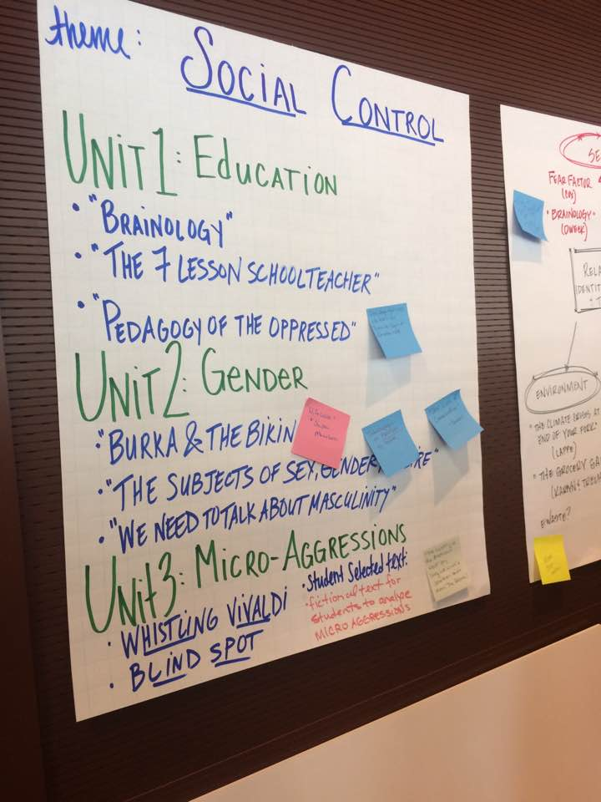
Thematic Courses
Samples from the CAP Network…
Food Justice
Love and Sex
Educational Inequality
Gang Violence
Why do we love monsters?
Hip Hop: Consumers to Agents of Change
Survivor: Using Psychological Theories to Analyze Reality TV
Intellectual Empathy: Cultivating this Superpower
Technology: The Superhuman and the Subhuman
The Immigrant Experience in America
Understanding Bias
For packet of sample thematic course outlines:
http://accelerationproject.org/Publications/ctl/ArticleView/mid/654/articleId/34/Thematic-Approaches-for-Integrated-Reading-and-Writing

Slide 36

Katie’s Tips re: Full-Length Anchor Texts

Slide 37
Choosing Texts for a Thematic Course
Don’t skimp on volume
Go for nonfiction about relevant issues
Evaluate the balance of narrative, information, and argument
Evaluate the density of unexplained references and terminology

Slide 38
Window into CAP Instructional Cycle
Speed Dating
Post-reading activity in which students process the assigned reading in rapidly shifting pairs, clarify misunderstandings, and prepare for upcoming quiz and essay

Slide 39
Speed Dating: Round One
Introduce yourself to your date.
Describe what Dweck means by “fixed mindset” and “growth mindset” so that someone who hasn’t read the article could understand her ideas.

Slide 40
Speed Dating: Round Two
Introduce yourself to your date.
How do students with fixed mindsets respond to things that are challenging or difficult in school, compared to students with growth mindsets?

Slide 41
Speed Dating: Round Three
Introduce yourself to your date.
How might you apply Dweck’s research in your own classroom?

Slide 42
Attending to the Affective
When students aren’t successful, the key issue is often not their reading and writing skills…
Handout: Summary of affective practices
Related Link:
http://gallery.carnegiefoundation.org/collections/windows_on_learning/katie_hern/index.html

Slide 43
Cautions about how we understand and use concepts like “mindset” and “grit”
http://hechingerreport.org/growth-mindset-guru-carol-dweck-says-teachers-and-parents-often-use-her-research-incorrectly/
https://learningliberationblog.wordpress.com/2017/04/25/the-new-bootstraps/

Slide 44
CAP Instructional Design Principles
Streamlined developmental curricula should reflect:
  Backward design from college-level courses
  Relevant, thinking-oriented curriculum
  Just-in-time remediation
  Low-stakes, collaborative practice
  Intentional support for students’ affective needs
  Illustrated in depth in Toward a Vision of Accelerated Curricula & Pedagogy (Hern & Snell, 2013). http://www.learningworksca.org/accelerated-pedagogy/

