Slide 1
How to get the most out of a 1 to 35 class ratio? Providing Effective Support to all Acceleration Students
Presenters:
Julia Raybould-Rodgers | jraybould-rodgers@hancockcollege.edu
Chellis Ying | chellis.ying@hancockcollege.edu
Notes:
Poll who teaches in classes of 20 or less, up 25, up 30, more 35 students. Who is teaching in a class using an acceleration model?

Slide 2
Why did we start to accelerate?
In the Fall 2013 semester, we recognized that our current system of four levels of basic skills was creating too many opportunities for students to fail.
The majority of incoming students were being placed in English remediation.
Students starting 4 levels below transfer had a 23% chance of enrollment in English 101 within 2 years.
Our placement policy favored the white student population.
Notes:
A little but back information

Slide 3
Replacing Developmental Courses with Acceleration
Spring 2016
English 595 (pilot): 5 sections
English 511, 512, 513, 514: 26 sections
Fall 2016:
English 595: 10 sections
English 511, 512, 513, 514: 23 sections
Spring 2017:
English 595: 9 sections
English 101/179B: 2 sections
English 511, 512, 513, 514: 16 sections
By adding more acceleration courses and decreasing the number of developmental courses, we are able to enroll students quicker into English 101, increasing their overall chances of graduating college.

Slide 4
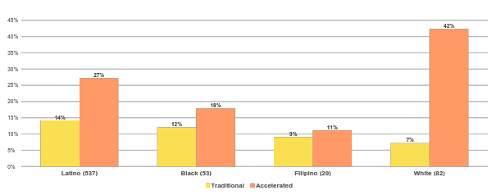
Success Rates: Developmental vs. Acceleration
For first-time students between fall 2014 and spring 2016 completing transfer level English 101
Notes:
Improvement across all racial demographics.

Slide 5
Suddenly, we had four levels of up to 35 students in one class. We learned that traditional methods of teaching did not work, and we needed solutions fast.
Notes:
We became aware of the vulnerable population and their needs and our limitations as instructors.

Slide 6
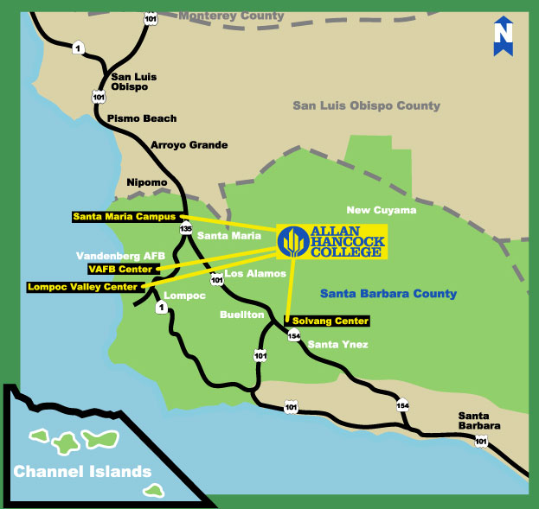
What are some of issues that our vulnerable population share that affect their learning experience in the classroom?
We have a large number of students with diverse skill sets in the same classroom.
Santa Barbara County is ranked 16th out of California’s 58 counties for teen birth rates, and according to the National Campaign to Prevent Teen Pregnancy, less than 2 percent of teens who give birth before age 18 attain a college degree by age 30.
Santa Maria is 70.6% Hispanic and many of our students come from ESL homes. They consider English to be their worst subject and least favorite.
Notes:
Plough through 1-6 and ask if any quick questions.

Slide 7
Top 10 Challenges Among Acceleration Students
Not doing work, but showing up for class.
Turning in late or incomplete assignments.
Having poor attendance, excessive tardiness or disappearing before class ends.
Not participating in class discussions or group work.
Not knowing how to ask for help. Unaware of the learning process for improvement.
Obsessing about grades, but overlooking the learning process.
Possessing low expectations in self and grades.
Lying about completing assignments and plagiarizing off the internet.
Lacking motivation and discipline.
Not getting off cell phones.
Notes:
Alternate reading the list.
Don’t immediately assume that the students lack reading and writing skills. These challenges can mask their ability.

Slide 8
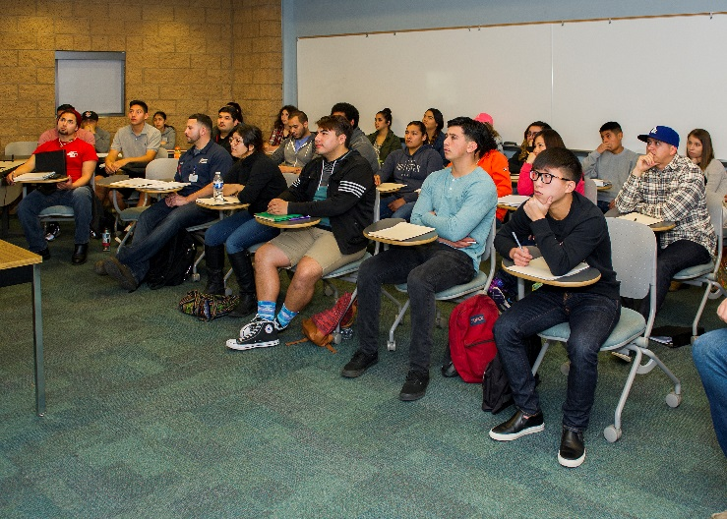
Classroom management: How do we get everybody to try?
Growth mindset. Introduce Carol Dweck’s “Brainology” and Rita Smillkstein’s “We’re Born to Learn” early on in the semester.
Fear of failure. Be conscious of emotional triggers that may cause a student to regress into a fixed mindset.
Second chances. Be empathetic to behavioral inconsistencies, such as turning in assignments late, missing class, and feelings of indifference.
Hand’s off approach. Enable students to be independent learners.
Relevant-Thinking Oriented Curriculum. Synthesize material that students can relate to.
Notes:
Moving on to discuss strategies to get the best out of your 1 to 35 ratio.

Slide 9
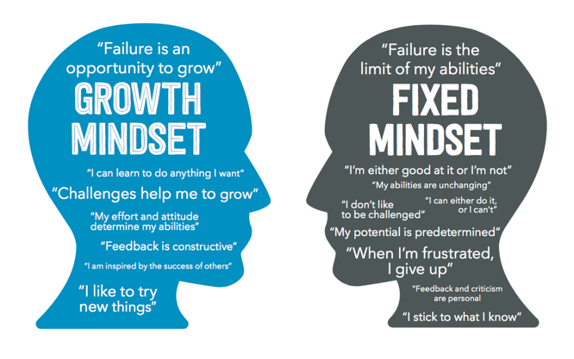
Encourage a Growth Mindset
Notes:
Distribute handout: https://docs.google.com/document/d/1WFhpLMj3ORQc3HqG3xe0GLqf8OdLSdQ3E6ywEdek3mA/edit?usp=sharing
Read the top part of the handout. Chellis

Slide 10
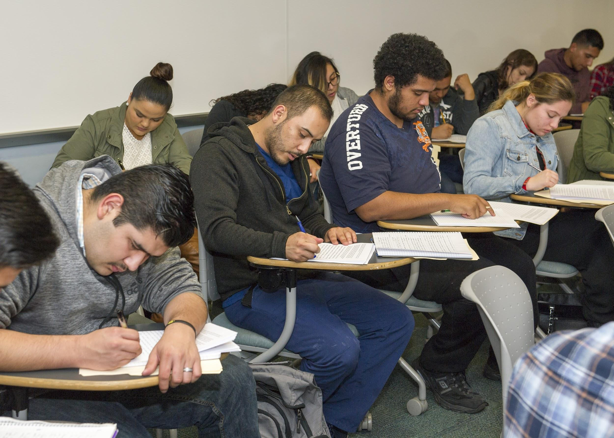
2. Be Sensitive to the Students’ Fear of Failure
Emotional triggers:
“English is my worse subject.”
“I don’t like to read.”
“I didn’t finish the writing assignment.”
“I have a job and three other classes to take.”
“I’m just not very good at writing a thesis.”
“I forgot the assignment was due.”
“Why is my grade so low?”
Students, who have struggled in an English class before, often think that they’re the only ones challenged by the material.
Notes:
Break up into groups Handout (Chellis): https://docs.google.com/document/d/1gI4aLf2TN16Z-GcGb-9y4kU27PVhWi8uV71LXxKNVbs/edit?usp=sharing Three classic examples.

Slide 11
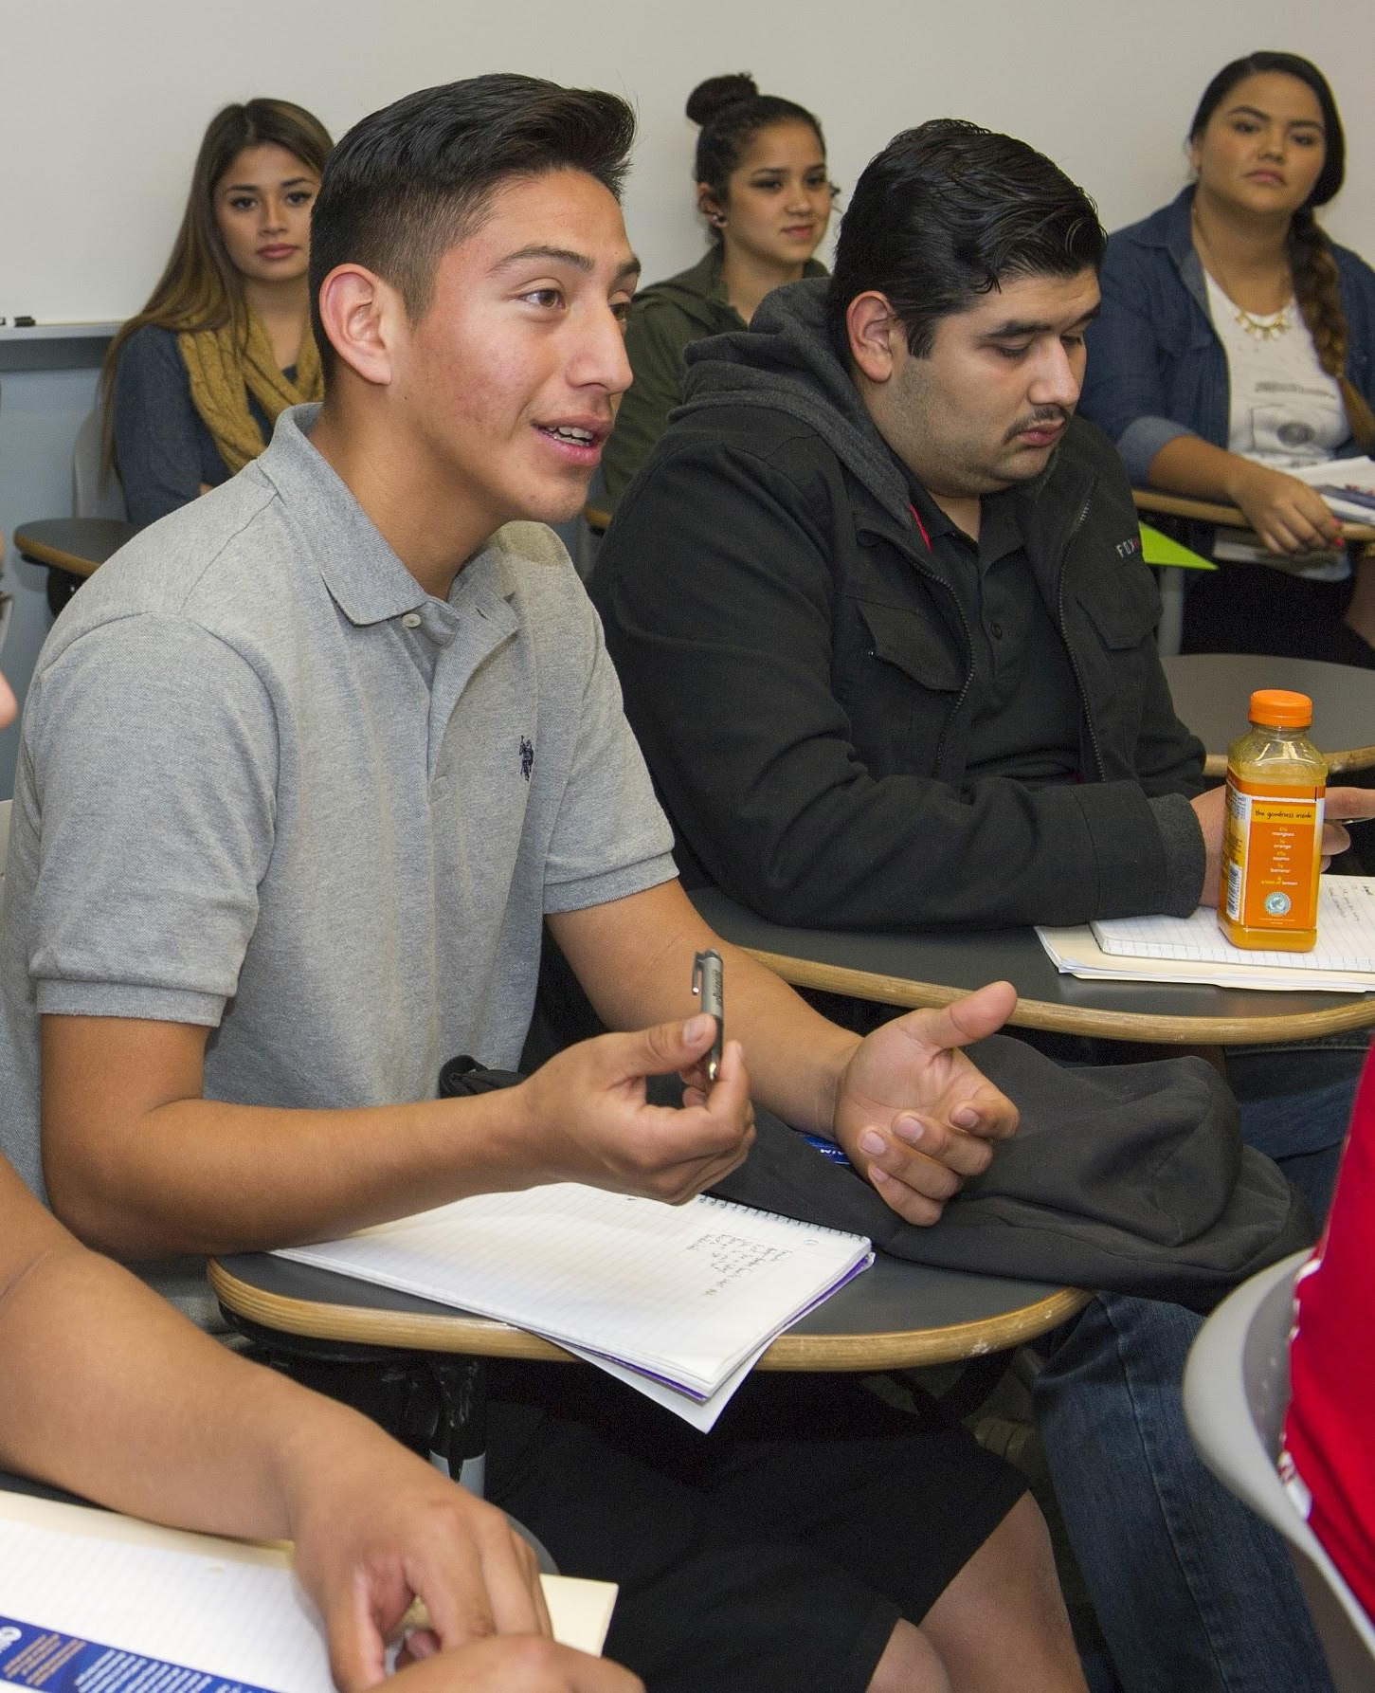
3. Provide Second Chances
To decrease feelings of isolation, remind the students that everyone in the class shares the same challenges.
Conference with the students one-on-one throughout the semester.
Create high expectations and be creative with methods on how to meet them.
Negotiate late work with caveats.
Realize that the students want to be challenged, but they don’t want to feel insecure about an assignment.
Don’t let the students get away with laziness, but be tolerant of personal issues.
Notes:
Julia

Slide 12
Dealing with
While plagiarism is an important issue, in particular for developmental students who may not know they are plagiarizing, don’t assume that students are doing it, and if they are, don’t obsess about it.
Plagiarism prevention:
Always teach students about plagiarism, even if they think they already know about it.
Have students go through the Indiana University Training Program: https://www.indiana.edu/~academy/firstPrinciples/index.html
Create a challenging makeup plagiarism assignment to give students a second chance if they break the rules.
Notes:
Julia Tips for Teachers: Dealing with Plagiarism by Megan Smith http://www.learningscientists.org/blog/2016/7/28-1
https://www.insidehighered.com/advice/2013/07/10/essay-how-deal-and-not-obsess-over-student-plagiarism

Slide 13
4. Take a Hands-Off Approach
Although you will be working closely with your acceleration students, trust their learning process, and give them the space to make mistakes and educational discoveries.
Low-stake assignments
Group work
Just in-time remediation
Class presentations
Peer review assignments
Study groups
Peer facilitator tutoring
Notes:
Julia

Slide 14
5. Develop Relevant Thinking-Oriented Curriculum
CAP Team Training Institutes 2014/15:
Social Identity
Where did we come from?
CAP Team Training Institutes 2015/16 :
Happiness
CAP Team Training Institutes 2016/17:
Success
Empathy
Notes:
(Chellis) Handout #3: https://docs.google.com/document/d/1qZTIzmopxMXGK9bZ_1x8KLGzm-gncz-zvXAn45Hwz-s/edit?usp=sharing

Slide 15
Suddenly, with an increased intensity in this new approach of instruction, we realized we needed help. Here we learned how to find effective support for ourselves and our students.

Slide 16
Multiple Angles and Approaches to
Address Students’ Needs
HELP!
Peer facilitators
Online tutoring support
Counseling for at risk students
Dealing with plagiarism
Modifying traditional grading system
Notes:
Julia will share her experiences getting these services integrated at AHC.

Slide 17
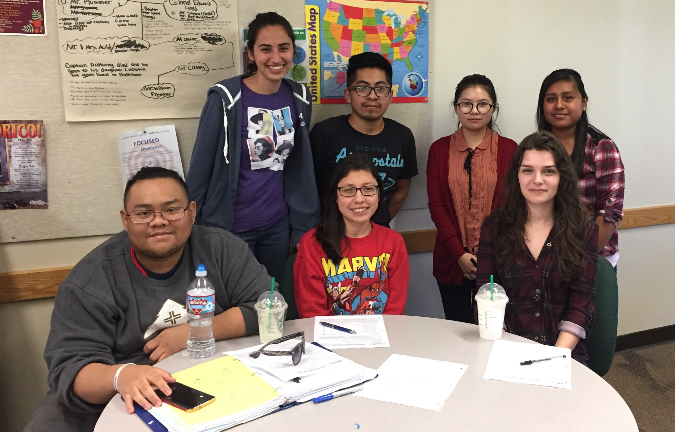
Saved by Peer Facilitators

Slide 18
Peer Facilitator Pilot Project (Spring 2017)
Utilizing funding from the Basic Skills Grant, 11 peer facilitators were hired to support developmental courses, including English 595:
Valuable role models for students.
Helpful in-class assistance to support lesson plan.
One-on-one out-of-class assistance for students who want extra help.
Peer facilitators are also offered a positive learning experience as paid interns.

Slide 19
How did we use the peer facilitators to
troubleshoot classroom challenges?
Participate in class discussions as “super students” to model active engagement.
Provide affective support by sharing their personal experiences completing English assignments.
Support the instructor by being an extra eye in class, cooperating in group work exercises, checking off low-stakes assignments, and maintaining course flow in case of substitute instruction.
Contact absent students and ask if they need help catching up on missed assignments.
Meet with students, recommended by the instructor, for out-of-class tutoring in order to receive an extension on an assignment.

Slide 20
Online Tutoring Support
www.Smarthinking.com
www.NetTutor.com
Peer facilitators

Slide 21
Counseling Academically Vulnerable Students
Students are identified by counselors during their intake meeting.
Students are educated on their options for English and Math acceleration.
Counselors promote acceleration to students that are capable based on Multiple Measures.
Counselors visit acceleration classrooms to provide mini-workshops regarding student services such as tutoring, book lending, and student educational goal setting.

Slide 22
Top 5 Suggestions for Struggling Students
Instructors have the ability to notify an “Early Alert” counselor if a student is not performing up to expectations.
This counselor contacts the student via email, phone, and sometimes shows up during class if the student has been unresponsive to previous attempts.
Students are then encouraged to meet with the counselor or “retention specialists” to develop an academic plan.
Regular meetings and contact between the counselor, student, and instructor can help the student feel engaged and supported throughout the term.
Students are also referred to appropriate support services on campus; health center, tutoring, writing center, financial aid, etc.
Notes:
Early alert handout: https://drive.google.com/file/d/0BydCHqPxJI7MLW0xZlVtT2FJam8/view?usp=sharing

Slide 23
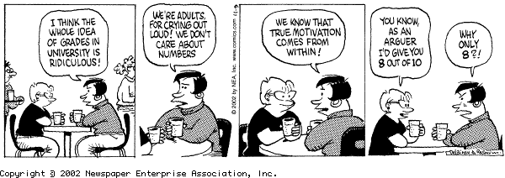
Modify Traditional Grading System
Give full credit on the 1st major essay assignment.
Provide low-stake writing assignments.
Accept late work with caveats.
Encourage attendance and office hours to discuss grades.
Set up contract grading.

Slide 24
Got questions?
Julia Raybould-Rodgers | jraybould-rodgers@hancockcollege.edu
Chellis Ying | chellis.ying@hancockcollege.edu

