Slide 1
Pathway to Composition Competency:
How Revising the They Say/I Say Templates
Advances Developmental Writers

Slide 2
TIMOR ALBUM SPATIUM
Fear of White Space

Slide 3
How can students learn to “fill up the white space” – to put words on paper?

Slide 4
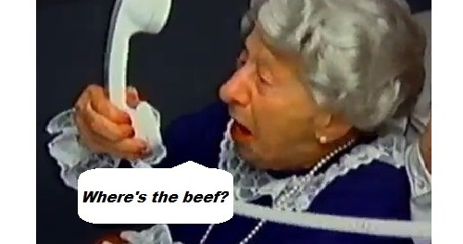
Writing Process Theory?
“Where’s the product?”

Slide 5
Post Process Theory
Writing can be learned but not taught.
There is no beef.

Slide 6
The Graff/Birkenstein Templates:
The Moves that Matter in Academic Writing
“In showing students how to make such moves,
templates do more than organize students’ ideas;
they help bring those ideas into existence.”

Slide 7
But do the G/B Templates work for developmental writers?

Slide 8
In a word…
No

Slide 9
Simplify the templates

Slide 10
Simplify the “They say” summary templates
In the essay________, __________ argues that _________________________.

Slide 11
In the essay “Past Experiences and Future Attitudes in Literacy,” Erika Petersen argues that ___________________.

Slide 12
In the essay “Past Experiences and Future Attitudes in Literacy,” Erika Petersen argues that praise and discouragement lead us to certain attitudes” about literacy.

Slide 13
In the essay “Past Experiences and Future Attitudes in Literacy,” Erika Petersen argues that praise and discouragement lead us to certain attitudes” about literacy,” with praise a positive factor and discouragement negative. Put another way, “Praise and encouragement should be taken into more consideration when teaching literacy."

Slide 14
For example, ___________________.

Slide 15
In the essay “Past Experiences and Future Attitudes in Literacy,” Erika Petersen argues that praise and discouragement lead us to certain attitudes” about literacy,” with praise a positive factor and discouragement negative. Put another way, “Praise and encouragement should be taken into more consideration when teaching literacy. For example, … Furthermore, … In addition, … What’s more…

Slide 16
Graff/Birkenstein “I say” templates—too much, too soon, and too fast for a one-week “boot camp”.

Slide 17
Simplify the “I say” response templates
“First glance” claim and support
“Closer look” claim and support

Slide 18
At first glance, Petersen’s argument makes a lot of sense. My own experience supports Petersen’s claims. For example, (REPORT PERSONAL EXPERIENCES). In addition, she reports that (USE HER EXAMPLES OF STUDENTS WHO WERE EITHER ENCOURAGED OR DISCOURAGED BY THEIR TEACHERS).

Slide 19
A closer look reveals that Petersen’s argument does not take into account problems with her “praise produces performance” formula—namely, that it is in reverse order. Instead of praise producing literacy skills, it is the skills that produce the praise.

Slide 20
“So what? Who Cares?” Simplified

Slide 21
In conclusion, this essay recognizes the value of Petersen’s claim about how praise helps achieve literacy but at the same time challenges her view that praise comes as a result of performance rather than the other way around. Therefore, Petersen’s most important point may be about the value of sincerity.

Slide 22
Incorporating TS/IS Revisions into ALP—An “All-in-One”
Comp Classroom

Slide 23
Incorporating TS/IS Revisions into ALP—An “All-in-One”
Comp Classroom

Slide 24
The Rhetorical Power of
The Commonplace, First Glance, and Closer Look

Slide 25
The Commonplace – creates the basis for an argument.
First Glance Support – why the commonplace matters.
Anomalies and a Closer Look

Slide 26
“The Missing Link”—
Rhetorical Invention

