Slide 1
The Brakes are Out!
Simultaneously starting, steering, evaluating
and re-designing a new accelerated English Curriculum
Rob Lee
Pasadena City College

Slide 2
Overview
Introductions
Quick overview of PCC
How I got here (the “new” acceleration program)
The purpose of this session

Slide 3
Introduce yourselves
Who, what, where
Characterize your school’s acceleration efforts using a car metaphor. Is your school aTesla or a Fiat, etc?

Slide 4
Who is here?
Experienced in ALP
New to ALP
Had great success with acceleration
Had some notable “oops” moments in implementing acceleration

Slide 5
Rob Lee
High School ESL department 1986-1992
ESL faculty at PCC 1992-2006
English Faculty (Writing Center Coordinator) 2006-2017
I’m NOT an acceleration expert

Slide 6
Pasadena City College
80% of students receive a BOG fee waiver
70-75% of students test into Basic Skills math and/or English
40 full-time English faculty 77 part-time English faculty

Slide 7
Pasadena City College
We have Pathways!
Aspen Award finalist (7th)
“We’re so GREAT”

Slide 8
But……………….
We award about 1,000-1,500 AA degrees a year (but some students earn multiple degrees)
Our average is 6 years for a degree
Many students come to PCC because of our reputation, so we have a small percentage of students who skew our data (success, retention, time to complete, etc) e.g., my oldest two children attended PCC and both transferred out after 2 years.

Slide 9
“New Acceleration model”
During Winter 2017, I heard about a new (small) pilot for English students in the spring. It was a “new” acceleration model for PCC.
An opportunity to embed tutors in an accelerated classroom (I’ve been waiting for years to do this after attending an SI conference).
I had 2 weeks to prepare everyone, including teachers

Slide 10
Co-Requisite (ALP) Model
English 1A (4 units) College Reading and Writing English 110 (2 units) Skills for College Success
Each English 1A class has two rosters: half the class is is made up of “regular” English 1A students.
The other roster of students placed one level below 1A. They are enrolled in a one-hour, English 110 follow-up session after each composition class meeting (2x per week)
Recognize this model?

Slide 11
Let’s Study this!
Week 2 surveys of faculty and students
Week 15 surveys of faculty and students
Interviews of faculty

Slide 12
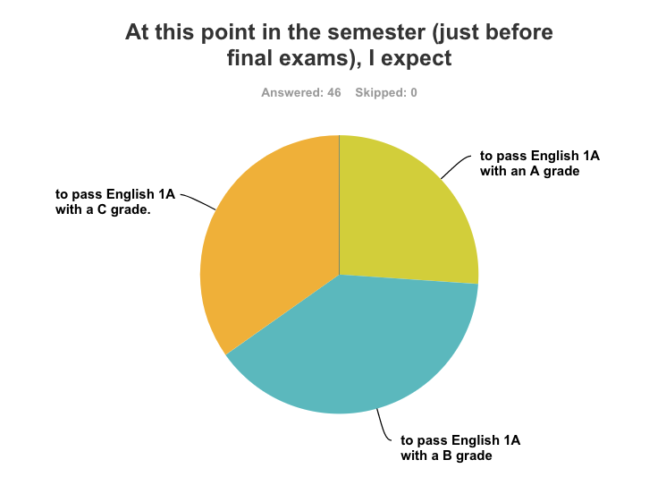
Student Beliefs
English 1A+110 Students

Slide 13
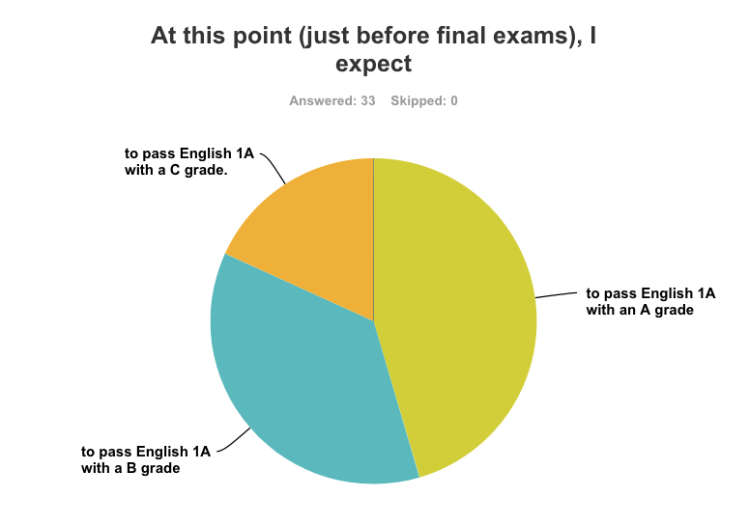
Student beliefs
Enrolled in English 1A-only

Slide 14
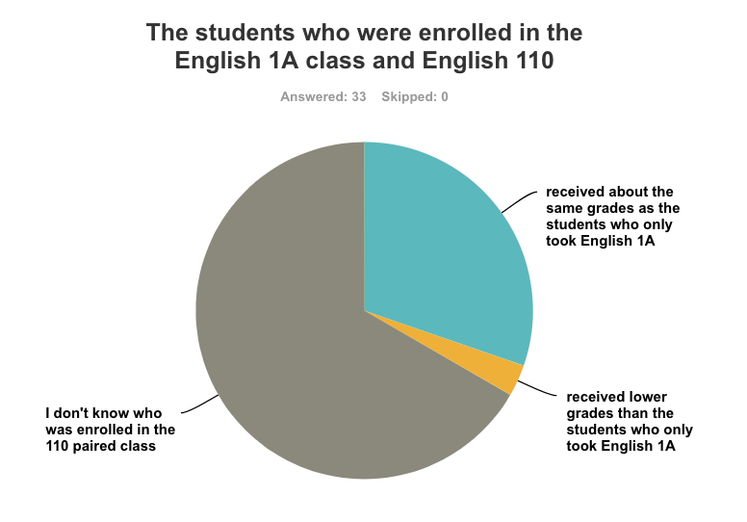
What English 1A-only Students think about 110+1A

Slide 15
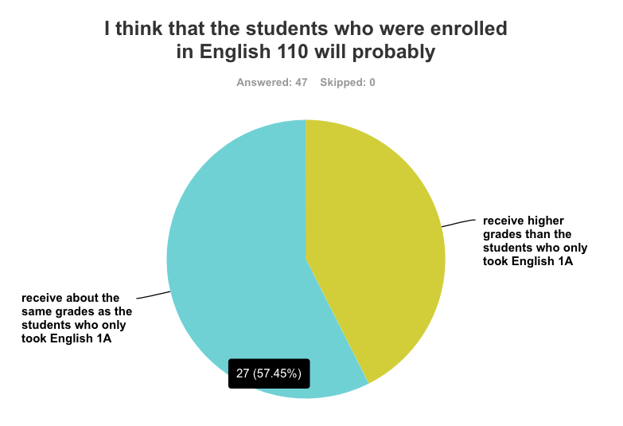
What English 110+1A students think

Slide 16
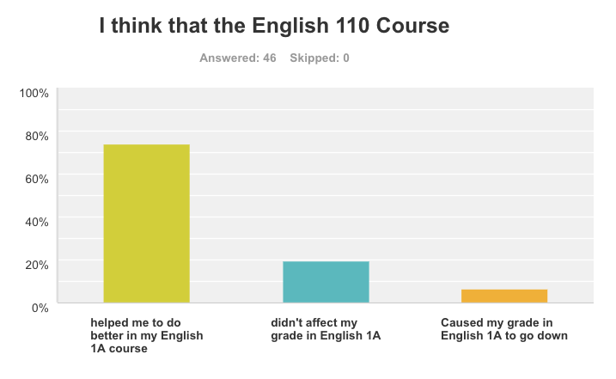
What 1A+110 students think

Slide 17
Grade Predictions for pilot
Grade | A | B | C | D | F | Drop
Prof A: Reg | 7 | 4 | 1 | 0 | 1
Prof A: Co | 7 | 1 | 2 | 1 |  | 1
Prof B: Reg | 4 | 5 | 1 |  | 1 | 3
Prof B: Co | 2 | 4 | 3 |  | 2 | 2
Prof C: Reg | 2 | 2 | 7 |  | 1 | 2
Prof C: Co |  | 2 | 7 | 1 |  | 2
Prof C Reg | 2 | 7 |  |  | 1 | 2
Prof C: Co | 2 | 4 | 4 | 2 |  | 2

Slide 18
Quick & Dirty Conclusion
This is a very successful pilot
Right?

Slide 19
Looking for P5
Pollyanna Perceptions of Pilot Program Progress
Faculty: three self-selected, full-time, younger instructors
14 students, one teacher and one embedded tutor
How the 110 students were recruited
Students who tested one level below 1A, but didn't enroll in that English class in the fall ====> Self-selected students
Small pilot number for only one semester

Slide 20
Teacher Interviews and research
I used to teach STACC, but I stopped
I’m teaching both co-req and STACC, and the co-req class is way better….
STACC
STACC
STACC

Slide 21
STACC History
2009: Initial Faculty Inquiry Group after 3CSN acceleration workshop
2 years of research and planning by faculty and administrators
2011: Several pilot versions were tried out cohorts, no cohorts, 400 (Basic Skills) mainstreamed into English 100
Eventually, the stretch, 2-semester cohort model was chosen
Funding for group training (4 days) and a coordinator

Slide 22
STACC Structure
STRETCH & ACCELERATION
Chose to model after Cal State San Bernardino program
English 400—100—1A in one year
Cohort for two semesters (same teacher)

Slide 23
Initial Data
Row Labels | Enrollment in ENGL100 | Success ENGL100 | Success Rate (ENGL100) | Enrollment in (Engl 1A) | Progression Rate (ENGL100 to ENGL001A) | Success in Engl 001A | 1A Success Rate | Sum of EST_THROUGH
Fall 2012 | 1203 | 872 | 72% | 740 | 62% | 556 | 75% | 34%
STACC | 176 | 147 | 84% | 139 | 79% | 110 | 79% | 52%
NonSTACC | 1027 | 725 | 71% | 601 | 59% | 446 | 74% | 31%
Fall 2013 | 1665 | 1185 | 71% | 1216 | 73% | 841 | 69% | 36%
STACC | 526 | 395 | 75% | 405 | 77% | 303 | 75% | 43%
NonSTACC | 1139 | 790 | 69% | 811 | 71% | 538 | 66% | 33%
Fall 2014 | 1816 | 1301 | 72% | 1301 | 72% | 838 | 64% | 33%
STACC | 777 | 542 | 70% | 567 | 73% | 381 | 67% | 34%
NonSTACC | 1039 | 759 | 73% | 734 | 71% | 457 | 62% | 32%

Slide 24
What happened to STACC?
Some “strong personalities” — passionate people had conflict
Inconsistent administrative support
Academic Freedom issues: handbook and joint assignments

Slide 25
What happened to STACC (2)
Most of the initial faculty stopped their involvement in STACC
Last funding proposal rejected (why?)
No stipends, no coordinator (just a committee chair)

Slide 26
STACC Today
Currently about 20 sections per fall & spring semester
Teachers: -a small group of dedicated, full-time instructors -all second-year full-time instructors -adjuncts
Voluntary, online training in Canvas, monthly meetings

Slide 27
PCC over the last few years
High stress level campus-wide
Series of “unpopular” presidents
Revolving door of VPs
Confusing series of programs, edicts and directions

Slide 28
PCC over the last few years
Polarized faculty—academic senate battles
Academic Senate president (active STACC teacher) driven from office
2015 WASC Accreditation visit led to Probation
The brakes are out and no one is steering!

Slide 29
Purpose of this session
From you!
Reinvigorate English Acceleration at PCC
SWOT analysis Strengths Weaknesses Opportunities Threats

Slide 30
A New Hope
Relative calm prevails
A new (2nd year) college president (and more new VPs and assistant deans)
New English Department dean (as of Tuesday)
Multiple Measures implementation means more students might need & choose acceleration

Slide 31
A new Hope
PCC growing Pathways program actively steers new pathways students into both acceleration models
A lot of new fun time English faculty: they already know acceleration and have less “PCC baggage”
Equity funding: there is a question about qualifying for it. However, I think we can get funded with a well-written strategic proposal (I’m here).

Slide 32
Participant Feedback
Issue #1: Can STACC and the Co-req model co-exist?
“Yes”
“Yes. Irvine Valley is trying both”
“No. Go Co-req and dump STACC. We debated doing both, but more schools re doing co-req and Stretch complicates registration.”
“MAYBE your school can use both types to support a variety of students”

Slide 33
Participant Feedback
Issue #2: funding and a coordinator/administrator
You must have a “point person” to
be the face of acceleration
“sell” acceleration in the department and school
work with school admin to ensure integration of acceleration into the school overall picture.
The point person(s) must have either release time or stipends

Slide 34
Session takeaways
You must have training and ongoing support (a cohort) for acceleration teachers
Check IVC for how to build in academic freedom Don’t overthink or make the co-req class too complicated or structured

Slide 35
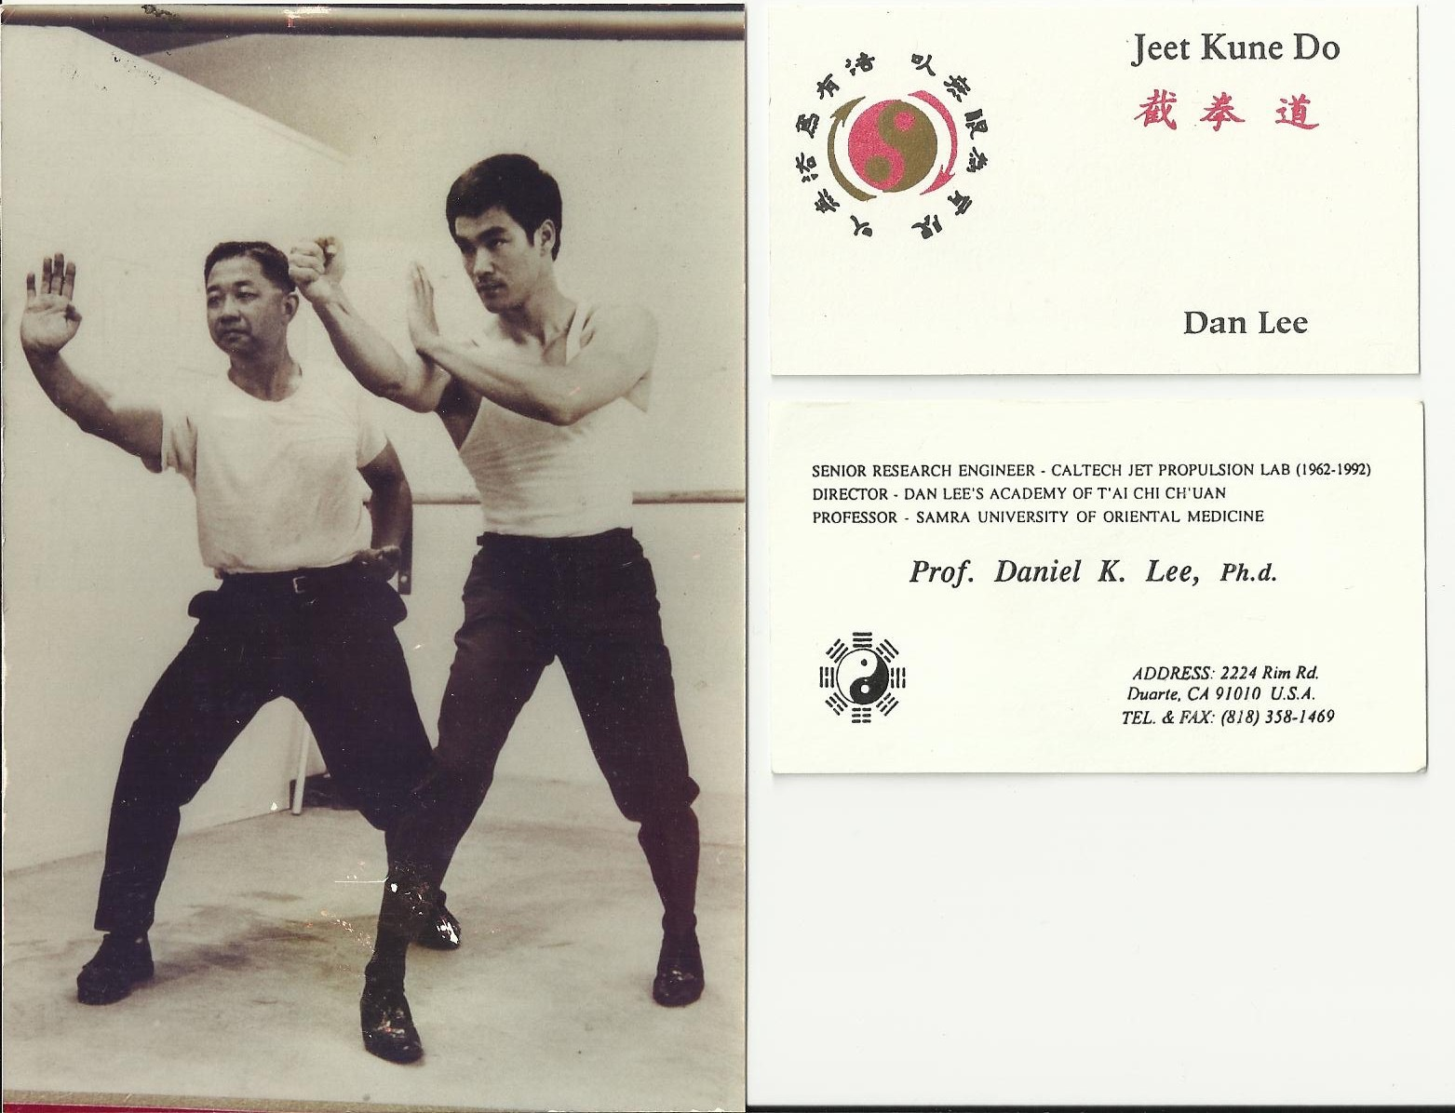
Fun fact:
My dad was the first student in Bruce Lee’s LA school of Jeet Kun Do, so I knew Bruce Lee

Slide 36
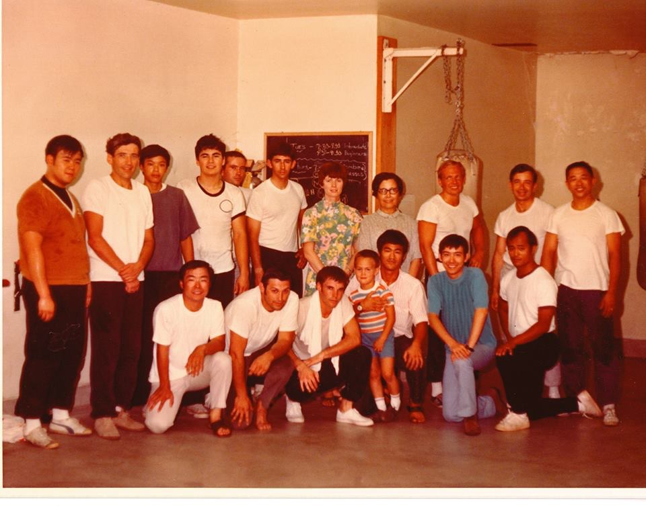
Y

