Slide 1
Backward Research:
A Demonstration of Research Writing Instruction Using Backward Design
2015 Conference on Acceleration in Developmental Education
June 26, 2015
Elsbeth Mantler, Instructor CCBC

Slide 2
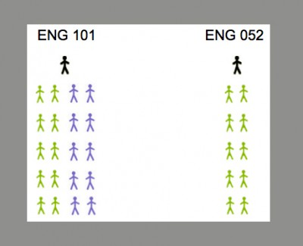
What is the structure of the alp course?
The Accelerated Learning Program (ALP) is a form of mainstreaming developed at the Community College Baltimore County. ALP attempts to combine the strongest features of earlier mainstreaming approaches and, thereby, to raise the success rates and lower the attrition rates for students placed in developmental writing. For this presentation, 052= developmental and 101= Composition.

Slide 3
what is backward design?
“Effective curriculum is planned backward from long-term, desired results through a three-stage design process (Desired Results, Evidence, and Learning Plan)” (Wiggins and McTighe).
Backward Design intentionally introduces concepts to students that will help bolster and support broader goals and concepts in the course. Often “smaller” concepts are worked on in class before major concepts are introduced. These help support student learning.

Slide 4
How does Backward design work in the alp course?
By using activities in the 052 class as building blocks for the “larger” assignments in the 101 class, the 052 students feel more prepared, supported, and confident about significant tasks in the 101 class such as a research essay.
Today, I am going to show you some of these “smaller,” low-stake activities that help prepare and support the mindset and work of the developmental student for a large undertaking (like a research essay) in the 101 class.

Slide 5
Why do I use backward design in this scenario?
Students stay focused on a tangible goal.
They can see a connection and purpose to all activities.
Exercises are contextualized and meaningful for students because they are serving the larger goal of the essay.

Slide 6
What was this particular alp course like?
The theme of the course is happiness; we study cultures around the world, positive psychologists, environmentalists, philanthropists to grapple with the definition of this term.
4 major essays
1 of the 4 is a semester long service learning project in the community.
1 of the 4 essays is the research paper which is worth 30% of their overall grade.

Slide 7
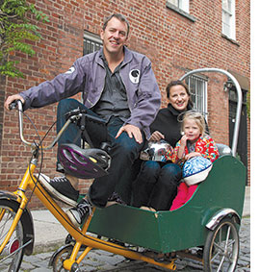
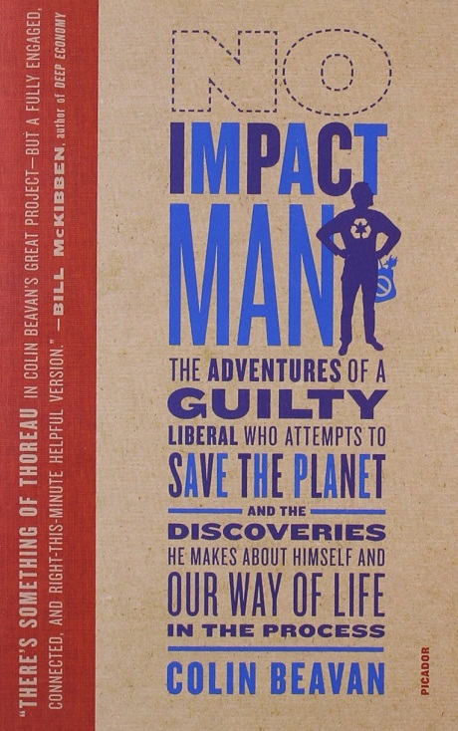
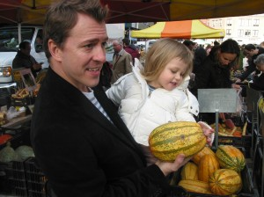
What was the topic of research essay?
This essay was tied to a book students read called No Impact Man. It is a non-fiction piece by Colin Beavan about a man and his family trying to live impact-free in NYC for a year.
Students picked a topic related to local environmental issues.

Slide 8
Research Essay Expectations
The essay called for a unique thesis or argument about said issue.
The essay was not a “for” or “against” essay. Rather, it gave students an opportunity to make their own unique claim about a topic.
4-6 pages
Minimum of 3 outside sources and smooth quote integration

Slide 9
Sample Topics
Fracking in Maryland
Inner Harbor Swimmable by 2020 Campaign
Plastic Bag ban in Baltimore City
Aquaculture in Maryland
Conowingo Dam Controversy
Urban Farming in Baltimore City
Issues with Farm Pollution in the Chesapeake Bay
Wind power in MD
Blue Crab population in the Chesapeake Bay
Commercial Fishing regulation in the bay
Microbeads
GMO’s or labeling of GMO’s (genetically modified organisms)
Fishing regulations in the state
Superfund site in Dundalk
The Red Line in Baltimore (mass transportation)
**These topics are merely suggestions. If students can think of another topic that is relevant, I want them to explore it! I ask them to run it by me first, though. I want to make sure the topic is feasible for the assignment.

Slide 10
classroom Activities to scaffold research essay writing
1. CHOOSING A TOPIC
I am passing out one activity that I give to my students in the developmental/052 class. This is handed out the same day the students receive the instructions for the essay. My hope is that they can pick a topic that is genuinely interesting to them.
Please take about 5 minutes to answer these questions and discuss with a partner.

Slide 11
Choosing a topic
I want students to have a real connection to the topic (this should not exist in a vacuum).
It allows students to think about everyday things in their life and realize they could possible write about them for this essay.
Students have had success with this exercise. I have had students write about environmental issues in their neighborhood, questions about where their food comes from, and transportation problems in their city just to name a few.
This gives the students a voice and agency because they are writing about something that is relevant to them.

Slide 12
2. Evaluating sources
The class visited the library and were taught a lesson about research methods within the CCBC databases. At this visit and during the next class period, students conducted research on the CCBC databases with the help of a librarian and myself.

Slide 13
√ Source Evaluation checklist
Students are asked to print out a few sources that seem like they will be a good fit for their essay.
After the library, in the 052 class, we start a discussion about what it means for a source to be reliable.
I have the students create a√ Source Evaluation Checklist via this discussion.
The students have the power to bring up what they think is important in a source, and we create a master class checklist that is posted on Blackboard.

Slide 14
Source evaluation checklist from spring 2015
“When did it come out?”
“Who does the author work for?”
“Where does the author get their information?”
“Where did this article come out?”
“Can we tell why the author wrote the article?”
“Do they seem to be on one side or the other side too much?”
“Is the author friends with or related to anyone involved in the topic?”
“Does it seem like they know what they are talking about? Why?”

Slide 15
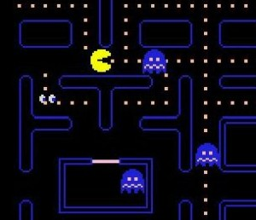
Exercise for analyzing their sources: “Check it out, or leave it on the shelf?”
We are information consumers

Slide 16
Check it out, or leave it on the shelf
Instructions: Read your source.
After reading the article, answer the questions you wrote for your √ Source Evaluation checklist
Based on your answers to these questions, would you…

Slide 17
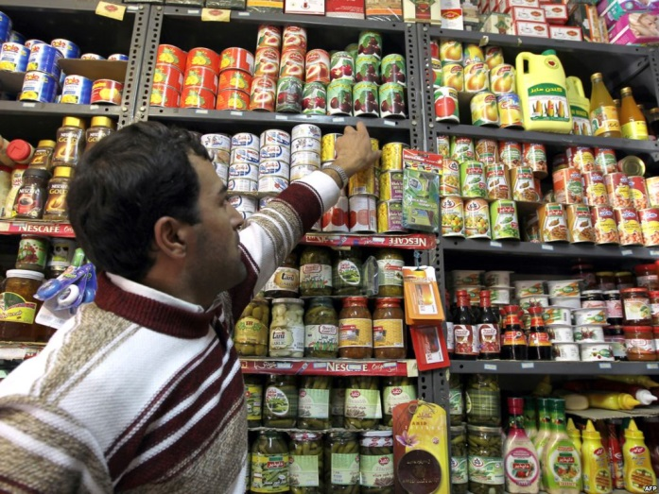
Decide if your source is ready to check out…
Or do you want to leave it on the shelf?
And, most importantly, why?

Slide 18
Evaluating sources
Students create their own standards for what makes a source legitimate.
Again, they have agency and confidence because the students are authentically creating this list—the qualifications are not a mandate from me.
Students have to justify their sources.
This leads to less procrastination and more valuable preparation for the essay.

Slide 19
3. Prewriting for the essay
Informal Annotated bibliography: Students must summarize main points of a source, explain how it relates to their essay, and write an MLA citation for the source.
Informal Outline: Students must show proof of a thesis and main ideas of the essay in whatever way they like (this includes diagrams, outlines, lists, etc.).
The format of these documents is not as important to me as the ideas generated here.

Slide 20
prewriting activities
After the students completed both of these activities on their own, the students shared their outlines in a “round table” type of format. Each student explained the main idea of their essay and how they planned to support it.
Their ideas were then “work-shopped” by their peers.
I intervened as little as possible, and let the students provide feedback to each other. This step is very important because it lets students feel confident and prepared to begin writing their draft.
Improves morale in the group and bonding.

Slide 21
5. During the draft process
Students meet with me individually with their drafts to help work on their essays.
Peer review and round table discussions are held in both the 101 and 052 class looking at sample essays and essays of peers.

Slide 22
6.After the Essay is completed, Self-assessment
Students write a reflective essay in the 052 class after they turn in their final copy of the research essay. This helps with the meta-cognitive aspect of the writing process.
It looks like this:
Instructions: I want you to think about the following questions when writing this essay:
What was the most difficult part of writing this essay?
What did you learn from writing this essay?
How will this essay change the way you approach writing?
What did you feel you were successful with in this essay?
Did this essay change the way you see yourself or your community?

Slide 23
In conclusion
Students in both the 052 and 101 class can benefit from backward design.
Activities and work in the 052 class is planned to help scaffold the major assignments in the 101 class (like the research essay).
By planning building activities like those discussed today, the developmental students feel more confident, prepared, connected, engaged and less intimidated by the research essay.
By using backward design to plan the course, the students are more focused.
emantler@ccbcmd.edu

Slide 24
Works Cited
Wiggins, Grant P., and Jay McTighe. Understanding by Design. Alexandria, VA: Association for Supervision and Curriculum Design. 2005.

